Slide 1


Fruit Fusion: A Strategic Puzzle Game
Cheekati Mani Shankar(BL.EN.U4CSE21046) Gontla Venkat Sujan(BL.EN.U4CSE21061) Hothur Ranga Neha(BL.EN.U4CSE21068) Hothur Shreyaa(BL.EN.U4CSE21069)
Department of Computer Science & Engineering,
Amrita School of Engineering, Bengaluru

Slide 2
Agenda
Introduction
Problem Statement
Literature Survey
Methodology
Results
Conclusion
References

Slide 3
Introduction
Develop a digital adaptation of the traditional Suika game in Unity, blending cultural tradition with modern technology to enhance the player experience. The game incorporates player movement and striking mechanics, complemented by a visually engaging environment and gameplay design. Machine learning is integrated to provide dynamic difficulty adjustments and analyze player behavior, ensuring a more personalized and challenging experience. Trained ML models are deployed for real-time adjustments, making the gameplay adaptive and immersive.

Slide 4
Problem Statement
The limitations of traditional Suika games by integrating dynamic difficulty adjustment, player behavior analysis, and an engaging digital environment. Traditional games lack adaptive elements, leading to a static and predictable experience. This project implements machine learning to evolve the game's difficulty based on player performance, maintaining engagement and challenge.
Finally, a vibrant, interactive setting with dynamic audio-visual effects creates an immersive experience. Features like real-time difficulty adjustments and personalized gameplay responses make "Suika Smash" a unique and captivating take on the classic game.

Slide 5
Literature Review
S.No | Paper Title, Year | Paper Type | Objective | Research Gap
1 | Game Development using Unity Game Engine, 2022 | Conference | The author uses a real-world platform namely the Unity Game Engine, a leading platform for developing or designing games to demonstrate its application of creating fun, engaging and aesthetic games. The study incorporates Unity’s Resource Store, scriptable object, physics engine as some of the tools that enhance the development of 2D and 3D games. | The study highlights Unity's tools but lacks exploration of scalability for larger, networked multiplayer games. There is minimal discussion on integrating emerging technologies like AR/VR within Unity-based projects.
2 | Developing video games with elementary adaptive artificial intelligence in unity: An intelligent systems approach 2017 | Conference | Authors were tasked with studying the implementation of simple adaptive artificial intelligence (AI) systems into video games designed with the Unity engine and proposed a set of ideas or approach for deploying adaptive AI techniques for improving game play environment.. | The proposed adaptive AI techniques lack validation in diverse genres beyond Unity-specific environments. There is limited discussion on optimizing adaptive AI for real-time decision-making under resource constraints.

Slide 6
Literature Review
S.No | Paper Title, Year | Paper Type | Objective | Research Gap
3 | Video Game Description Language Environment for Unity Machine Learning Agents, 2019 | Conference | Authors indicate the value of contemporary search engine programs including Elasticsearch and Apache Lucene. compelling games. The study emphasizes Unity's diverse tools, such as the Unity Asset Store, scriptable objects, and physics engine, to simplify the game development process for both 2D and 3D applications. | The focus on search engine integrations overlooks their adaptability in procedural content generation. There is limited examination of user experience impact due to dynamic content or search-based functionalities.
4 | Development and Performance Analysis of an AI based Agent to Play Computer Games using Reinforcement Learning Techniques, 2023 | Conference | Authors introduce an AI agent that employs reinforcement learning strategy of Q-learning as well as the deep Q-learning or DQN to enhance the game’s mechanical features. Training takes place inside of Unity using Unity ML Agents Toolkit which allows for reinforcement learning of an agent’s behaviors in complex environments such as RTS games | The study uses reinforcement learning but does not explore multi-agent interactions or adversarial training setups. Further work is needed to evaluate computational efficiency for large-scale environments.

Slide 7
Literature Review
S.No | Paper Title, Year | Paper Type | Objective | Research Gap
5 | Characterizing and modeling the effects of local latency on game performance and experience, 2018 | Conference | Authors examine the effects that local latency has on both competitiveness and user satisfaction in games. The work provides the latency influence simulation in current game engines such as Unity and Unreal and describes the acceptable latency thresholds in different game categories. | The work lacks in-depth analysis of how latency influences AI agent behavior during gameplay. There is no proposed solution for mitigating latency issues in real-time competitive gaming.
6 | Rapid and Reliable Adaptation of Video Game AI, 2009 | Conference | Authors enhanced the learning efficiency of the reinforcement learning algorithms by storing and reusing previous experiences. In this context, evaluation of the proposed system proves that RL algorithms are effective in solving complex problems in the context of gaming environment. | The research does not address the potential for integrating RL algorithms with other machine learning paradigms like transfer learning or meta-learning. No consideration of the ethical implications of experience reusability in dynamic gaming environments.

Slide 8
Literature Review
S.No | Paper Title, Year | Paper Type | Objective | Research Gap
7 | Video Game Description Language Environment for Unity Machine Learning Agents, 2019 | Conference | The authors incorporate VGDL with Unity’s Machine Learning Agents that is majorly focused to train AI agents on its own. By employing reinforcement learning, they seek to build intelligent behaviors for games with a efficiency which increases as it acquires experience on the players’ actions. Incorporation of VGDL with Unity means that game environments and objectives can be easily described and thus permit iteration when testing AI. | While integrating VGDL with Unity is promising, there is a need for evaluation of cross-platform compatibility and performance scalability. The paper does not explore real-world application challenges for non-traditional gaming environments like education or training simulators.
8 | Mobile Gamer Modelling and Game Performance Preference Measurement, 2020 | Conference | Authors employ data analytics and machine learning to model mobile gamer behaviors, utilizing tools like TensorFlow and Unity's analytics SDK. It is concentrated on the usage of player preferences to customize game mechanics for increased play time and everyday revenues. | The focus on player preferences misses an analysis of privacy concerns and ethical use of collected behavioral data. The study does not evaluate long-term effects of tailored mechanics on player engagement sustainability.

Slide 9
Literature Review
S.No | Paper Title, Year | Paper Type | Objective | Research Gap
9 | Design and Implement of Soccer Player AI Training System using Unity ML-Agents, 2022 | Conference | Authors leverage Unity ML-Agents to simulate soccer gameplay and train AI agents in tactical decision-making. PPO, an acronym for Proximal Policy Optimization is among the reinforcement learning frameworks incorporated in the system and ideal for building realistic AI players.. | While leveraging Unity ML-Agents is effective for tactical AI, there is a lack of focus on collaboration between AI and human players. Limited discussion on adapting the Proximal Policy Optimization framework for non-standard game dynamics.
10 | Development of a 2D Game using Artificial Intelligence in Unity, 2022 | Conference | Authors integrate AI-driven mechanisms, such as pathfinding and dynamic difficulty adjustment, into Unity-based 2D games. Using Unity's NavMesh and custom scripts, it focuses on enhancing gameplay interactivity and engagement. | The study primarily focuses on 2D games, leaving a gap in extending the methods to 3D or hybrid environments. No analysis of the computational trade-offs involved in integrating dynamic difficulty adjustment mechanisms.

Slide 10
Research Gap
Dynamic AI Adaptability: Research should focus on improving the adaptability of AI in wave-based games, particularly for evolving enemy behaviors across different waves.
Latency Impact in FPS Games: Studies should explore the effects of latency on dynamic AI behavior and real-time resource tracking in wave-based FPS survival games.
Immersive Environmental Design: Future work should investigate how lighting, sound, and environmental effects can be better integrated with gameplay to enhance emotional engagement in survival horror settings.
Player-Centric Difficulty Scaling: There is a need to develop methods that allow difficulty to scale based on player skill, available resources, and AI progression.

Slide 11
Methodology and Implementation
Game Design & Prototyping
Outlined essential rules for a puzzling game where similar fruits merge into more complex ones.
Created a detailed flowchart to describe gameplay, player interactions, and rating system.
Designed a user-friendly UI/UX with clear controls, navigation, and real-time updates.
Game Development in Unity
Used Unity's sprite management tools for detailed fruit rendering.
Incorporated Unity’s 2D colliders and rigid bodies for collision detection and fruit merging.
Established a scoring system to update scores electronically based on merges.
Physics Simulation
Leveraged Unity’s 2D physics engine to simulate fruit movements with effects like gravity, inertia, and collision responses.
Fine-tuned physics properties for a realistic and dynamic gameplay experience.
Machine Learning Integration
Trained a Support Vector Machine (SVM) model to classify players into performance levels.
Integrated the ML model using Flask to analyze player performance level in real-time.

Slide 12
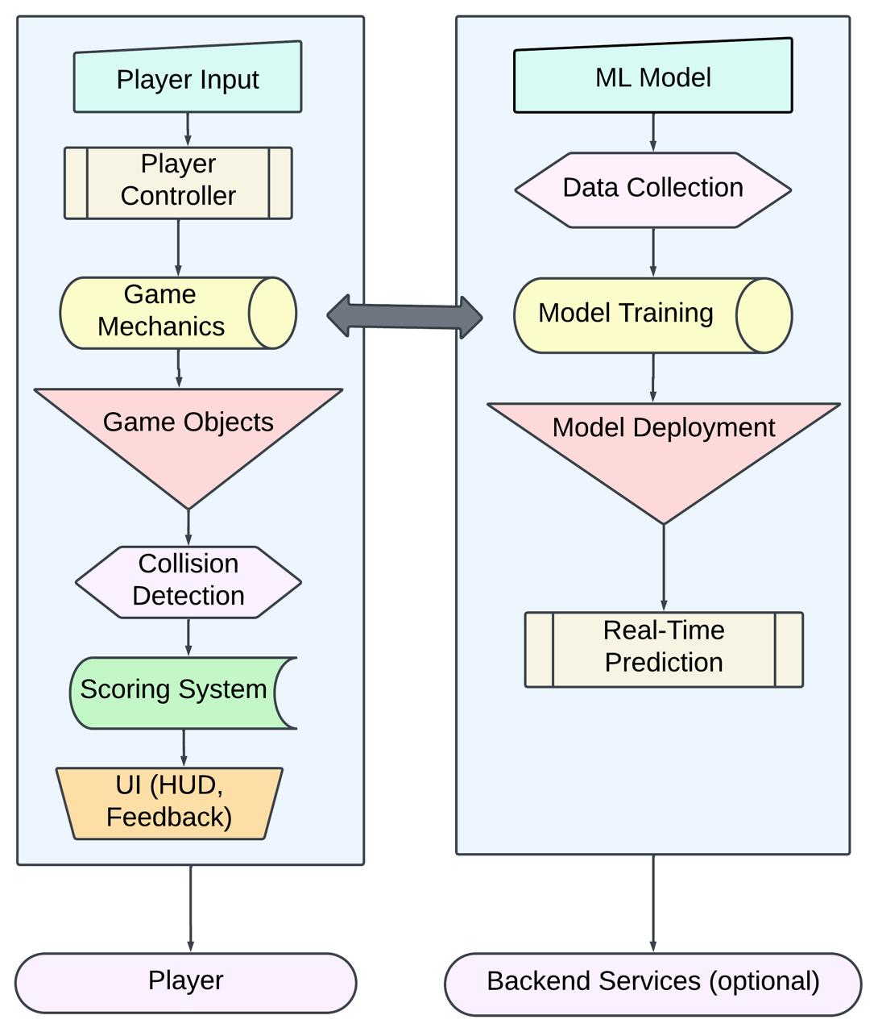
Architecture

Slide 13
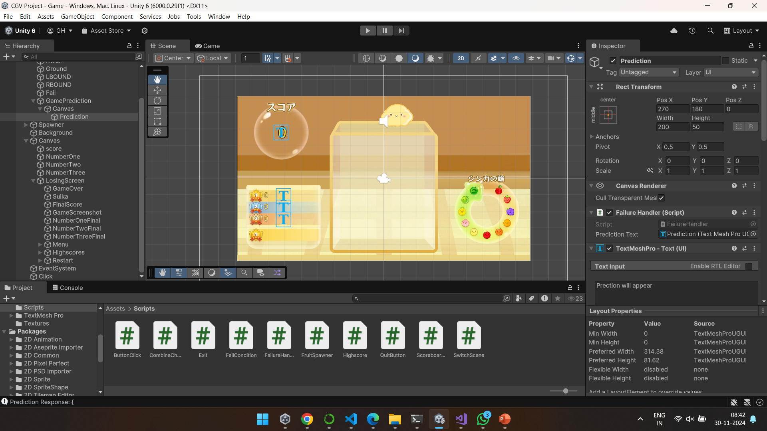
Results

Slide 14
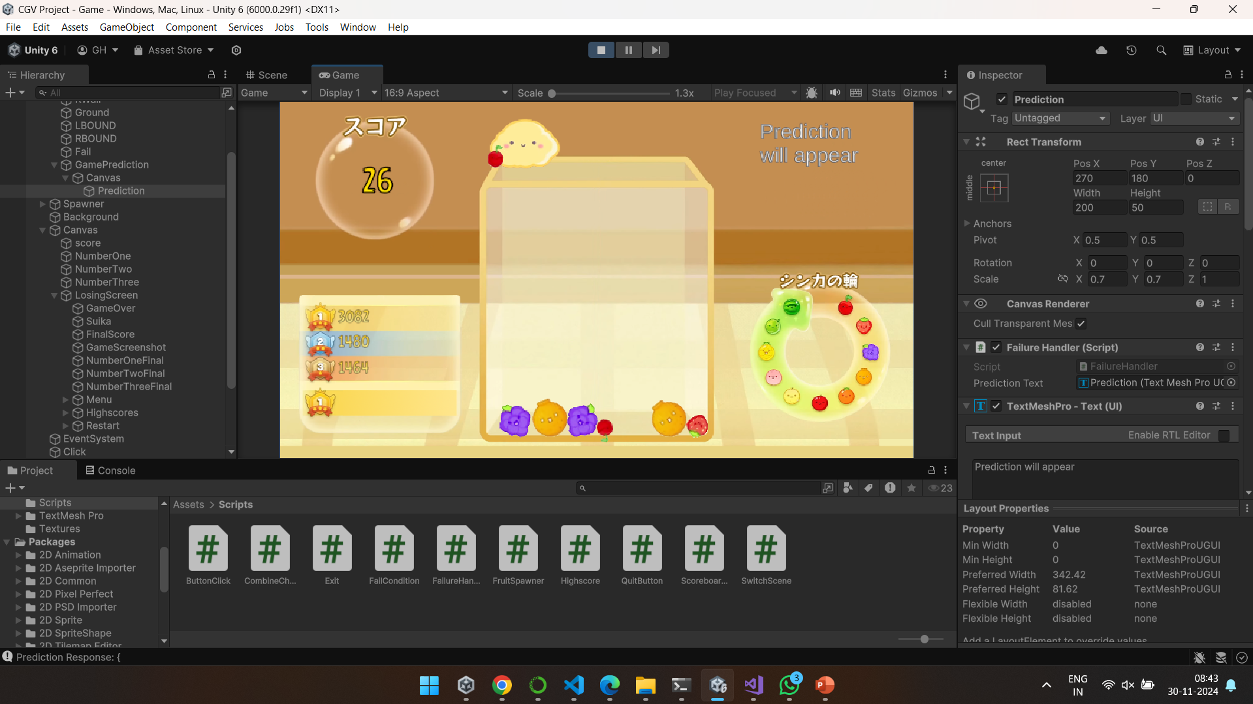
Results

Slide 15
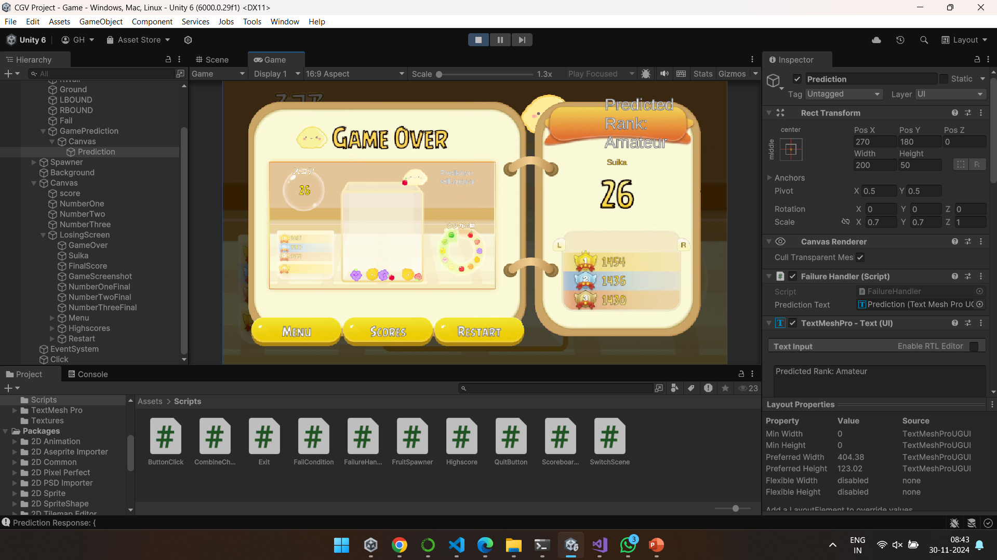
Results

Slide 16
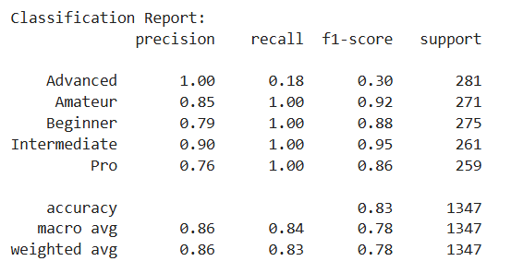
Results

Slide 17
Results

Slide 18
References
S. Singh and A. Kaur, "Game Development using Unity Game Engine," 2022 3rd International Conference on Computing, Analytics and Networks (ICAN), Rajpura, Punjab, India, 2022, pp. 1-6, doi: 10.1109/ICAN56228.2022.10007155.
M. Johansen, M. Pichlmair and S. Risi, "Video Game Description Language Environment for Unity Machine Learning Agents," 2019 IEEE Conference on Games (CoG), London, UK, 2019, pp. 1-8, doi: 10.1109/CIG.2019.8848072.
R. Dewan, R. Polishetty, N. Jagadam, M. K. Goyal, K. K. Ravulakollu and B. Sharan, "Significance of State-of-Art Search Engine in Game Development," 2023 10th International Conference on Computing for Sustainable Global Development (INDIACom), New Delhi, India, 2023, pp. 1134-1139.
K. U. Akkshay and B. Sreevidya, "Development and Performance Analysis of an AI based Agent to Play Computer Games using Reinforcement Learning Techniques," 2023 IEEE 3rd Mysore Sub Section International Conference (MysuruCon), HASSAN, India, 2023, pp. 1-8, doi: 10.1109/MysuruCon59703.2023.10397011.
M. Long and C. Gutwin, “Characterizing and modeling the effects of local latency on game performance and experience,” in Proceedings of ACM CHI Play, New York, NY, USA, 2018, pp. 285–297.

Slide 19
References
S. Bakkes, P. Spronck and J. van den Herik, "Rapid and Reliable Adaptation of Video Game AI," in IEEE Transactions on Computational Intelligence and AI in Games, vol. 1, no. 2, pp. 93-104, June 2009, doi: 10.1109/TCIAIG.2009.2029084.
A. Meliones and I. Plas, "Developing video games with elementary adaptive artificial intelligence in unity: An intelligent systems approach," 2017 Intelligent Systems Conference (IntelliSys), London, UK, 2017, pp. 104-111, doi: 10.1109/IntelliSys.2017.8324230.
Y. Liu, H. Dar and R. Sharp, "Mobile Gamer Modelling and Game Performance Preference Measurement," 2020 IEEE Conference on Games (CoG), Osaka, Japan, 2020, pp. 632-635, doi: 10.1109/CoG47356.2020.9231860.
H. Li, "Design and Implement of Soccer Player AI Training System using Unity ML-Agents," CIBDA 2022; 3rd International Conference on Computer Information and Big Data Applications, Wuhan, China, 2022, pp. 1-4.
R. M. Sindhu, L. S. P. Annabel and G. Monisha, "Development of a 2D Game using Artificial Intelligence in Unity," 2022 6th International Conference on Trends in Electronics and Informatics (ICOEI), Tirunelveli, India, 2022, pp. 1031-1037, doi: 10.1109/ICOEI53556.2022.9776750

Slide 20

Thank you !!!!!

