Slide 1

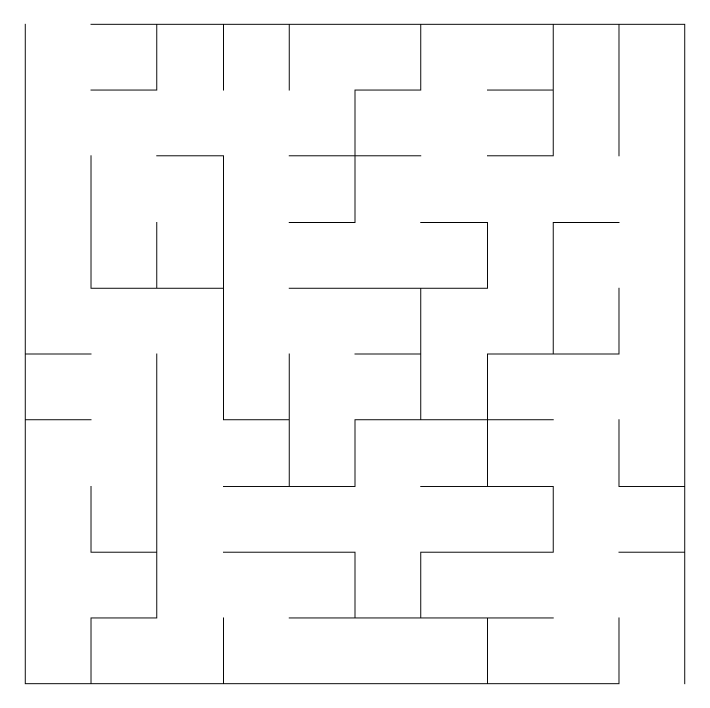
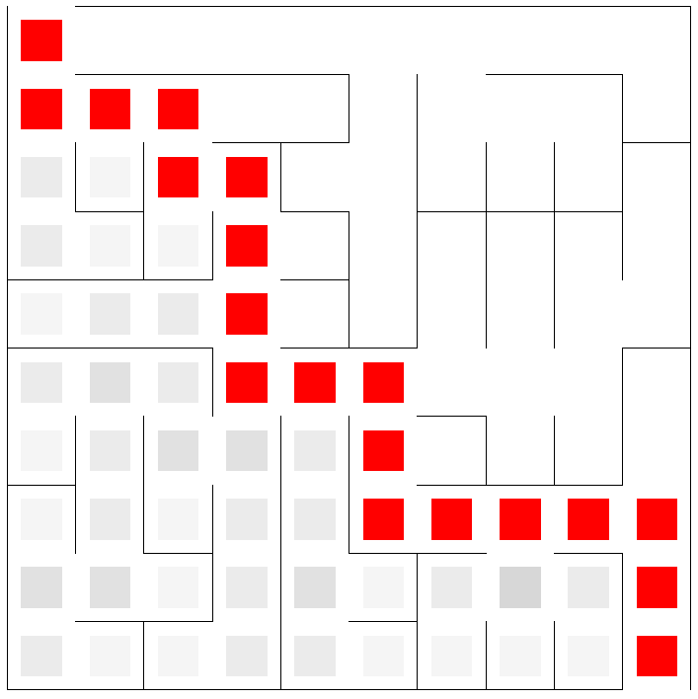
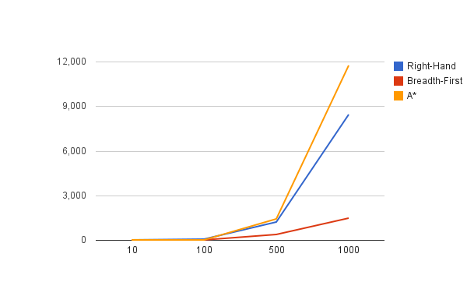
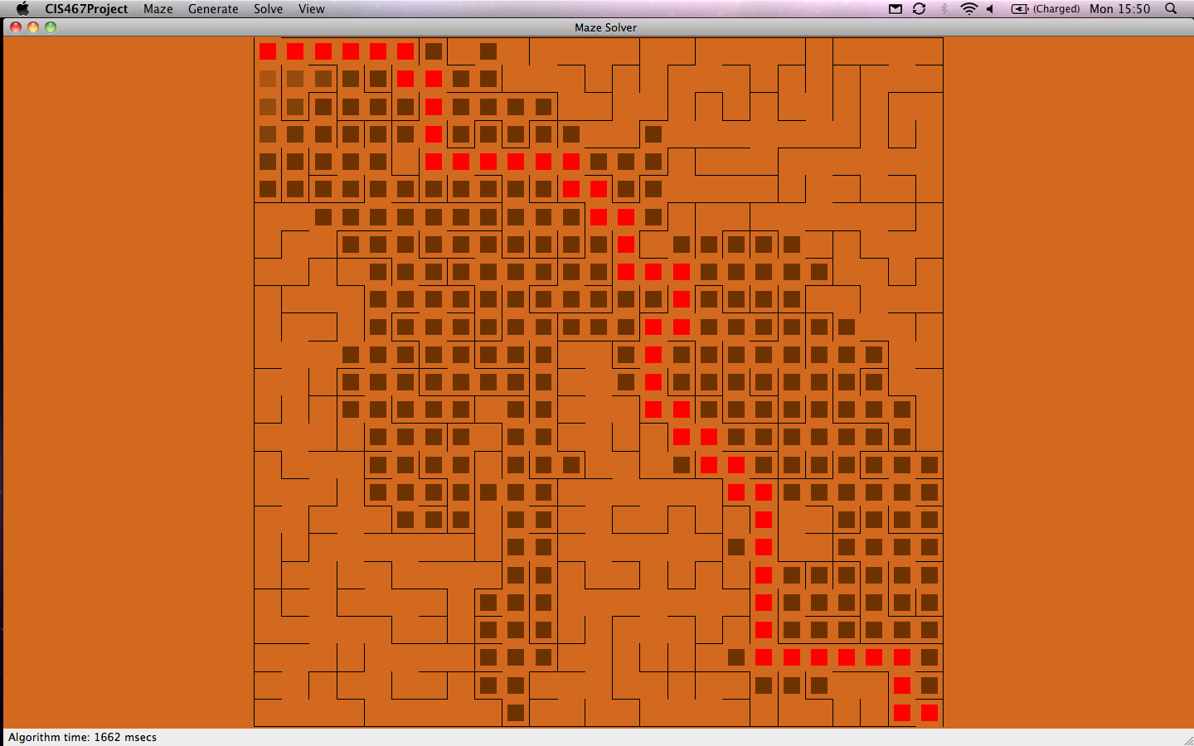
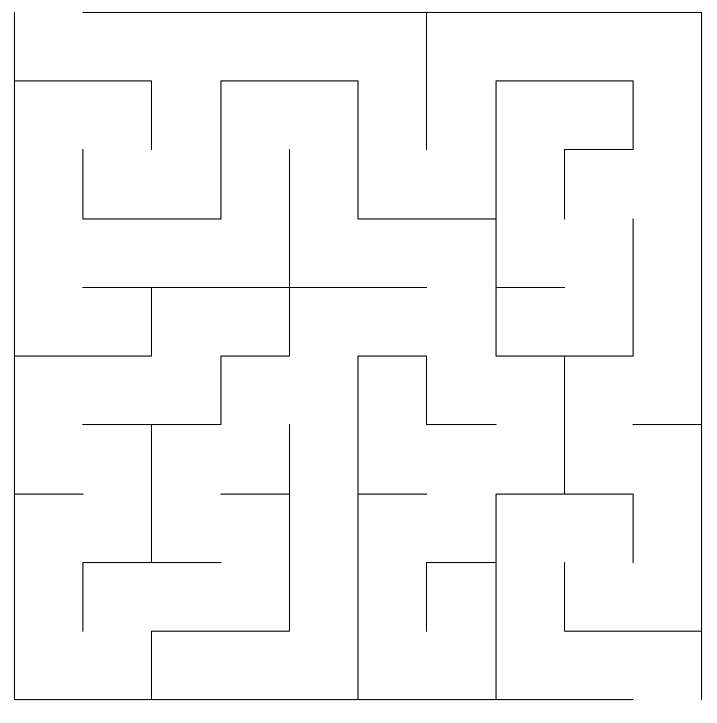
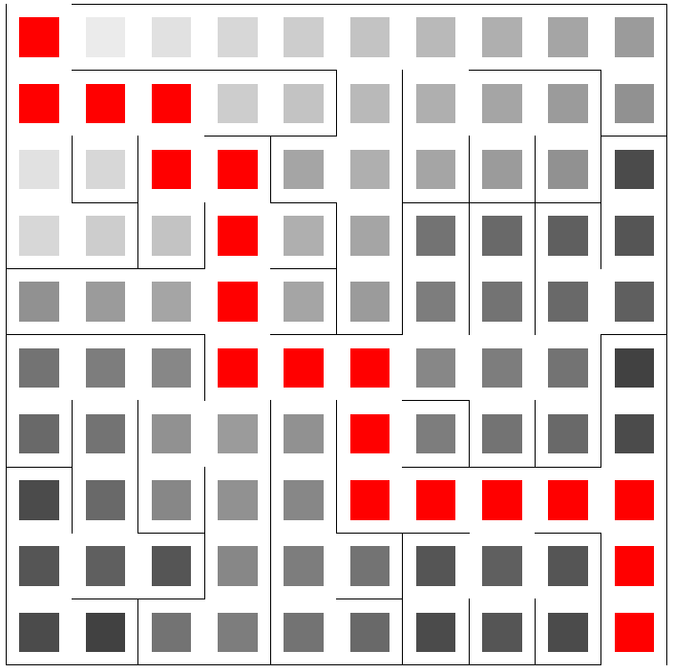
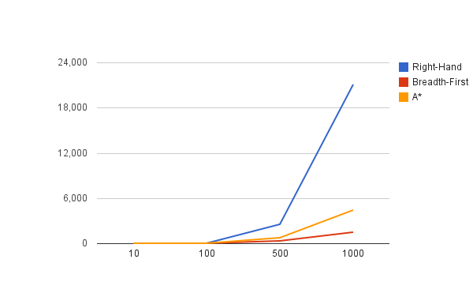

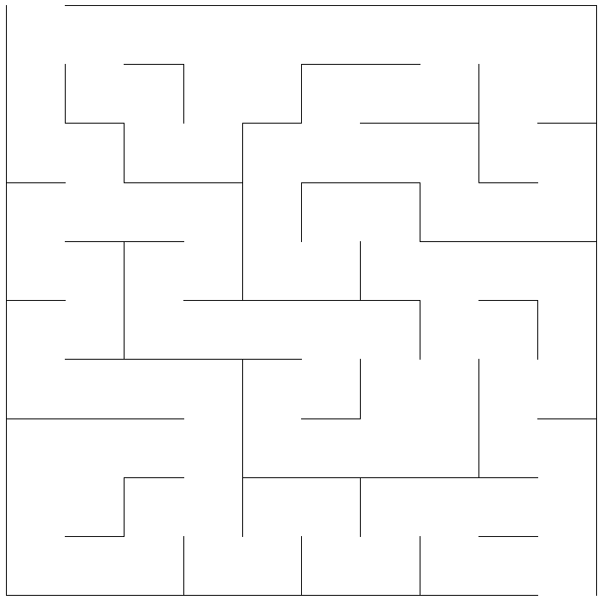
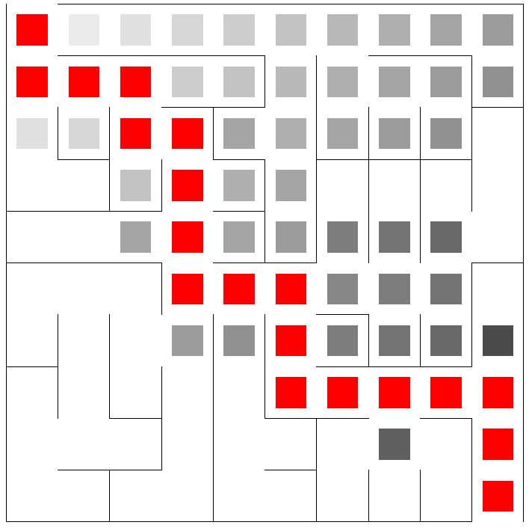
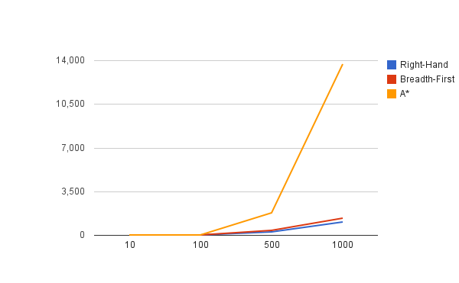

FREE iPADS!
Joseph Roth, Sean Fisk, Lucas Ausbury, Jacob Scott
Advised by Robert Adams
Generation
Solving
Prims
Right Hand
Prim’s algorithm generates a “perfect” maze by creating a minimum spanning tree between the cells in the maze. A perfect maze has one correct solution. The dead ends created by prims are very short.
One of the more common and more basic of the solving algorithms. Basically, whenever you are given a choice between two or more paths, you choose the right-most path with respect to your current facing. In all mazes with the entrance and exit on the outside, this is guaranteed to find a solution.
Summary
This project creates an interface to allow students to visualize various maze generation and solving algorithms. It displays a step by step demonstration of the progress of the different algorithms.
The program was written in C++ using the Q toolkit, allowing it to be cross-platform.
The GUI allows you to select a maze size, generation technique, solving algorithms and zoom in on various parts of the maze.
*There are no free iPads :(
Backtracker
Breadth First
The backtracker also creates perfect mazes. The dead ends are much longer, but there are less decision points. It follows one path as far as possible, and then backtracks to the first possible non-traversed cell. It corresponds to a depth first traversal of the maze.
A utilization of the breadth-first search algorithm. This solver analyzes all paths of length 1 followed by 2 and then 3 and so on. Essentially, whenever it is given two or more paths, it will take one step down each of them until it reaches a previously visited path or the end. While ensuring the shortest route, it also usually has to traverse nearly the entire maze before coming up with a solution. It is also not a practical approach when trying to solve a maze from within.
Braid
A*
A braid maze has no dead ends. It uses the backtracker algorithm and then removes all of the dead ends. Braid mazes can be more difficult for a human in the maze to solve, but computers can solve them easier.
A* is a heuristic that assigns two numbers to each cell. 1) the number of steps required to discover the cell 2) the estimated distance to the end. The algorithm analyzes cells with the smallest sum of numbers first and calculates the numbers for the newly discovered cells. This algorithm is very efficient and will find a good path, but not necessarily the optimal path.

