Slide 1
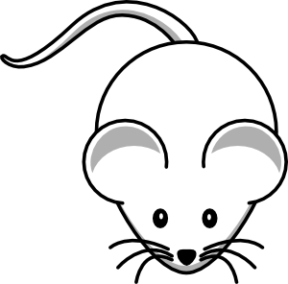
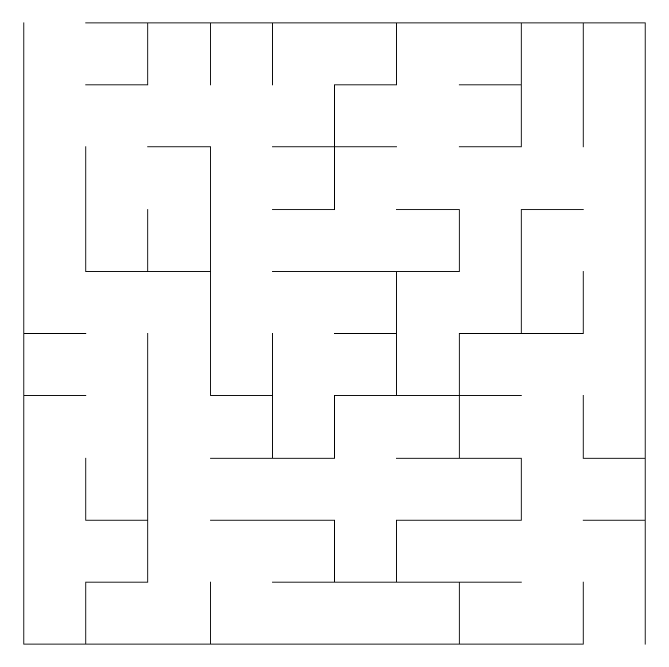
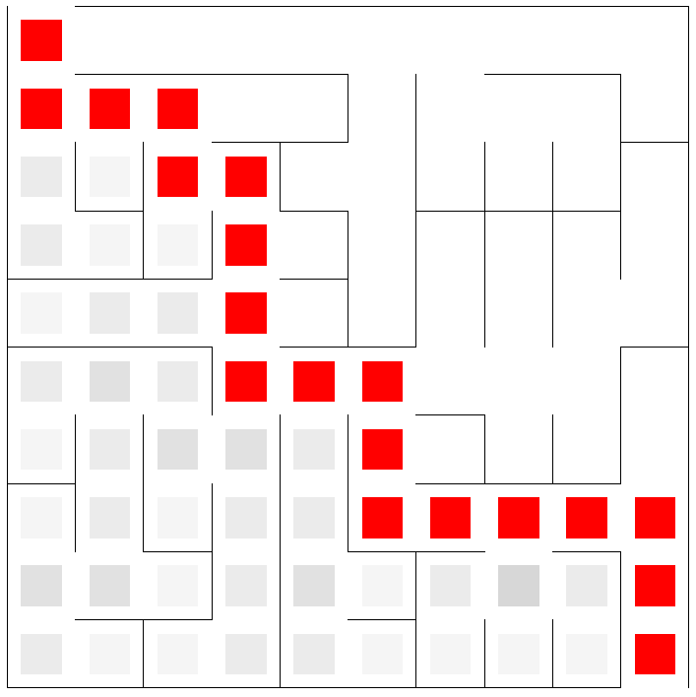
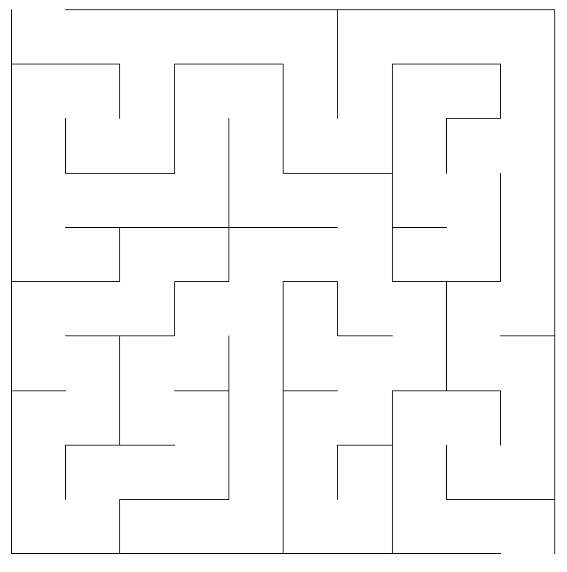
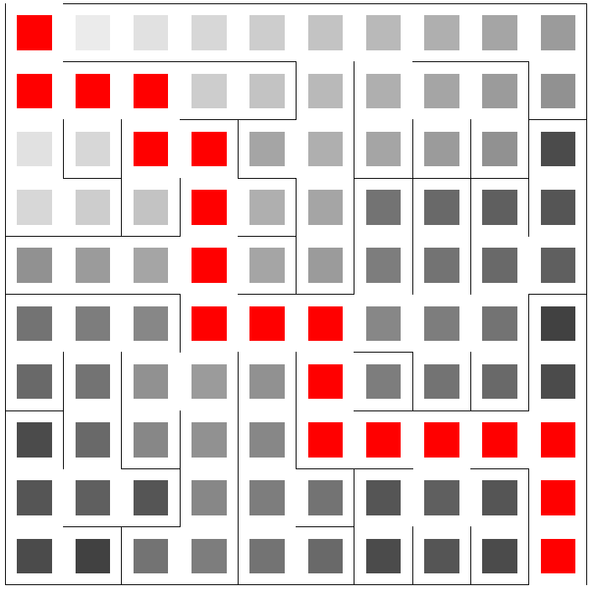

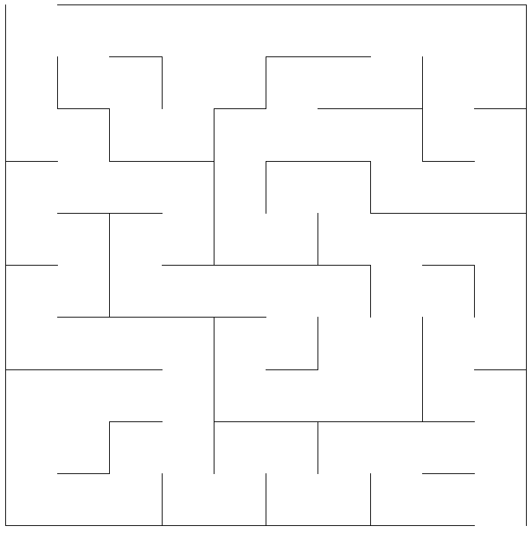
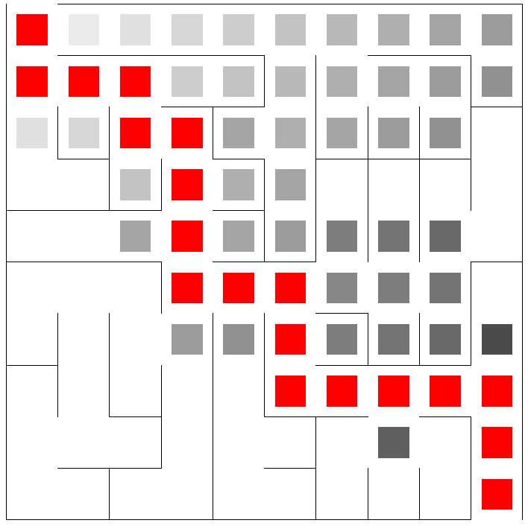

FREE iPADS!
Joseph Roth, Sean Fisk, Lucas Ausbury, Jacob Scott
Generation
Solving
Prims
Right Hand
Prim’s algorithm is one of the more common for maze generation. Each cell is initially marked as uninhabited. It then randomly chooses an uninhabited cell and marks it as inhabited, and marking all of its uninhabited neighbors as “frontier”. Then, picking one of the cell’s frontier neighbors, it marks it as inhabited, breaks down the wall between the two, and marks the new cell’s neighbors as frontier. It continues this loop until all the cell’s are marked as inhabited. This algorithm tends to produce mazes with shorter paths, but much more choices.
One of the more common and more basic of the solving algorithms. Basically, whenever you are given a choice between two or more paths, you choose the right-most path. In most mazes, this should ensure you a path to the goal.
Summary
Backtracker
Breadth First
The backtracker is used to create mazes with much longer corridors, but with fewer choices. In essence, it starts at a given cell and randomly picks a neighbor and breaks the wall in between them. It continues this until it reaches a point where all of its neighbors are a part of the maze or boundaries, at which point it will backtrack (thus the name) until it reaches a cell with a free neighbor. Once all of the cells have been traversed, it stops.
A utilization of the breadth-first algorithm, this solver when given a choice will take all options. Essentially, whenever it is given two or more paths, it will take one step down each of them, then one more step, and so on until it reaches the end. While ensuring the shortest route, it also usually has to traverse nearly the entire maze before coming up with a solution. It is also not a practical approach when trying to solve a tangible maze.
Braid
A*
A* is a heuristic that assigns two numbers to each cell. 1) the number of steps required to discover the cell 2) the estimated distance to the end. The algorithm analyzes cells with the smallest sum of numbers first and calculates the numbers for the newly discovered cells. This algorithm is very efficient and will find a good path, but not necessarily the optimal path.
The braid method is basically the exact same as the backtracker. The only addition is that after generating the maze, it goes through and eliminates all of the dead ends. This makes it so that any path can lead you to the end. This would be much easier for a human, but we wanted used it in order to test our algorithms and see how they would handle it.

