Slide 1

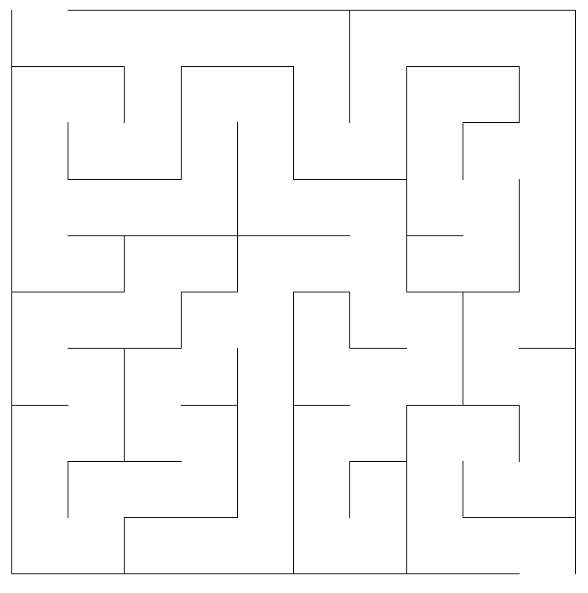



FREE iPADS!
Joseph Roth, Sean Fisk, Lucas Ausbury, Jacob Scott
Generation
Solving
Summay
Prims
Backtracker
Braid

