Slide 1
Smart rail Design
Akash Patel
Design of Large Programs (CS 351)

Slide 2
Overview
Show the UML diagram for the entire domino project
Give broader perspective of project
Class level associations
Class instantiations and usages
Only the public methods are show to show interactions between the objects

Slide 3
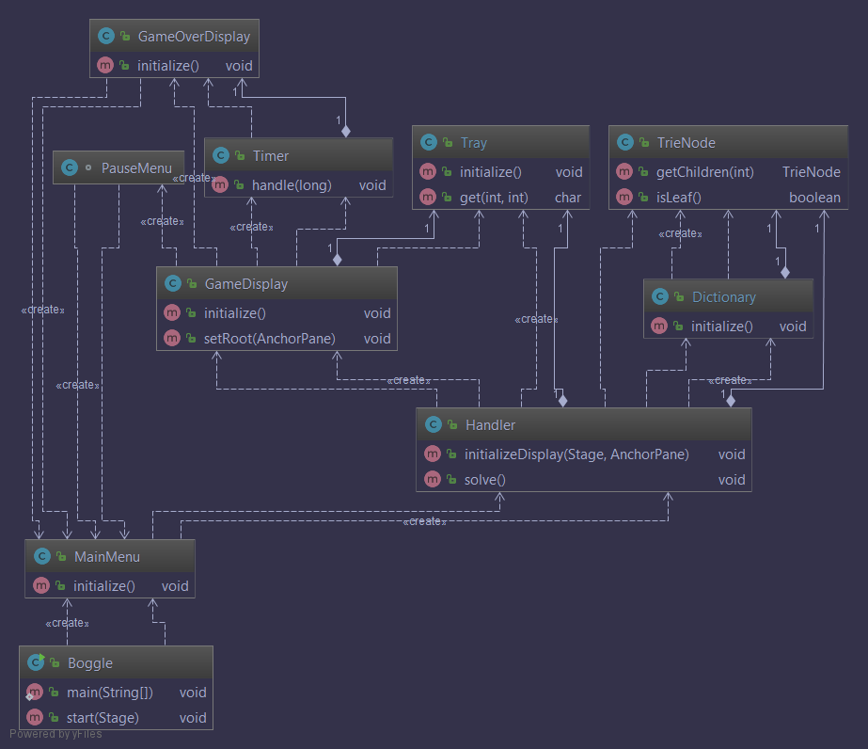
Full UML Diagram

Slide 4
Full UML Diagram - Description
Boggle is the entry point
The main method is only responsible for launching the main menu.
The Main Menu class launches the Handler when someone hits play and chooses a tray size.
The Handler creates the tray, loads the dictionary and solves the tray, storing the solutions in a list. The Handler also initializes the GUI.
The game display class creates all the game assets and updates and loads them when needed. It also includes a pause button that is used to return to the menu.
Once the three minute timer runs out the game exits to the game over screen and the results are viewable there. The game can be restarted by going back to the main menu.

