Slide 1
Smart rail Design
Akash Patel and Gabriel Urbaitis
Design of Large Programs (CS 351)

Slide 2
Overview
Show the UML diagram for the entire SmartRail Project
Give broader perspective of project
Class level associations
Class instantiations and usages
Only the public methods are show to show interactions between the objects

Slide 3
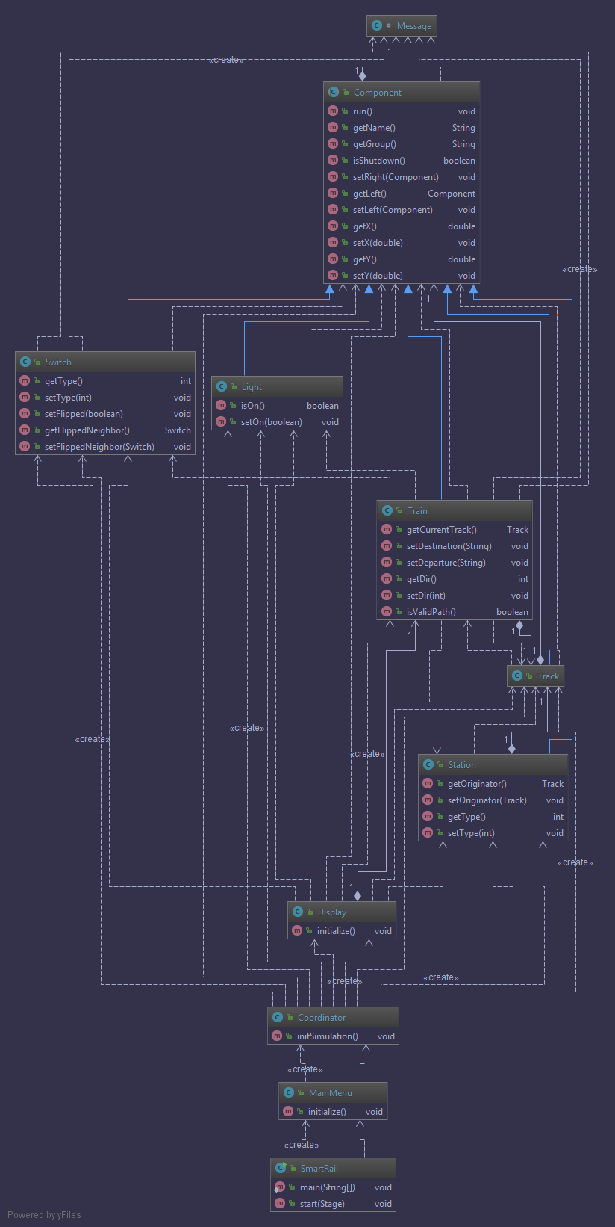
Full UML Diagram

Slide 4
Full UML Diagram - Description
SmartRail Class is the entry point
The main method is only responsible for launching the main menu.
The Main Menu creates the Coordinator which in turn instantiates all the objects, starts all the threads, and initializes the Display class.
The Coordinator reads the file and creates the appropriate objects with respect to the configuration that is read.
The Display class creates all GUI elements and updates the state/location of the train and the lights via the use of an Animation Timer rendering at 60 Hz.
The Main Menu allows the user to choose one of 4 config files, config3 and config_TA are left for the TAs to change as they please. Further instructions can be found in the read me.
Lastly, the diagram in the previous slide shows the relationship between all the classes and all their PUBLIC methods.

