Slide 1
The Power Up Challenge

Slide 2
Contents
Project brief
High level requirements
Assumptions
Solution walkthrough
Power BI demonstration
Extending my solution

Slide 3
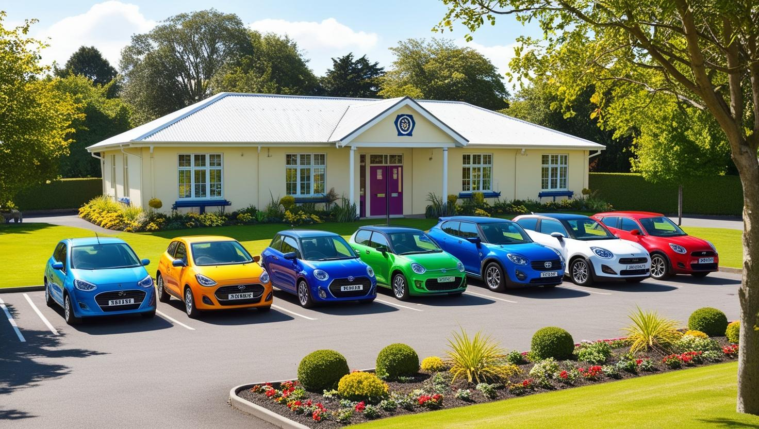
Parking Challenge
Contoso High school face challenges with parking availability that leads to complaints from both teachers & visitors.
To address this the leadership team seeks a better understanding of parking usage & occupancy.
A simple system that enables staff and visitors to request parking on a daily basis.
Additionally, the system should facilitate the inspection of parking spaces by a member of staff to verify who is using the parking.

Slide 4
High Level Requirements
A Power Platform solution called “Parking Challenge” with
  A dedicated publisher
  A data model comprising 3 tables
    Vehicle
    Parking Request
    Parking Inspection
  A model-driven app to enter visitor and staff parking requests on a daily basis
  A canvas app to be used by a parking inspector (a staff member) to log parking inspections
  A Power Automate cloud flow to confirm parking requests
A Power BI report is required to support the organization in managing their parking more effectively.

Slide 5
Assumptions
There is just 1 inspection of all parked vehicles each day at 5pm. During this inspection every vehicle parked at that time is logged
The inspection is performed by a member of staff using a canvas app on a tablet device
Parking requests made after the inspection takes place are not considered valid
There are only 15 car parking spaces available at any one time

Slide 6
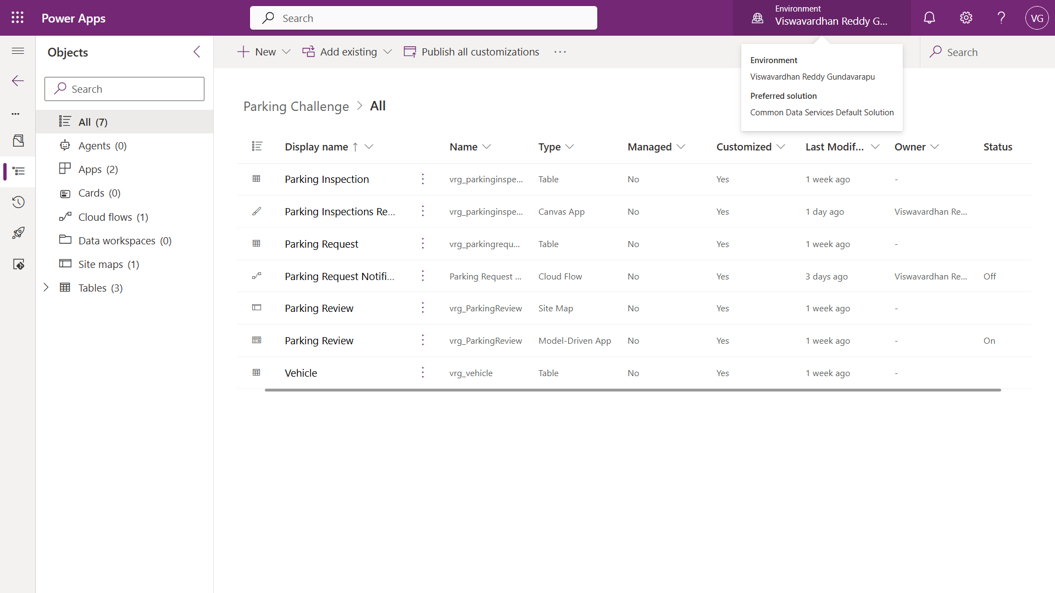
Solution Snapshot

Slide 7
Solution Walkthrough

Slide 8
Power BI Report Demonstration

Slide 9
Extending My Solution
Inspection should happen real-time using technologies like license plate recognition cameras, QR check-in at entry…
Introducing occupancy details
Parking requests should be either approved or rejected based on occupancy and then send an email notification
To prevent firing duplicate emails we’ve to add 2 more columns to the parking requests table
  IsRequestApproved
  NotificationSent

Slide 10
Thank You

