Slide 1
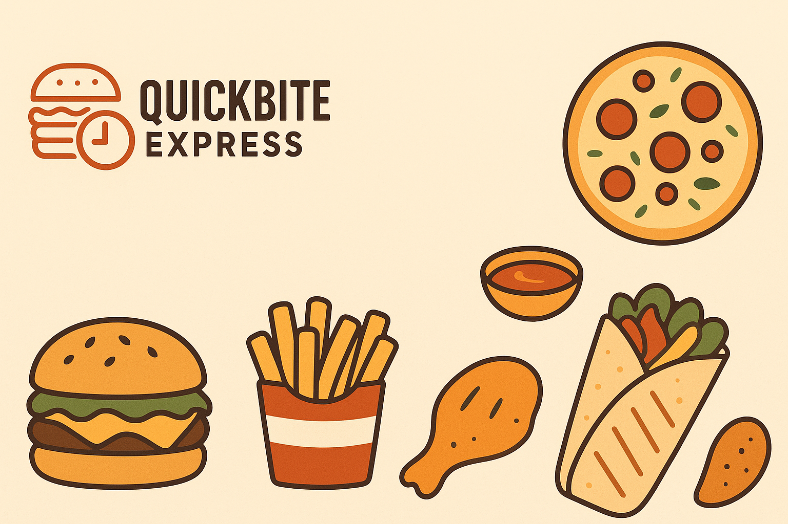

Slide 2

Rebuild Customer Trust through Safety & Transparency
Launch a 'SafeBite Guarantee' campaign to highlight hygiene and safety checks.
Partner with high-rated restaurants to showcase verified cleanliness and reliability.
Add 'Hygiene Verified' badges and short visual stories on restaurant pages.
Rebuild visibility and brand confidence using transparent communication.

Slide 3
Reactivate Loyal and High-Value Users
Target 4,800+ high-value lapsed users and 84% loyal churners with comeback offers.
Use personalized notifications and cashback for the first reorders.
Send emotional messages like 'We’ve earned back your trust — let’s serve you safely again.'
Focus on loyal users who still show higher average order value (+18%).

Slide 4
Retention-Focused Marketing
Shift budget from paid acquisition to retention-focused campaigns.
Launch a We Miss You program offering wallet credits for reactivating users.
Re-engage referral and organic users who dropped off fastest during the crisis.
Prioritize customer retention over new acquisition until trust stabilizes.

Slide 5
Restaurant & Partner Recovery
Promote reliable partners (83% retained) in premium visibility slots.
Introduce Partner Reliability Scorecards to track performance and risk.
Help high-risk restaurants with SLA audits, packaging upgrades, and quality coaching.
Boost high-rating partners as anchors for brand trust rebuilding.

Slide 6
Optimize Delivery Network Reliability
Build real-time SLA tracking dashboards for city-level performance.
Set recovery targets: raise on-time delivery from 36% to 60% in 3 months.
Pilot FastTrack Zones for premium SLA experience in top cities.
Strengthen delivery process management and route optimization systems.

Slide 7
Sentiment & Service Recovery Campaigns
Create a Feedback-First system to follow up on negative reviews with apologies and coupons.
Track keywords like 'cold food' or 'safety' weekly for early issue detection.
Add a Hear Us Improve page to display safety actions and resolved complaints.
Focus on emotional recovery with open, honest brand communication.

Slide 8
Recovery Funnel Framework
Awareness – Rebuild confidence via visible safety messaging (SafeBite Guarantee).
Trust – Improve satisfaction metrics like Avg Rating and Sentiment Score.
Re-engagement – Reactivate lapsed customers through targeted rewards and offers.
Track metrics monthly to monitor emotional and operational recovery.

Slide 9
Monitoring KPIs
Order Volume Recovery %
Churn Reduction %
Average Rating
Sentiment Index
On-Time Delivery %
Restaurant Retention %

Slide 10
Conclusion
QuickBite’s recovery depends on trust, reliability, and emotional connection.
First priority: rebuild customer confidence and delivery consistency.
Empower partners and customers with transparent communication.
With aligned campaigns and SLA reform, QuickBite can restore growth and reputation within 3–6 months.

Slide 11

Thank You

