Slide 1
Subscriber Insights
Subscriber Acquisition Trends
Subscriber distribution by city tier
Monthly Subscribers
Demographic Variations
Subscription plan distribution by age group
User Engagement Category
Paid Users Distribution
Paid user distribution % by subscription plan
Premium user distribution % by city tier

Slide 2
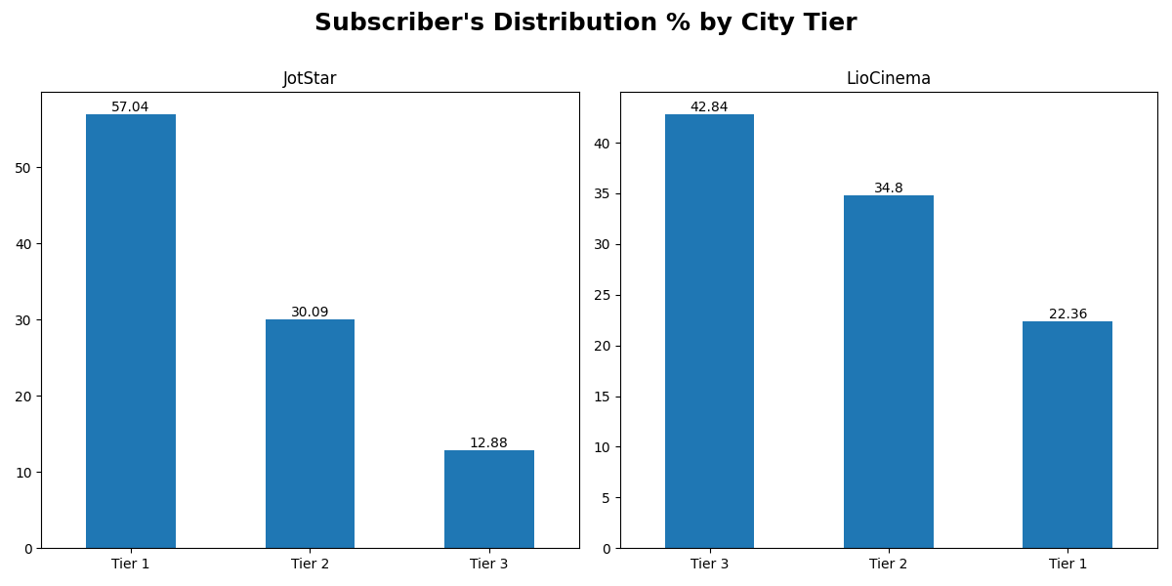
Subscriber distribution by city tier

Slide 3
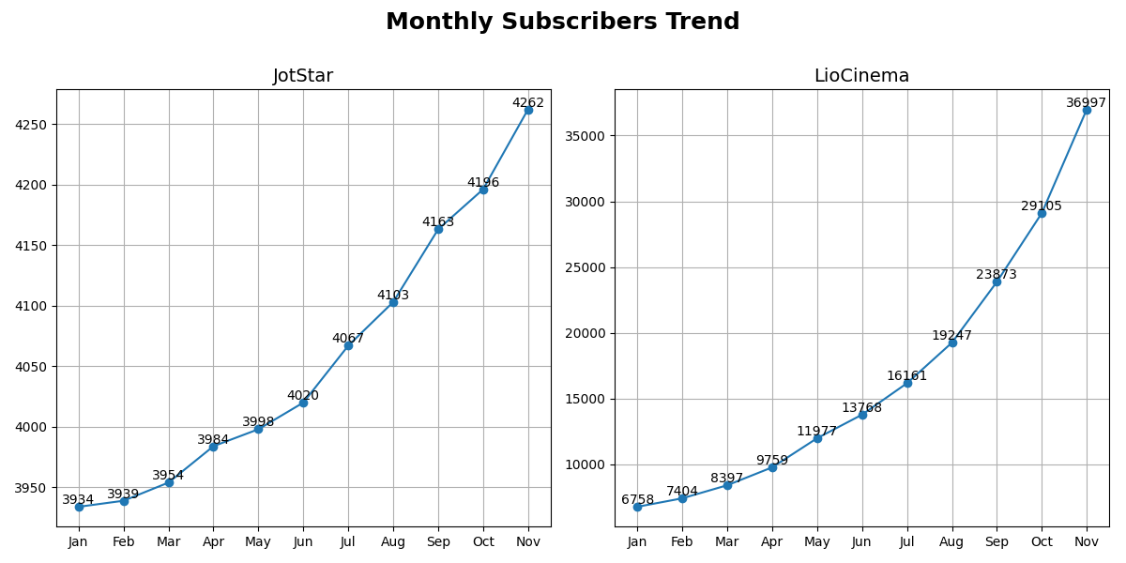
Monthly Subscribers

Slide 4
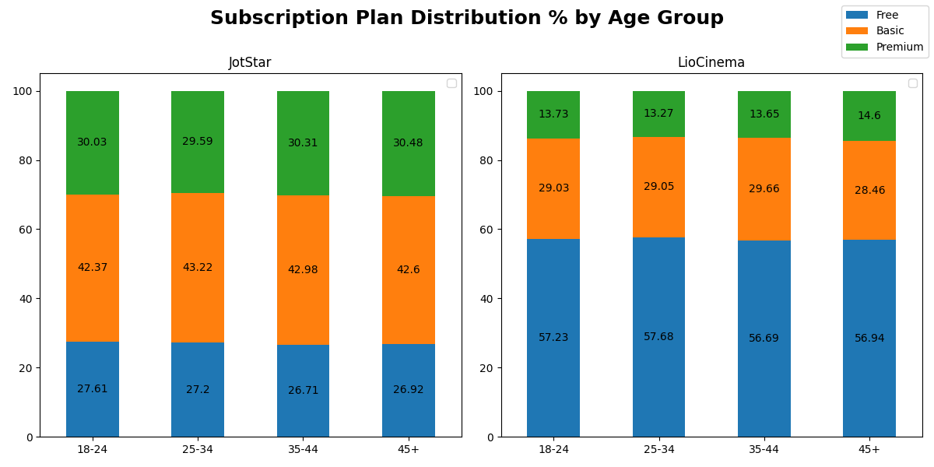
Demographic Variations

Slide 5
Engagement Category Criteria
Subscribers are segmented into 4 categories (1 active and 3 inactive) based on the number of days since last active date of the user (current date - last active date)
I considered 31 Dec 24 as the current date to capture the users who also became inactive late 2024
Segment | Days Since Last Active
Active | last_active_date IS NULL (No inactivity)
Highly Engaged | days_since_last_active <= 30
Moderately Engaged | 30 < days_since_last_active <= 90
Dormant | days_since_last_active > 90

Slide 6
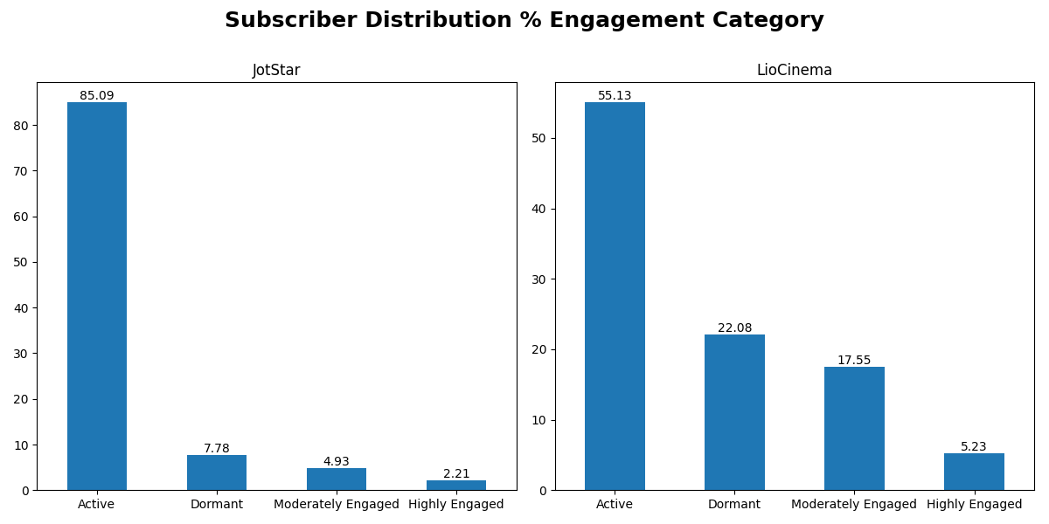
Subscriber Distribution by Engagement
Tier 2 & Tier 3 Cities
Free Plan

Slide 7
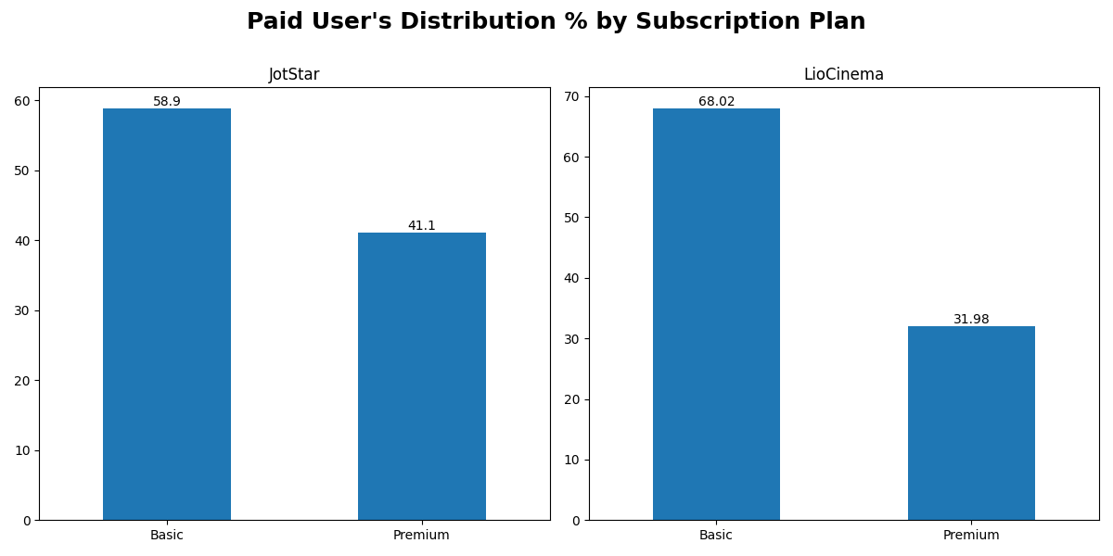
Paid User Distribution % by Subscription Plan

Slide 8
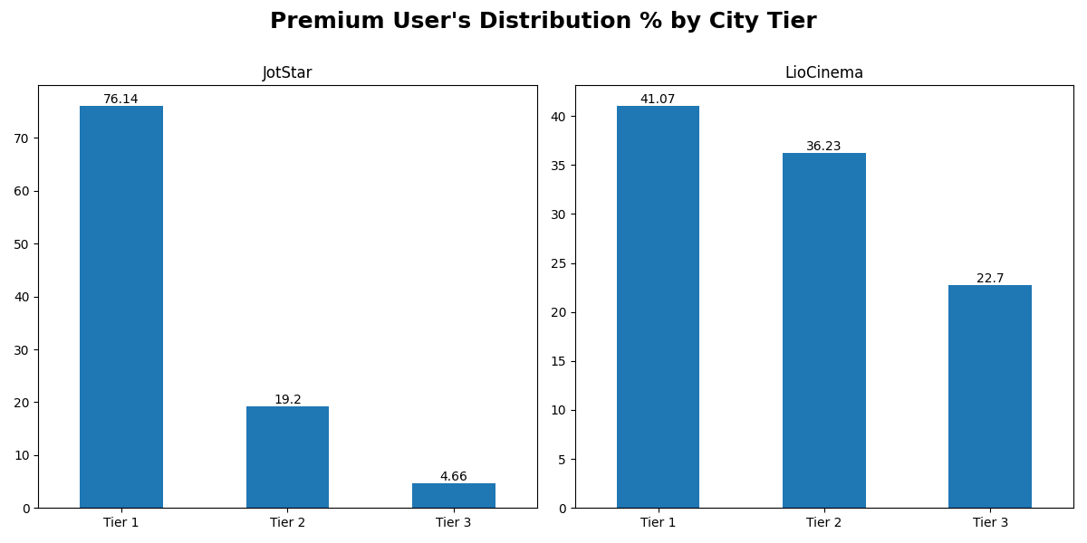
Premium User Distribution % by City Tier

