Slide 1
Content Library
Popular Content Categories (Content Type, Genre, & Language Analysis)
Genre vs. Average Run-Time Analysis

Slide 2
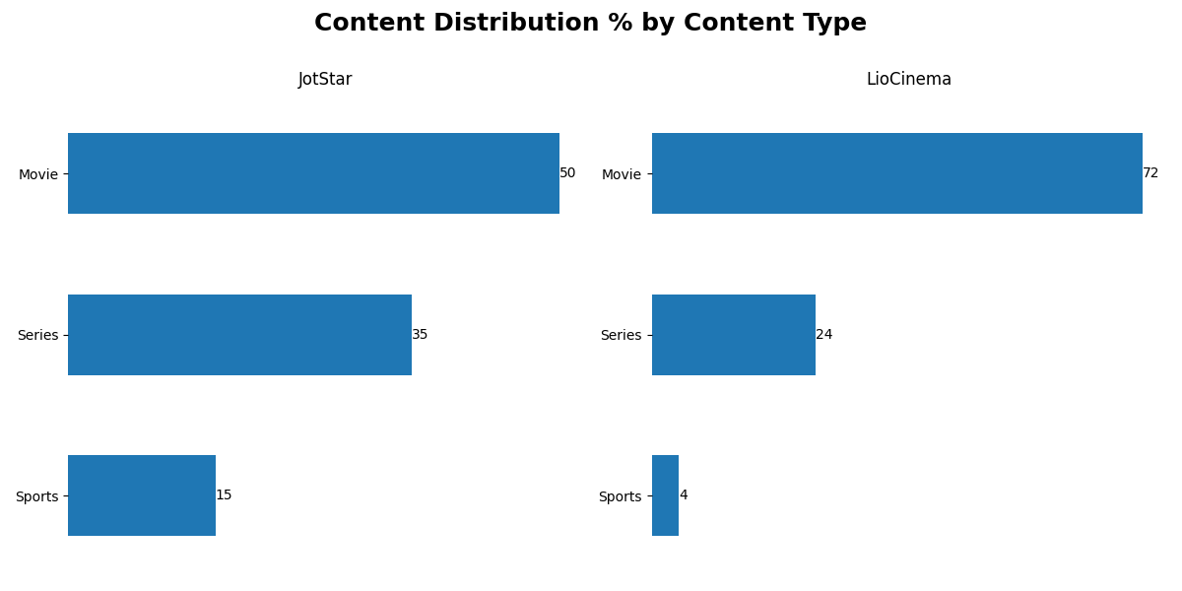
Content Type

Slide 3
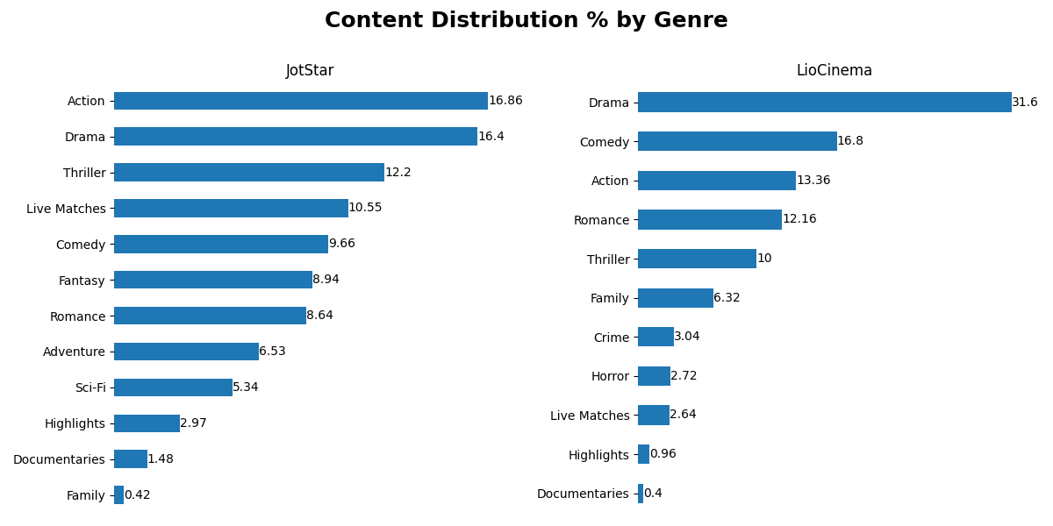
Genre

Slide 4
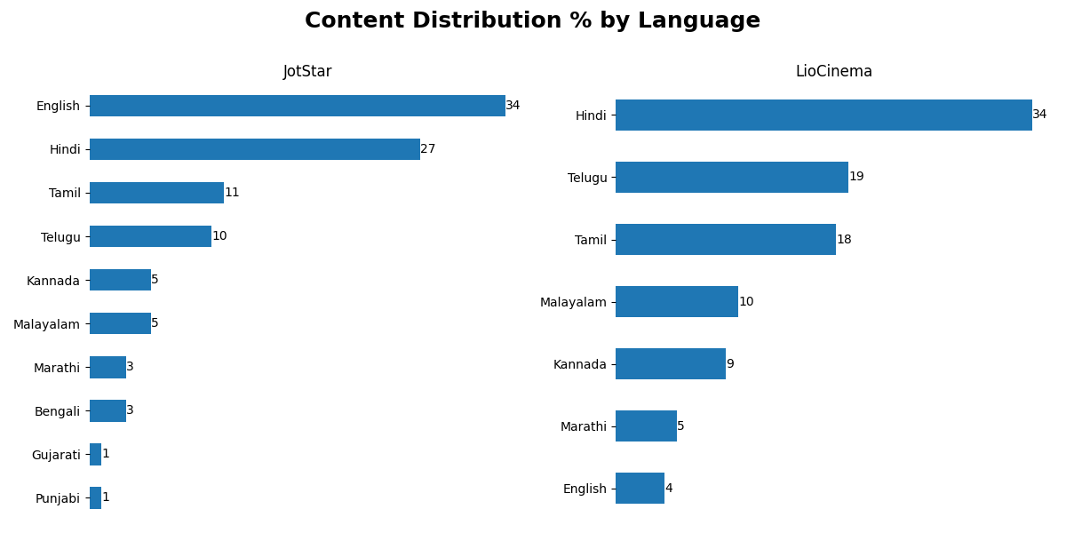
Language

Slide 5
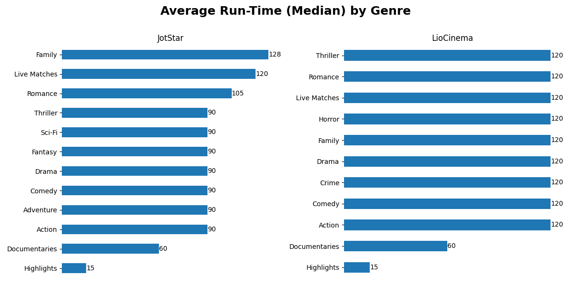
Genre vs. Average Run-Time (Median)

