Slide 1
Content Consumption
Average content consumption by device type
Heavy Watchers (Percentile-based approach)
Average content consumption differs based on user demographics

Slide 2
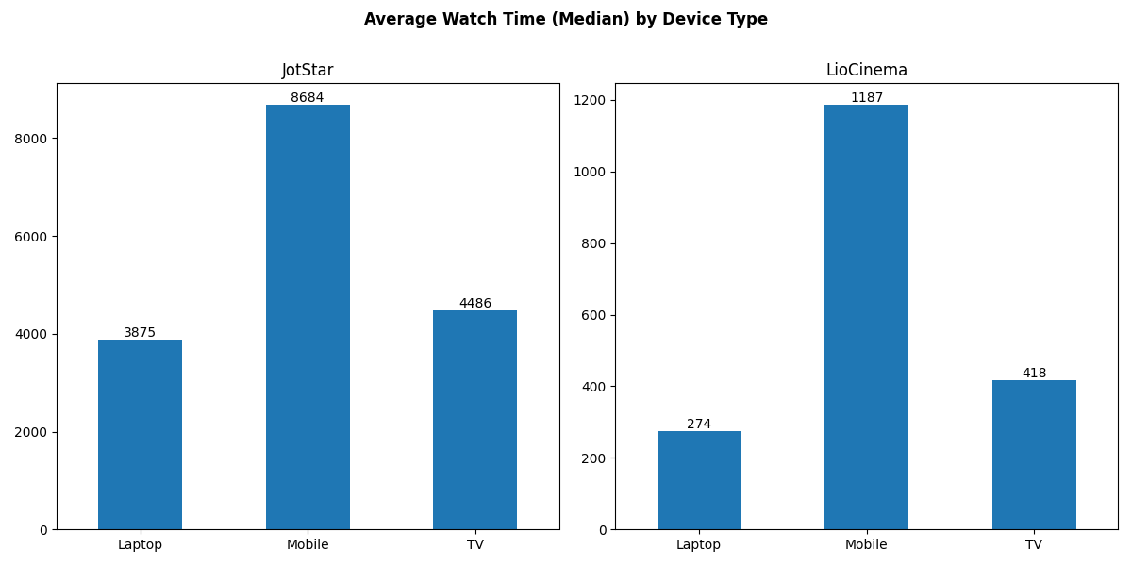
Content Consumption By Device

Slide 3
Heavy Watchers (Percentile-based approach)
95th percentile:
Finding the topmost engaged users rather than just those slightly above average
Dominant Device:
On both platforms, the highest watch time thresholds for heavy watchers are on mobile
Insights:
LioCinema has a larger number of highly engaged users
Jotstar’s most engaged users consume much more content than LioCinema
Avg Watch Time (Mins) Threshold per device
Platform | Laptop | Mobile | TV
Jotstar | 12612.10 | 26233.05 | 14882.05
LioCinema | 1692 | 10677.75 | 2611
Platform wise Heavy watchers
Platform | Users
Jotstar | 3371
LioCinema | 9919

Slide 4
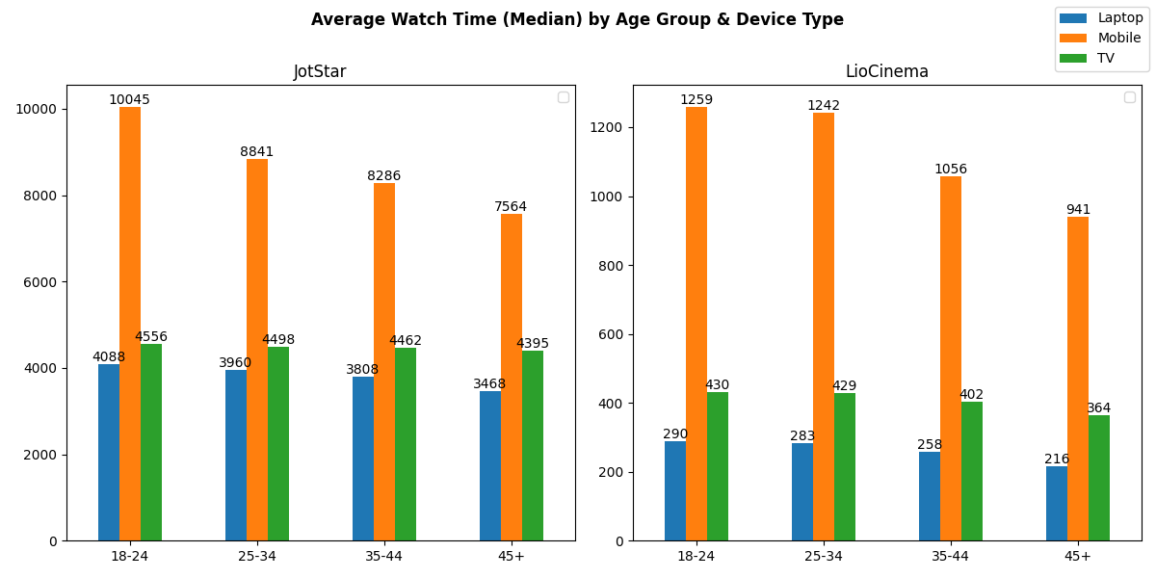
Age Group – Device Type

Slide 5
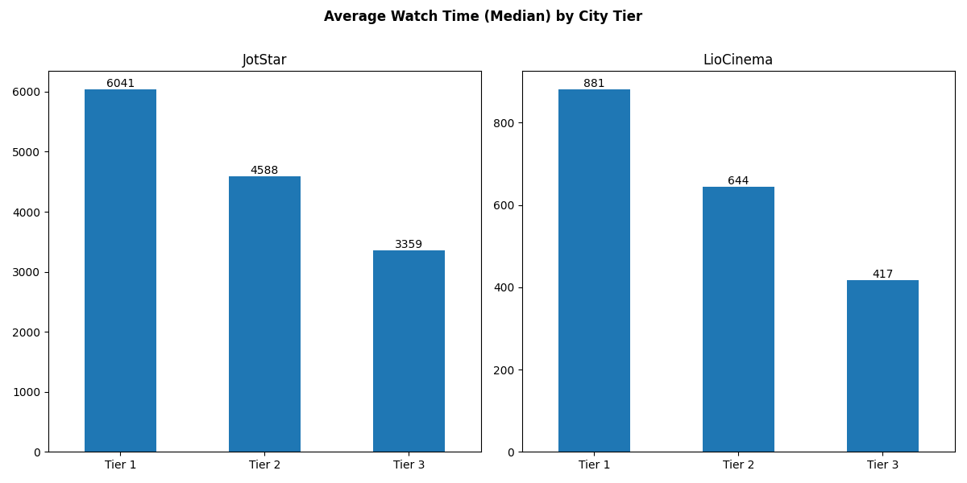
City Tier

Slide 6
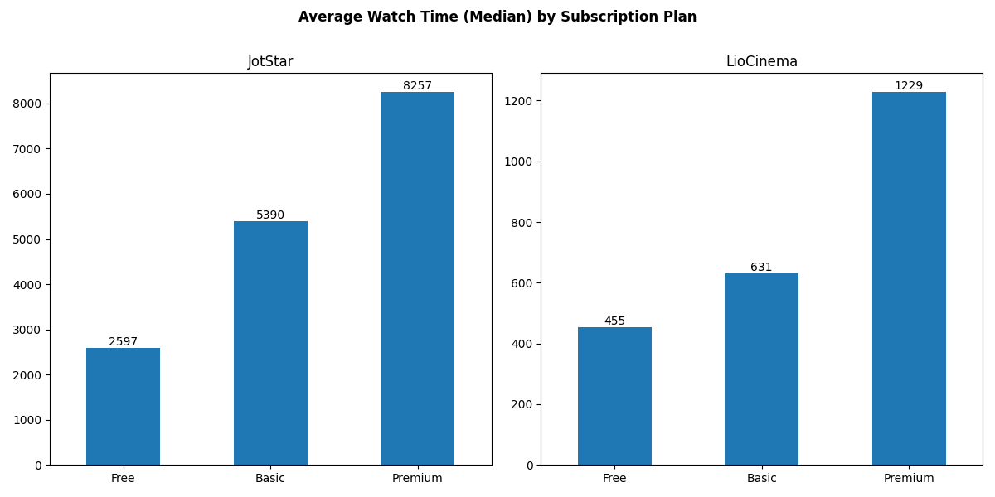
Subscription Plan

