Slide 1
Factors Influencing Subscription Upgrades
Monthly Upgrade Rate
Upgrade Rate by Age Group & City Tier
Upgrade Transition %

Slide 2
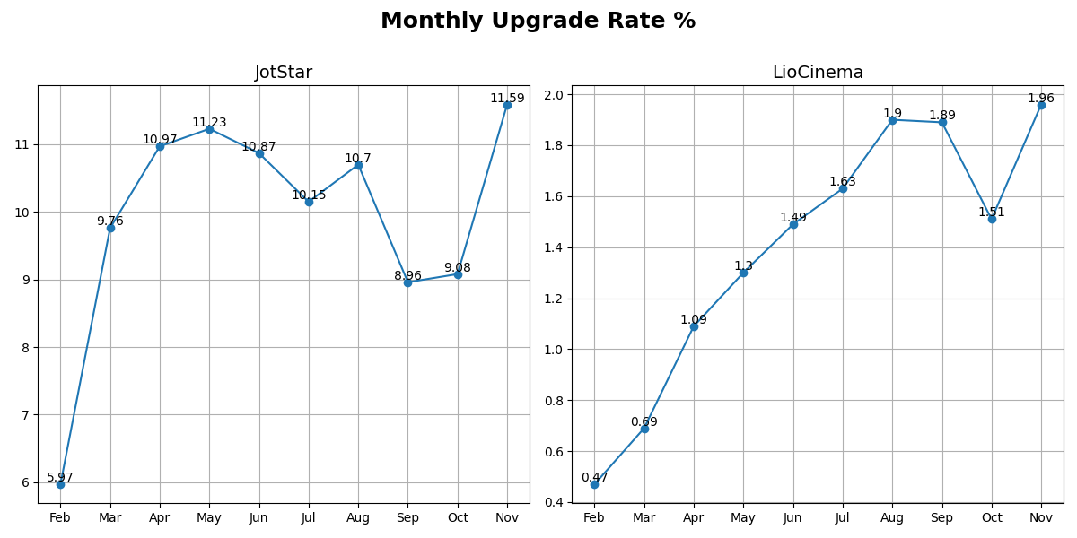
Monthly Upgrade Rate

Slide 3
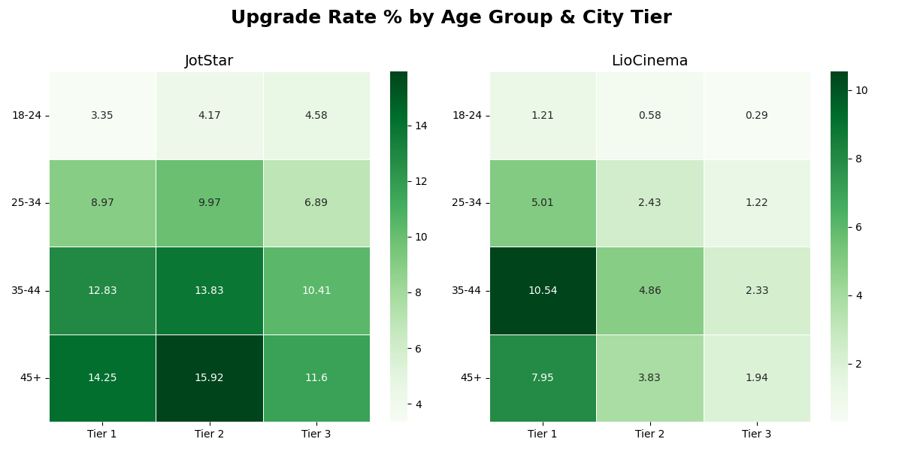
Upgrade Rate by Age Group & City Tier

Slide 4
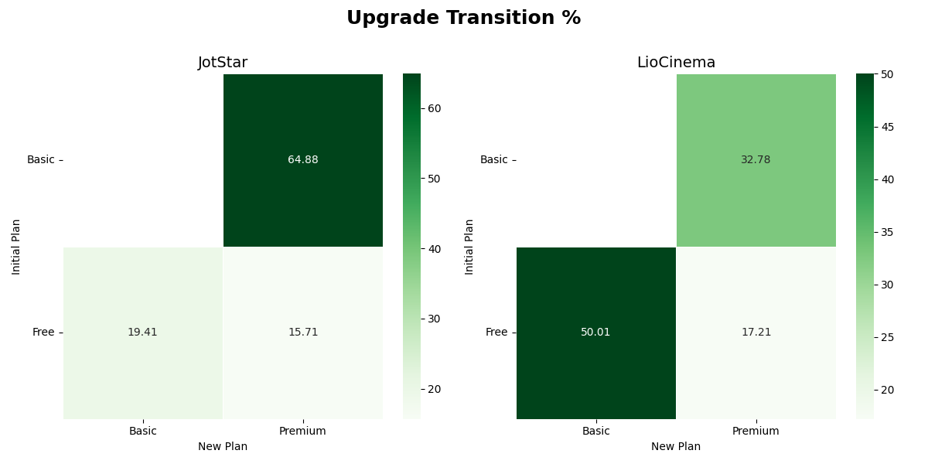
Upgrade Transition

