Slide 1
Factors Influencing Subscription Downgrades
Monthly Downgrade Rate
Downgrade Rate by Age Group & City Tier
Downgrade Transition %

Slide 2
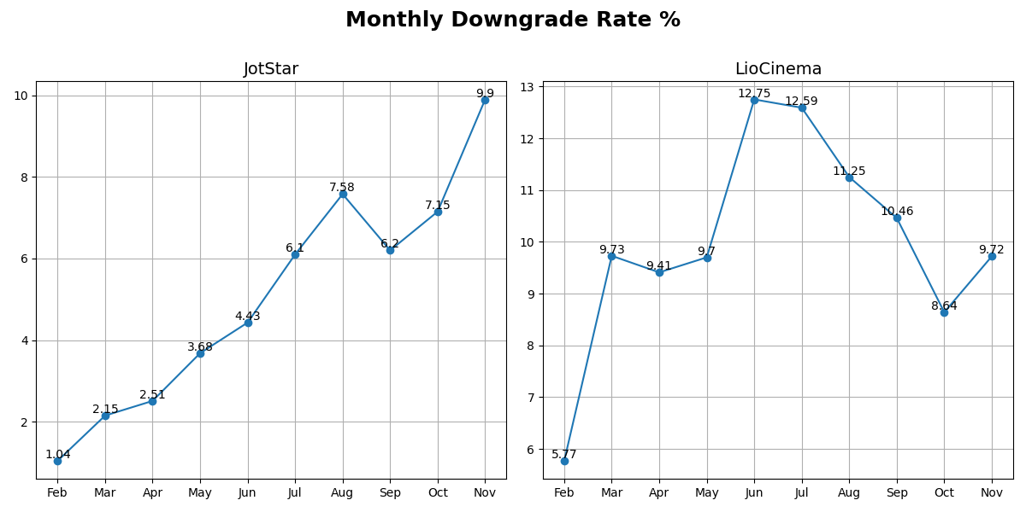
Monthly Downgrade Rate

Slide 3
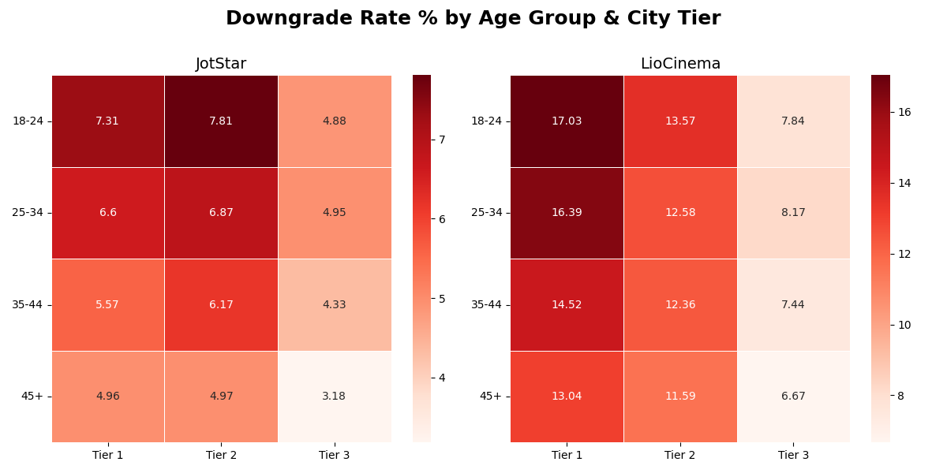
Downgrade Rate by Age Group & City Tier

Slide 4
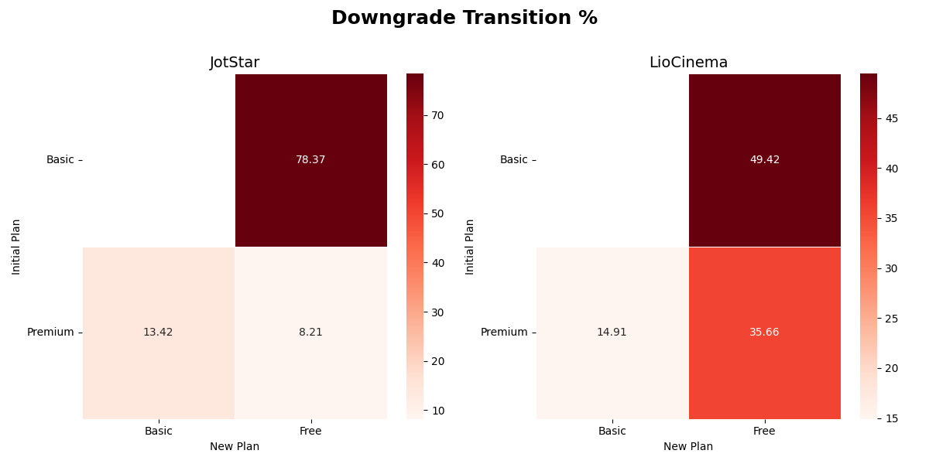
Downgrade Transition

