Slide 1
Inactivity Analysis
Active vs. Inactive Rate across Age Groups, City Tier, & Subscription Plan
Monthly Inactive Rate
Average watch-time by status

Slide 2
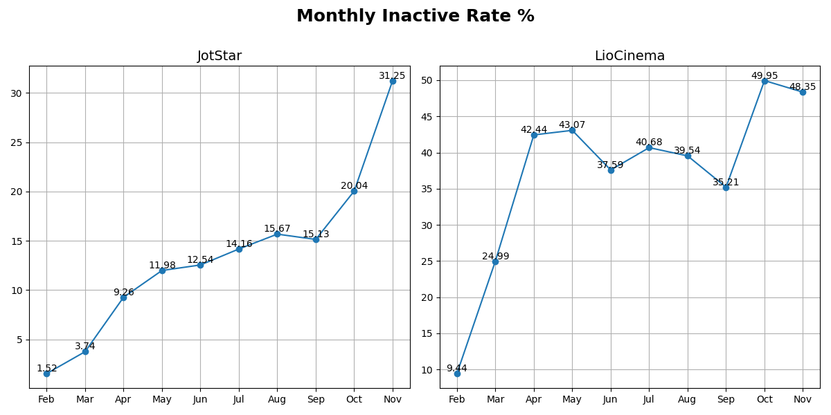
Monthly Inactive Rate

Slide 3
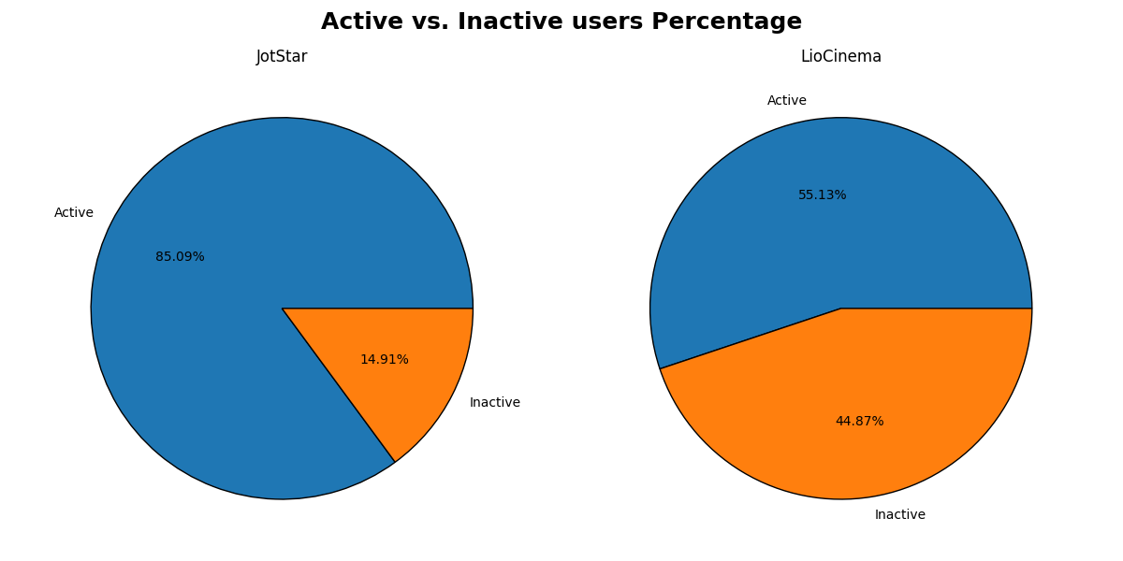
Active vs Inactive Rate

Slide 4
Overall Inactive Rate
Inactivity
High level of user inactivity often indicates a strong likelihood of a customer churning (stopping their service or engagement with the company)
LioCinema Has a Significantly Higher Inactive Rate (44.87%) Compared to JotStar (14.91%)
LioCinema has a high percentage of Free plan users (~57%), who are less committed and more likely to drop off
LioCinema primarily serves Tier 2 & 3 cities, where willingness to pay for streaming might be lower
Jotstar targets Tier 1 cities, where users might be more engaged and have higher purchasing power

Slide 5
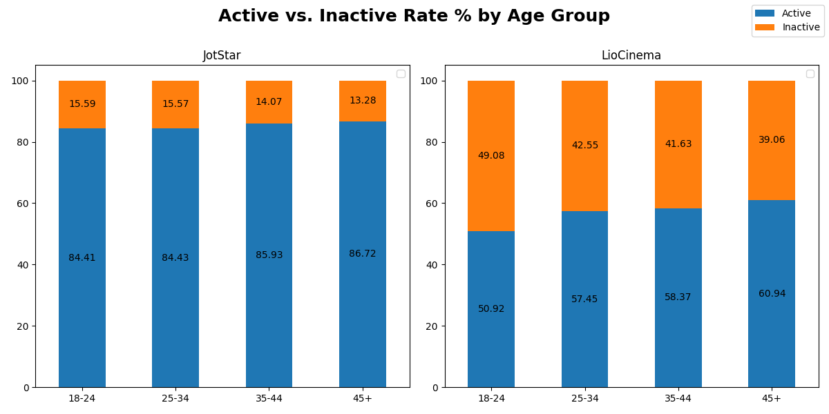
Active vs Inactive Rate by Age Group

Slide 6
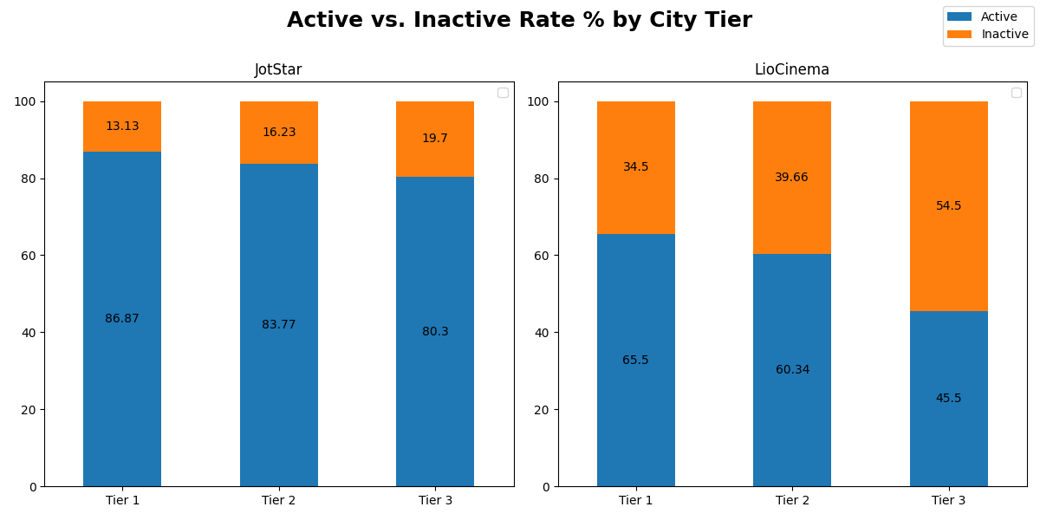
Active vs Inactive Rate by City Tier

Slide 7
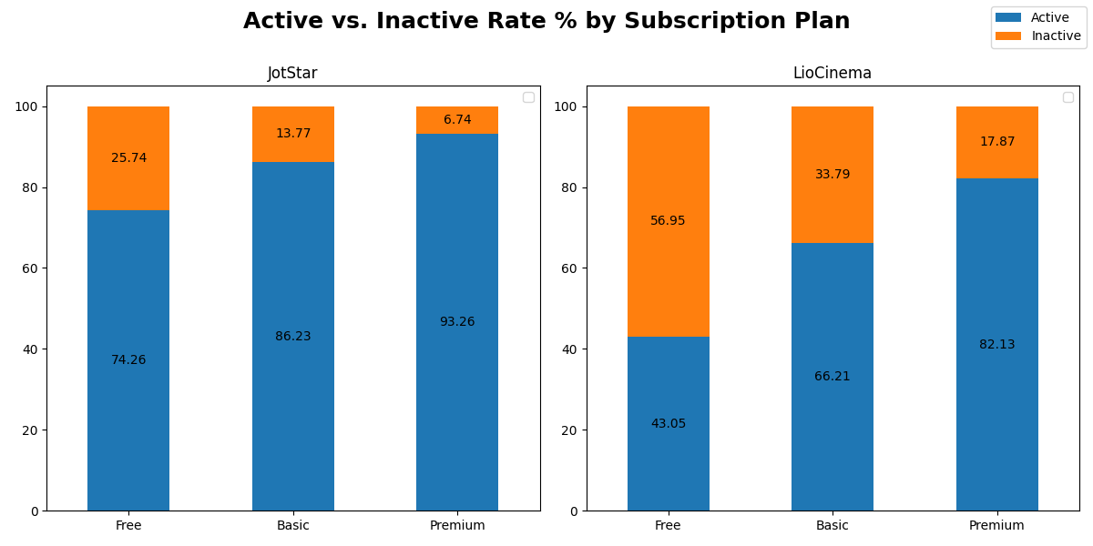
Active vs Inactive Rate by Subscription Plan

Slide 8
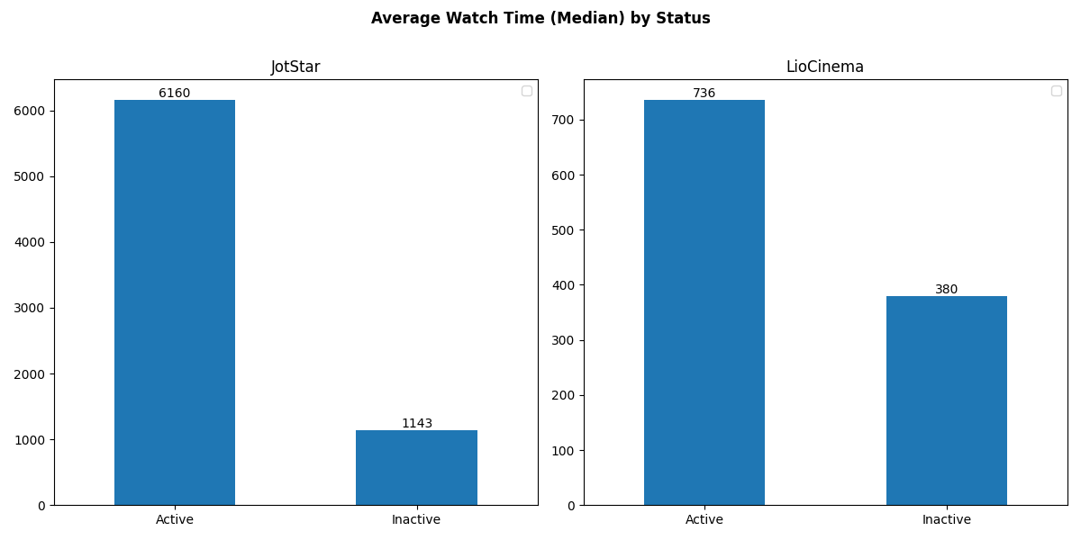
Average Watch Time by Status

