Slide 1

Sports Basics
Analyse historical IPL data and provide insights on IPL 2024 for a sports magazine
Created by
G Viswavardhan Reddy

Slide 2
Agenda
Project’s Objective
Data Overview
Primary Insights
Dashboard Demonstration
Predictions & Best 11

Slide 3

Objective
Sports Basics is a sports blog company that entered the space recently.
They aim to increase traffic to their website by releasing a special edition magazine on IPL 2024.
The magazine provides insights and facts for fans, analysts, and teams based on data from the last 3 years.

Slide 4
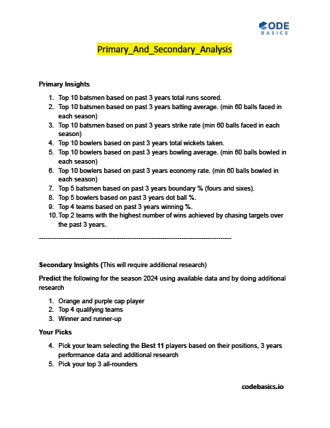



Slide 5
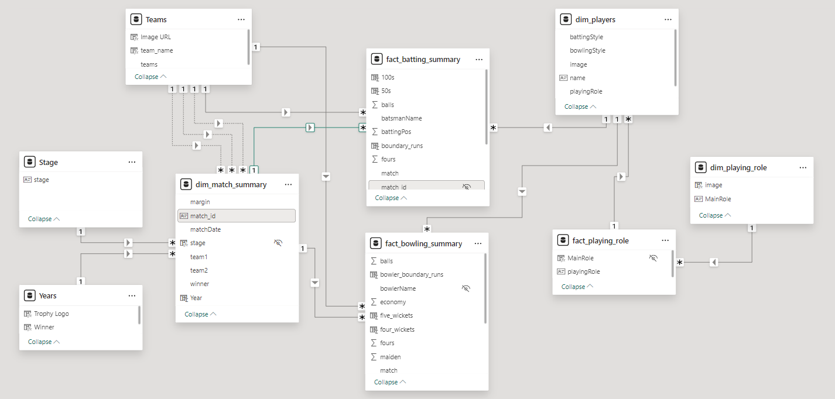
Data Overview and Model

Slide 6
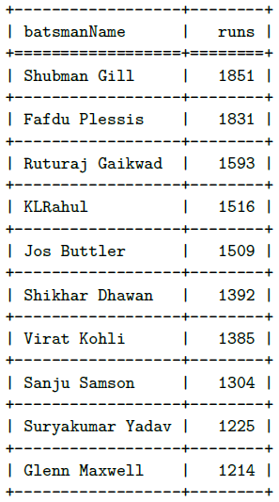
1. Top 10 batsmen based on past 3 years total runs scored.

Slide 7
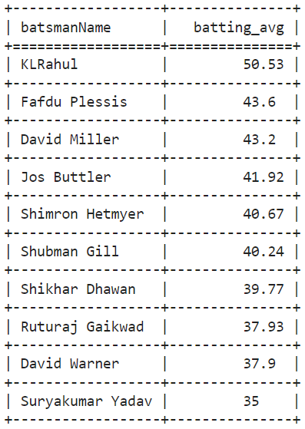
2. Top 10 batsmen based on past 3 years batting average. A minimum of 60 balls are faced in each season.

Slide 8
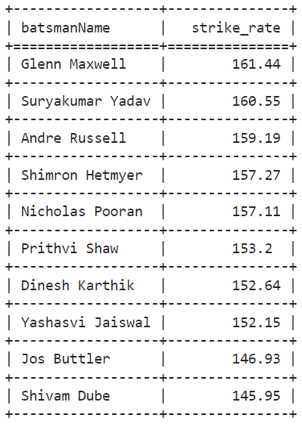
3. Top 10 batsmen based on past 3 years strike rate. A minimum of 60 balls are faced in each season.

Slide 9
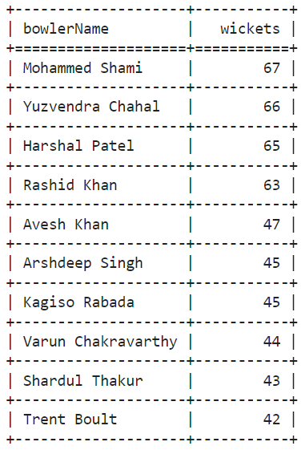
4. Top 10 bowlers based on past 3 years total wickets taken.

Slide 10
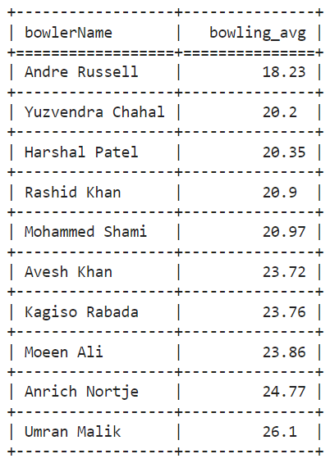
5. Top 10 bowlers based on past 3 years bowling average. A minimum of 60 balls are bowled in each season.

Slide 11
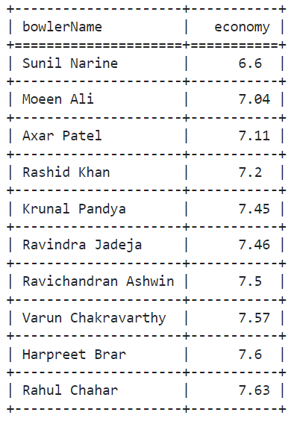
6. Top 10 bowlers based on past 3 years economy rate. A minimum of 60 balls are bowled in each season.

Slide 12
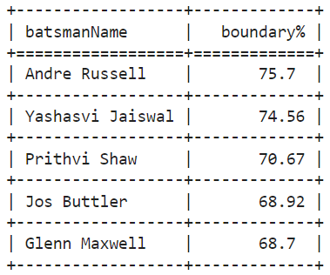
7. Top 5 batsmen based on past 3 years boundary %. A minimum of 60 balls are faced in each season.

Slide 13
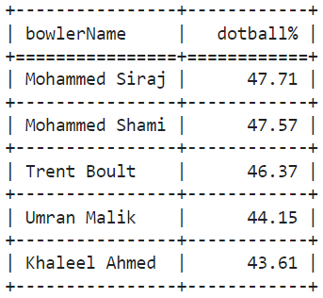
8. Top 5 bowlers based on past 3 years dot ball %. A minimum of 60 balls are bowled in each season.

Slide 14
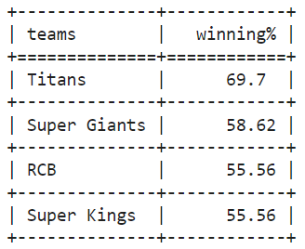
9. Top 4 teams based on past 3 years winning %.

Slide 15
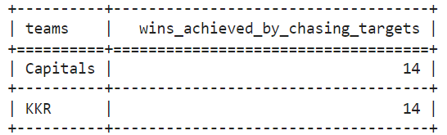
10. Top 2 teams with the highest number of wins achieved by chasing targets over the past 3 years.

Slide 16
Dashboard Demonstration

Slide 17
Thank You

