Slide 1

Bits of Evidence
What We Actually Know About
Software Development,
and
Why We Believe It’s True
Greg Wilson | http://third-bit.com | February 2012

Slide 2









You are free to:
Copy, share, adapt, or re-mix;
Photograph, film, or broadcast;
Blog, live-blog, or post video of;
This presentation. Provided that:
You attribute the work to its author and respect the rights and licenses associated with its components.

Slide 3

Once Upon a Time...
Seven Years’ War (actually 1754-63)
Britain lost 1,512 sailors to enemy action...
...and almost 100,000 to scurvy

Slide 4
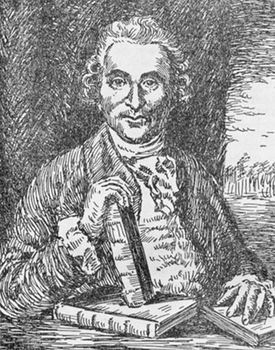
Oh, the Irony
James Lind (1716-94)
1747: (possibly) the first-ever controlled medical experiment
cider sulfuric acid vinegar | sea water oranges barley water
No-one paid attention until a proper Englishman repeated
the experiment in 1794...

Slide 5


It Took a While...
1950: Hill & Doll publish a
case-control study comparing
smokers with non-smokers
1951: start the British Doctors
Study (which runs until 2001)

Slide 6

What They Found
#1: Smoking causes
lung cancer
#2: Many people would rather fail than change
“...what happens ‘on average’ is of no help
when one is faced with a specific patient...”

Slide 7

Like Water on Stone
1992: Sackett coins the term
“evidence-based medicine”
Randomized double-blind
trials are accepted as the
gold standard for medical
research
The Cochrane Collaboration (http://www.cochrane.org/)
now archives results from hundreds of medical studies

Slide 8
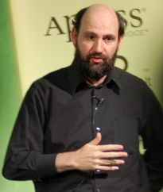
So Where Are We?
“[Using domain-specific languages] leads to two primary benefits. The first, and simplest, is improved programmer productivity... The second...is...communication with domain experts.”
– Martin Fowler,
IEEE Software,
July/August 2009

Slide 9

Look Closer
One of the smartest guys in our industry...
...made two substantive claims...
...in an academic journal...
...without a single citation
Please note: I’m not disagreeing with his claims—I just want to point out that even the best of us aren’t doing what we expect the makers of acne creams to do.

Slide 10
Our Real Problem
“Debate still continues about how valuable DSLs are in practice. I believe that debate is hampered because not enough people know how to develop DSLs effectively.”
I think debate is hampered by low standards for proof
The good news is, things have started to improve

Slide 11



A New Hope
Growing emphasis on empirical studies in software engineering research since the mid-1990s
Papers describing new tools or practices routinely include results from some kind of field study
Yes, many are flawed or incomplete, but standards are constantly improving

Slide 12
For Example
Aranda & Easterbrook (2005): “Anchoring and Adjustment in Software Estimation”
“How long do you think it will take to make a change to this program?”
Group A: “I admit I have no experience with software projects, but I guess this will take about 2 months to finish.”
Control Group: “I’d like to give an estimate for this project myself, but I admit I have no experience estimating. We’ll wait for your calculations for an estimate.”
Group B: “...I guess this will take about 20 months...”

Slide 13
Results
Group A (lowball) | 5.1 months
Control Group | 7.8 months
Group B (highball) | 15.4 months
The anchor mattered more than experience, how formal the estimation method was, or anything else.
Q: Are agile projects similarly afflicted,
just on a shorter and more rapid cycle?

Slide 14

Often Misquoted
Sackman, Erikson, and Grant (1968): “Exploratory experimental studies comparing online and offline programming performance.”
The best programmers are
up to 28 times more productive than the worst.
Or 10, or 40, or 100, or whatever other large number pops into the head of someone who can’t be bothered to look up the reference...

Slide 15

Pick That Apart
Study was designed to compare batch vs. interactive, not measure productivity
How was productivity measured, anyway?
Best vs. worst exaggerates any effect
Twelve programmers for an afternoon
Next major study was 54 programmers...
...for up to an hour

Slide 16


What Do We Know?
I’m not going to tell you
Instead, I’d like you to look at
Steve McConnell's summary
of 40+ years of study
http://third-bit.com/blog/archives/4125.html
Or Lutz Prechelt's studies
LOC per programmer per hour is roughly
constant regardless of language used

Slide 17
A Classic Result
Boehm et al (1975): “Some Experience with Automated Aids to the Design of Large-Scale
Reliable Software.”
...and many, many more since
Most errors are introduced during requirements analysis and design
The later they are removed, the most expensive it is to take them out
number / cost
time

Slide 18


It Explains a Lot
Pessimists: “If we tackle the hump in the error injection curve, fewer bugs will get to the expensive part of the fixing curve.”
Optimists: “If we
do lots of short iterations, the total cost of fixing bugs will go down.”

Slide 19
Why I Care
A: I've always believed that there are just
fundamental differences between the sexes...
B: What data are you basing that opinion on?
A: It's more of an unrefuted hypothesis based on
personal observation. I read a few studies on the
topic and I found them unconvincing...
B: Which studies were those?
A: [no reply]

Slide 20

Real Science
Ceci & Williams (eds): Why Aren’t
More Women in Science? Top
Researchers Debate the Evidence
Informed debate on nature vs. nurture
- Changes in gendered SAT-M scores over 20 years
- Workload distribution from mid-20s to early 40s
- The Dweck Effect
- Facts, data, and logic

Slide 21

Greatest Hits
Rigorous inspections can remove 60-90% of errors before the first test is run. (Fagan 1975)
The first review and hour matter most. (Cohen 2006)
People who pay attention to facts
tend to outperform
people who don't
This would be cuter if it was a kitten.

Slide 22


Not Just Numbers
I focus on quantative studies because
they're what I know best...
...but a lot of excellent work borrows techniques
from anthropology, business, sociology, etc.

Slide 23
Another Result
Nagappan et al (2007) & Bird et al (2009):
Geography has little effect on post-release fault rates

Slide 24
Another Result
Nagappan et al (2007) & Bird et al (2009):
Geography has little effect on post-release fault rates
Distance in the org chart matters a lot more

Slide 25
Another Result
Nagappan et al (2007) & Bird et al (2009):
Geography has little effect on post-release fault rates
Distance in the org chart matters a lot more
No, really—shouldn’t
development practices
be built around these facts?

Slide 26

Two Steps Forward...
“Progress” sometimes means saying, “Oops.”
Can code metrics predict post-release fault rates?

Slide 27
Two Steps Forward...
“Progress” sometimes means saying, “Oops.”
Can code metrics predict post-release fault rates?
We thought so, but then...
El Emam et al (2001): “The Confounding Effect of Class Size on the Validity of Object-Oriented Metrics”

Slide 28



Folk Medicine
Systematizing and synthesizing colloquial practice
has been very productive in other disciplines...

Slide 29

All Together Now
Andy Oram & Greg Wilson (ed):
Making Software: What Really Works, and Why We Believe It.
O'Reilly, 2010, 978-0596808327.

Slide 30

http://neverworkintheory.org/

Slide 31
http://neverworkintheory.org/
People get pretty worked up when you tell them that
Perl is as hard for novices to use
as a language with randomly-designed syntax…

Slide 32
Because

Slide 33
Because
Knowledge transfer

Slide 34
Because
Knowledge transfer
A better textbook

Slide 35
Because
Knowledge transfer
A better textbook
Change the debate

Slide 36
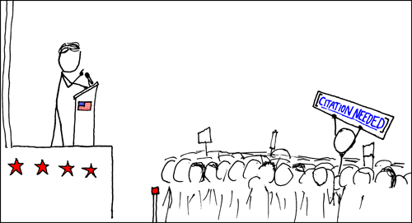
What We Hope For

Slide 37

Why I Really Care

Slide 38

Why I Really Care

Slide 39
Thank You

