Slide 1
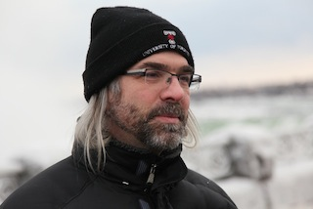

Software Carpentry in Five Minutes
Greg Wilson

Slide 2
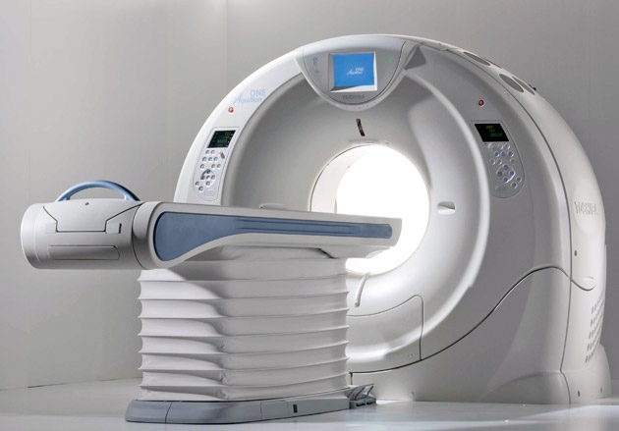

Where We (Still) Are
5-15%
85-95%
petabytes
in the cloud
spreadsheets
by email

Slide 3

So add computing to the curriculum
but it's already full...

Slide 4

And even if we did...
...who would teach?

Slide 5
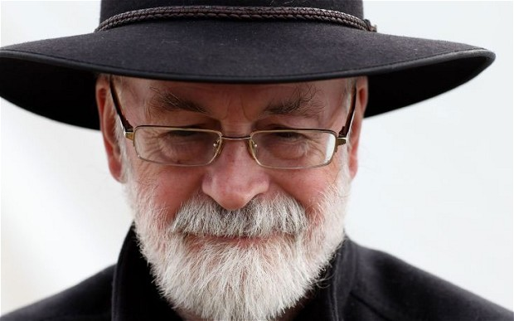
If you build a man a fire,
you'll keep him warm for a night.
If you set a man on fire,
you'll keep him warm for the rest of his life.
— Terry Pratchett

Slide 7
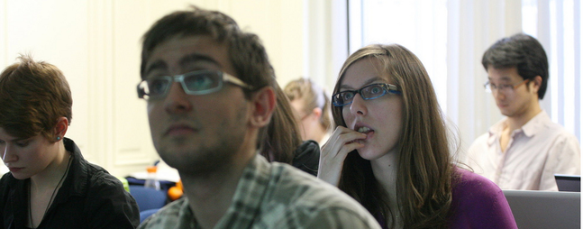
What We Teach
Unix shell
Git
Python or R
SQL

Slide 8
What Actually We Teach
Unix shell
Git
Python or R
SQL
Task automation
Tracking / sharing
Re-use
Data management

Slide 9
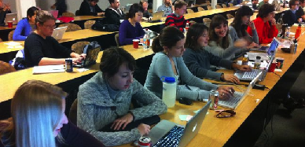
How It's Going
In 2015: 290 workshops
~9500 learners
28 countries

Slide 10

Community
581 certified instructors
scientists teaching scientists
20 partner organizations

Slide 11
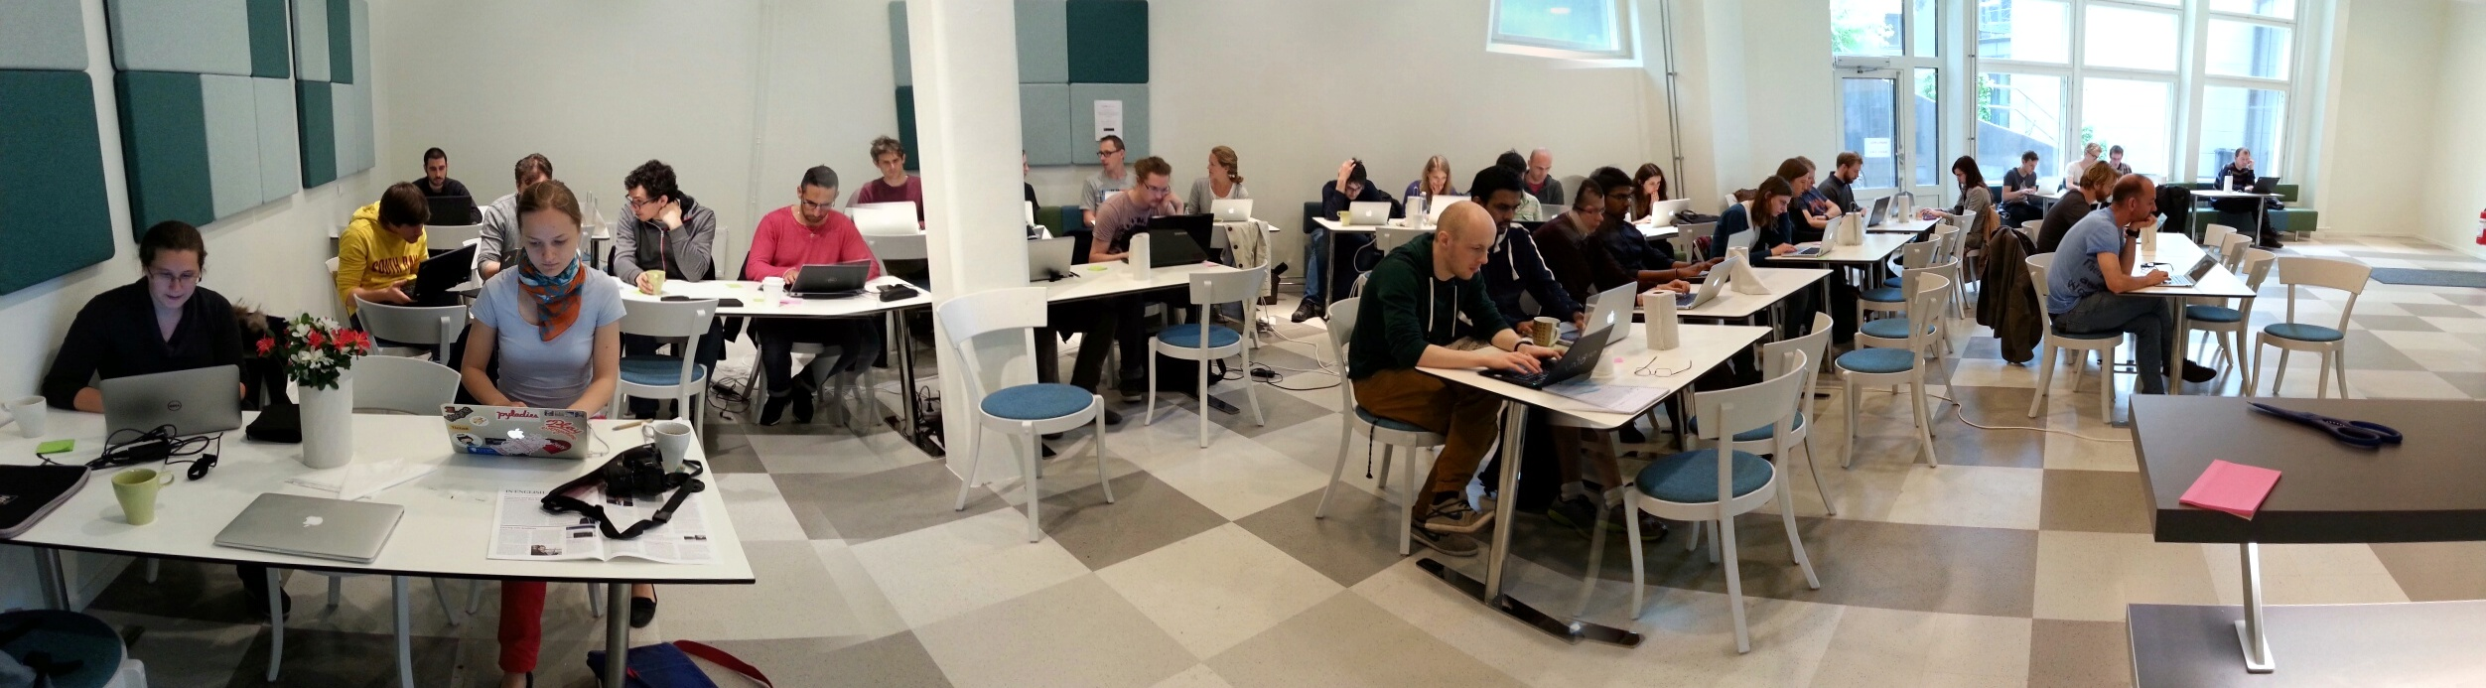
Why People Volunteer
Make the world a better place
Self-defense
Learn this stuff themselves
Make new friends
Boost their careers

Slide 12

The Model Transfers

Slide 13
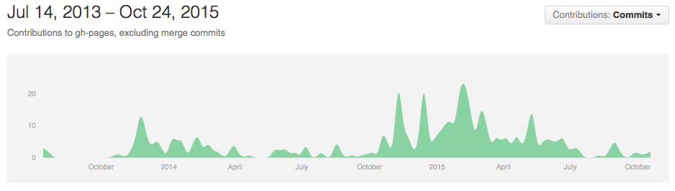
All Together Now
187 contributors to lessons in 2015
Why is this so rare??

Slide 14

My Biggest Lesson

Slide 15
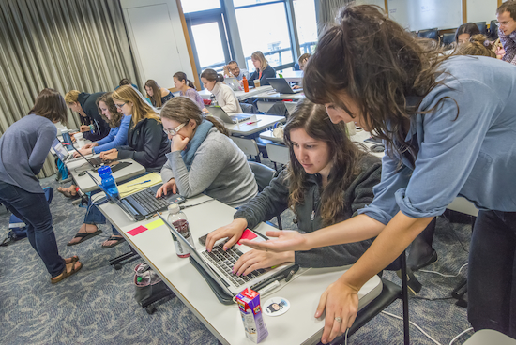
How You Can Help
Learn
Host
Teach
Write
Share

Slide 16
Thank You
http://software-carpentry.org

