Slide 1
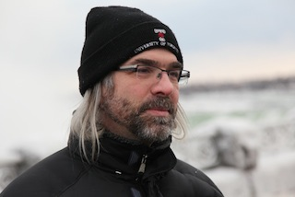
Software Engineering's
Greatest Hits
Greg Wilson
http://third-bit.com
2016

Slide 2
Terms and Conditions
Science (n): the use of the scientific method to figure out how the world works
Engineering (n): the use of the scientific method to make a better one
Which means most “software engineering” courses aren't actually teaching engineering

Slide 3
What Do They Teach?
Project management
(Ways to describe) software architecture
  which most practitioners don't use
(Maybe) some mathematical proofs
But not experiments or data analysis

Slide 4
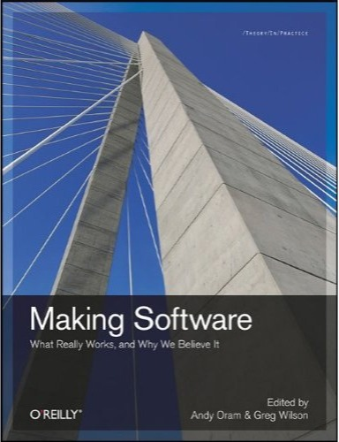
Our First Album
Oram & Wilson (eds):
Making Software:
What Really Works,
and Why We Believe It
O'Reilly, 2010.

Slide 5
A Classic Result
Rigorous inspection can remove 60-90% of errors before the first test is run. (Fagan 1975)
The first review and the first hour matter most. (Cohen 2006)
“Given enough eyeballs, all bugs are shallow” is plausible, but false.

Slide 6
Which Distance Matters?
Geographic distance has little correlation with software quality. (Nagappan et al 2007, Bird et al 2009)
Distance in the organization chart is a much better predictor.

Slide 7
Speaking of Quality...
Are any software metrics better at predicting effort or faults than counting lines of code?
No. (El Emam et al 2001, Herraiz & Hassan 2010)

Slide 8
Thank You
Greg Wilson
http://third-bit.com
2016

