Slide 1

How to Become Rich, Famous, and Popular While Using Your Programming Skills to Make the World a Better Place
Greg Wilson

Slide 2
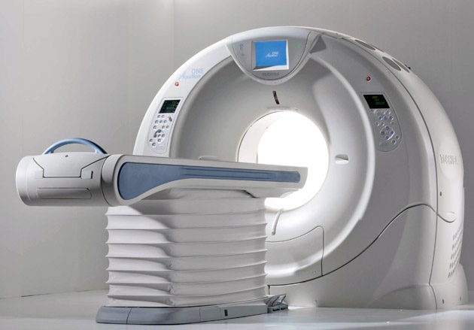
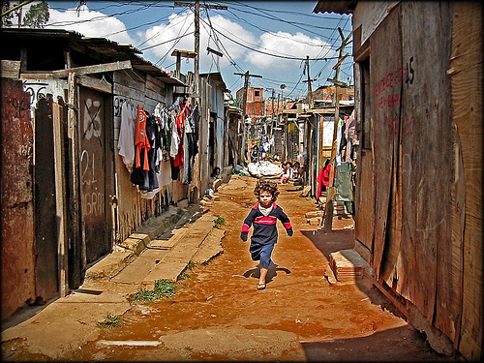
Scientists
5-15% use GPU clusters
to analyze petabytes
in the cloud
85-95% send one
other spreadsheets
by email

Slide 3

It Is Therefore Obvious That...
We should put more computing in the curriculum!
But it's already full

Slide 4
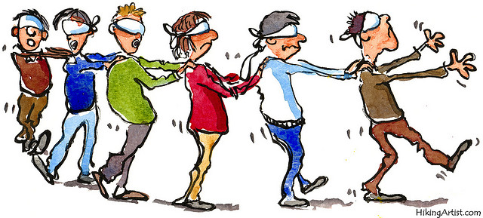
It Is Therefore Obvious That...
And even if we did...
...who would teach those classes?

Slide 5


Slide 6
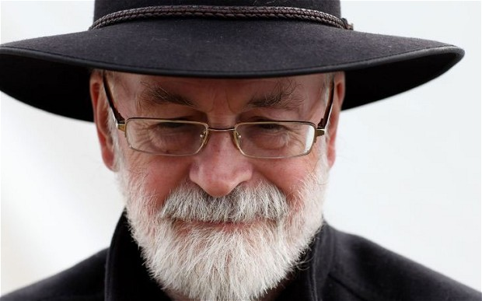
If you build a man a fire,
you'll keep him warm for a night.
If you set a man on fire,
you'll keep him warm for the rest of his life.
— Terry Pratchett

Slide 7
What We Teach
Unix shell
Version control
Python/R/MATLAB
SQL
Make

Slide 8
What We Actually Teach
Unix shell | => | Task automation
Version control | => | Track and share work
Python/R/MATLAB | => | Modular programming
SQL | => | Data management
Make | => | Reproducibility

Slide 9
How It's Going
Workshops

Slide 10
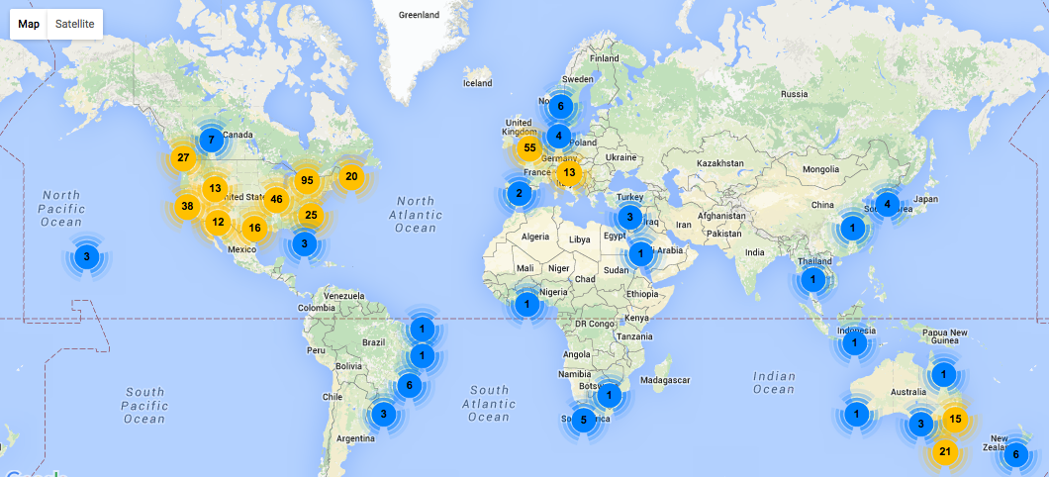
How It's Going
Workshops

Slide 11
How It's Going
Learners

Slide 12
How It's Going
Instructors

Slide 13
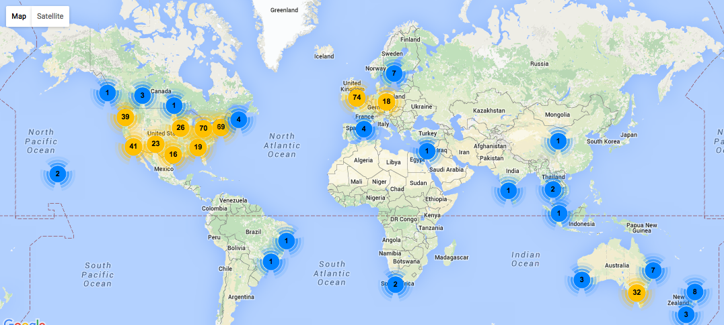
How It's Going
Instructors

Slide 14
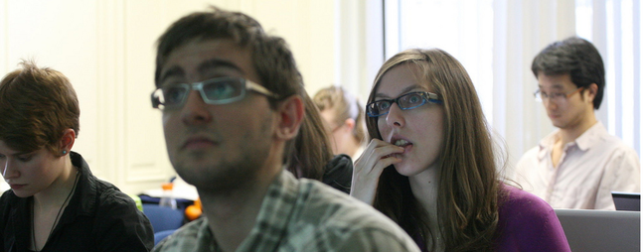
What We've Accomplished
Honestly don't know
Anecdotally, save people 10-20% of their time for the rest of their careers
And prepare them for all those petabytes and clouds

Slide 15

What I've Learned
We know stuff about things
It works
We mostly don't act on it

Slide 16
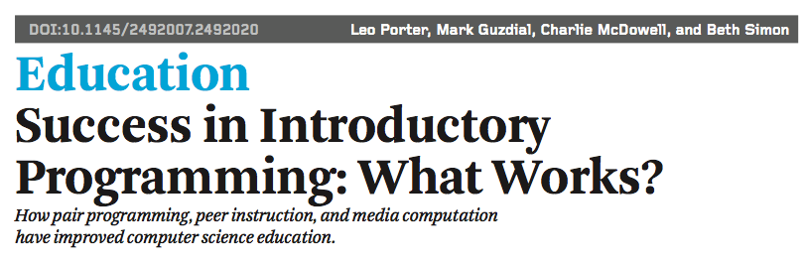
This presents Opportunity #1
https://www.youtube.com/watch?v=2LbuoxAy56o

Slide 17
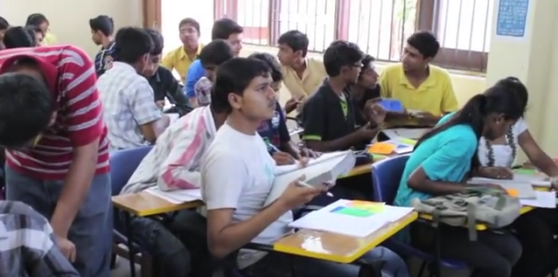
Today's MOOC platforms don't support PI
Piotr Banaszkiewicz showed that it's possible
github.com/pbanaszkiewicz/peer-instruction
Implement!

Slide 18
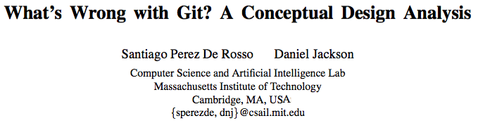
Andreas Stefik and Susanna Siebert: "An Empirical Investigation into Programming Language Syntax." ACM Transactions on Computing Education, 13(4), Nov. 2013.

Slide 19

A Puzzle
Thousands contribute patches to open source software projects
Millions have edited Wikipedia
Why don't people build lessons this way?

Slide 20
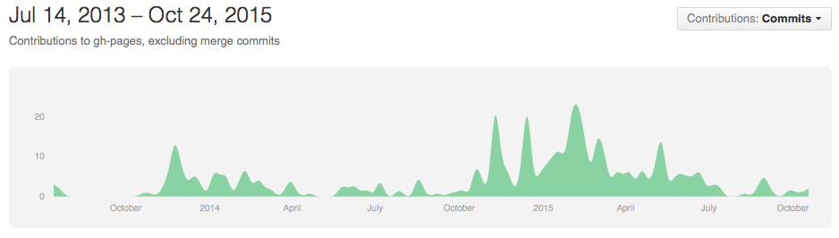
All Together Now
We've shown it can be done
And that it's useful
This presents more opportunities

Slide 21

To Sum Up
First-class support for peer instruction
A rational reconstruction of Git
Diff for all! (Excel first)
Browsercast

