Slide 1


Software & Data Carpentry:
Training to Enable More Effective
Computational Research
Tracy K. Teal, PhD Greg Wilson, PhD
Data Carpentry Software Carpentry
Executive Director Executive Director
@datacarpentry @swcarpentry
http://datacarpentry.org http://software-carpentry.org
Notes:
Strategies and Techniques for Analyzing Microbial Population Structure
Explorations in Data Analyses for Metagenomic Advances in Microbial Ecology

Slide 2
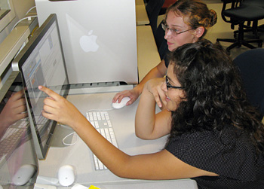
But Who Will Teach?
Rigorous inspections can remove 60-90% of errors before the first test is run. (Fagan 1975)

Slide 3
But Who Will Teach?
Rigorous inspections can remove 60-90% of errors before the first test is run. (Fagan 1975)
The first review and hour matter most. (Cohen 2006)

Slide 4

But Who Will Teach?
Rigorous inspections can remove 60-90% of errors before the first test is run. (Fagan 1975)
The first review and hour matter most. (Cohen 2006)
Scientists want review in situ by people who understand
their science (Petre & Wilson 2014)

Slide 5
Solution: Grow Your Own
Recruit willing scientists
Introduce them to evidence-based teaching practices
8-12 weeks or 2 full days (with followup)
Now 459 instructors in 26 countries

Slide 6

Solution: Grow Your Own

Slide 7
Guiding the Carpentries
Software Carpentry Steering Committee:
Matt Davis (Bay area company)
Adina Howe (Iowa State)
Katy Huff (UC Berkeley)
Karin Lagenstrom (Norway)
Aleksandra Pawlik (Software Sustainability Institute)
Raniere Silva (Brazil)
Jason Williams (CSHL)

Slide 8
Guiding the Carpentries
Data Carpentry Steering Committee:
Karen Cranston (NESCent / OpenTree of Life)
Hilmar Lapp (NESCent / Duke)
Aleksandra Pawlik (Software Sustainability Institute)
Karthik Ram (rOpenSci / BIDS Fellow)
Ethan White (University of Florida/Moore DDD Investigator)
Greg Wilson (Software Carpentry)

Slide 9






Data Carpentry Support

Slide 10













Software Carpentry Support

