Slide 1
How to Run a Meeting

Slide 2

0. You don’t have to invent this yourself
https://www.askamanager.org/

Slide 3
1. Does there actually need to be a meeting?
To review and give feedback? No—do it asynchronously
To inform? Only if you are expecting deep questions
To consult? Only if people get a veto
  Otherwise it’s just informing with pretense
To make decisions when asynchronous review can’t
  But only in small groups
  Or with well-defined procedural rules

Slide 4
A Theory
Meetings have proliferated because they’re easier to do (you don’t even have to get out of your chair)
and because they have become a substitute for casual social interaction
Resist, comrades—resist!

Slide 5
2. Create an agenda
If you don’t care enough to make a list, you don’t need a meeting
Include timings
Prioritize
Plan to end early

Slide 6
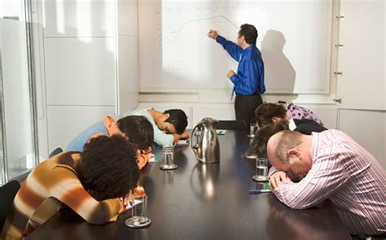
50 Minutes Plus a Break
“The fundamental unit of time is the bladder”

Slide 7
3. Have clear rules for making decisions
(And for knowing what decisions have been made)
“The Tyranny of Structurelessness” (Jo Freeman)
Every group has a power structure
  The only question is whether it’s explicit and accountable
  Or implicit and unaccountable
If you need Robert’s Rules of Order, you need training

Slide 8
3. Have clear rules for making decisions
Martha’s Rules
Proposal with sponsor
  A day before the meeting (no sandbagging)
Sense vote (+1, 0, -1)
  If no one objects, proposal passes
Discussion as needed
Binding vote (+1 or -1 only)

Slide 9
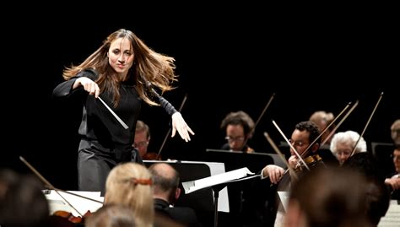
4. Have a moderator
Moderators should not do all the talking
  Any more than conductors play all the notes
Call on specific people in order
Allow them one point at a time
Keep a backlog

Slide 10
5. Require politeness
All the other rules are special cases of this…
No technology during in-person meeting
  Except for assistive technology or family need
  “Please put your devices in politeness mode”
No interruptions
  Except by moderator
No rambling

Slide 11
“But what do we talk about?”
Progress, plans, and problems go up
Context and priorities come down

Slide 12
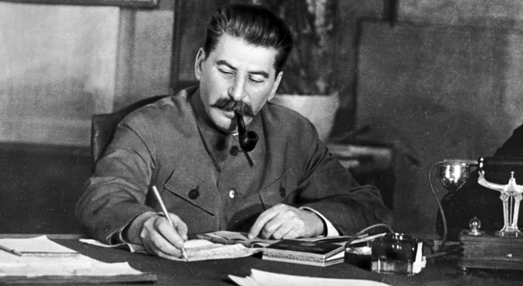
6. Record minutes
So people who weren’t there know what happened
So people who were there agree what happened
So people can be held accountable at later meetings

Slide 13
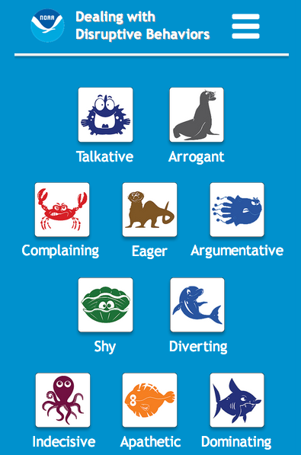
7. Manage “that guy”
This is the moderator’s other job
https://coast.noaa.gov/ddb/
Three stickies
Interruption bingo

Slide 14
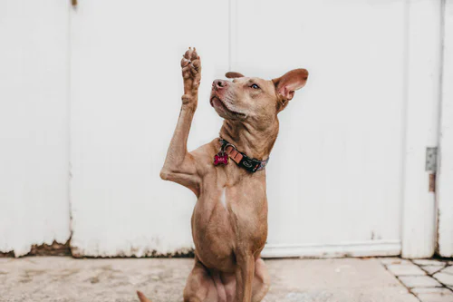
8. Be an active participant
Decline invitations
Read the agenda and material before the meeting
Take your own notes
Use participants’ names
Use definite nouns
Pause before speaking
Put down your hand

Slide 15
9. Life online
Do not record the meeting without willing consent
No mixed-mode meetings: all in person or all online
Take minutes in a shared document
Raise hands digitally
  /hand another budget item was better…
Review meeting protocol at the start
  “Are we chatting in Zoom, Slack, or the doc?”

Slide 16
Speaking of which…
I’ll Slack you a link to the Google spreadsheet that will tell you which GitHub repository’s wiki points to the Confluence page we’re using to track mailing lists in ZenDesk.
Oh wait, no, it’s in Figma…

Slide 17
10. Seek truth, not victory
Don’t raise points you don’t actually believe in
  The devil doesn’t need more advocates
No social dominance displays
  “Well actually…”
Don’t make excuses for your questions or opinions
  “This is probably stupid, but…”

Slide 18
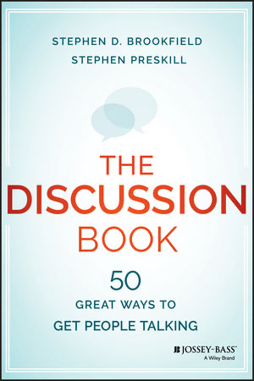
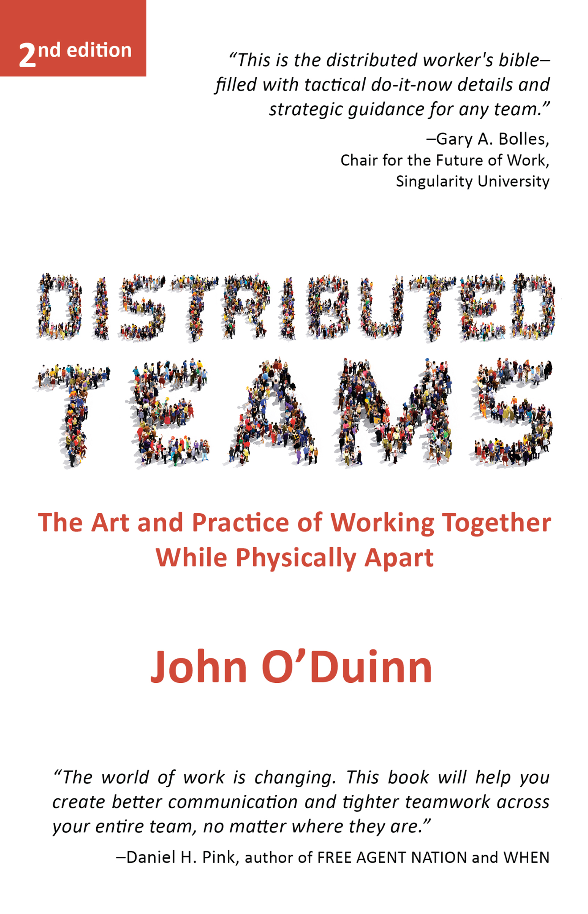

Please Read

Slide 19
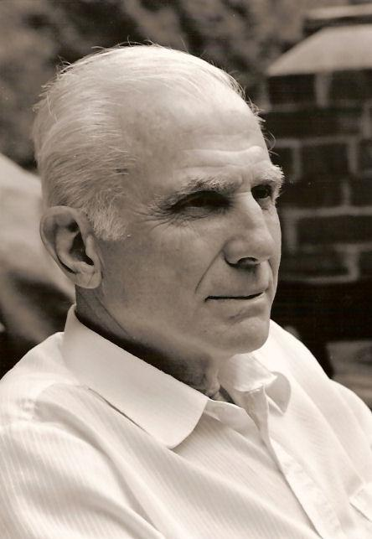
Thanks, Dad
Start where you are
Use what you have
Help who you can

