Slide 1

Greg Wilson
Teaching Tech Together
Notes:
Hello and welcome. This hour-long talk will cover some key ideas in evidence-based teaching that we hope you will find useful, both when passing on what you know and when learning new things yourself. All the material is covered by a Creative Commons license: you are free to share and remix it so long as you cite this talk as the original source.

Slide 2

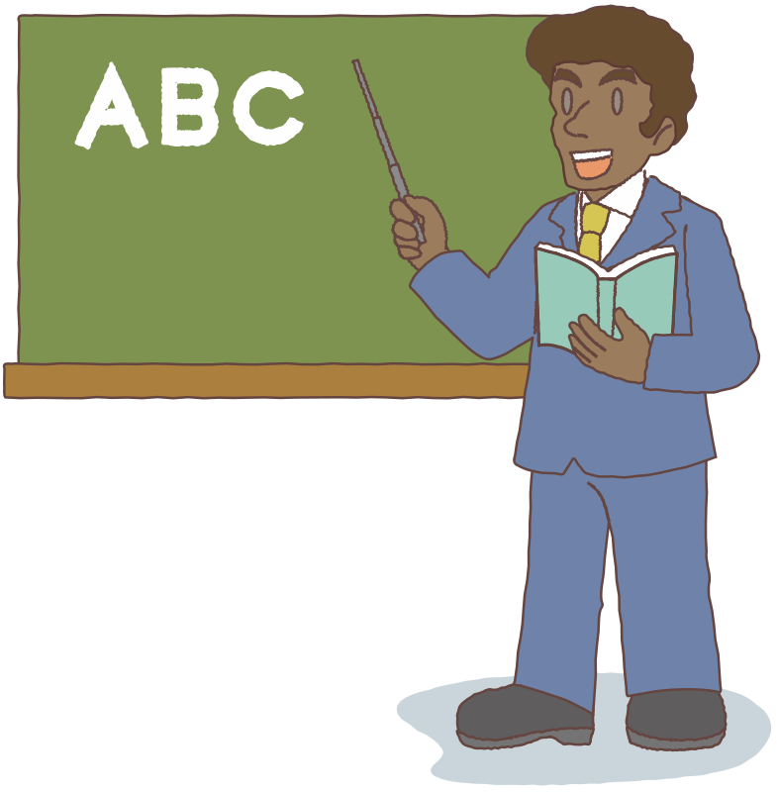

The Pitch
Notes:
We know as much about teaching and learning as we do about public health. The problem is, most people in tech (and most university professors) don’t know what we know. By the time you leave high school, you probably know what germs and vitamins are and where babies come from. You probably don’t know similarly basic facts about how people learn or how best to teach them.

Slide 3
Rule #1:
Design for three different kinds of learners
Notes:
Our first rule is that you have to figure out who you’re teaching before you can start to build a lesson.

Slide 4
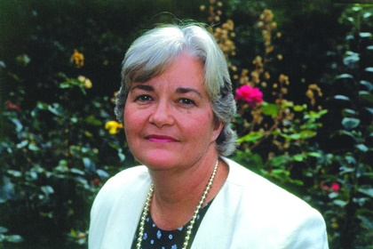
Cognitive Progression
Novice
Advanced beginner
Competent
Proficient
Expert
Prof. Patricia Benner
Notes:
Benner identified five stages, but for our purposes, we’re going to simplify the model to three and say that someone is either a novice, competent, or an expert.

Slide 5
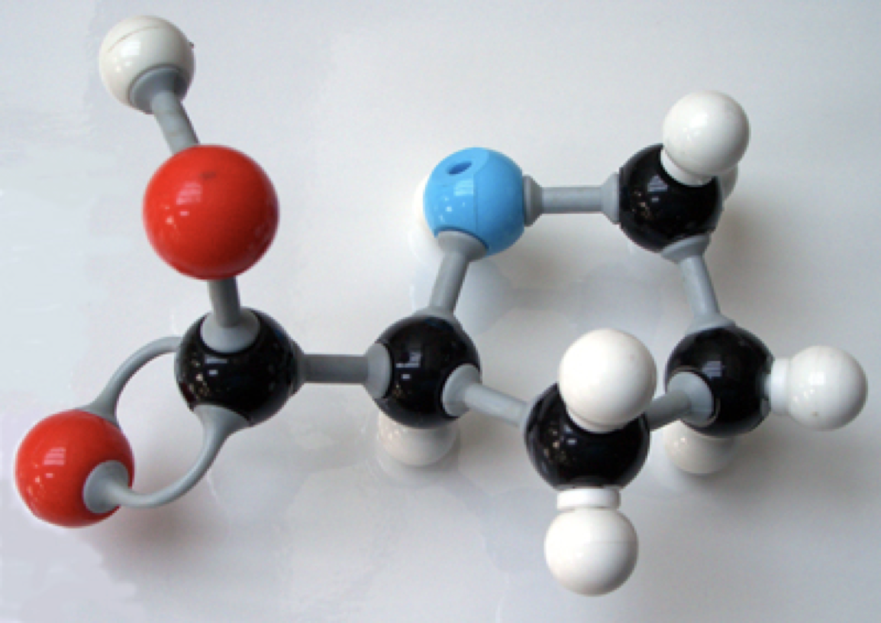
A Novice Doesn’t Have a Mental Model
Notes:
Here’s an example of what we mean by a mental model. In grade school science class, you were probably taught that atoms are brightly colored balls connected by springs. None of those things are actually true, but it’s a useful model for understanding the things people want to understand at that stage of their development, and for solving the problems they want to solve.

Slide 6
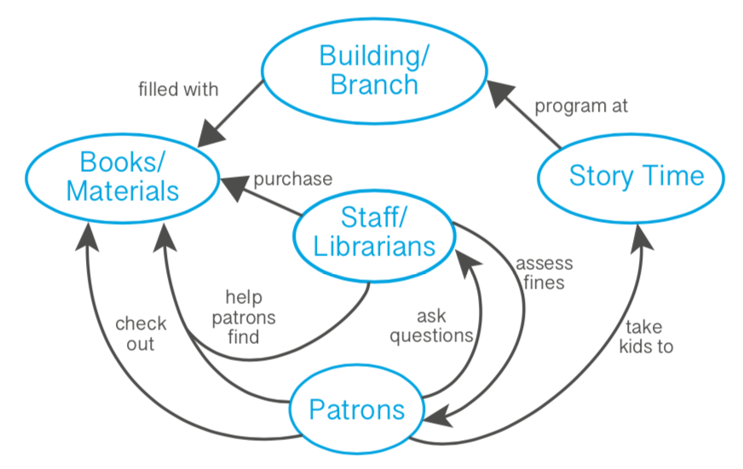
Concept Map
Notes:
Here’s one possible concept map for a library from a patron’s point of view.
(Original image from Amy Hodge of Stanford University.)

Slide 7
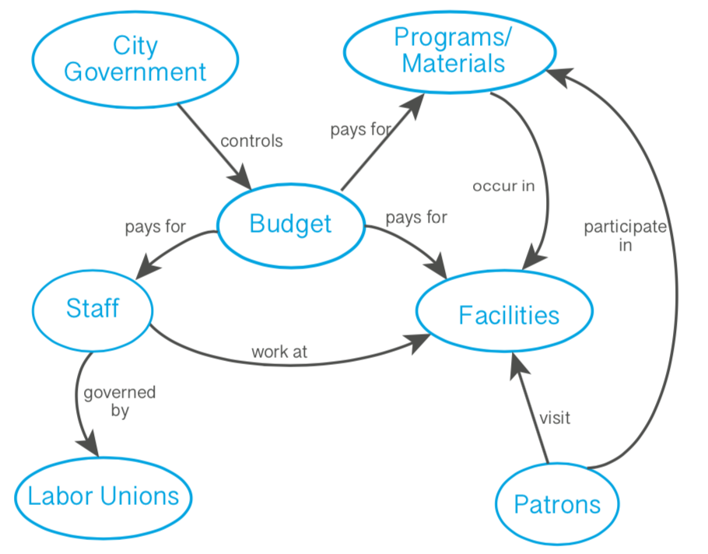
Concept Map
Notes:
Here’s another from the point of view of the director.

Slide 8

Symptoms of Being an Expert
See solutions at a glance
Multiple points of view
Much (much) better at debugging
Have difficulty explaining their thinking
Notes:
A lack of confidence doesn’t necessarily mean that someone is a novice.

Slide 9
A
B
C
E
D
F
Novice
Notes:
Neural networks don’t map directly to concept maps, but wiring helps explain the differences between novices, competent practitioners, and experts. Novices don’t have a lot of connections between concepts.

Slide 10
A
B
A
B
C
C
E
E
D
J
D
F
Q
F
Novice
Competent
Notes:
Competent practitioners have more, but it can take them several steps to get from what they know to what they need.

Slide 11
A
B
A
B
A
B
C
C
C
E
E
E
D
J
D
D
F
Q
F
F
Novice
Competent
Expert
Notes:
Experts have many more connections, so their path is shorter—so short, in fact, that they can often jump from start to finish in a single step. This is also what leads to expert blind spot: they can’t explain their reasoning because there isn’t any.

Slide 12
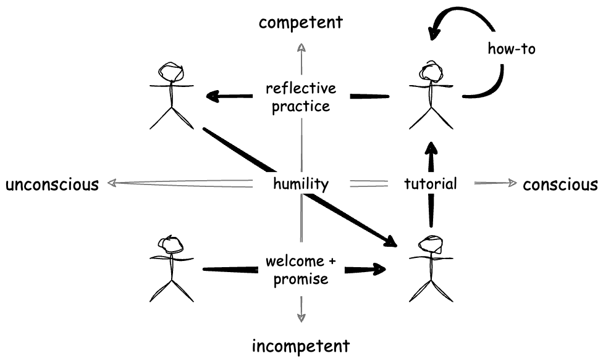
Teaching Methods
competent
expert
novice
Notes:
These differences mean that different teaching strategies work best for different learners. Novices need to be guided: the teacher has to decide what they need to learn next. Competent practitioners need to be mentored: they can make a lot of progress on their own, and the teacher’s role is to help them get unstuck or to help them pick their next problem. And if someone is an expert, the most effective strategy is to help them reflect on their own work.

Slide 13
Rule #2:
A lesson is a user interface
for knowledge
Notes:
Our second rule is that everything we know about building user interfaces applies directly to building lessons.

Slide 14

Example Persona
M’shelle, 38, degree in CS, programmed in Java for a decade, now a project manager.
Helped build a lot of reporting tools and done budget forecasts.
Needs to know enough to hire people and arbitrate technical decisions about tools.
Single parent of two young children, so evenings and weekends are spoken for.
Notes:
This is what a finished persona looks like.

Slide 15

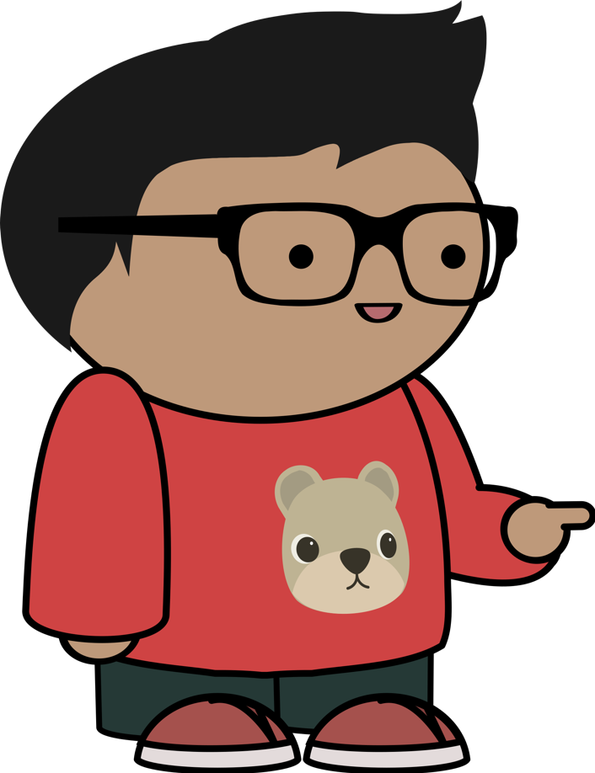

Four Different Learners
Anya Academic
Larry Legacy
Exton Excel
M’shelle Manager
Notes:
We need multiple explanations because we have multiple learners. For example, suppose we’re teaching data science. Anya is a professor who knows a lot of statistics but is new to programming; Exton has been using Excel for years but doesn’t know much stats; Larry has been using SAS for 35 years and doesn’t want to have to switch to R or Python, and M’shelle used to be a programmer but now manages a team of data scientists. The best intro for each person will be very different.

Slide 16
Rule #3:
Use formative assessments
as unit tests during learning
Notes:
Rule number three is to check for learning as we’re teaching.

Slide 17


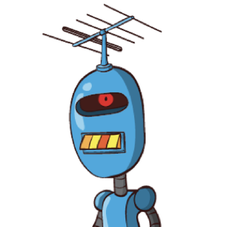
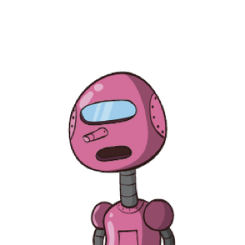
What Is 37 + 15 ?
52
412
42
43
Notes:
To see how to do this, let’s imagine we’re teaching some children how to do multi-digit addition, and we ask them to add 37 and 15.
If they say “52”, then either they understand how to do it or they’ve made a lucky guess.
If they got “42”, they probably didn’t carry. In fact, they probably wrote down “12” as the sum of 7 and 5, and then added 3 and 1 to get 4 and wrote that on top of the “1” from “12”.
What if they got 412? In this case, they still don’t understand how to carry, but it’s a step forward: they’re keeping the 1.
And what about 43? This child has almost got it: they’ve carried the 1, but they’ve carried it back into the 1’s column because they don’t understand it’s a 10.

Slide 18
Diagnosing Misconceptions
Forces the instructor to build a mental model of the learners’ mental models
Notes:
Each of the learners who gave a wrong answer has a different misconception. Each one therefore needs a different explanation to move forward. It might be a linear progression or it might not; what’s important is that if you don’t understand what they don’t understand, you’re just guessing about what to say next.

Slide 19
Formative Assessment
Quick (30-60 seconds)
Unambiguous (scalable)
Diagnostic power
“Can I move on?”
Notes:
They tell instructors whether they can move on or not (and if not, why not).

Slide 20

Formative Assessment
Quick (30-60 seconds)
Unambiguous (scalable)
Diagnostic power
“Do I understand this?”
Notes:
And they give learners a way to check that they actually understand something (because it’s easy to believe you do until you try to use knowledge).

Slide 21
Rule #4:
Manage cognitive load
Notes:
The fourth rule is to avoid overloading the learner.

Slide 22
Cognitive Architecture
encode
retrieve
long-term memory
short-term memory
Notes:
In simple form, we have two types of memory: long-term and short-term.

Slide 23
Cognitive Architecture
encode
verbal channel
ears
speech
∬
visual channel
eyes
images
retrieve
long-term memory
short-term memory
Notes:
On the input side, most data (for most people) comes through the visual channel, is integrated with linguistic information, then encoded and stored.

Slide 24

Reading Is Weird
ears
speech
text
eyes
images
Notes:
This model also explains why it’s less effective to present the same information as text and speech, such as by reading text-heavy slides aloud or by having captions that “say” the same thing as the presenter. Text comes in through the visual channel, but is then shunted sideways to the verbal channel. Your brain can’t help but try to reconcile the two streams of speech it’s receiving (one through your eyes and one through your ears), and doing that takes mental effort away from encoding the information for storage.
Description: a subset of the memory and cognition diagram built up previously, showing short-term memory, the verbal and visual channels, and the eyes and ears. An arrow labeled “speech” goes into “ears”, but there are now two arrows going into “eyes”, one labeled “images” as before, and a new one labeled “text”. There is also a new arrow going from the visual channel to the verbal channel, and an explosion icon in the box for the verbal channel.

Slide 25
The Magic Number 7 ± 2
∬
bottleneck
Notes:
Short-term memory is a serious cognitive bottleneck. Estimates in the 1950s were that it could hold 7±2 items; more recent estimates put the number closer to 4.

Slide 26
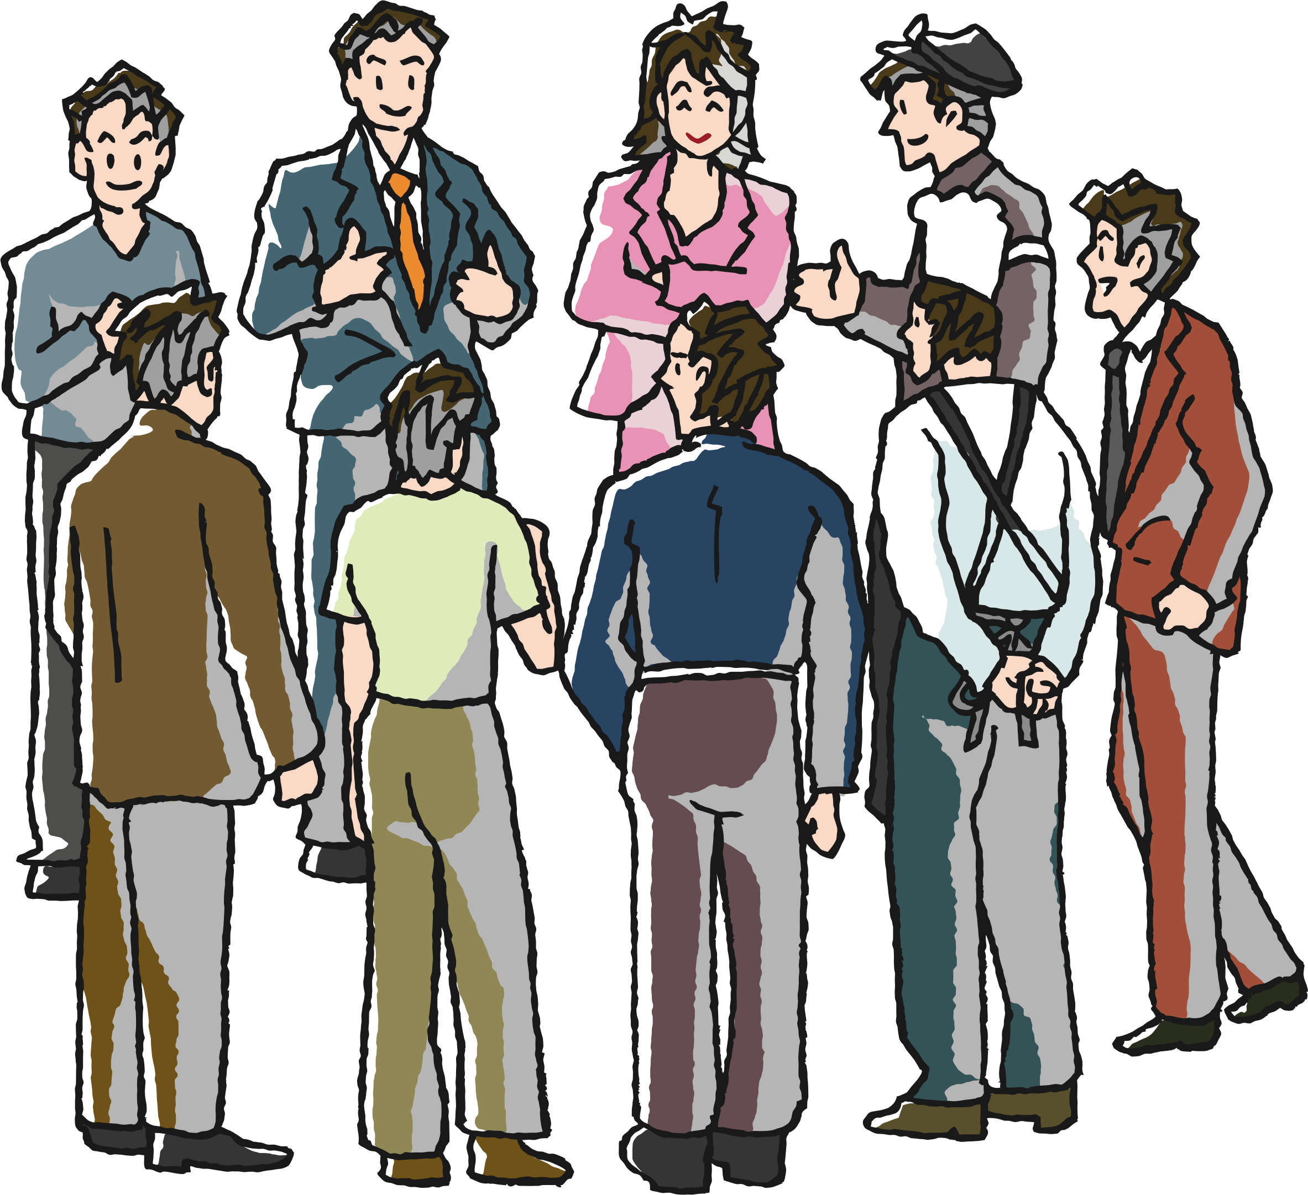

The Magic Number 7 ± 2
1
5
2
4
6
3
7
short-term memory
Notes:
This is why phone numbers are as long as they are. It may also be why the basic unit of human social organization is half a dozen people. From sports teams and military formations through knitting circles to meetings, that seems to be the limit of the number of people who can all be talking or working with one another at a time. Beyond that, larger groups quickly break down into sub-groups. (If you have 20 people in a meeting, you either have three meetings going on or one meeting of half a dozen people with a bunch of bystanders.)
Description: the short-term memory box from the previous slide containing the numbers 1 to 7, with a rotary telephone on its left, and a small crowd of people on its right.

Slide 27
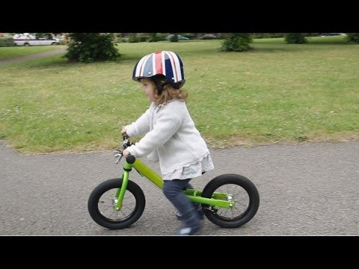
One Thing at a Time
Notes:
Balance bikes.

Slide 28
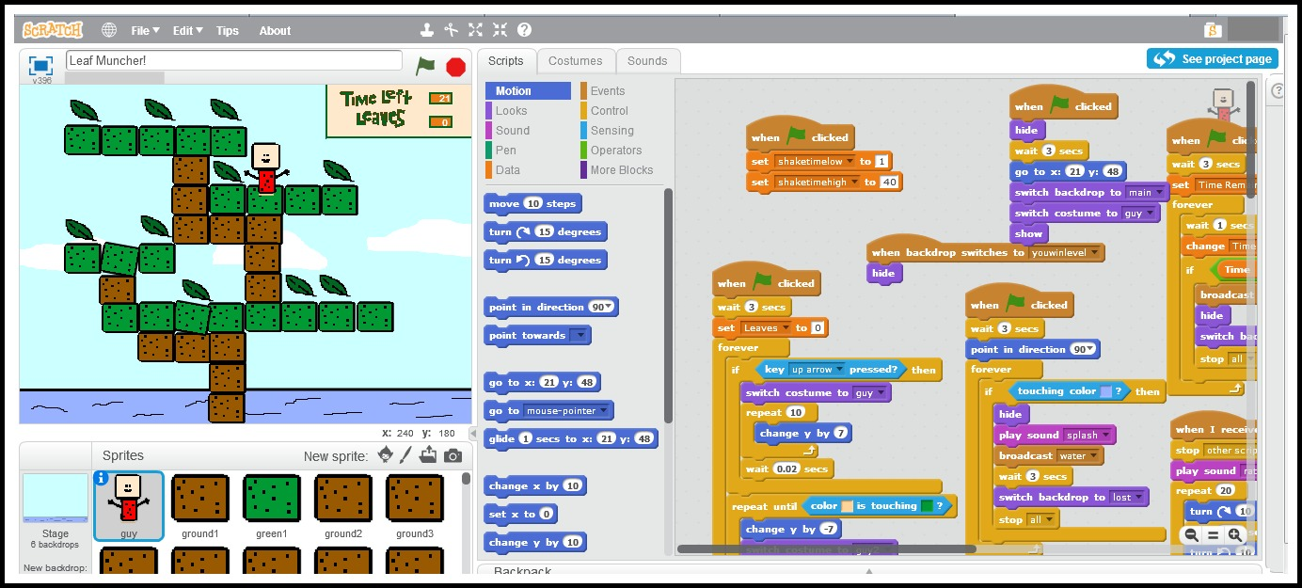
One Thing at a Time
Notes:
Balance bikes.

Slide 29
This Is Hard
Memorize the symbol used to represent each number.
1
4
7
2
5
8
3
6
9
Notes:
Balance bikes.

Slide 30
Let’s Try That Again
Does this make it easier?
1
2
3
4
5
6
7
8
9
Notes:
Balance bikes.

Slide 31
Cognitive Load
How is her knee today?
Notes:
To explain the differences, imagine that you’re learning to speak Frisian, and that you’ve been asked to translate this sentence. You have to do two things: recall some words, and arrange them grammatically.
Description: this slide contains only the sentence “How is her knee today?”

Slide 32
Cognitive Load
How is her knee today?
hoe
har
is
hjoed
knie
Notes:
But suppose I give you the words you need, so that all you have to do is arrange them in the right order.
Description: this slide contains the sentence and five boxes in a line labeled “hoe”, “har”, “is”, “hjoed”, and “knie”. Each label is in a different font.

Slide 33
Cognitive Load
How is her knee today?
hoe
is
har
knie
hjoed
hoe
har
is
hjoed
knie
Notes:
I’ve made them problem much simpler by giving you the vocabulary and allowing you to focus your attention on the grammar.
Description: the five boxes have been rearranged to form the sentence “Hoe is har knie hjoed”.

Slide 34
Cognitive Load
Intrinsic | What the learning task is supposed to be about | Grammar
Germane | Extra relevant work (such as retrieving supporting information) | Vocabulary
Extrinsic | Handling irrelevancies | Fonts
Notes:
In general, intrinsic load is what the learning task is supposed to be about. Germane load is extra relevant work, such as remembering words or picking a proof strategy. Extrinsic load is irrelevancies. In this case, the intrinsic load is figuring out the order of the words. The germane load is recalling the words, which we can reduce by giving them to you. And the extrinsic load is the use of a different font for each word: it draws your attention, but it doesn’t add anything to the lesson.

Slide 35
Rule #5:
Active beats passive
Notes:
Rule number five is that active learning beats passive learning.

Slide 36
Two Ways to Learn
Read about something | Try it out
Watch a video | Do exercises
Attend a lecture | Discuss a topic
Hear something explained | Try to explain it
Passive Learning | Active Learning
Notes:
The strategies on the left are “learn now, use later”. Those on the right are “use while learning”, and the latter always beats the former.

Slide 37
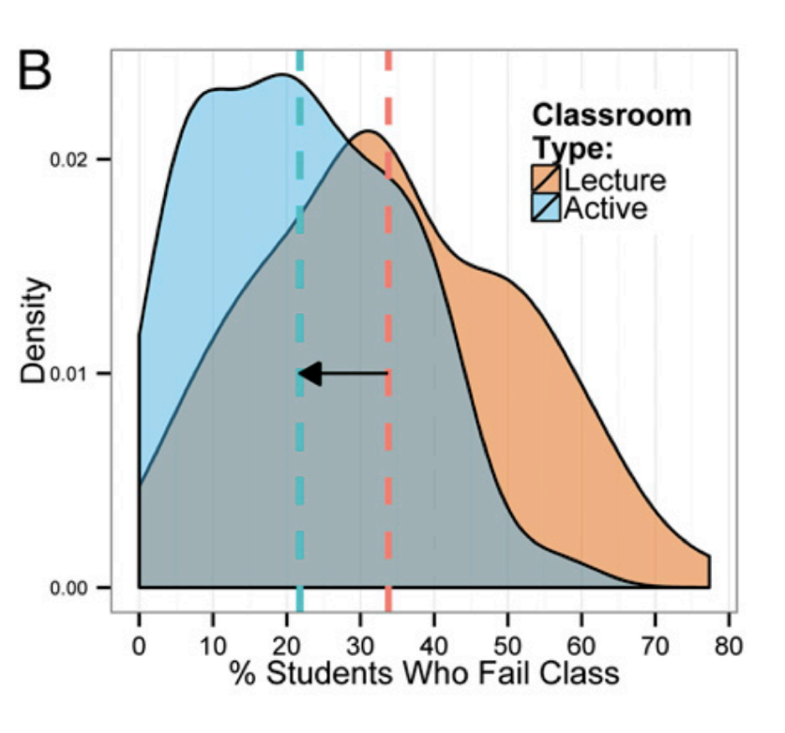
Active Learning is Better
…but university students report that they prefer passive learning…
Notes:
For example, this plot shows reduction in failure rates in STEM classes (from http://www.pnas.org/content/111/23/8410.full.pdf), and we now have the cognitive science to explain why. However, learners report that they prefer passive learning, even though active learning works better (https://www.pnas.org/content/116/39/19251)

Slide 38
Six Strategies
Spaced practice | Interleaving
Retrieval practice | Concrete examples
Elaboration | Dual coding
Notes:
There are six strategies that you and your learners can use to leverage all of this, and the best summary of them comes from the Learning Scientists website. We don’t have time to go through them all…

Slide 39
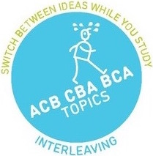
Interleaving
Randomize study order to build long-range connections
And to avoid accidentally training your brain to recall things only in a specific order
Notes:
…but this is my favorite: randomizing study order improves learning.

Slide 40
Rule #6:
Learners are not robots
Notes:
It shouldn’t be necessary to say this, but our sixth rule is that learners are people with feelings and beliefs.

Slide 41
Motivation
Intrinsic | Doing this for my own reasons
Extrinsic | Doing this because I have to
Notes:
The single strongest predictor of whether an adult learns something or not is their motivation, and any discussion of motivation has to start with the difference between intrinsic and extrinsic motivation. Learning to play the ukulele because you’ve always wanted to is intrinsic; learning because you’re in Grade 5 and the teacher said so is extrinsic, and unlikely to stick.

Slide 42

Positive: Self-Efficacy
I am in control of my own life.
Notes:
First and most importantly, adults want to be in control of their own lives - they don’t like to jump through hoops. Self-efficacy is the driving force behind self-paced online training: it allows people (well, those privileged enough to have free time) to learn what they want and when they want.

Slide 43
Positive: Utility
This will help me meet my goals.
Notes:
Utility is the second big motivator for adults. Is this useful? Will it help me meet my goals? (It’s important to note that there are many kinds of utility, just as people have many different kinds of goals—learning the ukulele probably won’t help you find a job, but that’s not why you’re doing it.)

Slide 44
Positive: Community
People I know are learning this with me.
Notes:
The third motivator is community. People like to do what their friends, neighbors, and colleagues are doing, and they like to do things together - this is why the best predictor of whether someone actually uses a gym membership is whether or not someone they know is going with them.

Slide 45
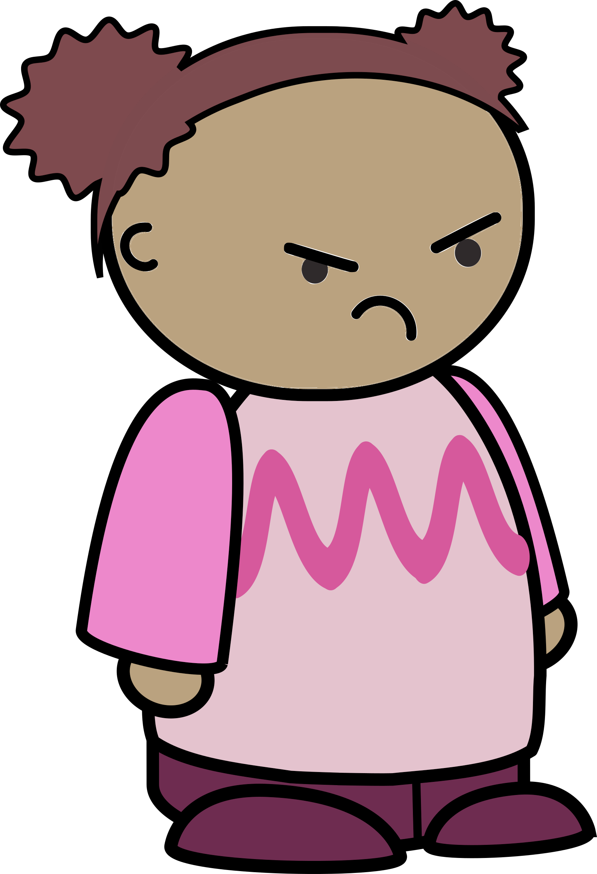
Negative: Unpredictability
What I do doesn’t seem to affect the outcome.
Notes:
Now let’s look at demotivators. The most important is unpredictability: if taking actions works some of the time, but not other times, people give up trying because there’s no point. This is called learned helplessness.

Slide 46
Negative: Unfairness
The teacher plays favorites.
Notes:
A second big demotivator is unfairness. Studies have shown that if people believe the game is rigged, everyone will do less well—even those that the game is rigged in favor of.

Slide 47
Negative: Indifference
Nobody cares.
Notes:
The third of our demotivators is indifference—the feeling that nobody cares if you succeed or not. It’s easy for students to feel this way in large classes or when learning online, but it’s also easy for instructors to give this impression even when they’re teaching one-to-one.

Slide 48
And while we’re here…
Notes:
Something that comes up regularly

Slide 49
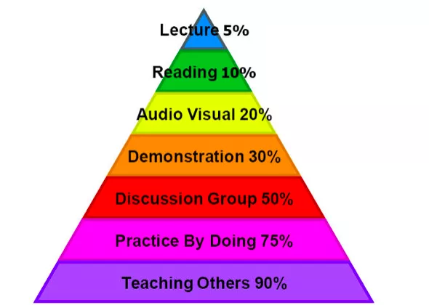
Myths
Visual/auditory/kinesthetic learning styles are the astrology of teaching
Meyers-Briggs Type Indicators are astrology too
The Learning Pyramid was made up by an ad agency
Notes:
At this point you might think we believe that everything about education can be explained in terms of cognitive science. We don’t, because we don’t yet have all the science. More importantly, there are a lot of pseudoscientific myths about education that refuse to die:
People don’t actually learn better if lesson materials are tailored to visual, auditory, or kinesthetic learning styles
The so-called “learning pyramid” (10% of what you read, 30% of what you see—the numbers vary) is completely made up.
The status of some other ideas, like stereotype threat and growth mindset, is currently unknown. They make sense, and early studies seemed to bear them out, but more recent work hasn’t been as clear. But this is how science works: we test and refine our ideas, and change our opinions as more evidence comes in.

Slide 50
Wrapping up
Notes:
So let’s wrap up.

Slide 51

What Next?
Notes:
Critics sometimes say that online education is what everybody wants for somebody else’s children. They’re right, but only if the online education is done poorly (as it is in most MOOCs). The most important distinction isn’t online versus in-person; it’s interactive versus scripted. Books and videos have far more in common with each other than they do with chat groups or in-person discussions. I think the future of education looks like my daughter playing Minecraft: she doesn’t care if the people she’s playing with are sitting beside her or an ocean away as long as they can talk to each other in real time.

Slide 52

What Next?
https://teachtogether.tech
Notes:
Teaching Tech Together is what I know condensed into one volume.

Slide 53
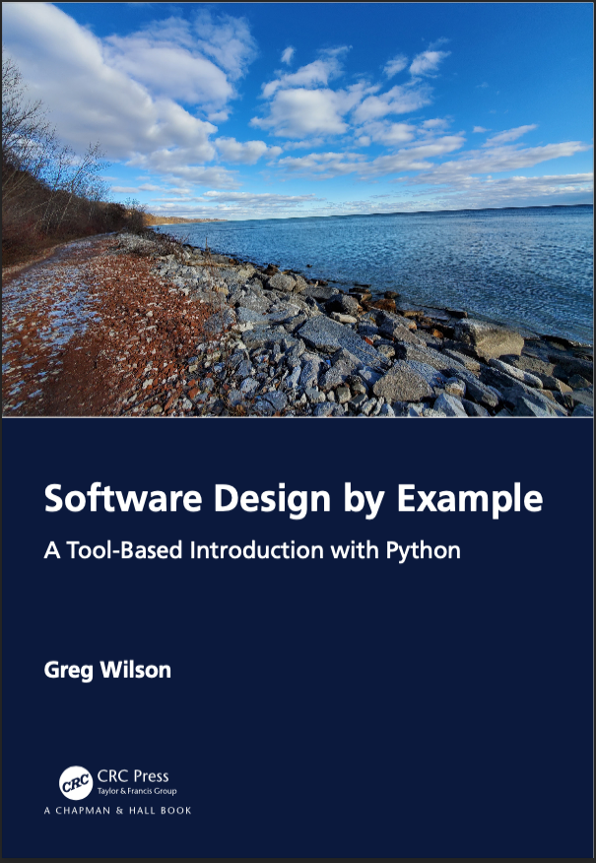
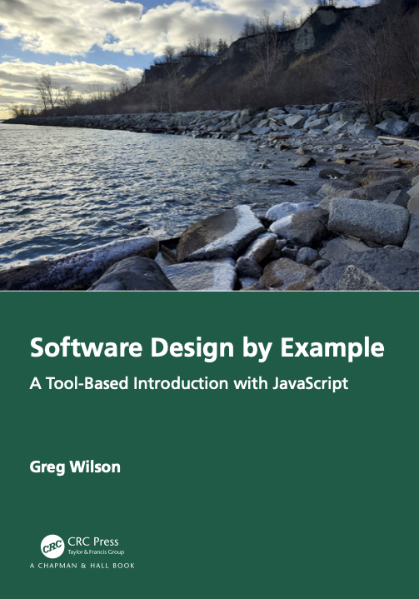
What Next?
https://third-bit.com/sdxpy/
https://third-bit.com/sdxjs/
Notes:
Software Desig by Example covers exactly what it says on the cover.

Slide 54

Start where you are.
Use what you have.
Help who you can.
Thank you for listening
Greg Wilson
http://third-bit.com/
Notes:
These rules are not the whole of teaching, but they’re a pretty good start.
Thank you for listening.

Slide 56
Count Them All
photosynthesis
produces
occurs in
requires
glucose
chloroplasts
absorb
oxygen
CO₂
water
stores
released to
light
absorbed from
energy
air
Notes:
Limits to short-term memory can tell us when we’re trying to teach too much, too quickly. This concept map has nineteen things in it. That’s too many, so part of the craft of designing a lesson is to break it into chunks guided by the formative assessments we can do.

Slide 57
Count Them All
photosynthesis
produces
occurs in
requires
glucose
chloroplasts
absorb
oxygen
CO₂
water
stores
released to
light
absorbed from
energy
air
Notes:
Here’s one digestible chunk.

Slide 58
Count Them All
photosynthesis
produces
occurs in
requires
glucose
chloroplasts
absorb
oxygen
CO₂
water
stores
released to
light
absorbed from
energy
air
Notes:
And here’s another. We’re using the concept map to guide our choice of chunk size as well as subgoals.

Slide 59

Learner Personas
General background
Relevant experience
Their perceived needs
Special considerations
Notes:
We can capture these differences by creating learner personas with these features. Anyone who teachers, or any group that teaches together, should create a handful of these that describe the range of learners they’re trying to help. Personas will remind you of one of the most important rules of teaching: you are not your learners.

Slide 60
The Bad News
Neither the training programs that most companies put all workers through nor the grievance procedures that they have implemented are helping to solve the problem of sexual harassment in the workplace. In fact, both tend to increase worker disaffection and turnover.
— Dobbin & Kalev
Notes:
Most attempts to fix this problem have had no effect.

Slide 61
The Good News
Bystander intervention training…is the most promising alternative we’ve come across…
— Dobbin & Kalev
Notes:
However, training people how to intervene does make things better.

Slide 62
Allyship Scenario
A student in your class has a medically diagnosed attention challenge. To maintain focus, they have to talk to themselves while problem solving. Some other students in the class have come to you and said they find this distracting. What steps would you take in what order?
Notes:
This is an example of the kind of scenario teachers should go through.

