Slide 1








CSCI 6907: Advanced Network Systems Programming
Your Name
CSCI 6907.11 Overview
NetAlytics: Flexible and Dynamic Network Analysis Framework
This class is an advanced topics seminar for MS, PhD, and upper level undergraduates. The class gives students hands-on practice with two emerging network technologies: Software Defined Networking (SDN) and Network Function Virtualization (NFV).
This poster presents some of the projects we have developed on top of the GENI platform.
Project description goes here.
Project Name
More Text
A major problem in today’s networks is the lack of robots and unicorns. If we had more unicorns, networks would be faster and more magical. In this project we show how SDNs allow the network to dynamically adjust the number of unicorns deployed in the network.
Our project:
Automatically detects XYZ.
Reconfigures the network in order to…
…
(replace all of this with your content…)
Load Balancing and Dynamic Topology Modification
Project description goes here.
Notes:
Avoid having lots of long sentences
Include diagrams / screen shots / anything to make it more visually interesting
Try to keep the colors/styles consistent with the rest of the document
Use the images on the next page when possible to keep things consistent (you can shrink them down a lot)
You can rearrange things within your own section however you like
Sample Deployment:
POX

Slide 2










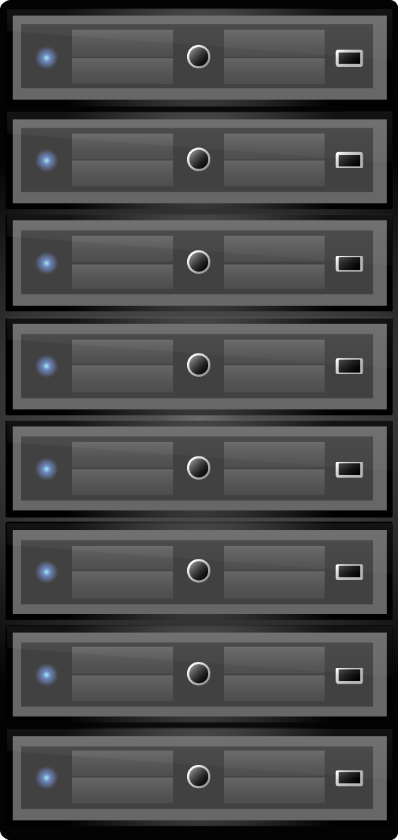








Useful icons from vmware

Slide 3












