Slide 1
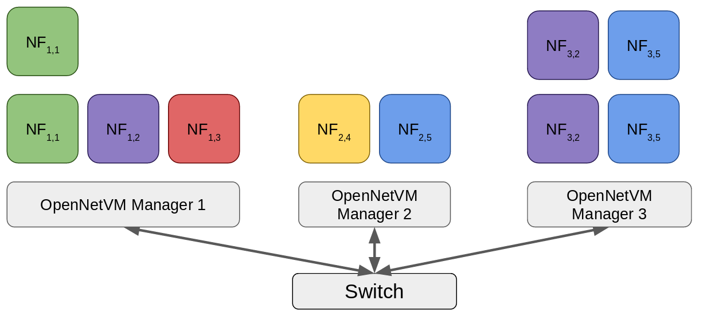
Computer Science Department: Distributed openNetVM: Automatic Scaling for Enterprise NFV Using Commodity Hardware
Background
Distributed Manager
Traditional networks are comprised of individual hardware components called network functions (NFs)
Hardware-based NFs are inflexible and expensive
Network Function Virtualization (NFV) abstracts NFs into software for greater flexibility
As networks grow, more middle boxes need to be deploy for efficient scaling
openNetVM has a dynamic management component which provides elasticity to network topology
The manager can detect overloaded NFs and automatically start additional copies to effectively load-balance traffic
Results
We can route packet flows through dynamic network topologies at line speeds
The distributed openNetVM system can automatically scale NF capacity to meet current demand
Improved allocation of available resources

