Slide 1
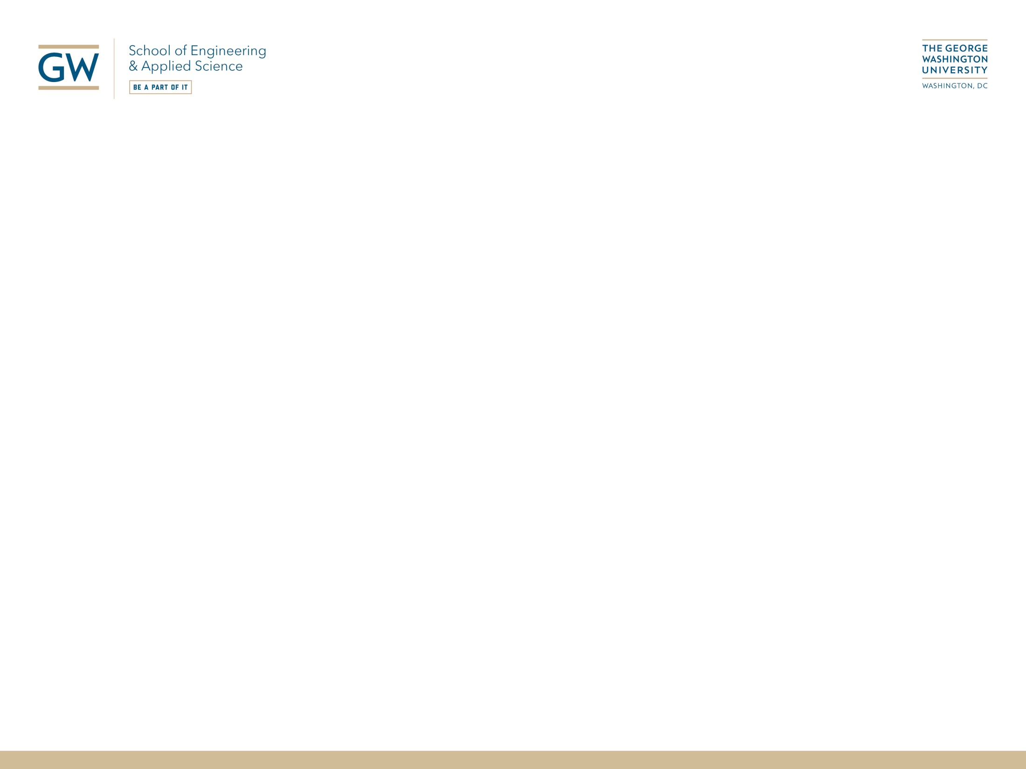
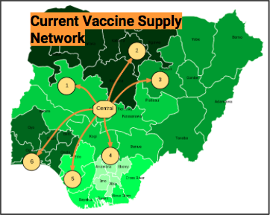
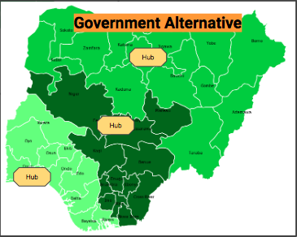
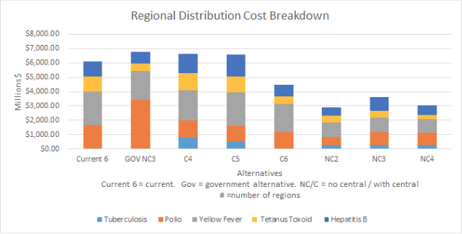
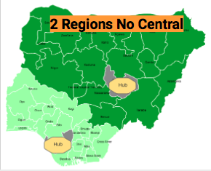
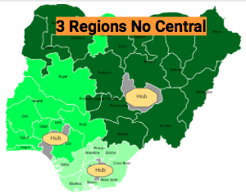
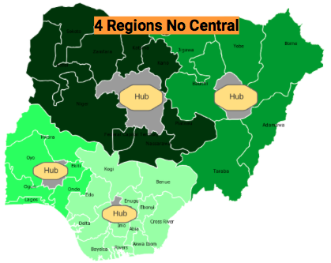
EMSE Department: Vaccination Supply Chain in Developing Countries: A Case Study of Nigeria
Overview
Supply Chains Face Backorder and Demand Issues
Optimize Distribution Alternatives as compared to current network and proposed government alternative
Results
Qualitative and quantitative solutions indicate alternative regional distributions without a central location, with the cheapest options being two regions, followed by three and four.

