Slide 1

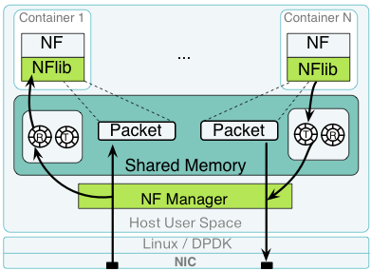
Distributed openNetVM: Automatic Scaling for Enterprise Network Function Virtualization Using Commodity Hardware
Phil Lopreiato
The George Washington University
Background
openNetVM Platform
Auto-Scaling NFs
Traditionally, networks are comprised of individual hardware components called network functions (NFs):
Container based NFs: Ease of user-space process management brought to networking
NF Manager: Orchestrates traffic flow between various NFs to bring elasticity
Zero-Copy IO: Packets DMA’d into shared memory granting NFs direct access to data without copies
NUMA-Aware: Maximizes performance by ensuring data in memory is local to a thread’s CPU Socket
Interrupt-Free: DPDK’s poll mode driver allows non-traditional network to process incoming traffic at 10Gbps and beyond
Single NFs can be limited by hardware resources available on the host server
The openNetVM manager can detect when an NF is operating at its performance limits
Automatically start additional instance to handle packet load
Firewall
Intrusion Detection System (IDS)
Load Balancer
Overloaded NF Detection
This model is very expensive and inflexible which makes changes/upgrade difficult
Trends in networking produced network function virtualization (NFV)
  Cost effectiveness of software
  Flexibility of software
  All network functions on one or multiple hosts
  Like NFs are grouped into services
Choose Scale Location
Start new NF
Distributed openNetVM Manager
As networks grow, more middle boxes need to be deployed to scale efficiently
openNetVM has a dynamic manager which makes networks elastic
  Aware of all active and newly created NFs
  Re organizes global data structures upon NF creation and destruction
The openNetVM manager can route traffic to the middle box instance with most available processing capacity
Need to track which hosts have available CPU resources to potentially start new NFs
When needed, find a host that already has the desired NF service running (in order to maintain locality of packet flows)
Choose the host that has the most available resources (to properly load balance computation across the cluster)
Enqueue a “scale request” into a distributed queue. Each openNetVM manager instance polls for incoming messages and handles starting new NF instances on that machine
Overall, prefer to start additional instances “locally” to avoid network overhead on critical packet flow paths
Firewall
Intrusion Detection
Quality of Service
Load Balancer
NFV Platform
Results
We can easily route packet flows through dynamic topology “on-the-fly” without performance loss (at network line speeds)
The distributed openNetVM system can automatically scale NF capacities to meet the current demand
Improved allocation and utilization of computing resources
NF_{1,1}
10G
Switch
NF_{2,2}
NF_{2,4}
NF_{1,1}
NF_{1,2}
NF_{1,3}
NF_{2,1}
NF_{2,2}
NF_{2,4}
OpenNetVM Manager 1
Global
Data Store
OpenNetVM Manager 2

