Slide 1
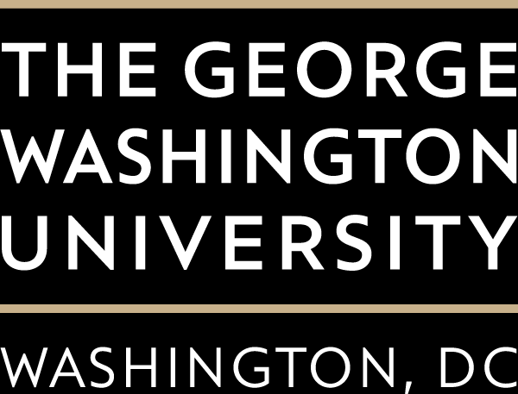
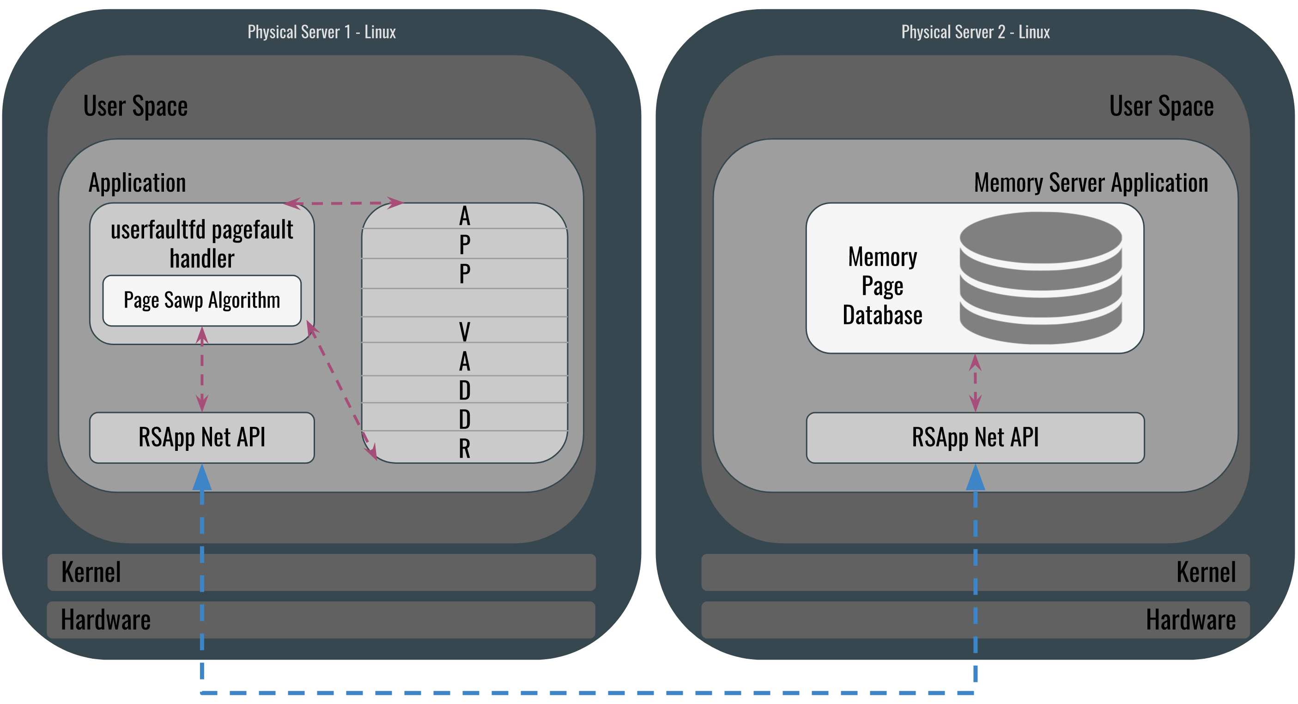
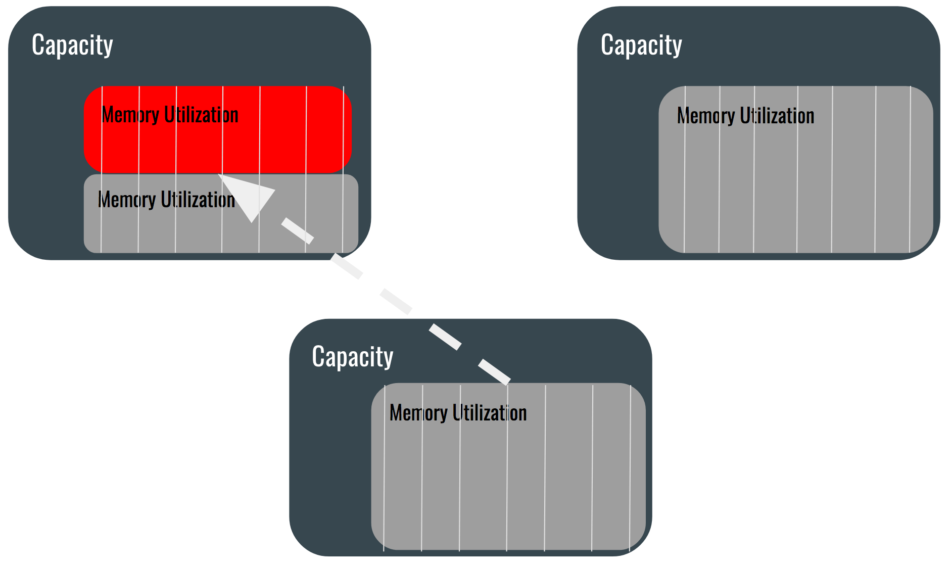
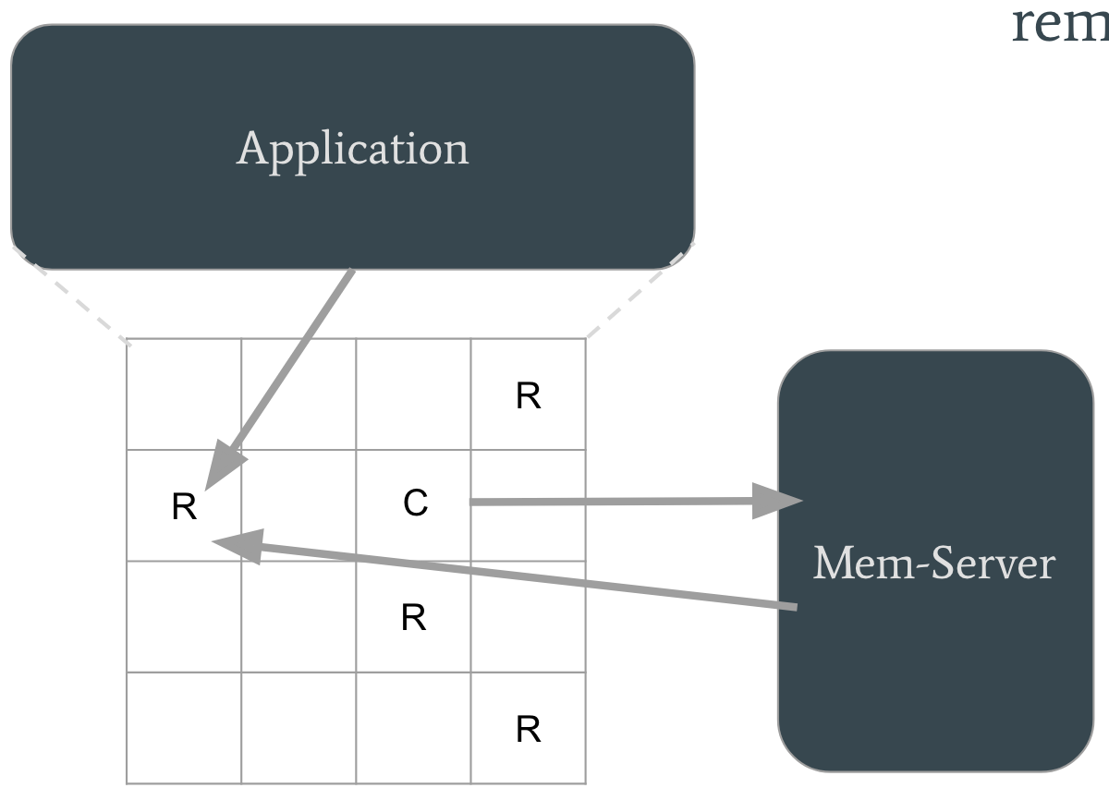
Rack Scale Apps
Neel Shah (nshah95@gwu.edu)
Background
Rack Scale Apps
It has been said that “the cloud” is one of the biggest trends that computing has seen. The cloud is a model where servers in datacenters host programs or compute data for end users to consume. Datacenters are not fit to reliably scale to compensate the cloud’s growth rate. Many servers waste resources by sitting idle, costing the world upwards of $30 billion per year. We need to better manage our computing resources.
userfaultfd-based page fault handler monitors when an application access certain pages of memory
RSApi Net Library transfers data to and from a remote memory server
Memory Server receives, stores, maintains and sends back all memory data from a remote application
Pools server hardware (memory) together in a rack by allowing an application to store and retrieve memory pages on another server
Page swapping algorithm determines when to swap pages of memory between the application and memory server.
Key Problems
Page Swapping Algorithm
The page swapping algorithm intelligently decides when to swap pages back and forth between an application and the memory server.
Mark arbitrary amount of pages as “remote” pages
Wait for the application to access a “remote” page
Find the “coldest” page in the application’s address space
Swap the contents of the “coldest” page to the memory server
Check the memory server to see if the ”remote” page that was accessed has data stored there. If so, swap it back
Three memory utilization scenarios: underutilization, high-utilization, exceeding capacity
Goal: maintain equal memory utilization across all of the servers in a rack
Solution: move memory pages between servers to distribute load evenly
Challenges:
Memory is organized into pages
When do we “swap” these pages back and forth between servers?
(2)
(3)
(4)
(5)

