Slide 1
Athena
TCP Load Balancing & anti-DDoS for Services
All pictures taken from Wikimedia Commons, unless otherwise noted
Notes:
Tonight I’m going to talk to you guys about Athena, a TCP load balancer for web services.
All photos taken from Wikimedia Commons, unless otherwise noted.

Slide 2

Let’s make a website!
Tweeter: a micro-blogging website
DeviantArt user Rev-Mono; licensed under CC3.0 (http://creativecommons.org/licenses/by/3.0/)
Notes:
…so, let’s start a website! The website we’re going to be starting is called Tweeter. It’s this really cool, totally original idea for a micro-blogging website that I have. You sign up, claim your Tweeter handle, and start publicly posting 140-character snippets about whatever you wanna talk about.
*START HERE*

Slide 3
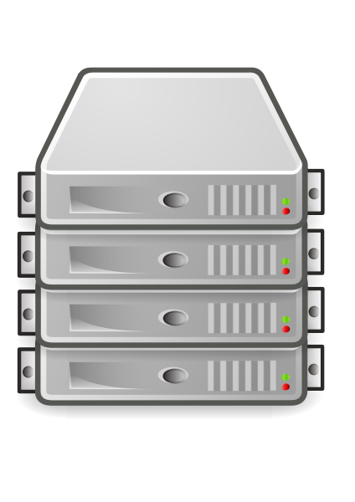

What’s a website look like?
Request: Tweeter.com homepage
Response
Tweeter Web Server
Firefox logo is property of Mozilla Corporation; licensed under MPL2
Notes:
HTTP Server, maybe a database tier.

Slide 4
What’s a (slow) website look like?
Tweeter Web Server
Notes:
HTTP Server, maybe a database tier.
Feedback: This is where the problem comes in. All my users are upset because it's slow.

Slide 5
Timeline of a web request
Request: http://tweeter.com/
Response: http://tweeter.com/

Slide 6
Timeline of a web request
Request
Request
Response
Response

Slide 7
What’s a (slow) website look like?
Tweeter Web Server
Notes:
HTTP Server, maybe a database tier.
Feedback: This is where the problem comes in. All my users are upset because it's slow.

Slide 8
How can we make this better?
TWS
Load Balancer
TWS
Notes:
Stick Athena between the Internet and TWS.
This allows us to distribute requests evenly across a pool of webservers.
We need to avoid overloading a single server with too many requests
This is how DDoS attacks work
Using a load balancer allows us to:
evenly distribute requests across servers
add capacity to the system by adding more TWS
allows us to add/remove TWS from the service as needed

Slide 9
How to distribute requests?
Randomly
Round-robin
Least requests
Notes:
FEEDBACK:
Have some performance analysis. Why is your system better?

Slide 10
How to distribute requests?
TWS
TWS
TWS
TWS
Notes:
FEEDBACK:
Have some performance analysis. Why is your system better?

Slide 11
Athena cares about “Queue Time”
TWS
TWS
TWS
TWS
Notes:
FEEDBACK:
Have some performance analysis. Why is your system better?

Slide 12
Results
<compare Athena with HAProxy, nginx, and other load balancers>
Notes:
FEEDBACK:
Have some performance analysis. Why is your system better?

Slide 13
Questions?

