Slide 1
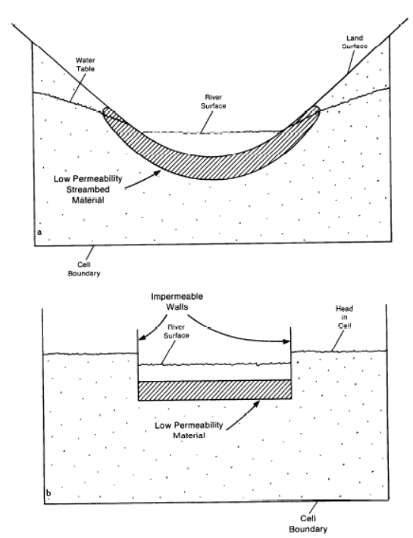
Schematic of Field Setting
Land Surface
Water Table
River Surface
River Surface
Low Permeability Material
River Bottom
Cell Boundary
Simplification to Obtain an
Average Value of Each River Feature
Impermeable Walls
Head in Cell
River Surface
Low Permeability Material
River Bottom
Cell Boundary

Slide 2
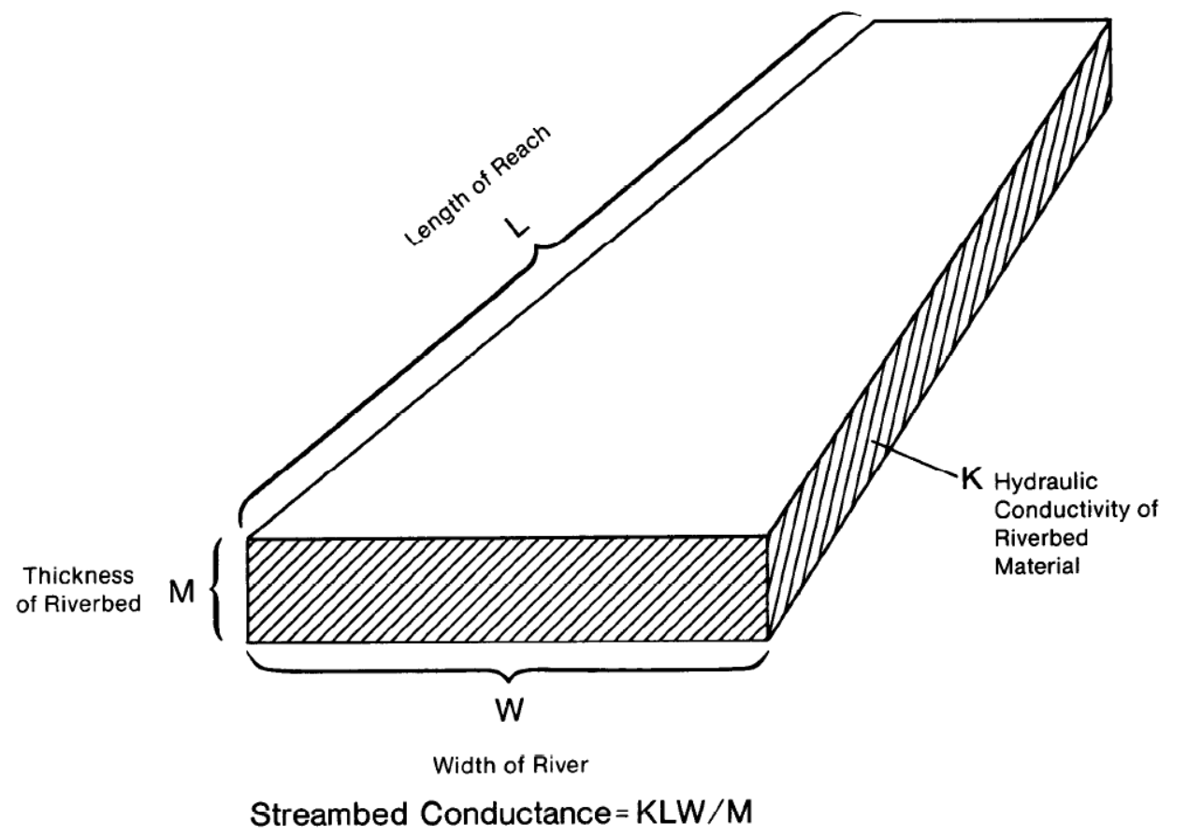

Slide 3
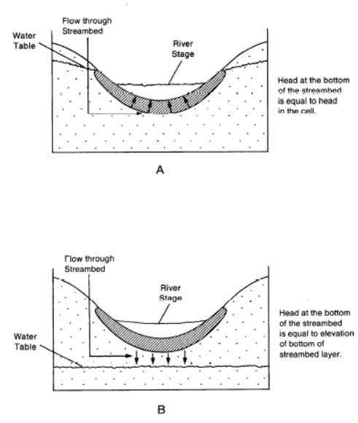
Aquifer Head Higher than River Head
Flow is from Aquifer to River
Flow from aquifer to river through streambed
Water Table
River Surface
Head at the bottom of the streambed is equal to head in the aquifer
Aquifer Head Lower than River Bottom
Flow is from Aquifer to River
Flow from river through streambed to aquifer
River Surface
Head at the bottom of the streambed is equal to elevation of the bottom of the streambed
Water Table

