Slide 1
Fast Algorithm for Computing the Penetration Depth between Polyhedra
Bjoern Cheng Yi

Slide 2
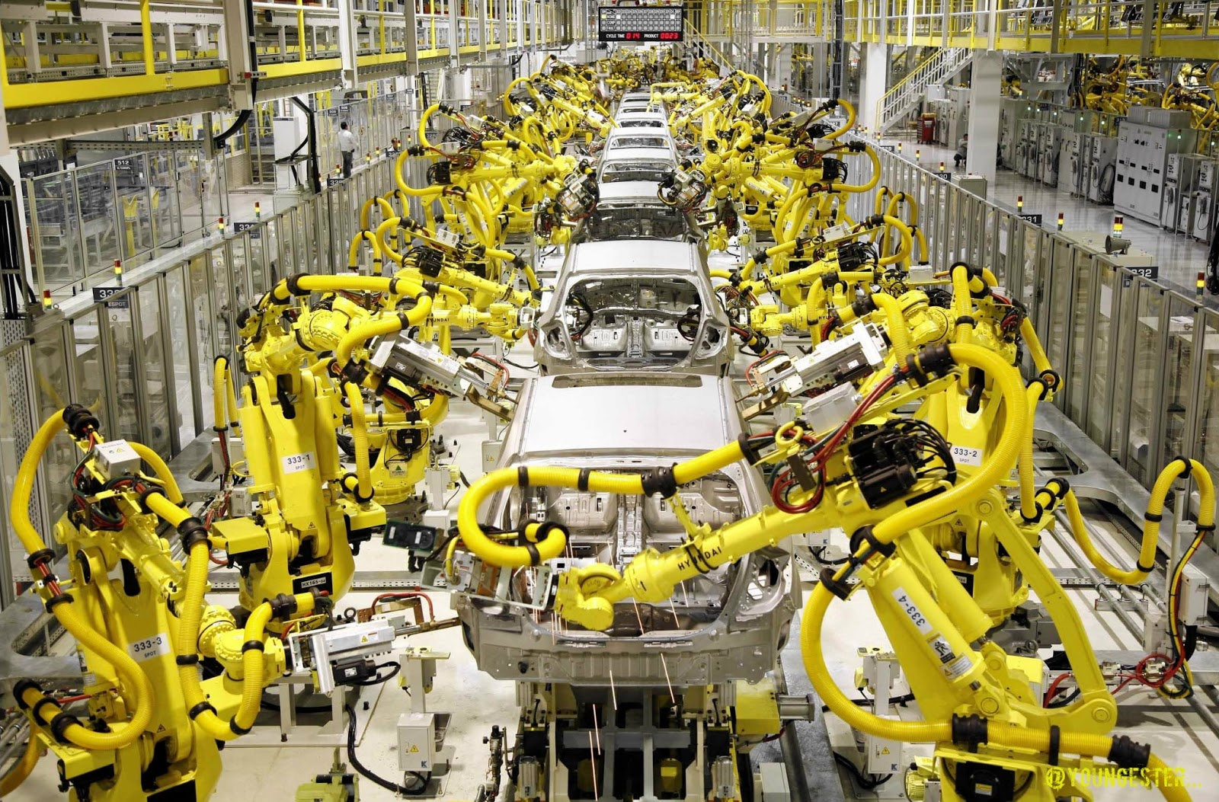

Robots
Widely used in different areas
Dangerous
Testing is expensive and time consuming

Slide 3
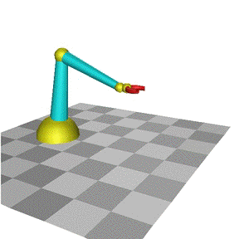
Rigid body simulation
No need for physical equipment
Allow running multiple test in parallel
Cannot reliably simulate contacts

Slide 5
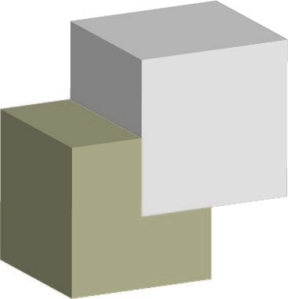
Why?
Local Triangle based (Currently used)
Penetration depth based

Slide 6
Result

Slide 7
Challenge
Finding Penetration depth is hard
Minkowski Difference, an existing algorithm is O(n²)
Solution – Developed a faster algorithm

Slide 8
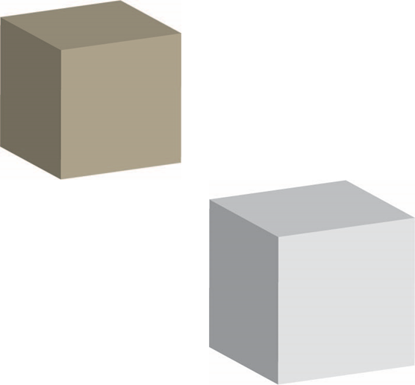
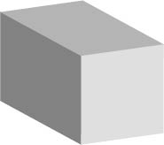
How does it work?

Slide 9
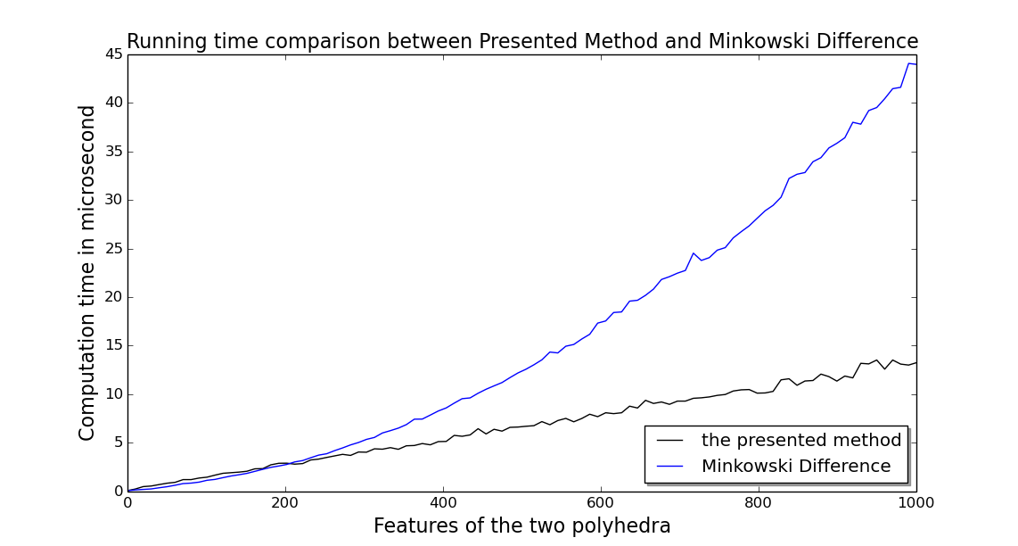
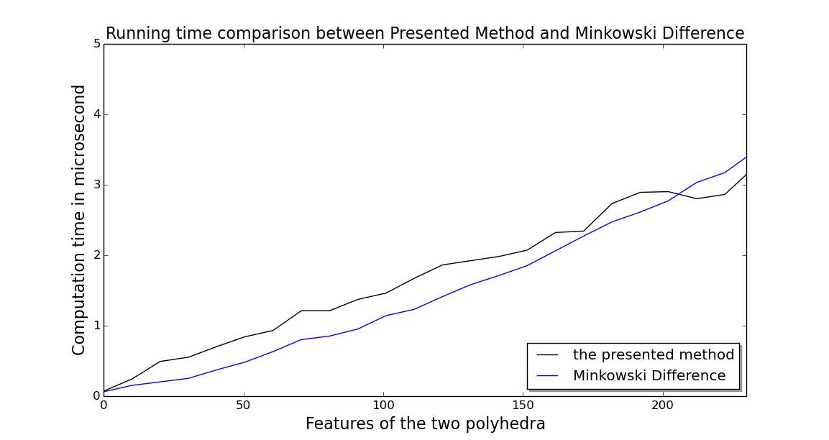
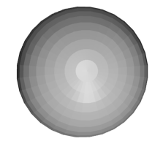
Comparison with the state of art
600 features

Slide 10
Conclusion
Hard Problem has been solved
Next generation simulator
More efficient development

