Slide 1
Credit Risk Score
How to make (fairer) predictions?

Slide 2
Dataset overview
1000 rows (no nulls or duplicates)
21 features (3 numerical, 18 categorical)
Loaded and then manually adjusted according to additional instructions
700 good vs 300 bad credit

Slide 3
Interesting EDA findings
5% critical accounts
~90% with good credit behavior
Men that are married/widowed loan the most
71% rent (live in a house they don't own)
The best loaners are the customers with the most money in savings (status=4)
Most of the dataset is composed of people that are stable across multiple features:
63% pay a rate <25% of their disposable income
90% have no co-applicants or guarantors
81% have no additional loans in other places
77% are skilled/highly qualified
The majority are domestic workers; good/bad outcomes almost evenly split among them

Slide 4
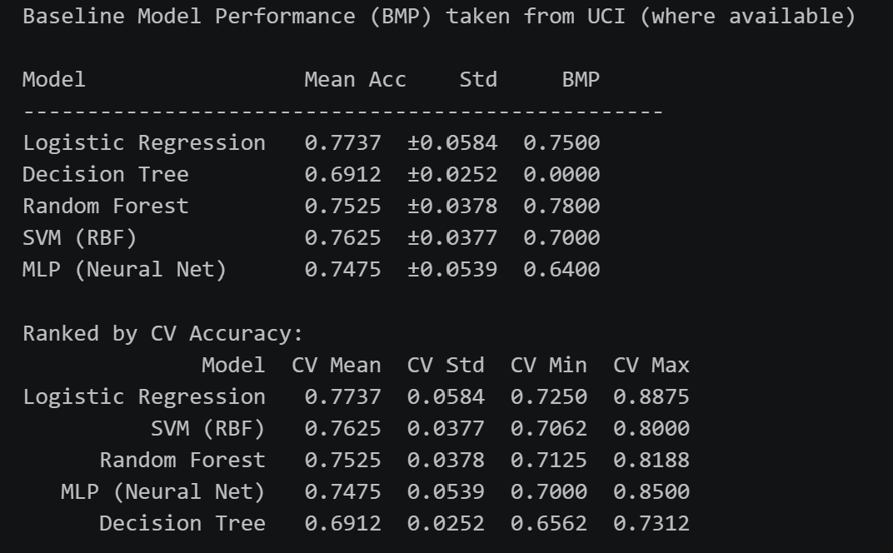
Starting point & results
No outlier modification
StandardScaler
OneHotEncoder
No feature reduction/enrichment
Stratify=y to cover class imbalance
Starting models choices (listed in the results)

Slide 5
Hyperparameter tuning results
Chosen for:
Baseline (RF/LR)
Interpretability (DT/LR)
Neural network (MLP)
Random Forest Best parameters : {'clf__ccp_alpha': 0, 'clf__criterion': 'entropy', 'clf__max_depth': None, 'clf__min_samples_leaf': 4, 'clf__n_estimators': 300} Best CV ROC-AUC : 0.7983
Logistic Regression Best parameters : {'clf__C': 0.1, 'clf__max_iter': 800, 'clf__penalty': 'l2', 'clf__solver': 'lbfgs'} Best CV ROC-AUC : 0.7988
Decision Tree Best parameters : {'clf__ccp_alpha': 0, 'clf__criterion': 'entropy', 'clf__max_depth': 6, 'clf__min_samples_leaf': 5, 'clf__min_samples_split': 2} Best CV ROC-AUC : 0.7000
Neural Network Best parameters : {'clf__activation': 'relu', 'clf__hidden_layer_sizes': (100,), 'clf__max_iter': 800, 'clf__solver': 'sgd'} Best CV ROC-AUC : 0.7977

Slide 6
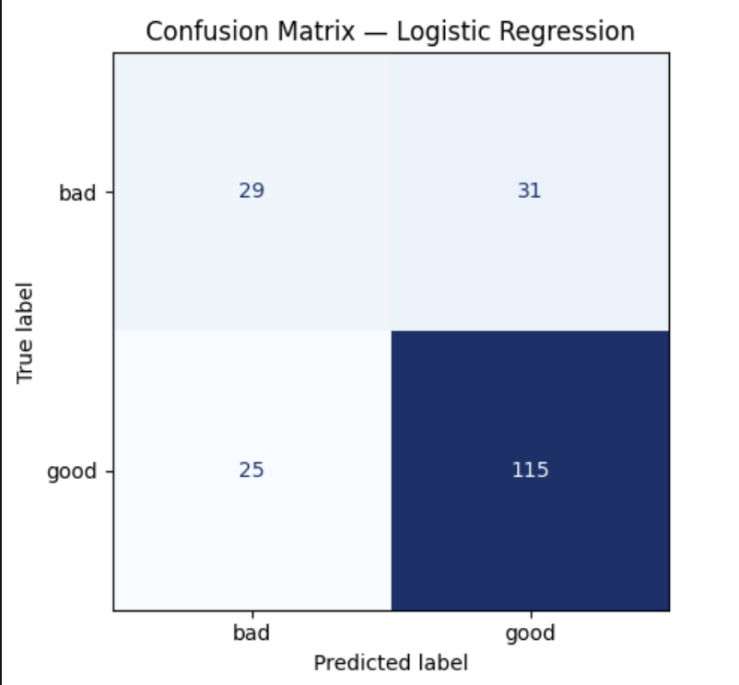
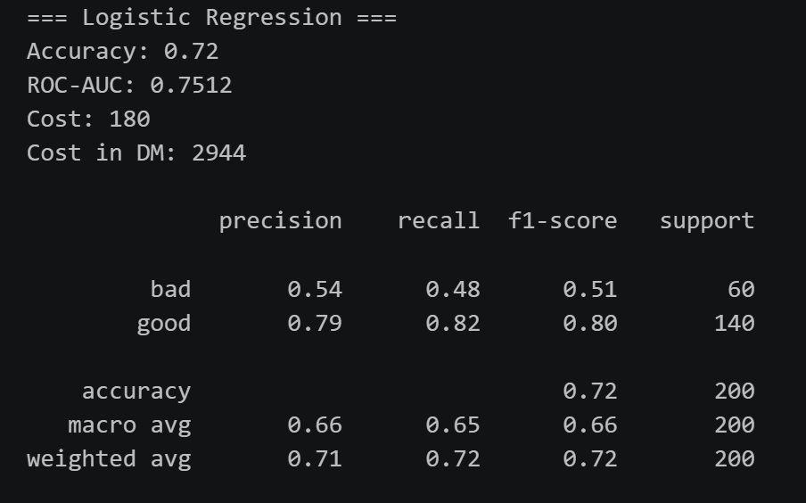
Baseline results - LR

Slide 7
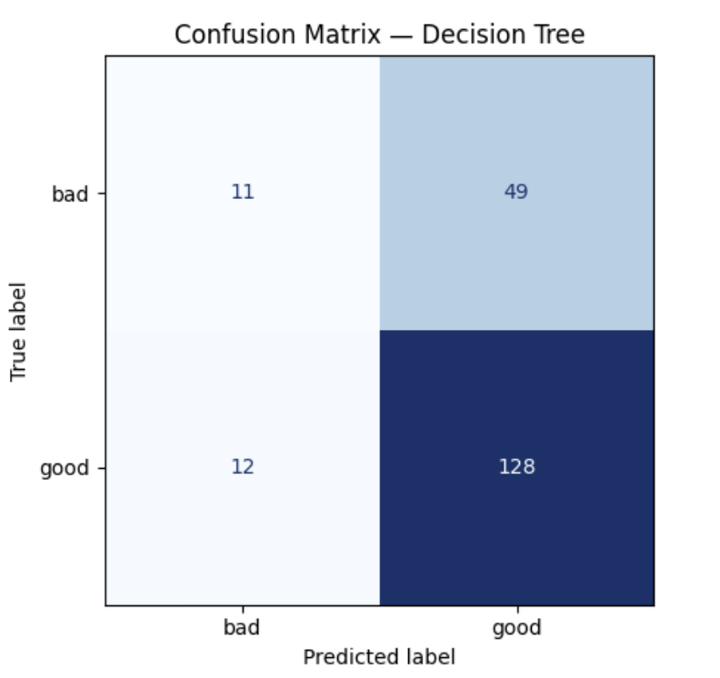
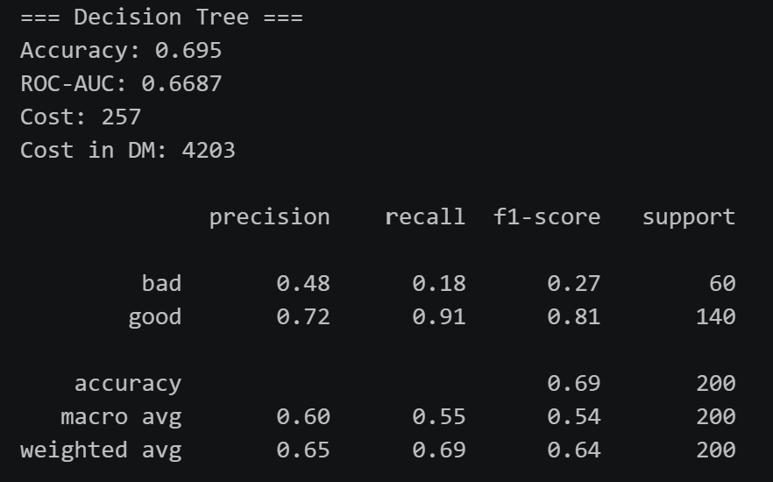
Baseline results - DT

Slide 8
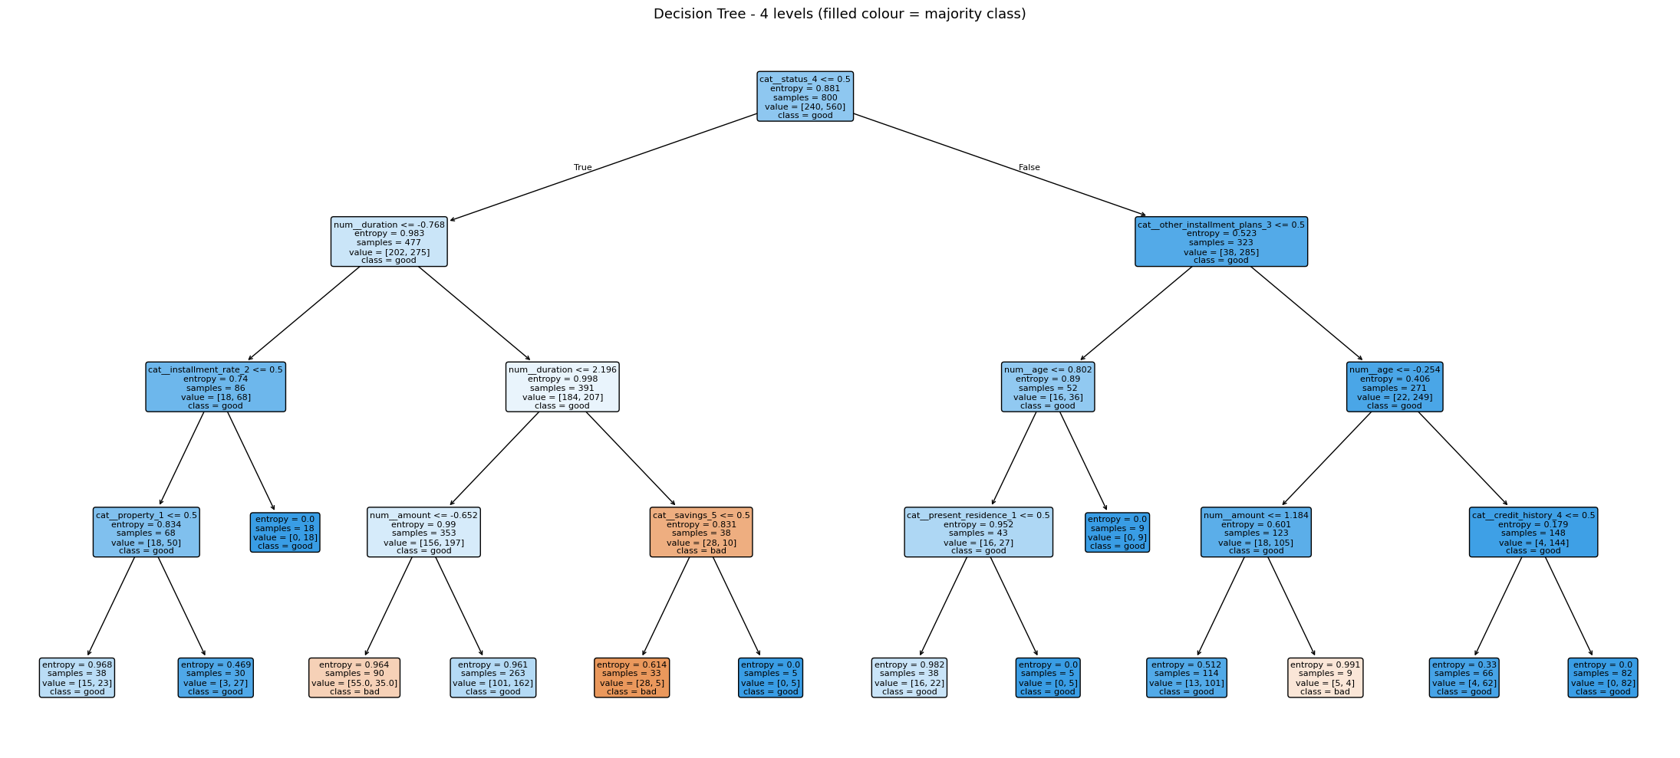
DT - Visualized

Slide 9
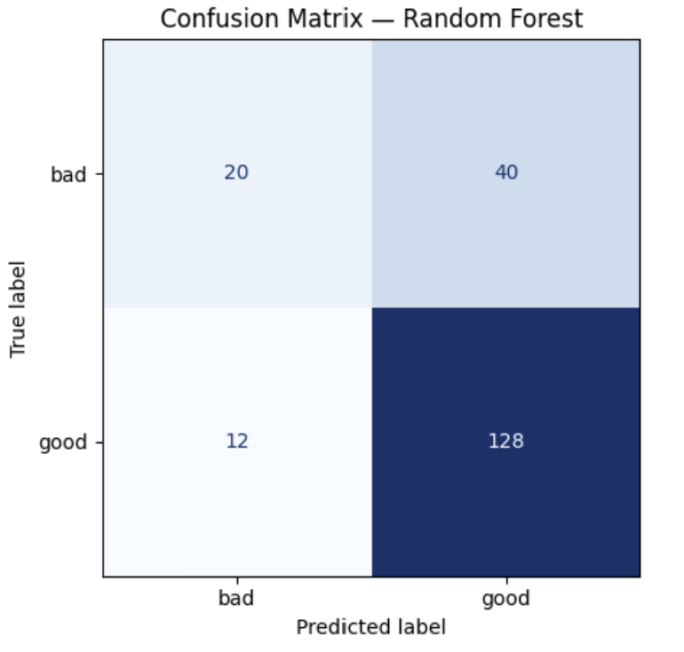
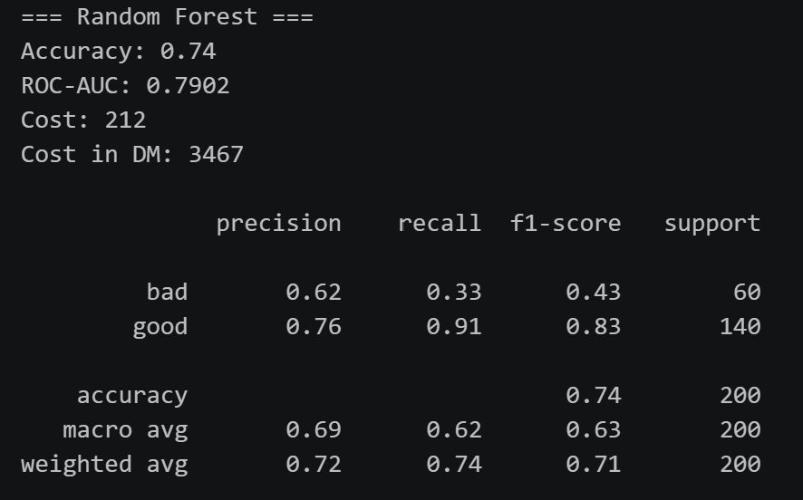
Baseline results - RF

Slide 10
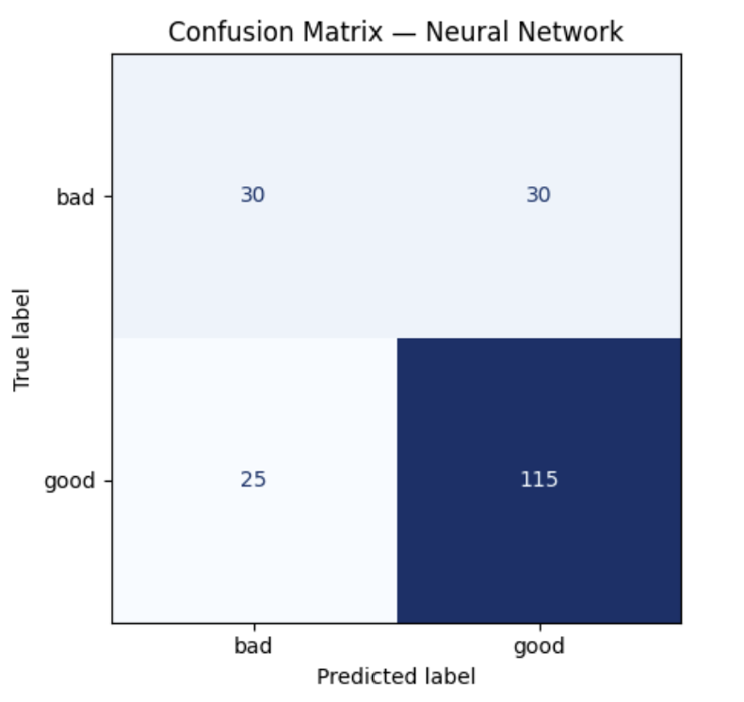
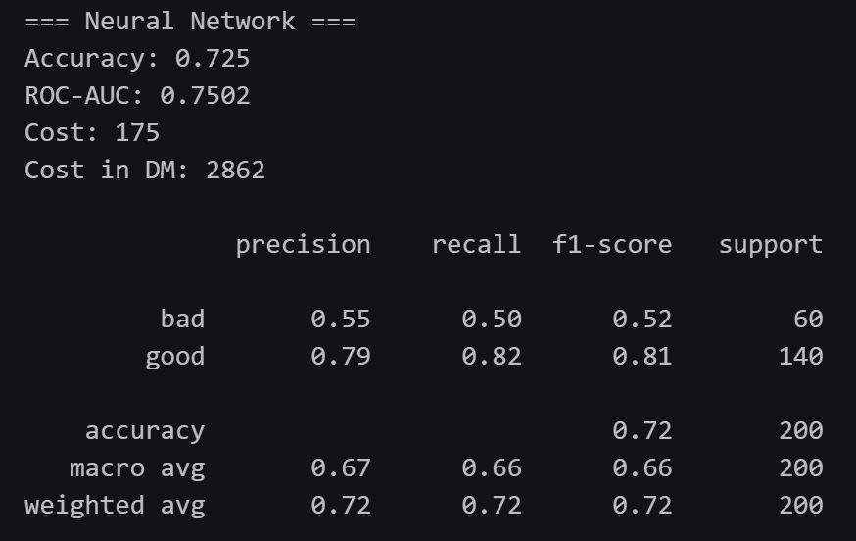
Baseline results - MLP

Slide 11
Model results & further steps
Models built
Baseline picked (LR)
Refine for bias
Pre-training
In-processing
Post-training
Compare and analyze results

Slide 12
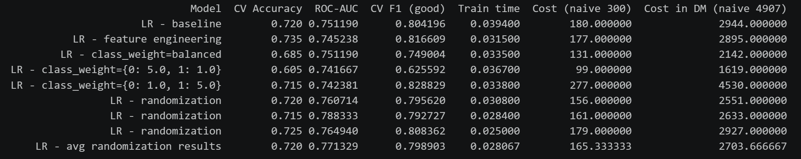
LR bias experiments
Baseline – from previous run (comparison only)
Feature engineering – best stable results with minimal modification
Weight changes – several approaches yielding different results
Randomization – on average same results as baseline

Slide 13

Results
evaluating and correcting the dataset manually according to a provided guideline
performing a thorough EDA on the dataset
building multiple scoring models and evaluating them
implementing multiple bias-correcting strategies

