Slide 1

Distributed Deep Learning Inference for Trajectory Predictions
Presented by:
Wissam Sleiman
Tze Henn
Kalyani Vinayagam Sivasundari
Ashish Telukunta

Slide 2
Outline
Problem statement
Different systems
Key design choices
Code showcase
Demo
Results
Conclusion

Slide 3
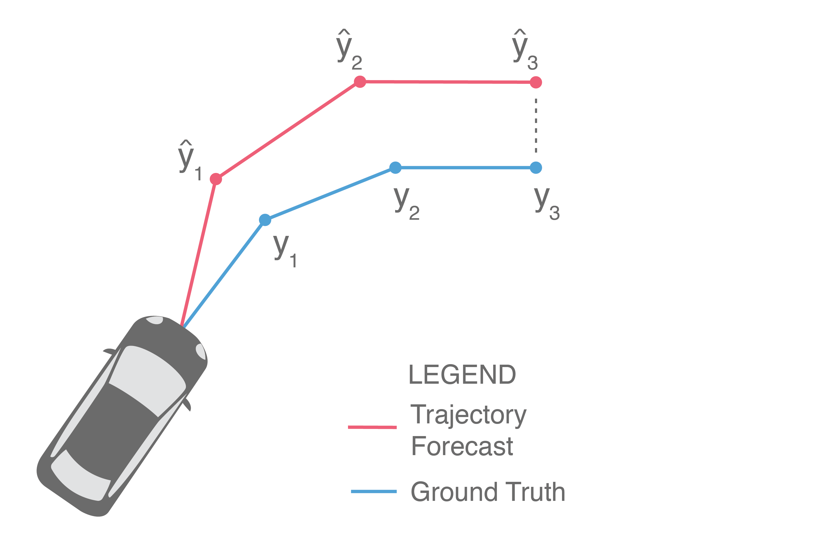
Problem statement
Autonomous vehicles require accurate trajectory predictions to make informed decisions about their movements
Such application is associated with a large input of real-time geo-encoded data.
This creates the need to maximize the throughput of the model for it to be able to predict more locations per unit time.

Slide 4
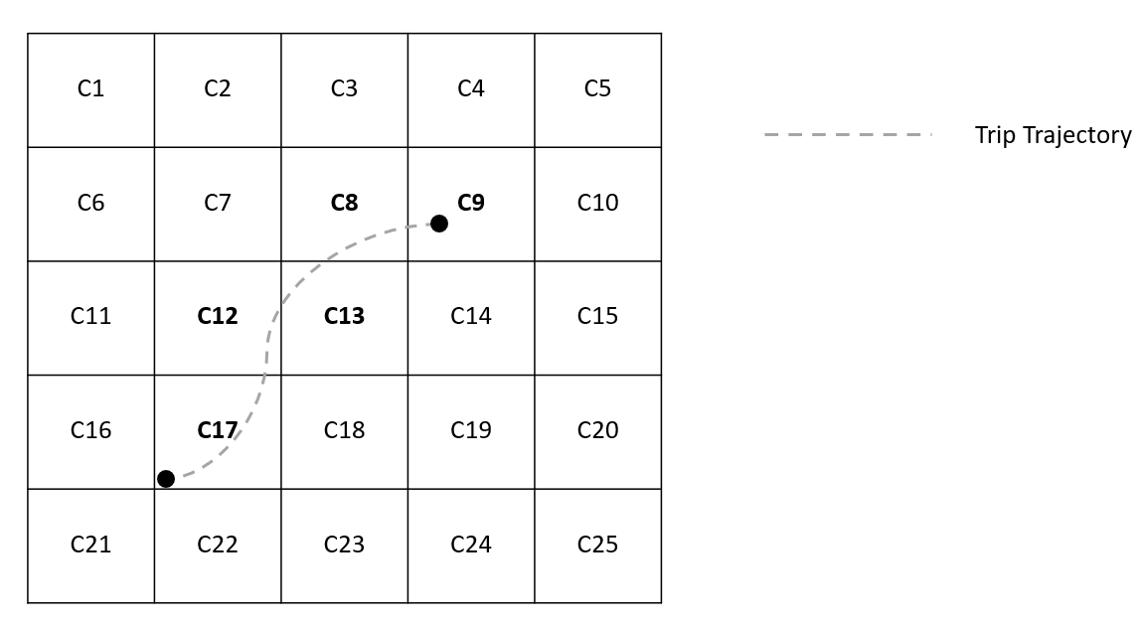
ML Model
For instance, considering a trajectory that visits m cells, that is, Tr=[𝑐1,𝑐2,⋯,𝑐𝑚] the RNN model is set to have m + 1 GRU layers
Multiple layers needed as a rational use case for distributed inference
Long trajectories needed to fit the model
Smaller grid size and bigger number of cells C that represent the map
Huge input matrix where each position is represented by one-hot encoded vector of size C

Slide 5
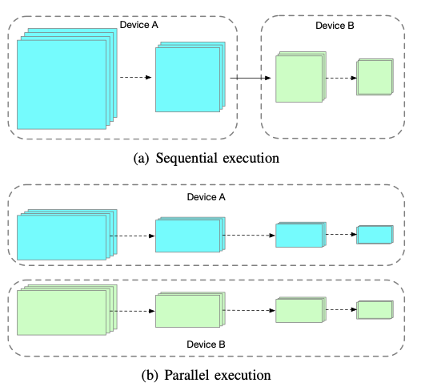
Literature Review
Fig 1: Different types of distributed inference

Slide 6
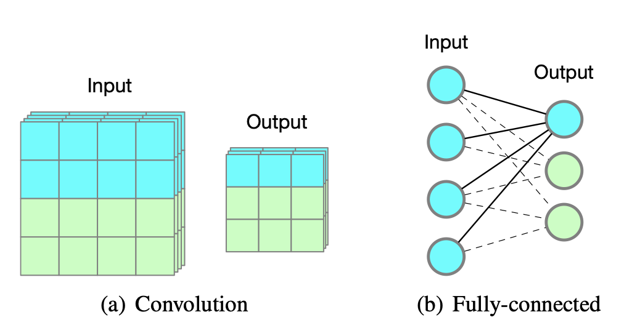
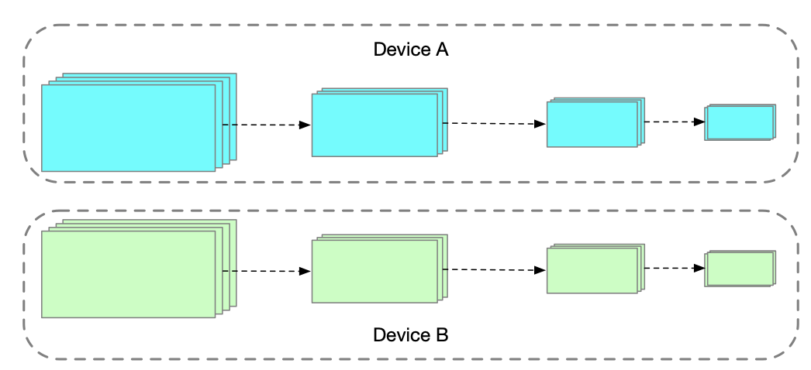
Literature review
Fig 2: Input and output dependency among convolution and fully-connected layers
Fig 3: Parallel execution
Parts of the output of a convolution layer only require a subset of the input, one can partition the input into multiple pieces and feed to different devices, such that each of them can compute parts of the output which can then be assembled back to get the original output

Slide 7
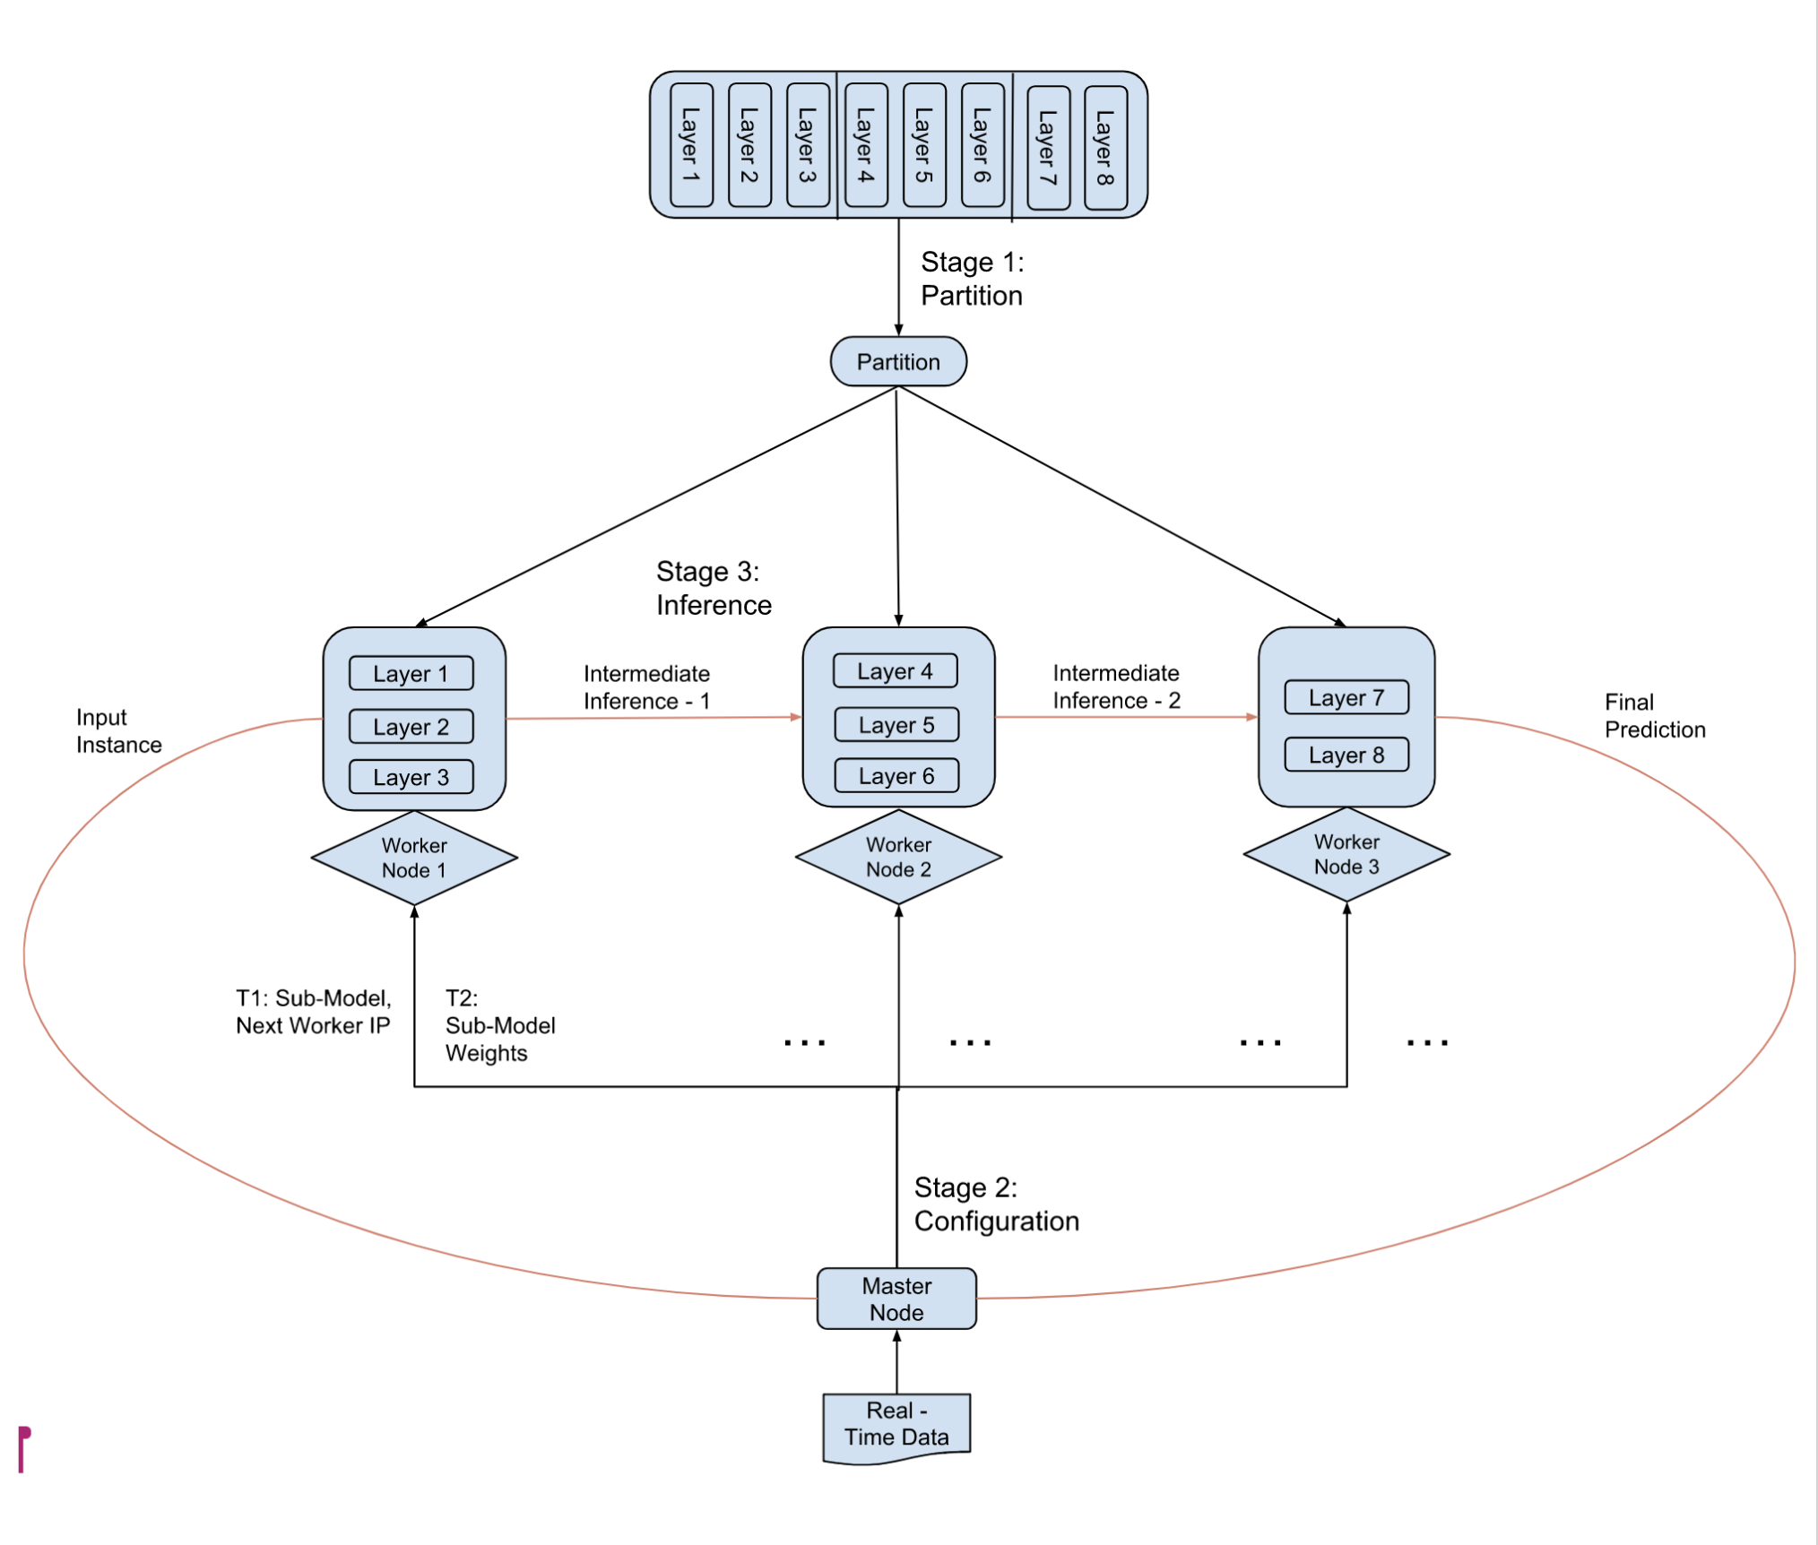
Literature review
Fig 3: Overall architecture

Slide 8
Key design choices
- Openness
Used an Object Oriented Programming Style
Architecture is cleanly modularized into multiple sub-components, which makes it easy to extend each sub-component individually.
Each python file in the codebase represents each sub-component.

Slide 9
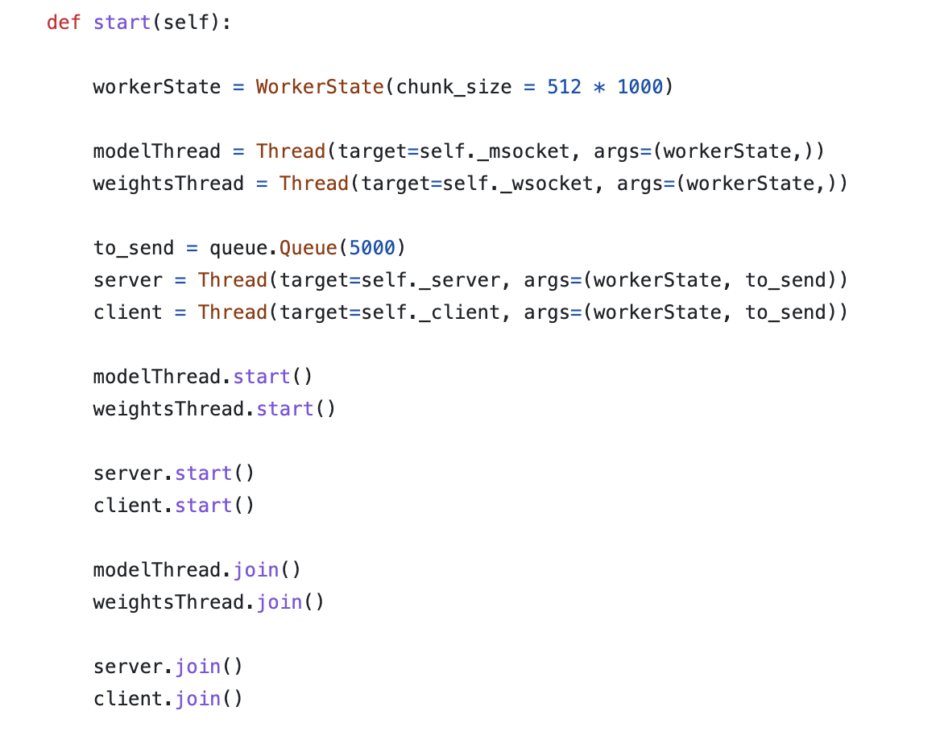
Key design choices
- Concurrency
Heavy use of multi-threading
Specifically we used a separate thread each for the transfer of models’ weights, models itself and data to have maximal concurrency
Used queues to store inputs/outputs between each compute node so that the threads are non-blocking (asynchronous)
TCP socket connections allowed cooperation to parallelize computations

Slide 10
Key design choices
-Transparency
The user data is uploaded and then directed to the master node that deals with the partitioning, node configuration and inference by itself.
No input from the user is needed for the well functioning of the master and worker nodes. The nodes layer is hidden from the user and we therefore consider our system transparent
The only user input needed are the initial model, data input and number of nodes

Slide 11
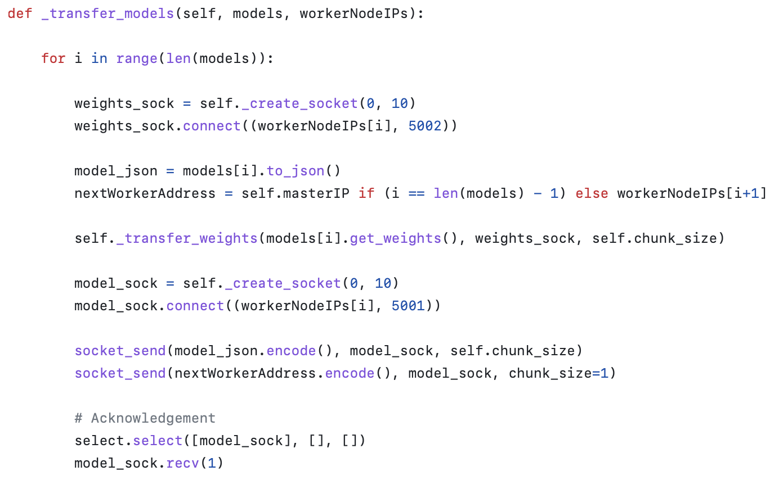
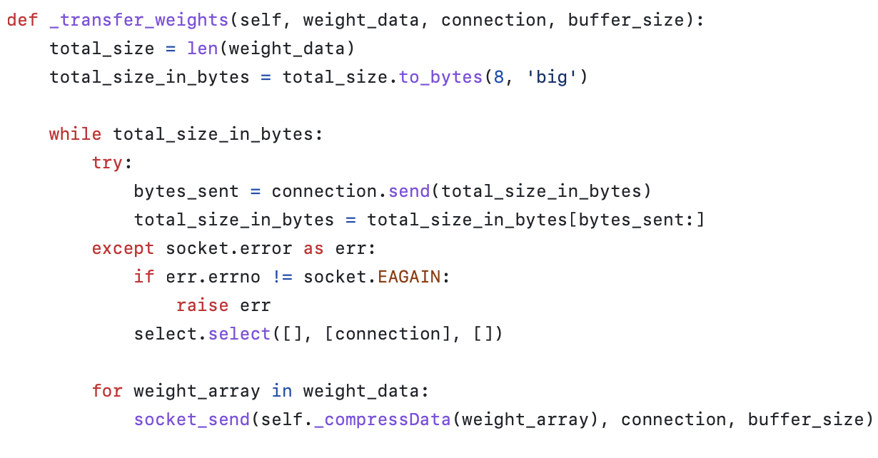
Code main components (master side)

Slide 12
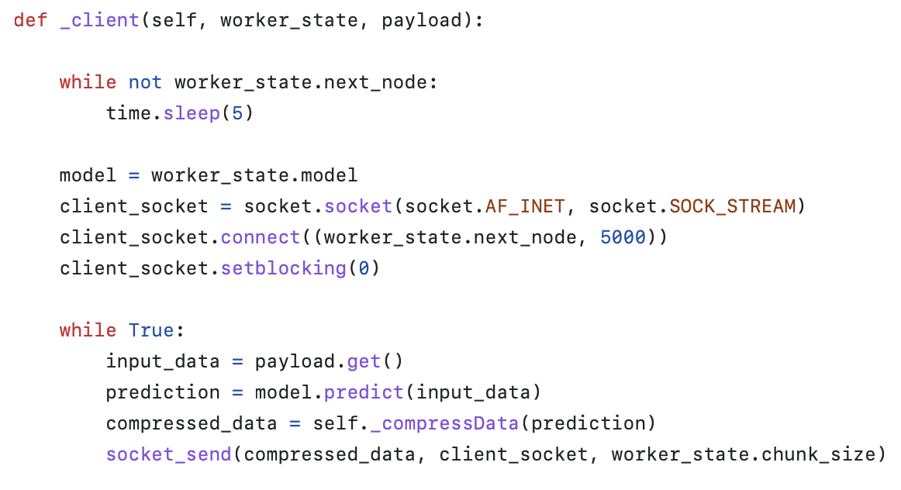
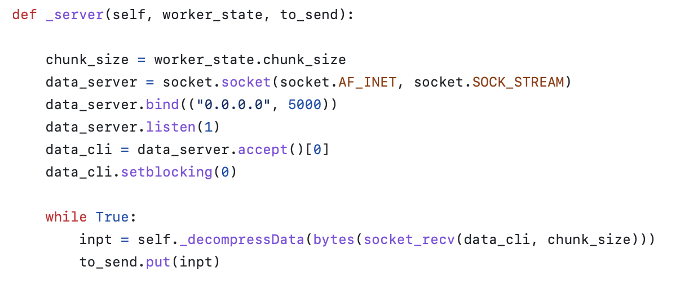
Code main components (worker side)

Slide 13
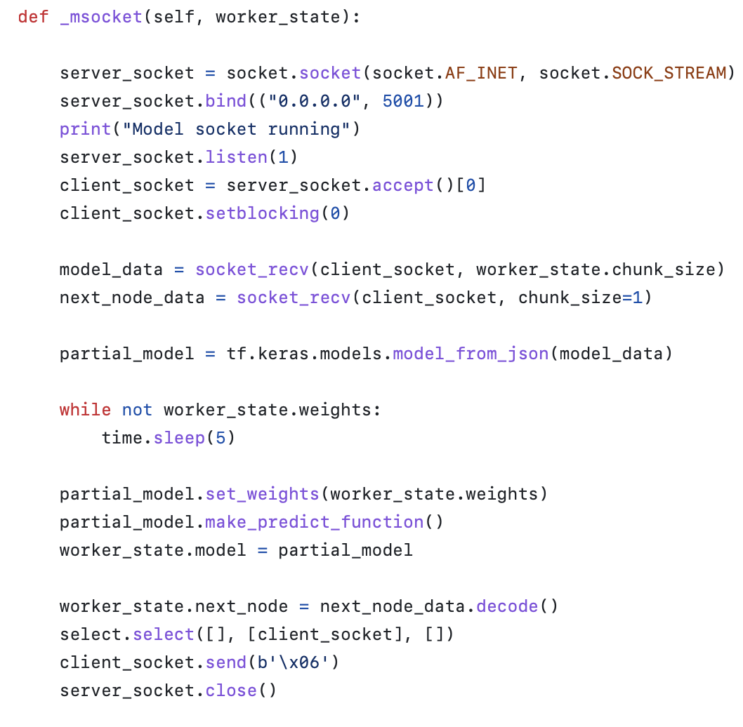
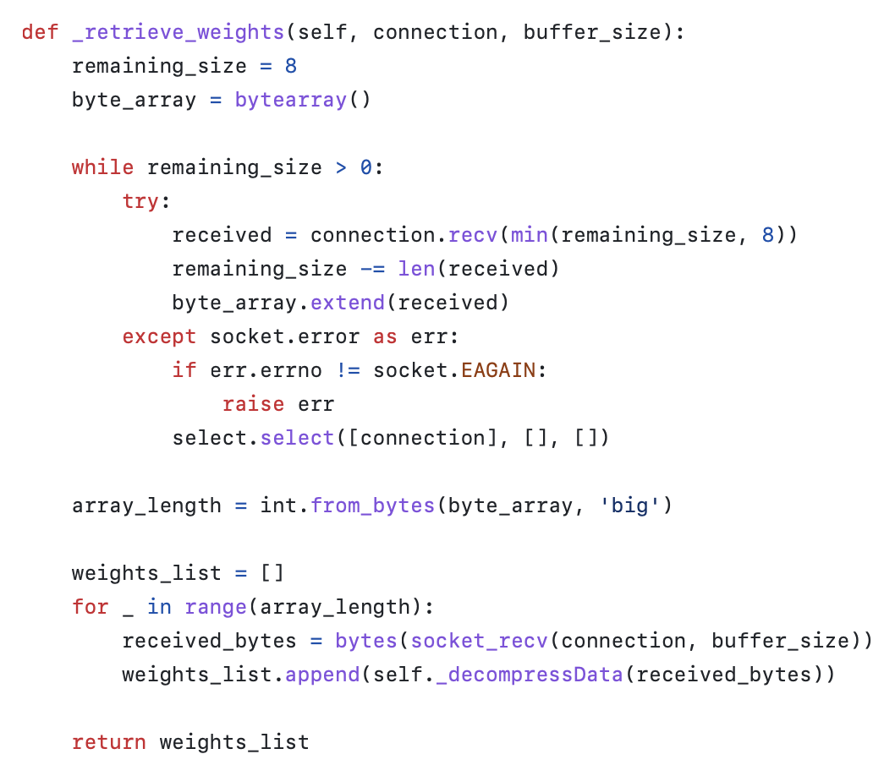
Code main components (worker side)

Slide 14
DEMO

Slide 15
Results
Architecture: 3 nodes | Energy consumption (J) | (de)serialization Overhead (s) | Network payload (Mb) | Inference Time (s) | Communication overhead (s) | Latency (s)
Dispatcher | 4.70E-05 | 18.1 | 573.79 |  | 50.71 | 68.81
Node 1 | 2.45E-06 | 0.12 | 29.85 | 37.2 | 31.49 | 31.61
Node 2 | 4.10E-07 | 0.219 | 5 | 30.81 | 37.781 | 38
Node 3 | 1.36E-06 | 42.91 | 16.57 | 24.96 | 0.94 | 43.85
Total | 5.12E-05 | 61.349 | 625.21 | 92.97 | 120.921 | 182.27

Slide 16
Results and Conclusions
Architecture: 4 nodes | Energy consumption (J) | (de)serialization Overhead (s) | Network payload (Mb) | Inference Time (s) | Communication overhead (s) | Latency (s)
Dispatcher | 4.53E-05 | 13.28 | 552.72 | - | 55.72 | 69
Node1 | 2.44E-06 | 0.13 | 29.74 | 38.39 | 30.48 | 30.61
Node2 | 3.96E-07 | 0.2008 | 4.84 | 33.128 | 35.6712 | 35.872
Node 3 | 3.93E-07 | 0.238 | 4.8 | 30 | 38.762 | 39
Node 4 | 1.34E-06 | 42.63 | 16.3 | 26.75 | 0.62 | 43.25
Total | 4.98E-05 | 56.4788 | 608.4 | 127.268 | 161.2532 | 217.732
Distributed inference advantages highly depend on the input data size
In the case of big data transfer, more nodes result in more communication burden after a certain node number
Architecture: 5 nodes | Energy consumption (J) | (de)serialization Overhead (s) | Network payload (Mb) | Inference Time (s) | Communication overhead (s) | Latency (s)
Dispatcher | 4.36E-05 | 13.64 | 532.11 | - | 55.99 | 69.63
Node1 | 2.44E-06 | 0.5 | 29.73 | 46.913 | 22.217 | 22.717
Node2 | 3.95E-07 | 0.228 | 4.82 | 33.875 | 35.527 | 35.755
Node 3 | 3.92E-07 | 0.226 | 4.78 | 35.07 | 34.334 | 34.56
Node 4 | 3.78E-07 | 0.233 | 4.61 | 36.58 | 32.817 | 33.05
Node 5 | 1.31E-06 | 45.81 | 15.96 | 27.5 | 0.32 | 46.13
Total | 4.36E-05 | 60.637 | 592.01 | 175.938 | 181.205 | 241.842

Slide 17
THANK YOU

Slide 18
References
[1] C. Hu and B. Li, "Distributed Inference with Deep Learning Models across Heterogeneous Edge Devices," IEEE INFOCOM 2022 - IEEE Conference on Computer Communications, London, United Kingdom, 2022, pp. 330-339, doi: 10.1109/INFOCOM48880.2022.9796896
[2] A. Parthasarathy and B. Krishnamachari, "DEFER: Distributed Edge Inference for Deep Neural Networks," 2022 14th International Conference on COMmunication Systems & NETworkS (COMSNETS), Bangalore, India, 2022, pp. 749-753, doi:10.1109/COMSNETS53615.2022.9668515.

