Slide 1

THE THEORY OF PRODUCTION
Production involves transformation of inputs such as capital, equipment, labor, and land into output - goods and services
In this production process, the manager is concerned with efficiency in the use of the inputs
  - technical vs. economical efficiency

Slide 2
Two Concepts of Efficiency
Economic efficiency:
  occurs when the cost of producing a given output is as low as possible
Technological efficiency:
  occurs when it is not possible to increase output without increasing inputs

Slide 3
You will see that basic production theory is simply an application of constrained optimization:
the firm attempts either to minimize the cost of producing a given level of output
or
to maximize the output attainable with a given level of cost.
Both optimization problems lead to same rule for the allocation of inputs and choice of technology

Slide 4
Production Function
A production function is purely technical relation which connects factor inputs & outputs. It describes the transformation of factor inputs into outputs at any particular time period.
Q = f( L,K,R,L_{d},T,t)
  where
  Q = output R= Raw Material
  L= Labour L_{d} = Land
  K= Capital T = Technology
  t = time
For our current analysis, let’s reduce the inputs to two, capital (K) and labor (L):
Q = f(L, K)

Slide 5
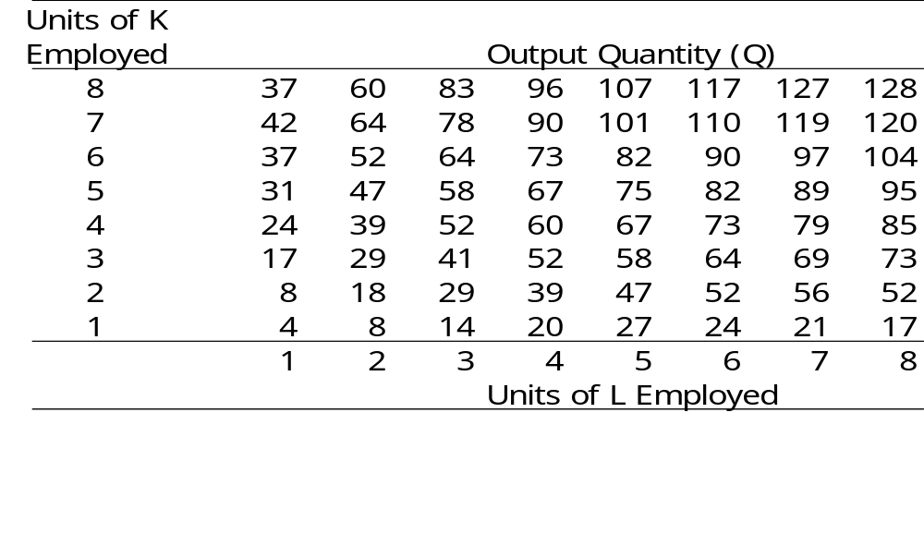
Production Table
Same Q can be produced with different combinations of inputs, e.g. inputs are substitutable in some degree

Slide 6
Short-Run and Long-Run Production
In the short run some inputs are fixed and some variable
  e.g. the firm may be able to vary the amount of labor, but cannot change the amount of capital
  in the short run we can talk about factor productivity / law of variable proportion/law of diminishing returns

Slide 7

In the long run all inputs become variable
  e.g. the long run is the period in which a firm can adjust all inputs to changed conditions
  in the long run we can talk about returns to scale

Slide 8

Short-Run Changes in Production
Factor Productivity
How much does the quantity of Q change, when the quantity of L is increased?

Slide 9

Long-Run Changes in Production
Returns to Scale
How much does the quantity of Q change, when the quantity of both L and K is increased?

Slide 10
Relationship Between Total, Average, and Marginal Product: Short-Run Analysis
Total Product (TP) = total quantity of output
Average Product (AP) = total product per total input
Marginal Product (MP) = change in quantity when one additional unit of input used

Slide 11
The Marginal Product of Labor
The marginal product of labor is the increase in output obtained by adding 1 unit of labor but holding constant the inputs of all other factors
Marginal Product of L:
MP_{L}= ΔQ/ΔL (holding K constant)
= δQ/δL
Average Product of L:
AP_{L}= Q/L (holding K constant)

Slide 12
Law of Diminishing Returns
(Diminishing Marginal Product)
The law of diminishing returns states that when more and more units of a variable input are applied to a given quantity of fixed inputs, the total output may initially increase at an increasing rate and then at a constant rate but it will eventually increases at diminishing rates.
Assumptions. The law of diminishing returns is based on the following assumptions: (i) the state of technology is given (ii) labour is homogenous and (iii) input prices are given.

Slide 13
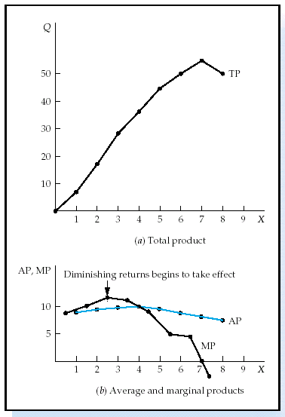
Short-Run Analysis of Total,
Average, and Marginal Product
If MP > AP then AP is rising
If MP < AP then AP is falling
MP = AP when AP is maximized
TP maximized when MP = 0

Slide 14
Three Stages of Production in Short Run
AP,MP
Stage I
Stage III
Stage II
AP_{X}
MP_{X}
X
TP_{L} Increases at increasing rate.
MP Increases at decreasing rate.
AP is increasing and reaches its maximum at the end of stage I
TP_{L} Increases at Diminshing rate.
MP_{L} Begins to decline.
TP reaches maximum level at the end of stage II, MP = 0.
AP_{L} declines
TPL begins to decline
MP becomes negative
AP continues to decline

Slide 15
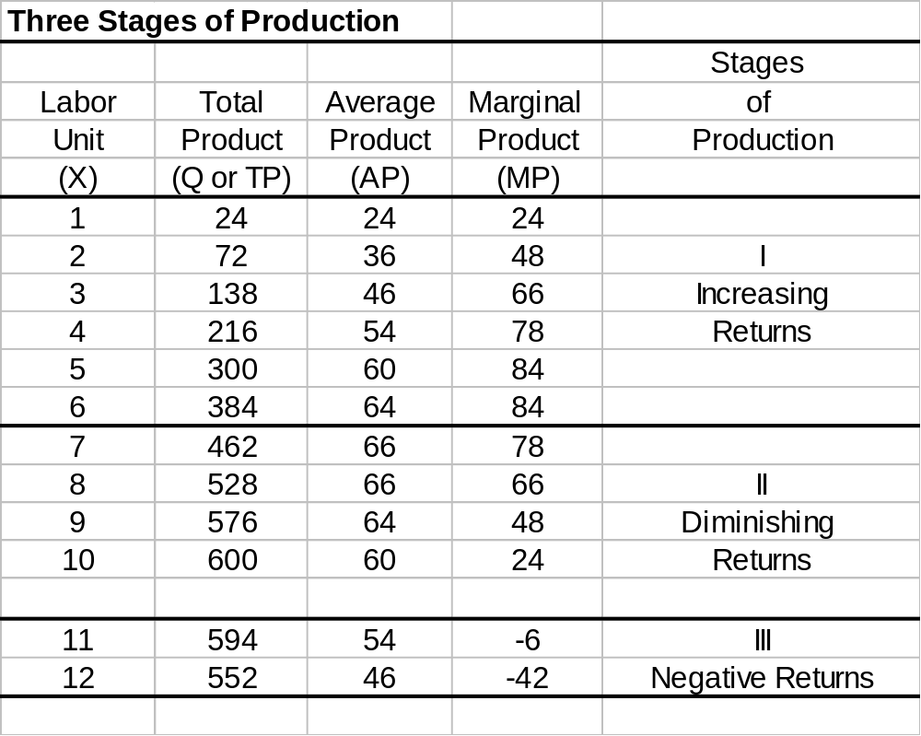

Slide 16
Application of Law of Diminishing Returns:
It helps in identifying the rational and irrational stages of operations.
It gives answers to question –
How much to produce?
What number of workers to apply to a given fixed inputs so that the output is maximum?

Slide 17
Production in the Long-Run
  All inputs are now considered to be variable (both L and K in our case)
  How to determine the optimal combination of inputs?
To illustrate this case we will use production isoquants.
An isoquant is a locus of all technically efficient methods or all possible combinations of inputs for producing a given level of output.

Slide 18
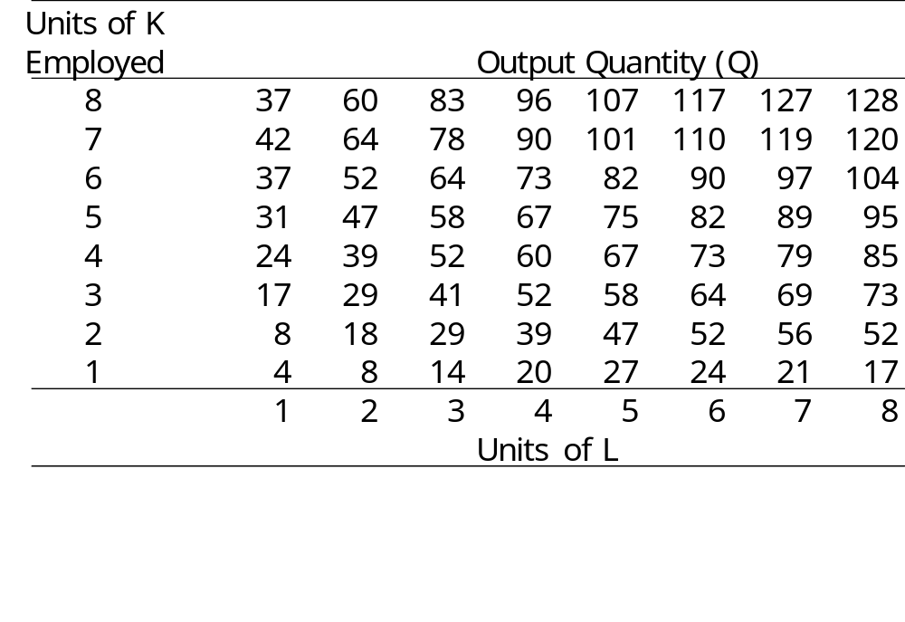
Production Table
Units of K
Employed
Isoquant

Slide 19
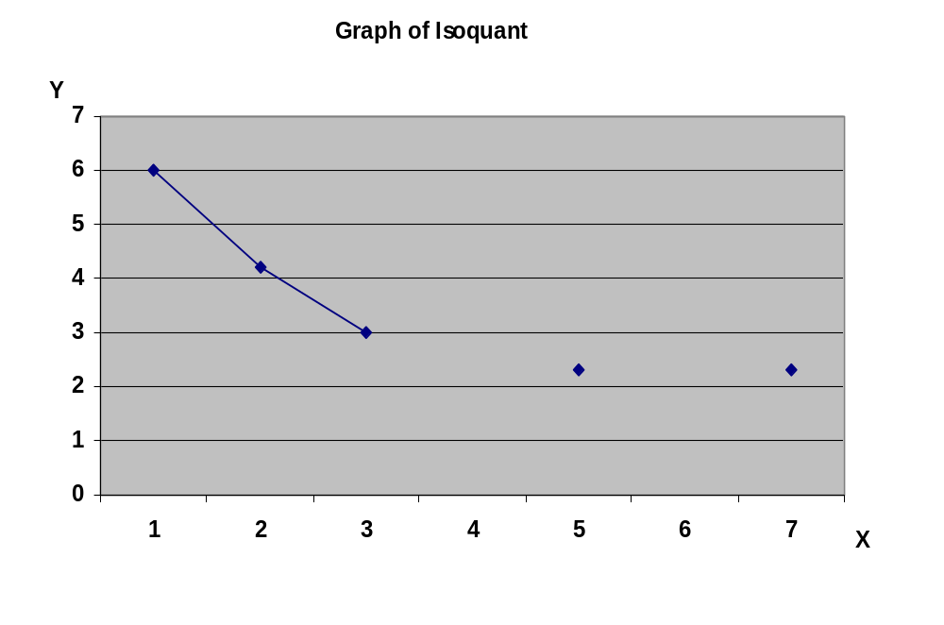
Isoquant

Slide 20
Types of Isoquant
There exists some degree of substitutability between inputs.
Different degrees of substitution:
SugarCane
syrup
Natural flavoring
Capital
K₁ K₂ K₃ K₄
Q
Q
Sugar
All other ingredients
L₁ L₂ L₃ L₄
Labor
b) Input – Output/ L-Shaped Isoquant (Perfect complementarity)
c) Kinked/Acitivity
Analysis Isoquant –
(Limited substitutability)
Linear Isoquant (Perfect substitution)

Slide 21
Marginal Rate of Technical Substitution MRTS
The degree of imperfection in substitutability is measured with marginal rate of technical substitution (MRTS- Slope of Isoquant):
MRTS = ΔL/ΔK
(in this MRTS some of L is removed from the production and substituted by K to maintain the same level of output)

Slide 22
Properties of Isoquants
Isoquants have a negative slope.
Isoquants are convex to the origin.
Isoquants cannot intersect or be tangent to each other.
Upper Isoquants represents higher level of output

Slide 23
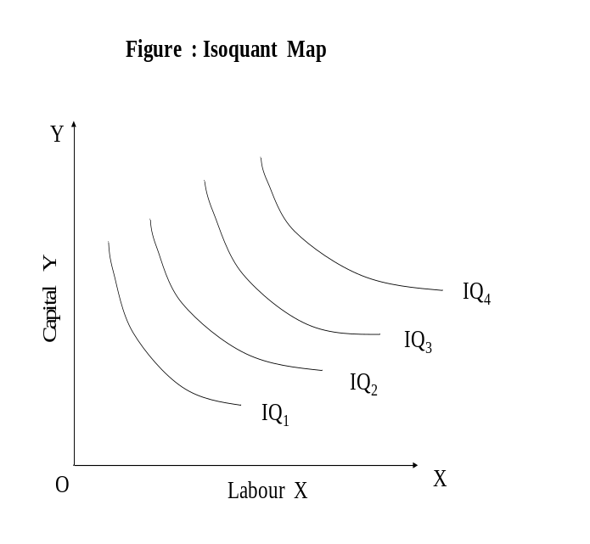
Isoquant Map
Isoquant map is a set of isoquants presented on a two dimensional plain. Each isoquant shows various combinations of two inputs that can be used to produce a given level of output.

Slide 24
Laws of Returns to Scale
It explains the behavior of output in response to a proportional and simultaneous change in input.
When a firm increases both the inputs, there are three technical possibilities –
TP may increase more than proportionately – Increasing RTS
TP may increase proportionately – constant RTS
TP may increase less than proportionately – diminishing RTS

Slide 25
Increasing RTS
K
Product Line
3K
3X
2K
2X
K
X
0
L
2L
3L
L

Slide 26
Constant RTS
K
Product Line
3K
3X
2K
2X
K
X
0
L
2L
3L
L

Slide 27
Decreasing RTS
K
Product Line
3K
3X
2K
2X
K
X
0
L
2L
3L
L

Slide 28
Elasticity of Factor Substitution
() is formally defined as the percentage change in the capital labour ratios (K/L) divided by the percentage change in marginal rate of technical substitution (MRTS), i.e
Percentage change in K/L
()=
Percentage change in MRTS
д(K/L) / (K/L)
()=
д(MRTS) / (MRTS)

Slide 29
Cobb – Dougles Production function: -
X= b₀ L^{b1} K^{b2}
X= Out put
L = qty of Labour
K = qty of Capital
bo , b₁ , b₂ Coefficient
b1 - Labour
b2 - Capital

Slide 30
Characteristics of Cobb – Dougles Prodn function: -
The Marginal Product of Factor:
(a) MP _{L} = dx/dl
X = b₀L^{b1}K^{b2}
dx/dl = b₀ b₁ L^{b1-1}K^{b2}
= b₁ (boL^{b1} K ^{b2}) L⁻¹
= b₁ X/L
= b₁ (AP _{L})
AP_{L} Average Product of Labour
Similarly
(b) MP _{K} = dx/dk
= b₂ b₀L^{b1}K^{b2-1}
= b₂ ( b₀ L^{b1} K^{b2}) K⁻¹
= b₂ X/K
AP_{k} Average Product of Capital

Slide 31
2. The Marginal rate of technical substitution
MRTS _{L.K} = MP_{L}
MP_{K}
= dx/dL = b₁(X/L)
dx/dk b₂(X/K)
MRTS _{LK} = b₁ K
b₂ L

Slide 32
3. The Elasticity of Substitution
σ = Δd k/L / k/l
dMRTS / MRTS
= dK/L/k/L
b₁ dk b₁ k
b₂ L b₂ L
EOS =1
This function is perfectly substitutable function.

Slide 33
4.Factor intensity: -
In cobb-Douglas function factor intensity is measured by ratio b1/b2. The higher is the ratio (b1/b2), the more labour intensive is the technique. Similarly, the lower the ratio (b1/b2) the more capital intensive is the technique.
OR
b1/b2 labour intensive
b1/b2 capital intensive

Slide 34
5. Returns to scale:-
In cobb – Dougles production function RTS is measured by the sum of the coefficients
b₁+b₂ = V
x ₀= f (L,K)
X*= f(_{k}L, _{K}K)
A homogenous function is a function such that if each of the inputs is multiplied by K i.e ‘K’ can the completely factored out. ‘K’ also has a power V which is called the degree of homogeneity and it measures RTS.

Slide 35
X*= K^{v} f(x₀)
X₀ = b₀ L ^{b1} K ^{b2}
X* = b₀ (kL) ^{b1} (kK)^{b2}
= K^{b1+b2} (b_{o} L ^{b1} K ^{b2})
=K^{v} f (X₀)
(V=b₁ + b₂)
∴ X* = K ^{v} f (X_{o})
In case when
V=1 we have constant RTS
V>1 we have increasing RTS
V<1 we have decreasing RTS

Slide 36
6.Efficiency of Production
The efficiency in the organization of the factor of production is measured by the coefficient b₀ :-
If two firms have the same K, L, b₁, b₂ and still produce different quantities of output, the difference can be due to superior organization and entrepreneurship of one of the firms, which results in different effectiveness.
The more efficient firm will have a larger b₀ than the less efficient one.
b₀ More efficient is firm

Slide 37
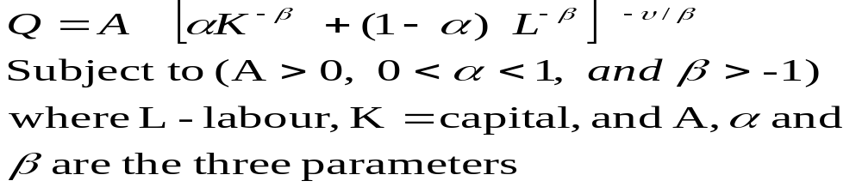
Constant Elasticity Substitution (CES) Production Functions
The CES production function is expressed as
‘A’ is the efficiency parameter and shows the scale effect. It indicates state of technology and entrepreneurial organizational aspects of production.
Higher Value of A higher output (given same inputs)

Slide 38
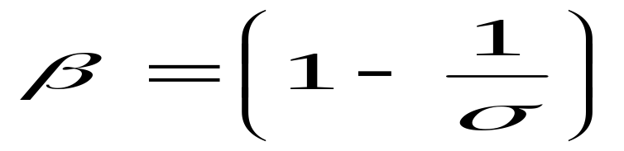
 is the capital intensity factor coefficient and (1- ) is the labour intensity of coefficient . The value of  indicates the relative contribution of capital input and labour input to total output.
Value of Elasticity of Substitution () depends upon the value of substitution parameter ‘β’
The parameter v represents degree of returns to scale.
Marginal Products of labour and capital are always positive if we assume constant return to scale.

Slide 39
Equilibrium of the firm: Choice of optimal combination of factors of prod^{n}
Assumptions:
1. The goal of the firm is profit maximization i.e maximization of difference
  ∏ - Profit
  R- Revenue
  C-Cost
  2. The price of o/p is given, Px
  3. The price of factors are given w is the given wage rate r is given price capital

Slide 40
Single Decision of the firm
(a) Maximize profit ∏, subject to cost constraint. In this case total cost & prices are given and maximization of ∏ is if X is maximised since c & Px are given constant.
        ∏ = R-C
        = P _{x} X-C
(b) Maximise Profit ∏ for a given level of o/p. Maximisation of ∏ is achieved in this case if cost c is minimized , given that X & Px are given constants.
        ∏= R-C
        ∏= P_{x}X - C

Slide 41
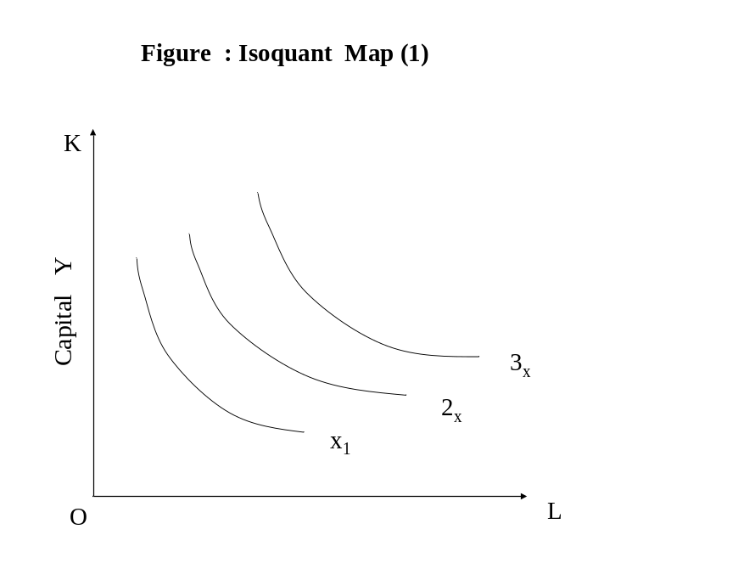
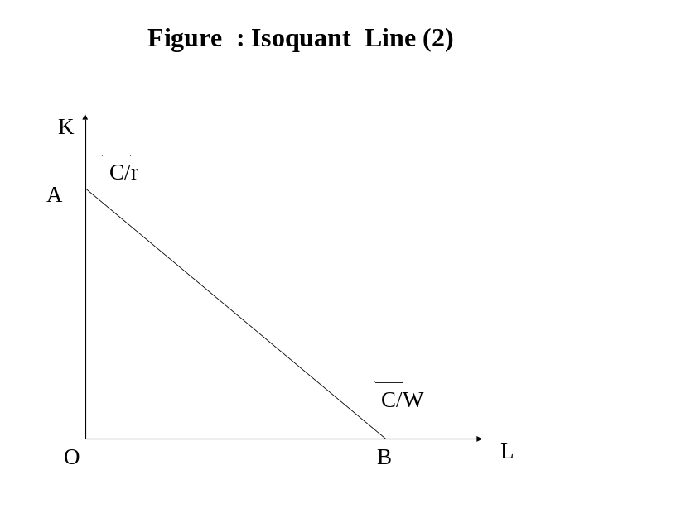
We will use isoquant map (1) and isoquant line (2)
The cost line is defined by cost equation
C= (r) (k) + (w) (L)
W wage rate r= price of capital service

Slide 42
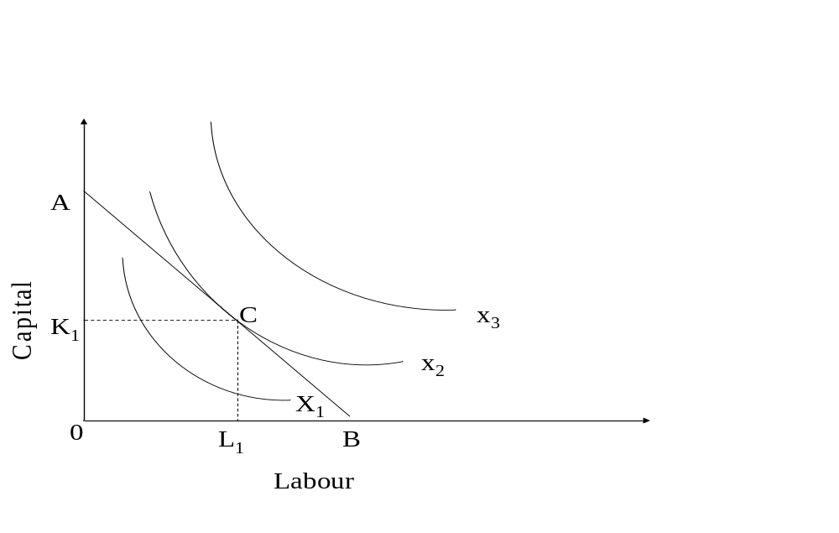
Case I
Maximization of output subject to cost constraint

Slide 43
Condition for Equilibrium
At point of tendency slope of isocost line (w/r ) = slope of isoquant. (MP_{L}/MP_{K})
The isoquants should be convex to origin

Slide 44
Case II
Minimization of cost for given level of output
K
K₁
e
X
0
L₁
L

