Slide 1
Concepts
of
Value and Return

Slide 2
LEARNING OBJECTIVES
Understand what gives money its time value.
Explain the methods of calculating present and future values.
Highlight the use of present value technique (discounting) in financial decisions.
Introduce the concept of internal rate of return.

Slide 3
Time Preference for Money
Time preference for money is an individual’s preference for possession of a given amount of money now, rather than the same amount at some future time.
Three reasons may be attributed to the individual’s time preference for money:
  risk
  preference for consumption
  investment opportunities

Slide 4
Required Rate of Return
The time preference for money is generally expressed by an interest rate. This rate will be positive even in the absence of any risk. It may be therefore called the risk-free rate.
An investor requires compensation for assuming risk, which is called risk premium.
The investor’s required rate of return is:
Risk-free rate + Risk premium.

Slide 5
Required Rate of Return
Would an investor want Rs. 100 today or after one year
Cash flows occurring in different time periods are not comparable.
It is necessary to adjust cash flows for their differences in timing and risk.
Example : If preference rate =10 percent
  An investor can invest if Rs. 100 if he is offered Rs 110 after one year.
  Rs 110 is the future value of Rs 100 today at 10% interest rate.
  Also, Rs 100 today is the present value of Rs 110 after a year at 10% interest rate.
  If the investor gets less than Rs. 110 then he will not invest. Anything above Rs. 110 is favourable.

Slide 6
Time Value Adjustment
Two most common methods of adjusting cash flows for time value of money:
  Compounding—the process of calculating future values of cash flows and
  Discounting—the process of calculating present values of cash flows.

Slide 7
Future Value
Compounding is the process of finding the future values of cash flows by applying the concept of compound interest.
Compound interest is the interest that is received on the original amount (principal) as well as on any interest earned but not withdrawn during earlier periods.
Simple interest is the interest that is calculated only on the original amount (principal), and thus, no compounding of interest takes place.

Slide 8
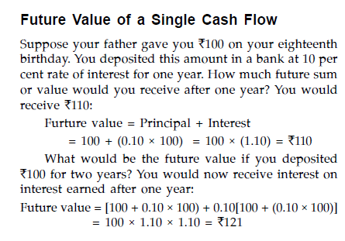

Slide 9
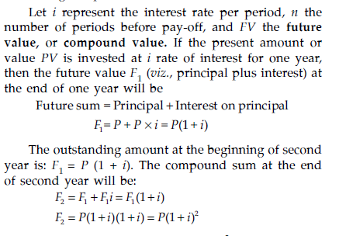

Slide 10
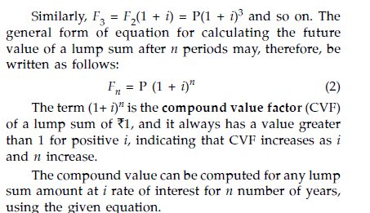

Slide 11
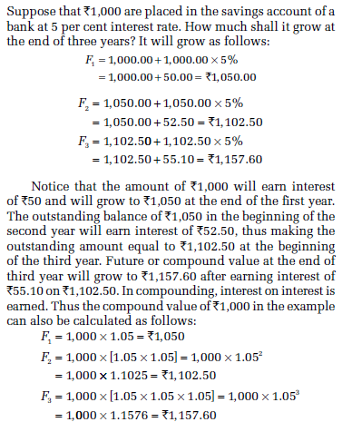

Slide 12
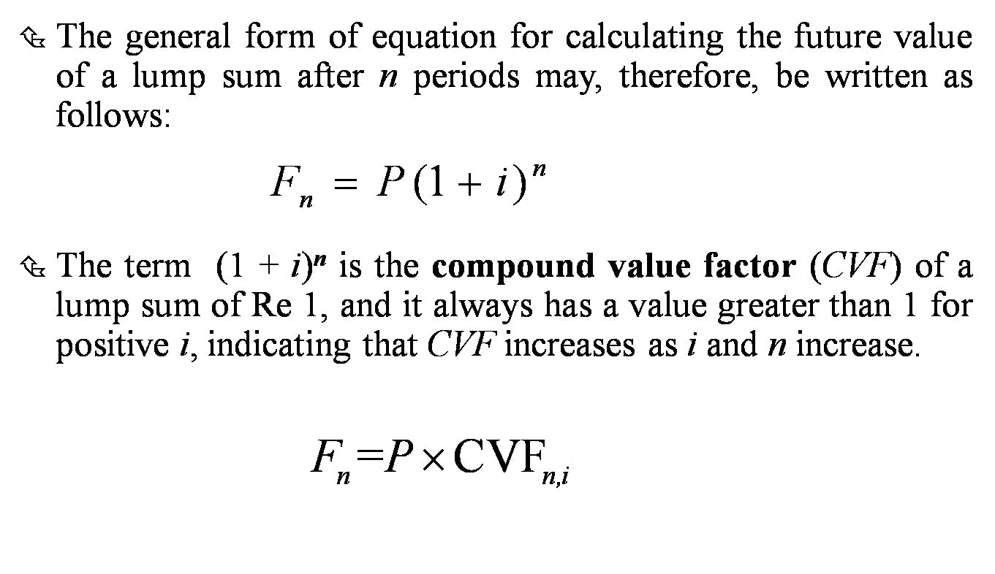
Future Value

Slide 13
Future Value
In Microsoft Excel: Use FV function.
FV(rate,nper,pmt,pv,type)
rate= interest rate.
nper= n periods
pmt= annuity value
pv= present value
type= 1 for beginning of the period and 0 for end for end of period.

Slide 14
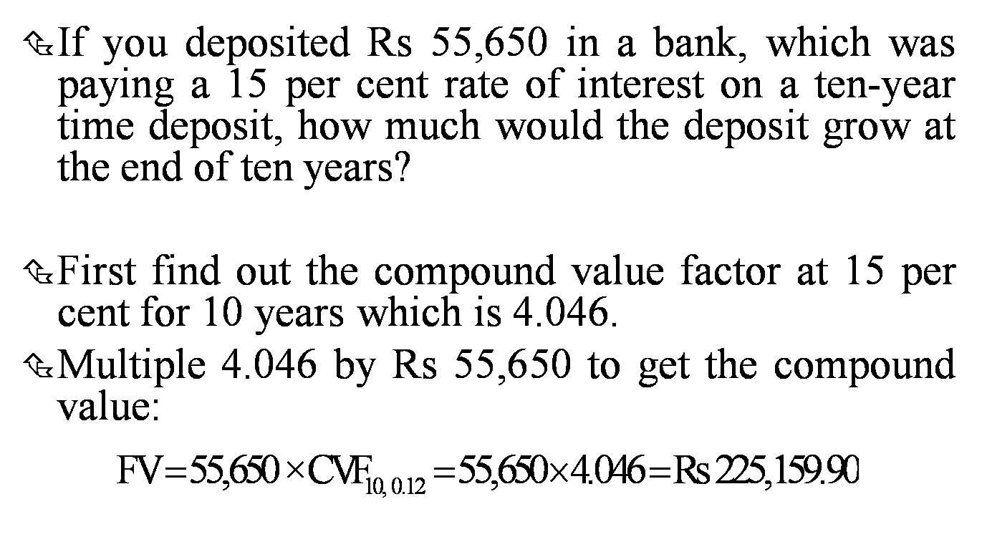
Future Value: Example

Slide 15
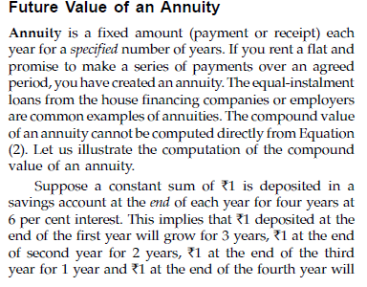

Slide 16
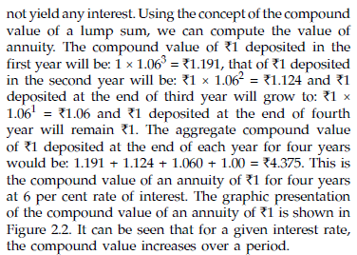

Slide 17
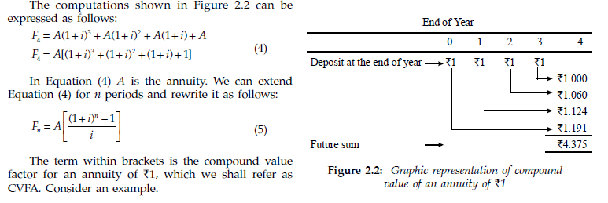

Slide 18
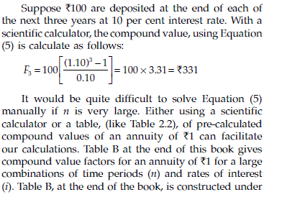

Slide 19
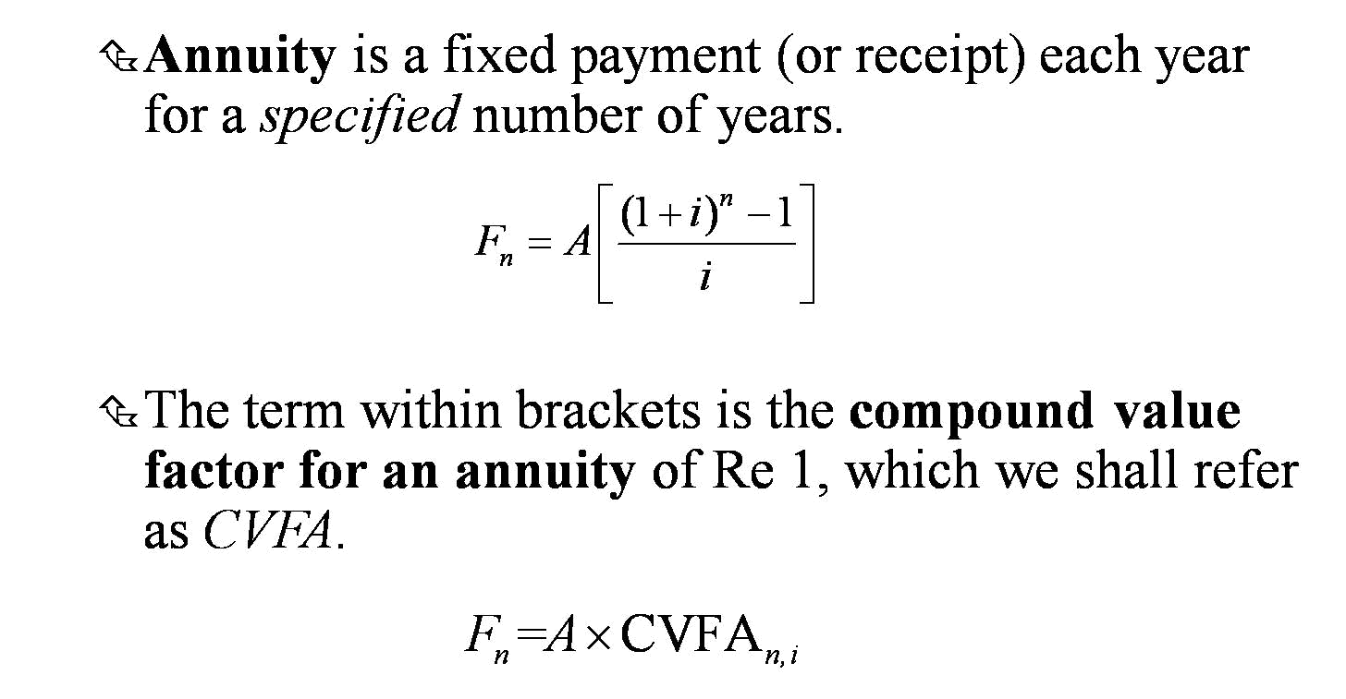
Future Value of an Annuity

Slide 20
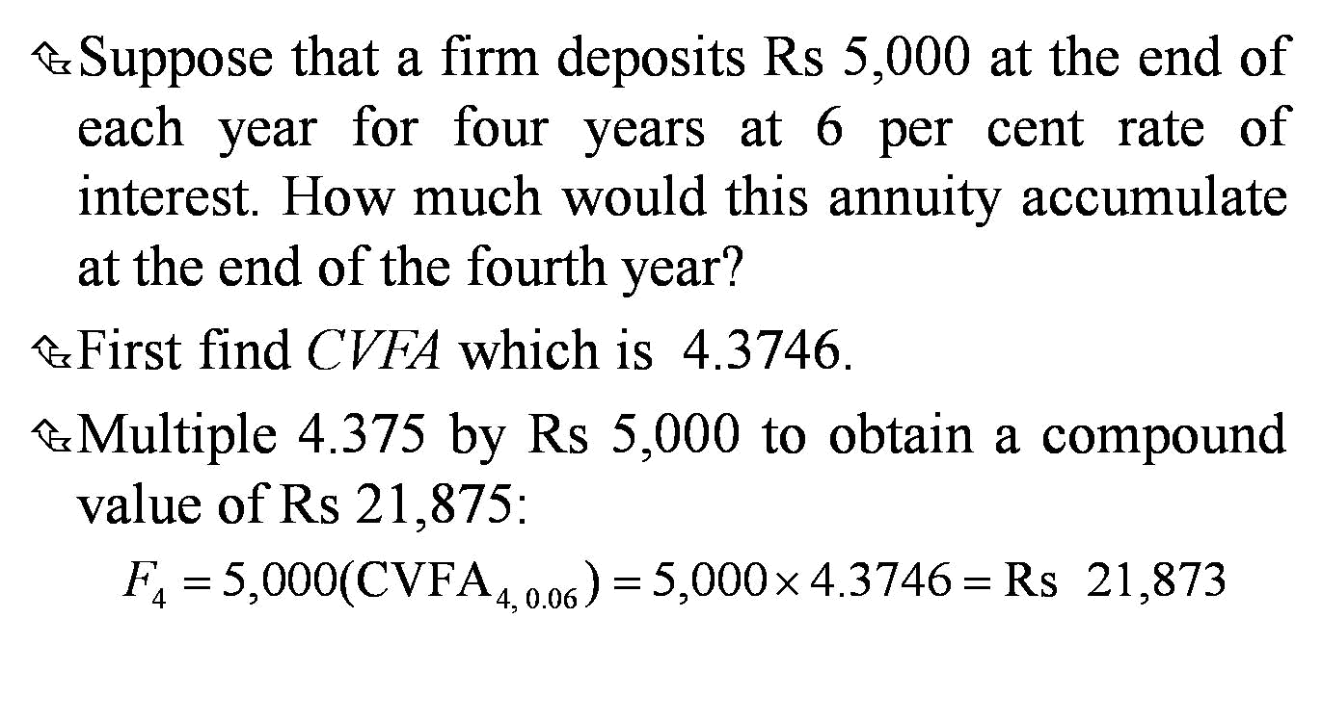
Future Value of an Annuity: Example

Slide 21
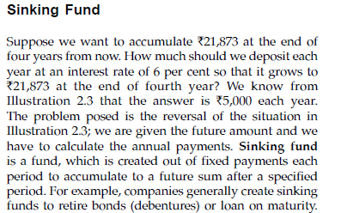

Slide 22
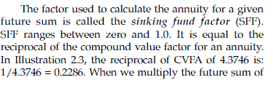

Slide 23
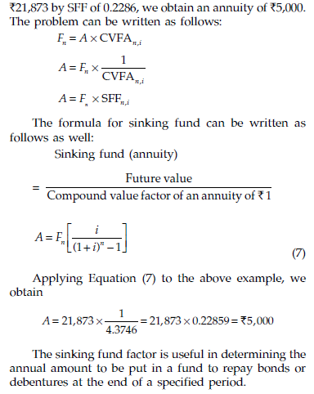

Slide 24
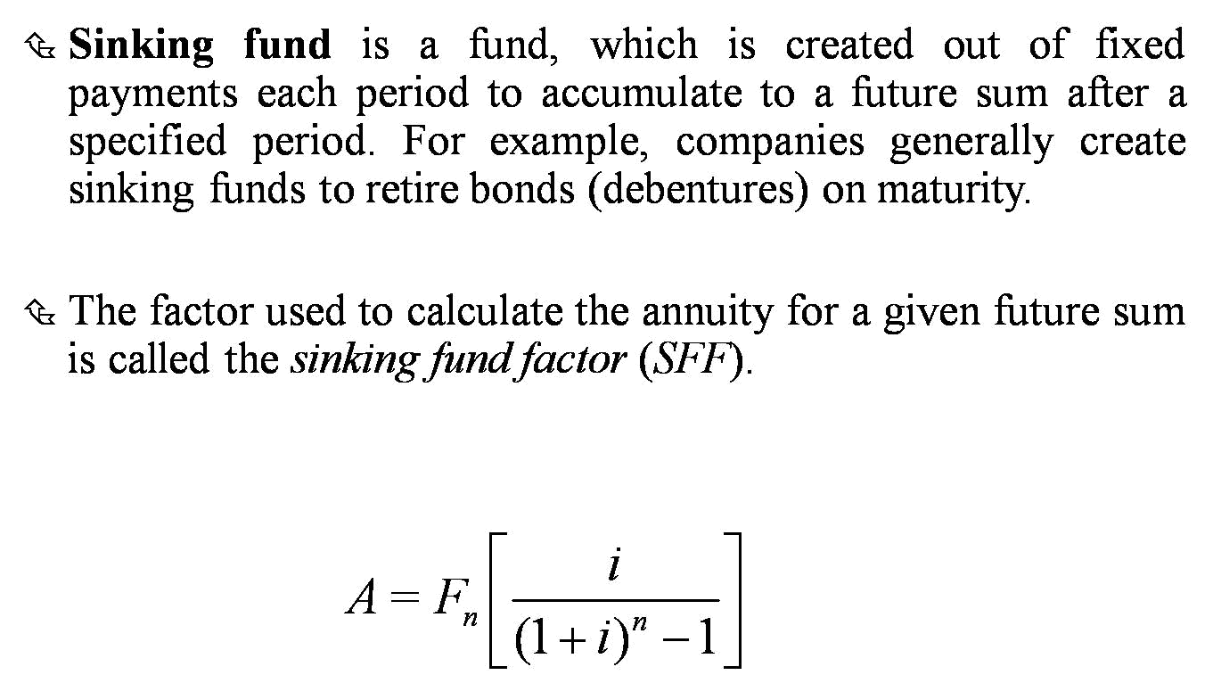
Sinking Fund

Slide 25
Present Value
Present value of a future cash flow (inflow or outflow) is the amount of current cash that is of equivalent value to the decision-maker.
Discounting is the process of determining present value of a series of future cash flows.
The interest rate used for discounting cash flows is also called the discount rate.

Slide 26
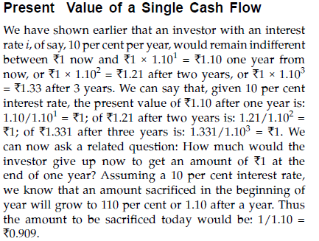

Slide 27
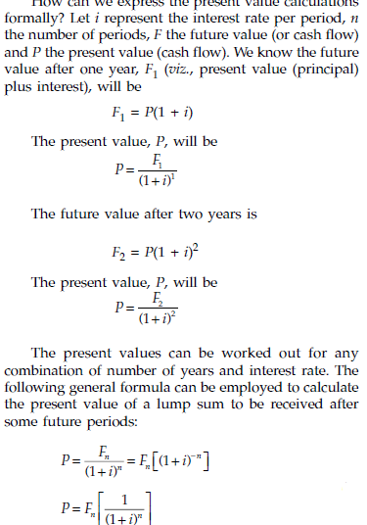

Slide 28
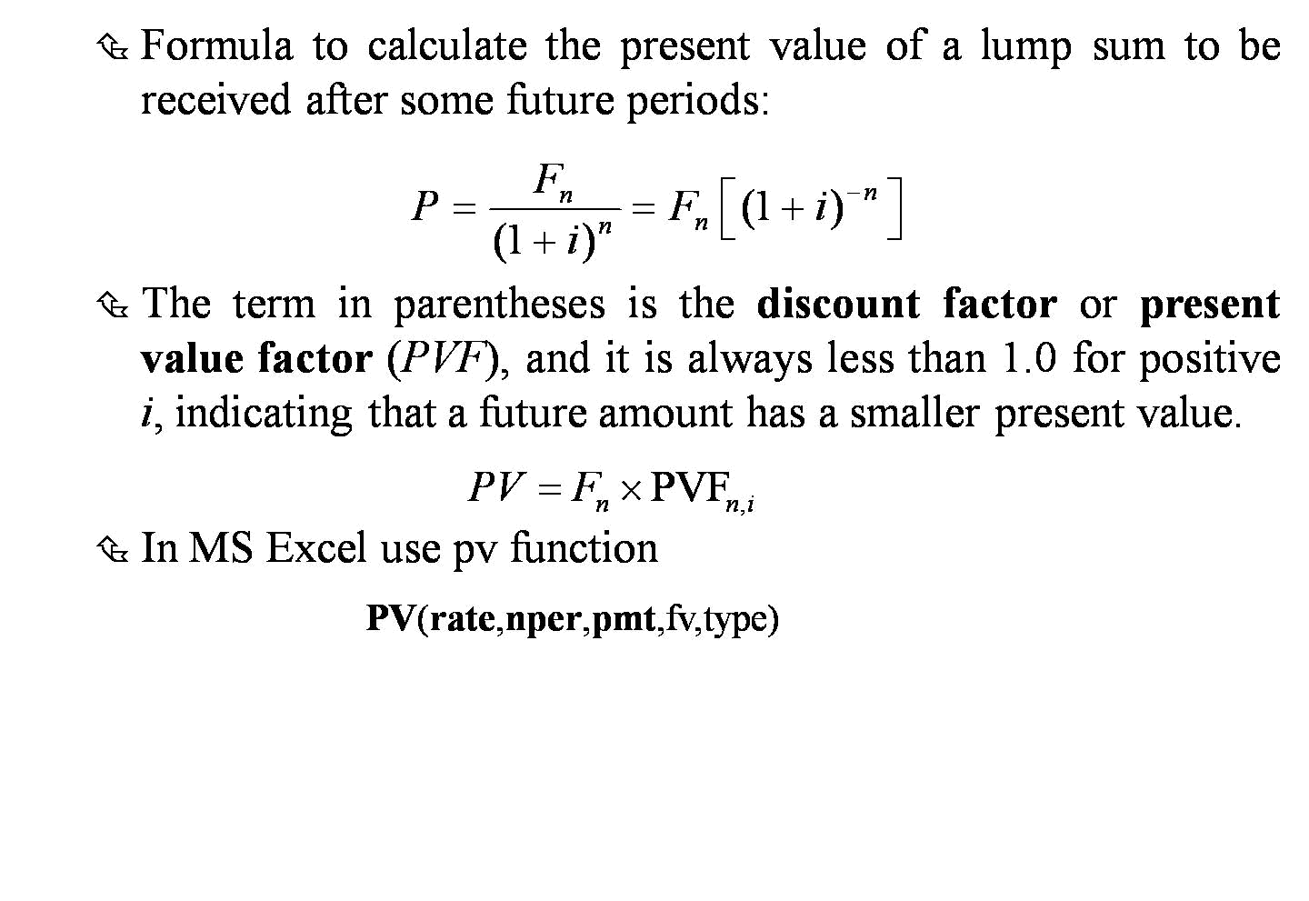
Present Value of a
Single Cash Flow

Slide 29
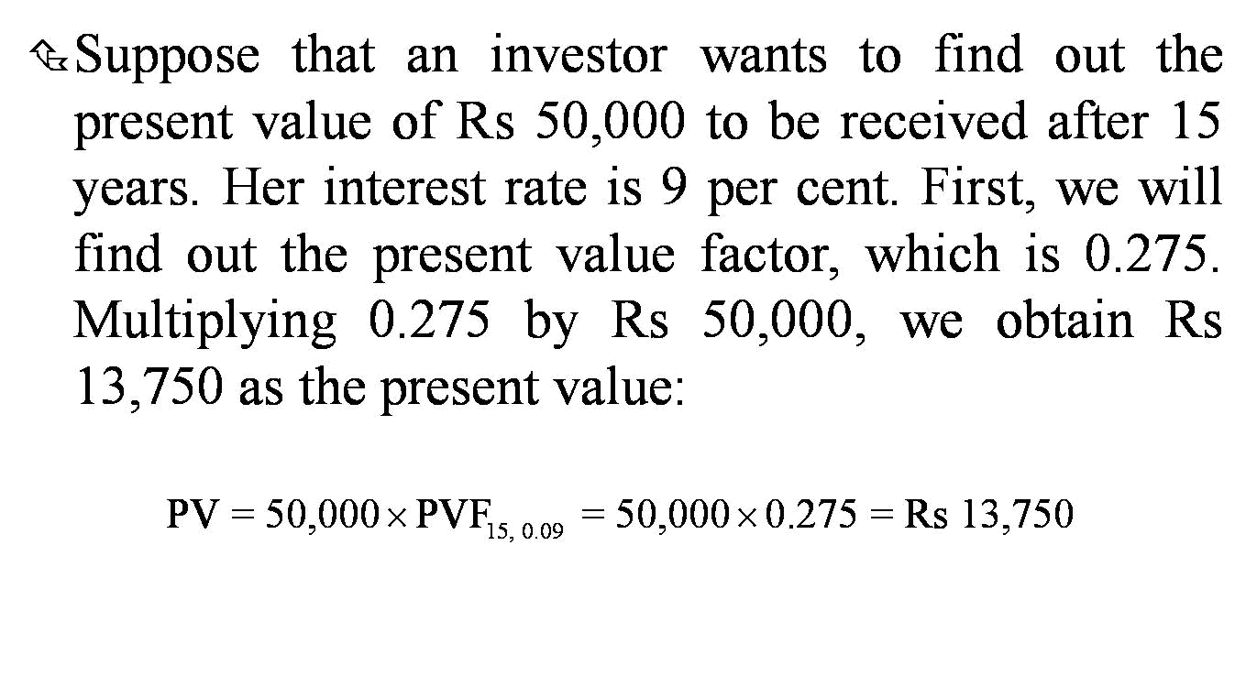
Example

Slide 30
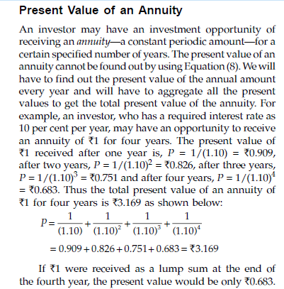

Slide 31
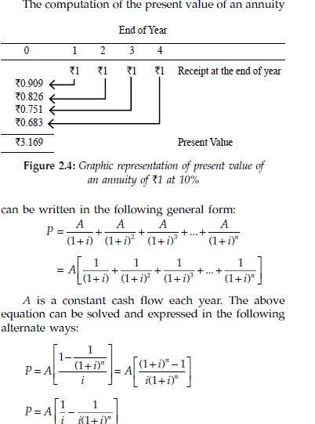

Slide 32
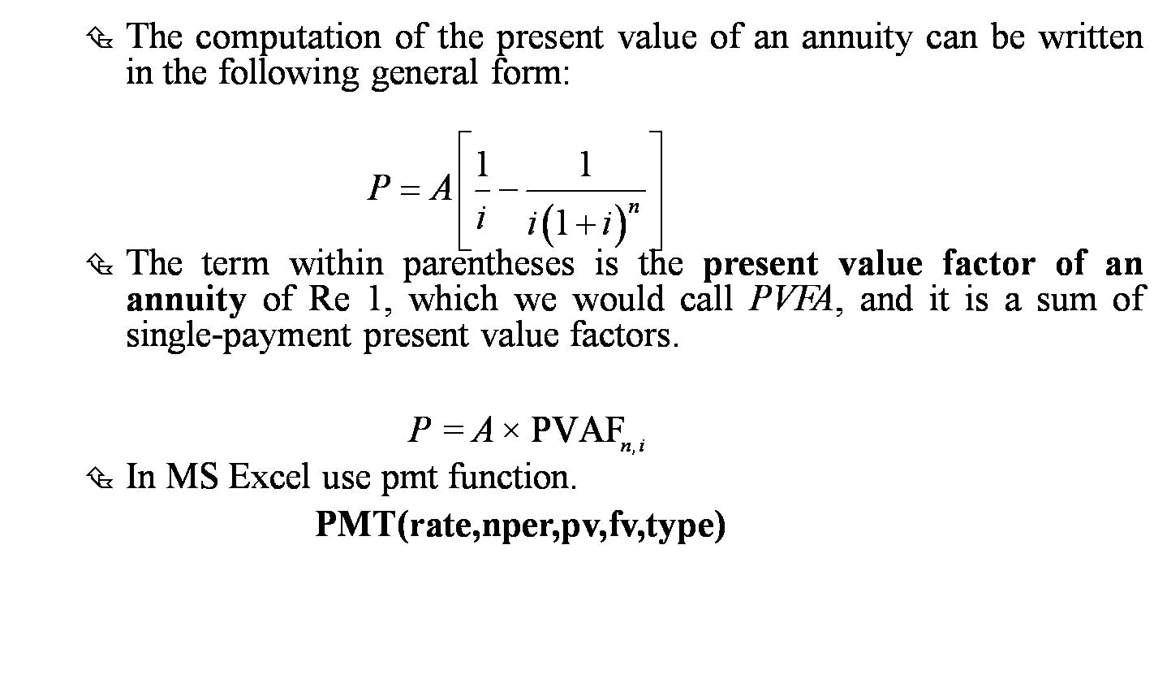
Present Value of an Annuity

Slide 33
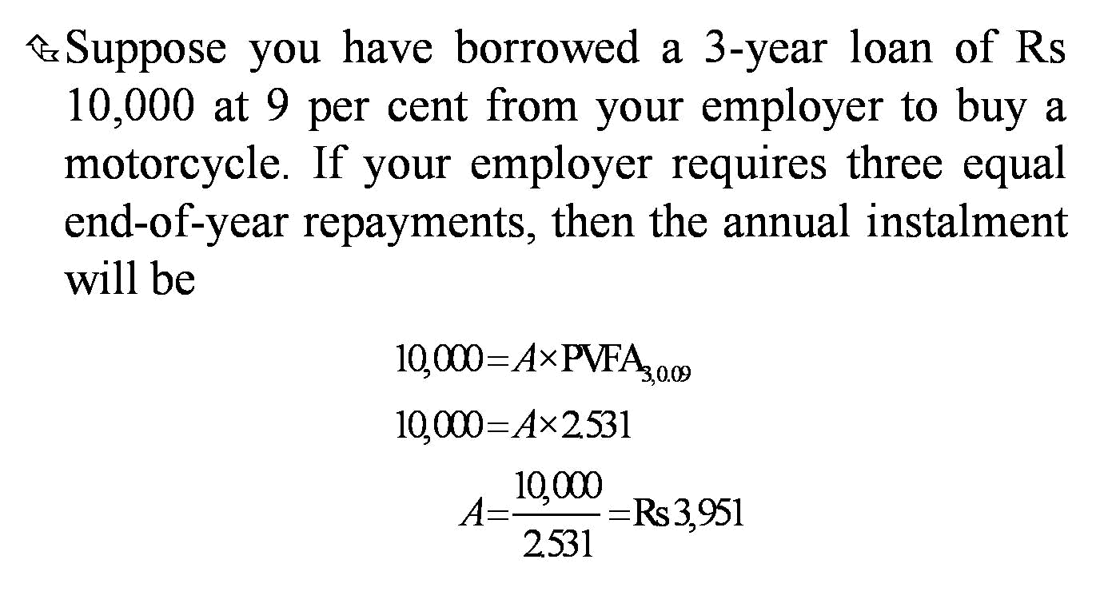
Example

Slide 34
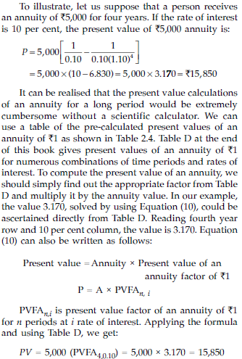

Slide 35
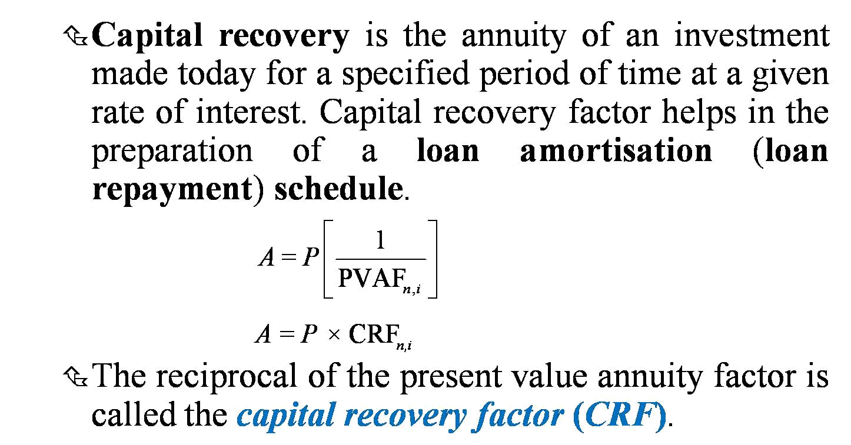
Capital Recovery and Loan Amortisation

Slide 36
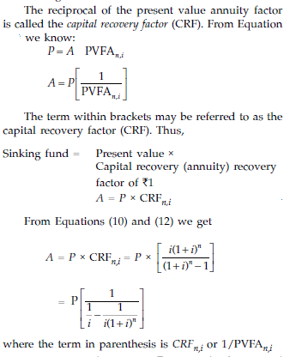

Slide 37
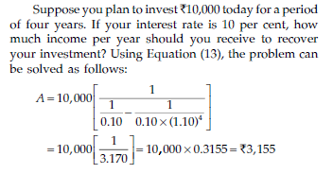

Slide 38
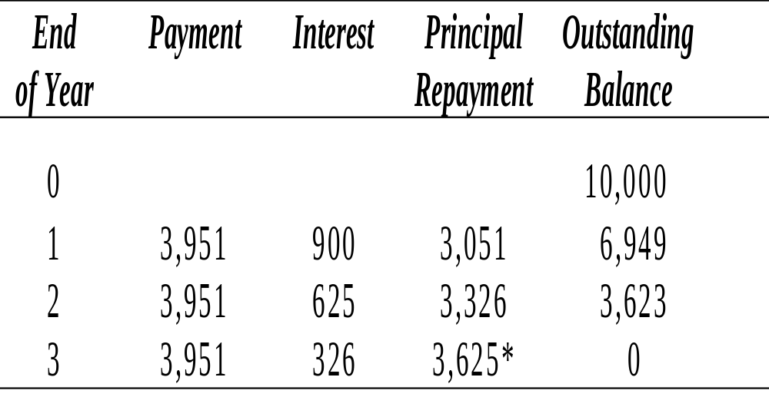
Loan Amortisation Schedule

Slide 39
Present Value of an
Uneven Periodic Sum
In most instances the firm receives a stream of uneven cash flows. Thus the present value factors for an annuity cannot be used.
The procedure is to calculate the present value of each cash flow and aggregate all present values.

Slide 40
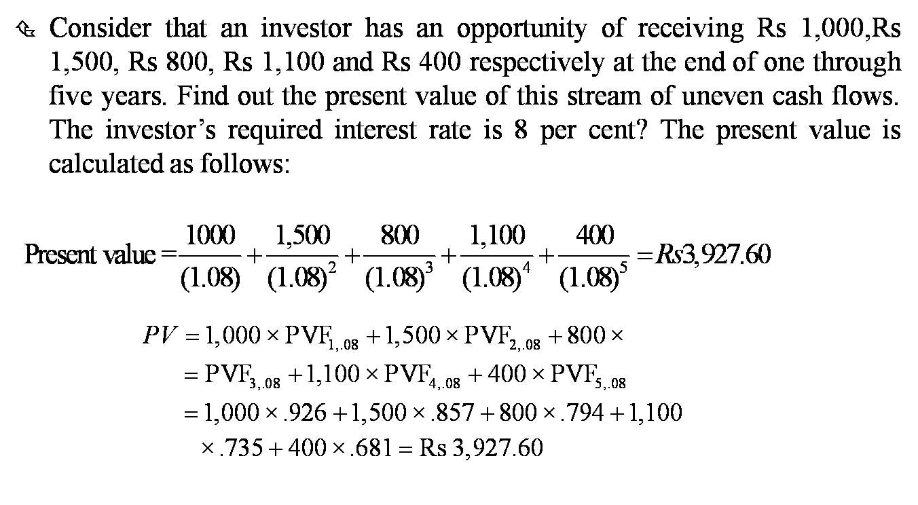
PV of Uneven Cash Flows Example

Slide 41
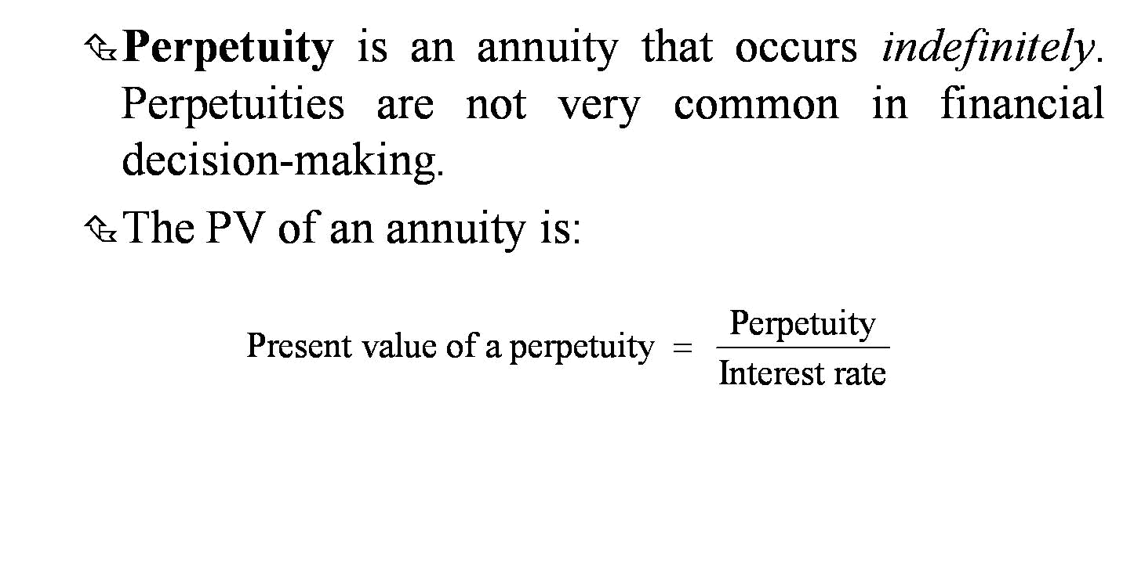
Present Value of Perpetuity

Slide 42
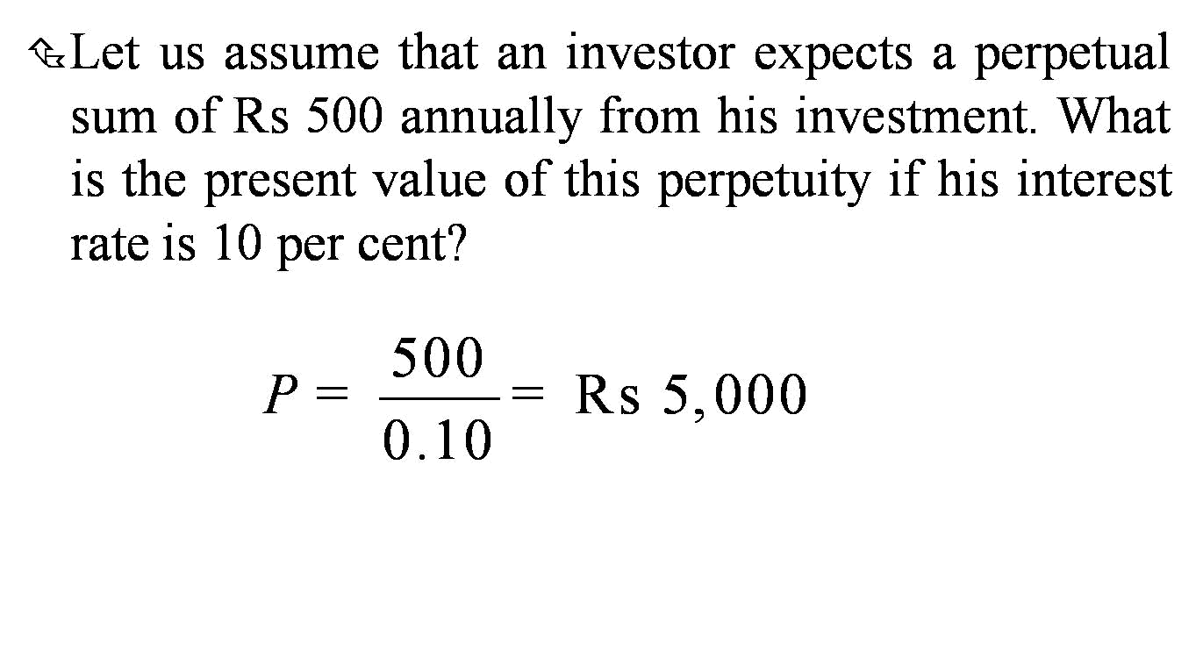
Present Value of a Perpetuity: Example

Slide 43
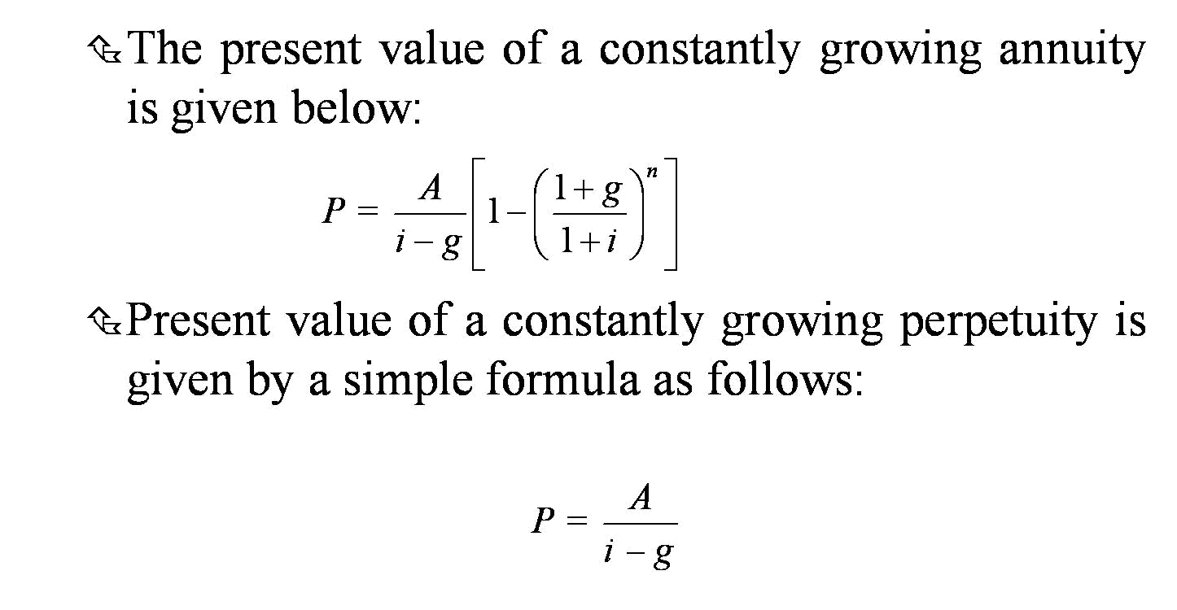
Present Value of Growing Annuities

Slide 44
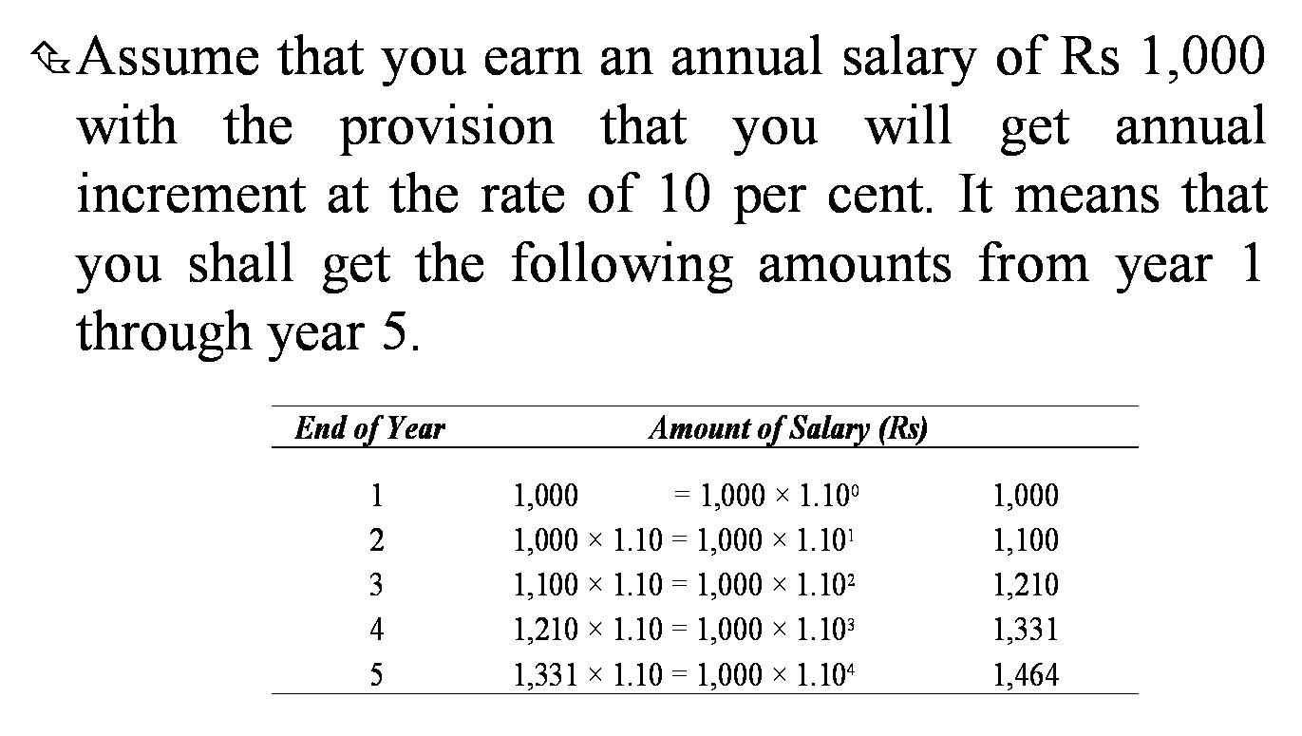
Example

Slide 45
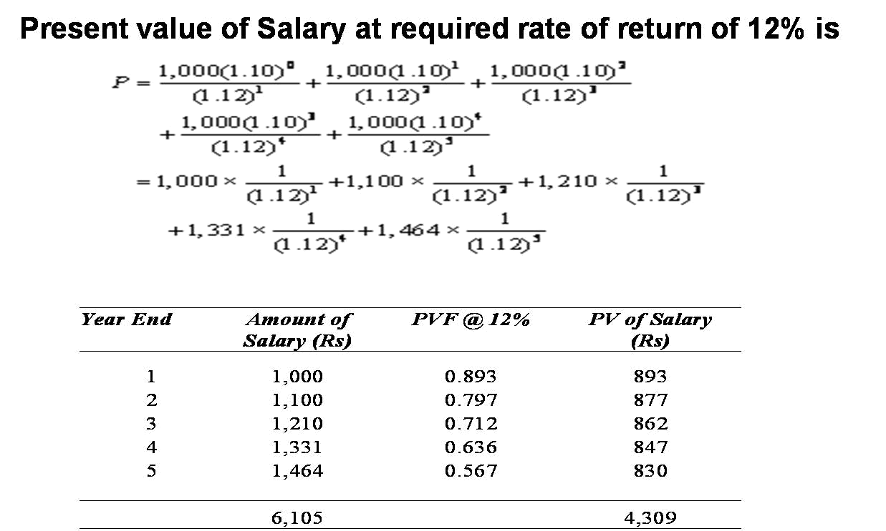
Example

Slide 46
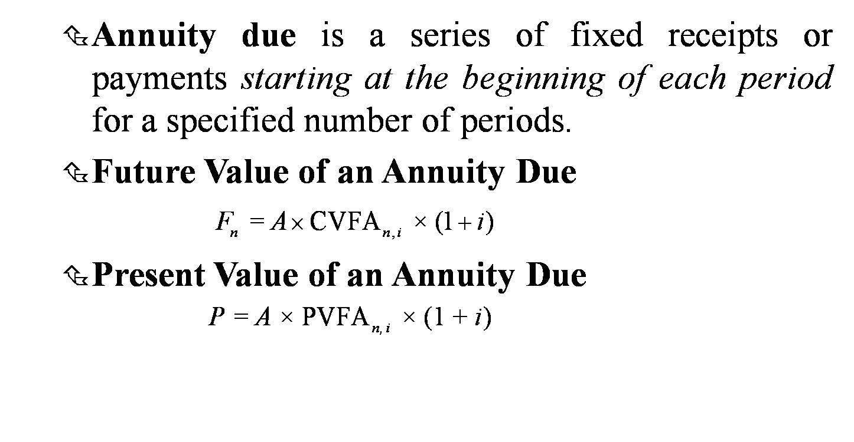
Value of an Annuity Due

Slide 47
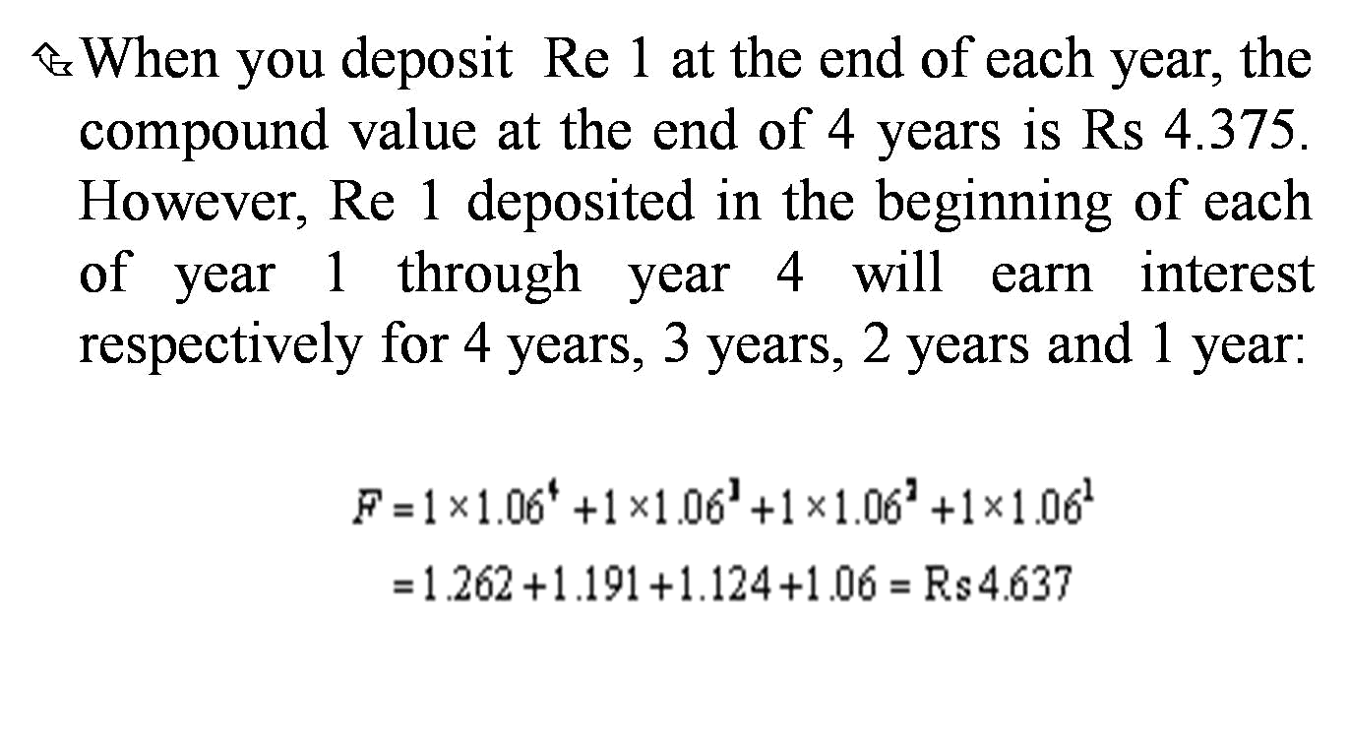
Future Value of An Annuity: Example

Slide 48
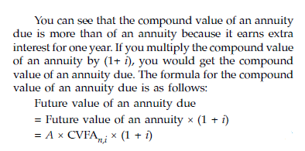
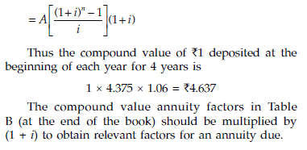

Slide 49
Example
The present value of Re 1 paid at the beginning of each year for 4 years is
1 × 3.170 × 1.10 = Rs 3.487

Slide 50
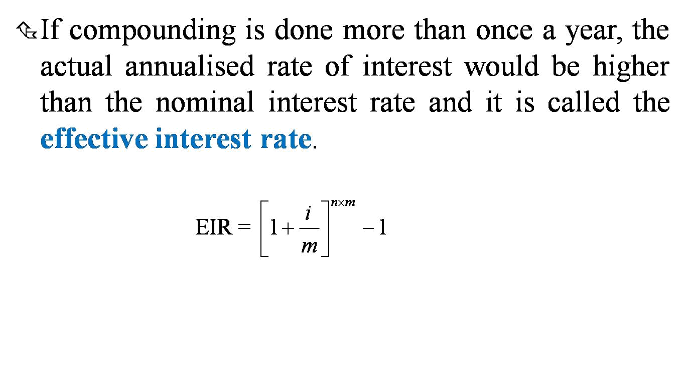
Multi-Period Compounding

Slide 51
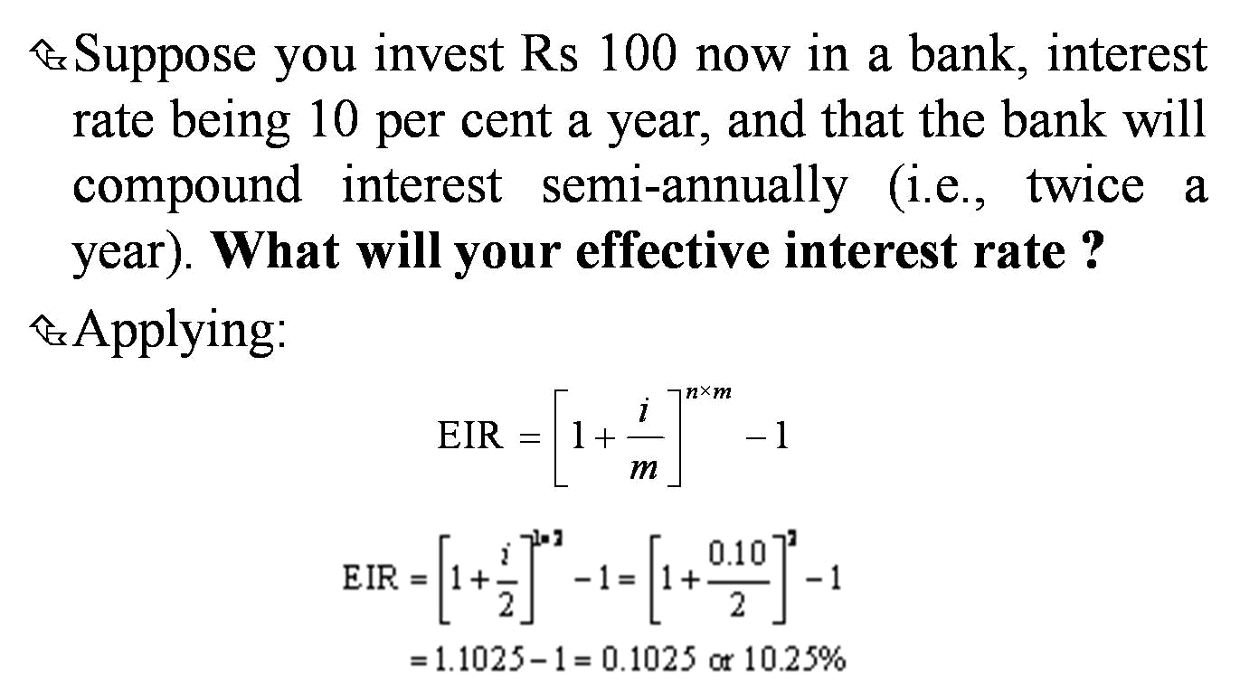
Effective Interest Rate: Example

Slide 52
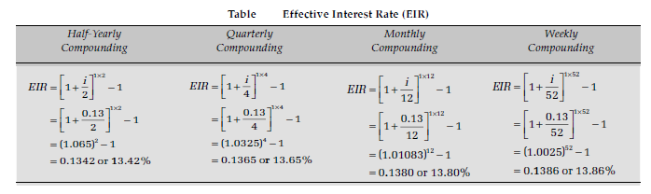

Slide 53
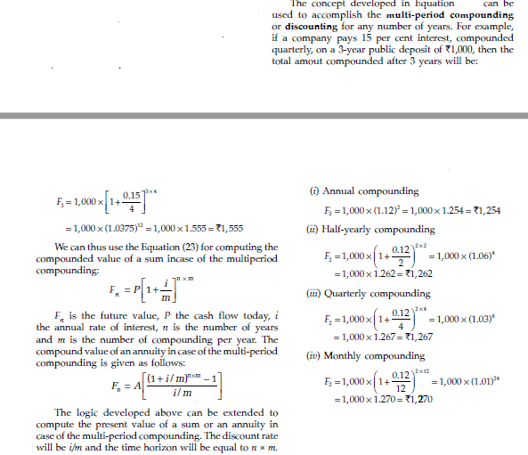

Slide 54
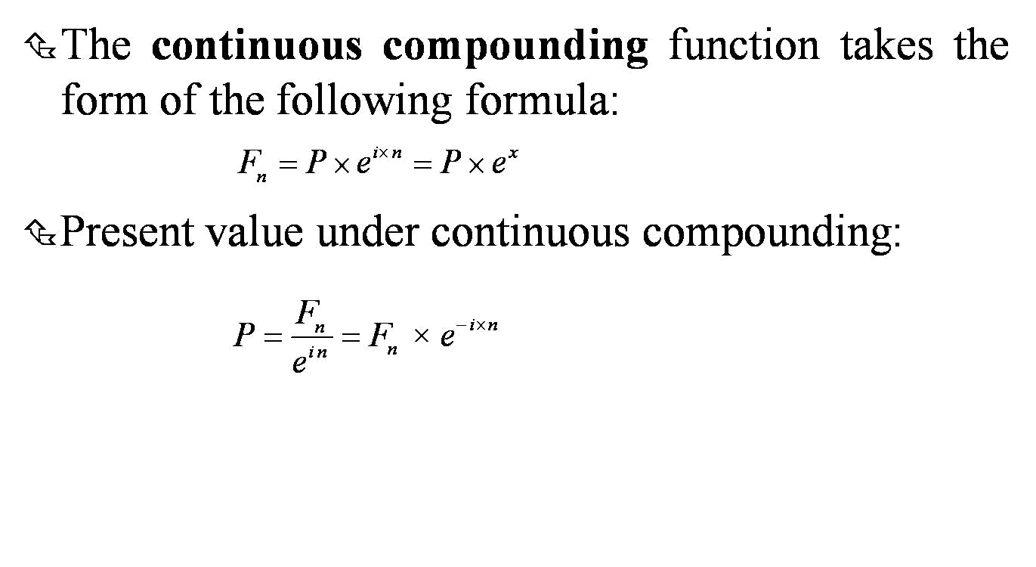
Continuous Compounding

Slide 55
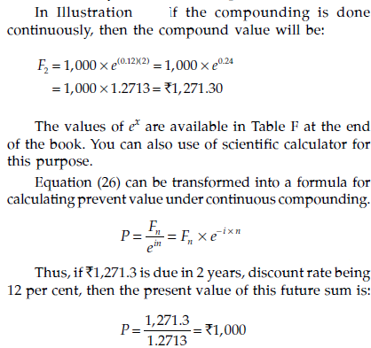

Slide 56
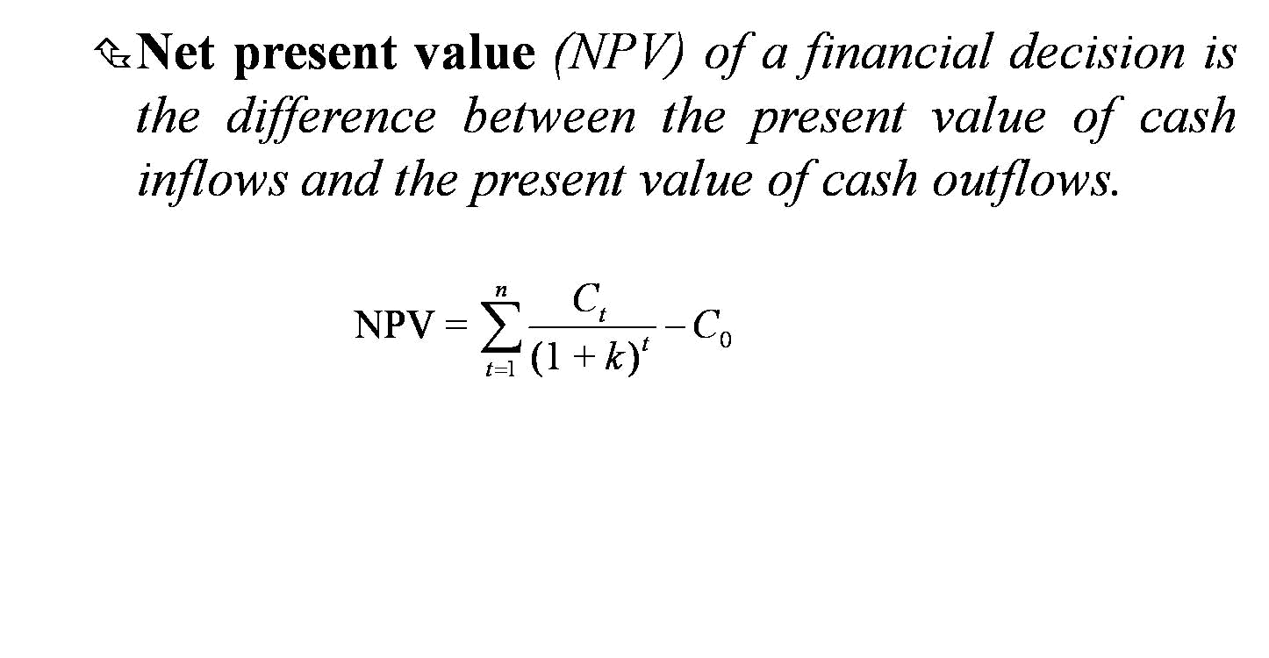
Net Present Value

Slide 57
Present Value and Rate of Return
A bond that pays some specified amount in future (without periodic interest) in exchange for the current price today is called a zero-interest bond or zero-coupon bond.
In such situations, one would be interested to know what rate of interest the advertiser is offering. One can use the concept of present value to find out the rate of return or yield of these offers.
The rate of return of an investment is called internal rate of return since it depends exclusively on the cash flows of the investment.

Slide 58
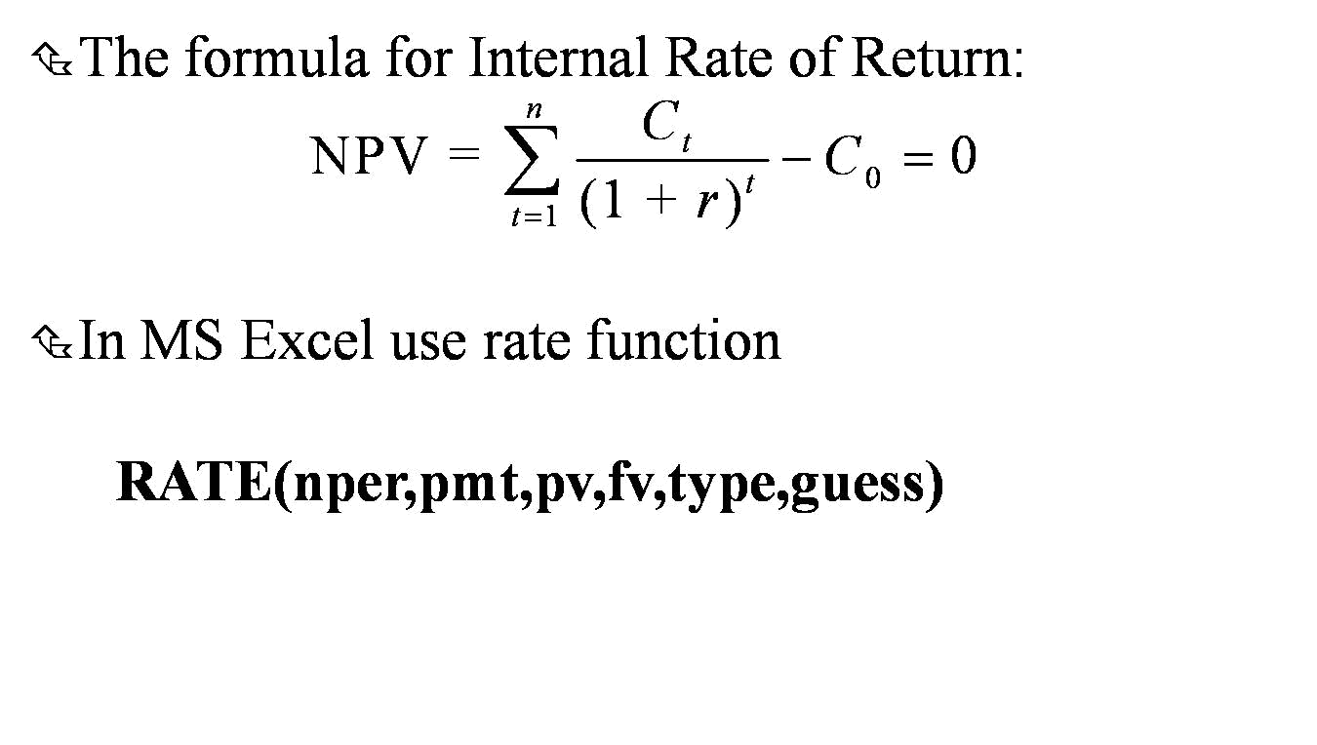
Internal Rate of Return

Slide 59
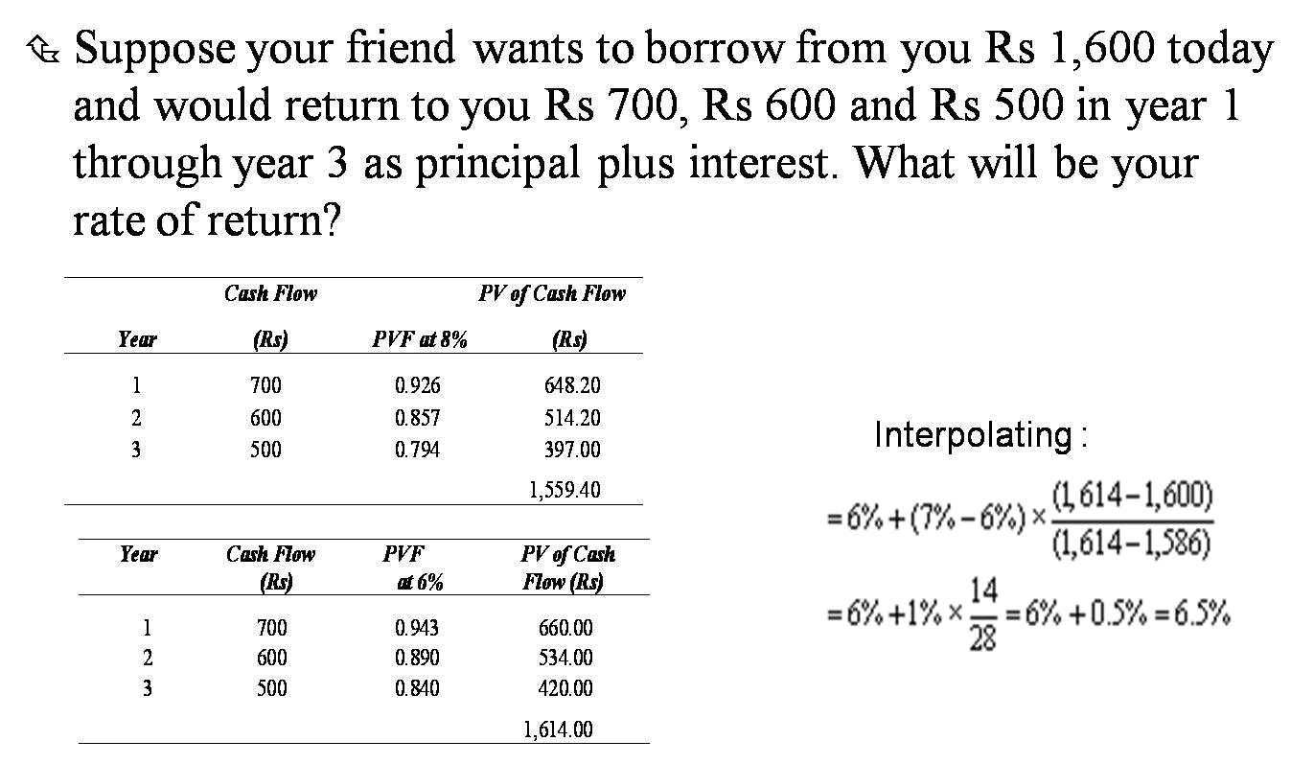
IRR Calculation:
Example of Trial-Error Method

