Slide 1

Microeconomics: Supply and Demand

Slide 2

Review
The United States runs a mixed economy called Capitalism. This is closest to a market economy.
The basic questions of economics are what, how and for whom to produce. In the Market economy these are all answered through individuals, and through supply and demand.
The US practices Free Enterprise by limiting regulations of the economy to protect consumers and workers.

Slide 3



Microeconomics
Microeconomics is the branch of economics that deals with the behavior and decision making by individual businesses and households.
Micro-economists study concepts such as supply and demand, opening and closing of businesses and individual household budgets.

Slide 4
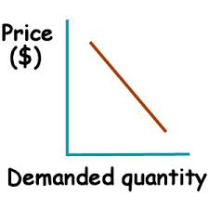
Demand
Demand involves the relationship between price and quantity.
Demand is the amount of a good or service that consumers are willing and able to buy.
There are two conditions, the ability and the desire to buy goods. A person may want a new computer but not have the means to purchase it.

Slide 5
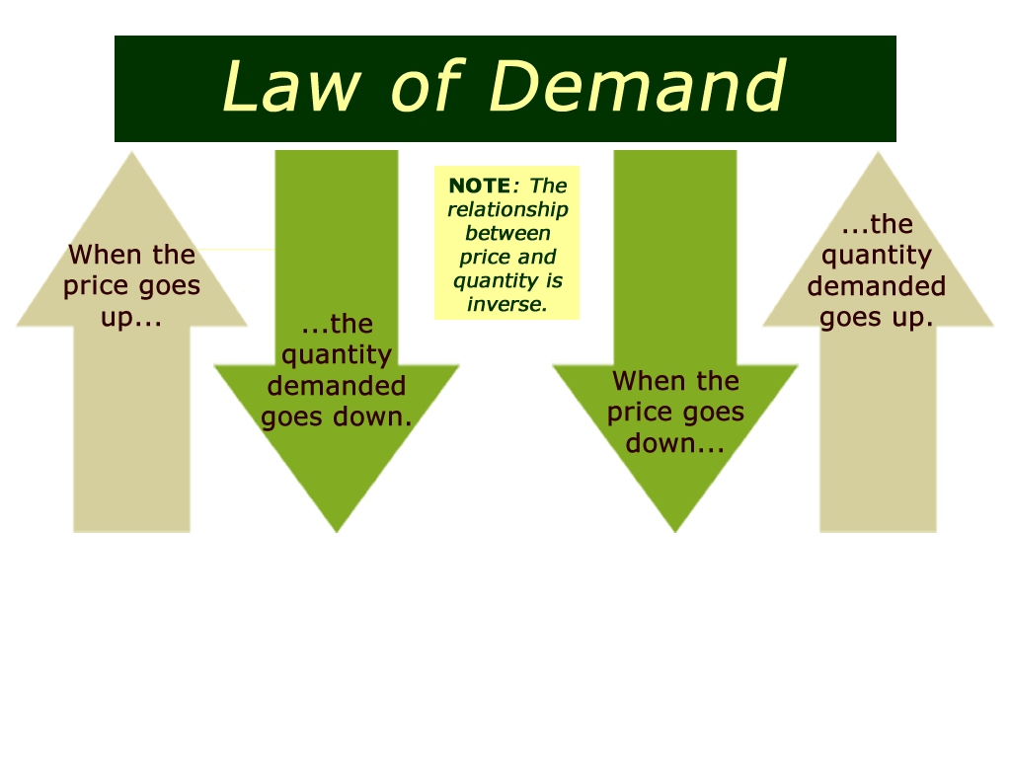
Law of Demand
The Law of Demand is an inverse relationship between price and quantity demanded.
The Law of Demand states that an increase in price causes a decrease in the quantity demanded. Consumers will buy more at lower prices and buy less at higher prices. A decrease in price causes an increase in demand.
Law of Demand
Price Demand
or
Price Demand

Slide 6
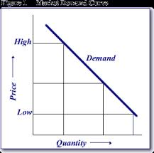
Example: Law of Demand
Susie wants a new computer. She has saved $700 to buy it. When she goes to Best Buy to purchase her computer she finds the price has increased to $1200. She does not have that extra money, so she can not buy the computer. However, she may not even be willing to pay that increased price.
This is an example of the increase in
price lowering demand. It also shows
how Susie is using her resources, in
this case money.
There are three economic concepts that explain the relationship between demand and price:
Income Effect
Substitution Effect
Diminishing Marginal Utility
Think of three real-life examples of the Law of Demand in effect.

Slide 7
Types of goods
A normal good means an increase in income causes an increase in demand. It has a positive income elasticity of demand YED. Note a normal good can be income elastic or income inelastic.
Inferior good
An inferior good means an increase in income causes a fall in demand. It is a good with a negative income elasticity of demand (YED). An example of an inferior good is Tesco value bread. When your income rises you buy less Tesco value bread and more high quality, organic bread.
Luxury good
A luxury good means an increase in income causes a bigger percentage increase in demand. It means that the income elasticity of demand is greater than one. For example, HD TV’s would be a luxury good. When income rises, people spend a higher percentage of their income on the luxury good.

Slide 8

The Income Effect
The amount of money, or income, that people have available to spend on goods and services is called their Purchasing Power
An increase in a consumer’s purchasing power caused by a change in PRICE is called the Income Effect.
The Income Effect says that when the price of a product goes down, people can afford to buy more of it. When the price goes up, people can’t buy as much.
Example:
If a person has $60 to spend on CDs but the price changes from $15 each to $10 each, their purchasing power has increased. Instead of being able to afford 4 CDs, they can now purchase 6 CDs.

Slide 9


Substitution Effect
The substitution effect says that when the price of a good or service rises, people will buy less of that good in favor of a cheaper substitute.
Consumers have the tendency to substitute a similar, lower priced product for another product that is relatively more expensive.
Example: the price of steak increases, so many consumers will switch to chicken, a lower priced substitute.
Generic Products: typically sell for up to 40% less and are roughly identical products

Slide 10

**Important**
The Income Effect and the Substitution Effect are only for goods and services that are wanted. Goods and services that are needed will still be purchased regardless of price.
Example: Although a consumer may substitute chicken for steak when the price goes up, when the price for milk goes up, there are no comparable substitutes. Therefore, an increase in the price of milk will not affect the amount demanded.

Slide 11
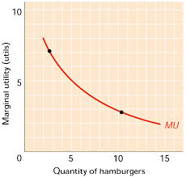
Diminishing Marginal Utility
Utility describes the usefulness of a product, or amount of satisfaction that an individual receives from consuming a product.
A product’s overall utility usually increases as more of the product is consumed. However, as more units of product are consumed, the satisfaction received from consuming each additional unit declines.
Example: Going out to eat tacos for $3 each. The first two tacos are well worth the $3 because you are so hungry. However, as you think about the third taco, you realize you are nearly full, so the $3 taco may not be as worth it to you.

Slide 12
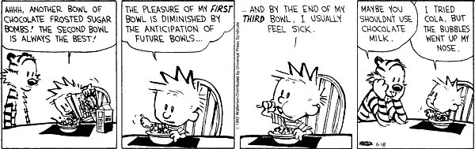
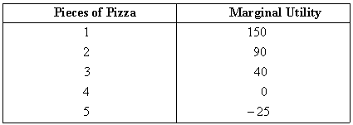
Diminishing Marginal Utility
Same idea. The more pizza consumed, the lower the satisfaction, or utility
The utility of each bowl is to feed him but his satisfaction diminishes the more he consumes.

Slide 13
Demand Schedules
To show the relationship between the price and demand we often refer to demand schedules. A demand schedule lists the quantity of a good consumers are willing and able to buy at a number of prices.
Demand schedules allow businesses to set their price to achieve the largest revenue. Sometimes they will charge more even though they sell less because their revenue is higher.
Price per watch | Quantity demanded
$600 | 0
$500 | 1,500
$400 | 2,750
$300 | 3,750
$200 | 4,500

Slide 14
Demand Schedules
To determine the best price for their watches, this business only needs to multiply the price per watch by the quantity demanded. This is a rough estimate of the revenue, or money, they would bring in.
Example:
$500 a watch x 1,500 sold= $750,000
Price per watch | Quantity demanded | Revenue
$600 | 0 | 0
$500 | 1,500 | $750,000
$400 | 2,750
$300 | 3,750
$200 | 4,500

Slide 15
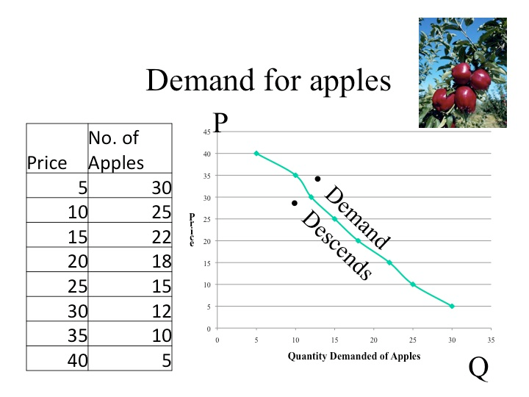
Demand Curve
A demand curve is another way to show the relationship between the price and quantity demanded. The demand curve plots the information from a demand schedule.

Slide 16
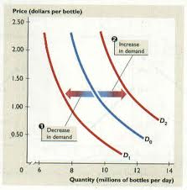
Demand Shifts
Demand can change for a variety of reasons other than price including:
-Consumer tastes and preferences
-Market size
-Income
-Price of related goods
-Consumer expectations
Markets are constantly changing. The factors above are able to shift the ENTIRE demand curve
A right shift means an increase in demand
A left shift means a decrease in demand

Slide 17


Demand Shifts
Consumer Tastes and Preferences
As a new band becomes popular the demand for that band grows.
When the band gets poor reviews the demand decreases
Income
Generally when income increases consumers have more money to spend, or more ability.
This leads to a greater demand for goods

Slide 18

Demand Shifts
Market Size
A larger market means more demand, but a smaller market means less demand.
Markets are the people that will be purchasing. For instance, a pizza shop will deliver to a 5 mile radius. The people in that area are their market. If they increase delivery to 10 miles they are increasing their market size.

Slide 19


Demand Shifts
Price of Related Goods
Two types: substitute goods or complementary goods
Substitute good- similar goods that replace higher priced goods
Complimentary good- goods commonly used with other goods (ex: paint and paintbrushes)
Consumer Expectations
When a consumer expects an increase in pay they tend to spend more, increasing demand.
When expecting a lower income they spend less, decreasing demand.

Slide 20
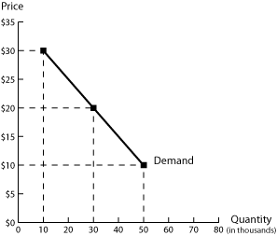
Reading Demand Graphs
To read demand graphs, you need to find the point where price and quantity meet. That point is the demand.
When looking at the graph to the right, you will see the y-axis shows price and the x-axis shows quantity in thousands.
At $20 the demand is 30 thousand. At $10 the demand is 50 thousand.

Slide 21
Change in D vs. Change in Q_{d}
Change in Demand - a change in a factor that effects demand other than the price of the good, thus there is a change in quantity demanded at EVERY price.
Change in Quantity Demanded - a movement along a given demand curve-due only to a change in the price of the good itself
What is the difference between movement along the demand curve and shift in demand curve?

Slide 22
Increase in Demand
P
D’
D
Q_{d}/t
Notes:
52

Slide 23
Increase in Q_{d}
P($)
A
B
D
Q_{d}/t
Notes:
58

Slide 24
Behind the Demand Curve
A demand curve is drawn under the assumption of ceteris paribus - all other important factors remaining unchanged
Factors to be considered may be remembered by D = D(PINTE)

Slide 25
Factors affecting market demand, PINTE
P = Prices
I = income
N = number of buyers
T = tastes or preferences
E = expectations about future prices and market conditions

Slide 26
Price of Other Goods
The price of substitutes- increase
The price of complements- increase
Notes:
35

Slide 27
Price of Substitutes
What would happen to the demand for Peanuts if the price of pretzels fell?
  The demand for Peanuts would probably fall since people would buy pretzels instead.
There is a positive relationship between the demand for a good and the price of its substitutes
Notes:
35

Slide 28
Price of Substitutes
Thus an increase in the price of a substitute will increase the demand for the good
And a decrease in the price of a substitute will decrease the demand for the good

Slide 29
Price of Complements
Complementary goods are goods used together
What if the price of beer goes up? What ought to happen to the demand for Peanuts?
  It ought to go down, since people want beer to drink with Peanuts. If the price of beer rises, the demand for Peanuts will fall.
Notes:
38

Slide 30
Price of Complements
Thus an increase in the price of a complement will decrease the demand for the good
And a decrease in the price of a complement will increase the demand for the good

Slide 31
Price of Other Goods -Summary
Thus, either of the following will increase Demand
  Price of a substitute good increases
  Price of a complement good decreases
And either of the following will decrease Demand
  Price of a substitute good decreases
  Price of a complement good increases
Notes:
41

Slide 32
Income
For most goods there is a positive relationship between income and demand. These are defined as normal goods.
For inferior goods, there is an inverse relationship between income and demand.
Notes:
31

Slide 33
Normal and Inferior Goods
Are Peanuts a normal good? Are they for you? If they are, upon graduation and a higher salary you would buy more peanuts.
The question is empirical - how do people react?

Slide 34
Normal and Inferior Goods
What about Spam? Is the relationship between income and demand positive or negative, c.p.?
Cheaper food products are examples of inferior goods

Slide 35
Number of Buyers
A positive relationship - the greater the number of buyers, the larger the total quantity demanded of the good at a given price. Demand increases, or the demand curve shifts to the right.
Likewise, if there are fewer buyers in the market there is less quantity demanded at every price, so demand has decreased.

Slide 36
Tastes and Preferences
If we find out Peanuts improves our attractiveness to others, our willingness to pay for Peanuts would increase (an upward shift of the demand curve)
If we find out Peanuts are unhealthy the demand for the good decreases (a leftward shift of the curve)
Notes:
30

Slide 37
Expectations
If we were to hear a new story about how Peanut prices were going to go up would you stock up?
If you expect your employer to begin downsizing would you reduce your demand for goods now?
Notes:
44

Slide 38
Demand Reminders
Demand curves downward and to the right.
Changes in only the price of a good cause changes in the quantity demanded.
The only demand factor that cannot cause a change in the demand of a good is a change in its own price.
PINTE factors may alone or jointly change the demand for a good.

Slide 40
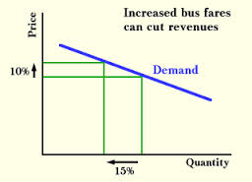

Elastic Demand
Elasticity of demand refers to the degree in which a change in price can affect the quantity demanded. There are two types: Elastic and Inelastic Demand
Elastic- when a small change in a good’s price causes a major, opposite change in the quantity demanded
Inelastic- when a change in a good’s price has little impact on the quantity demanded (usually necessities like milk)
The Big Idea: A small increase in price may actually cut profit. For example, a pizza shop sells 500 pizzas at $10 each. But when they increase the price to $12.50 they only sell 300.
(500x10=$5000 or 300x12.50= $3750)

Slide 41
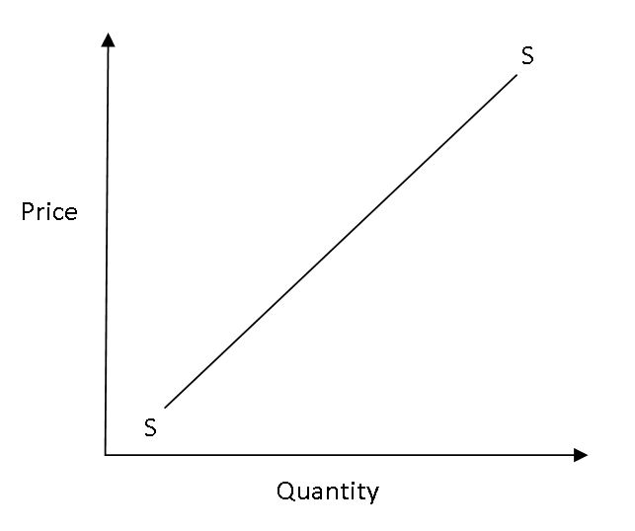
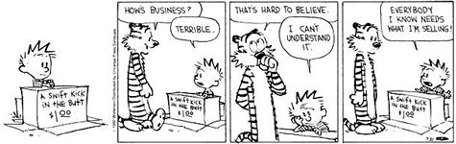
Supply
Supply also involves the relationship between price and quantity.
Supply is the quantity of goods and services that producers are willing to offer at various possible prices.

Slide 42
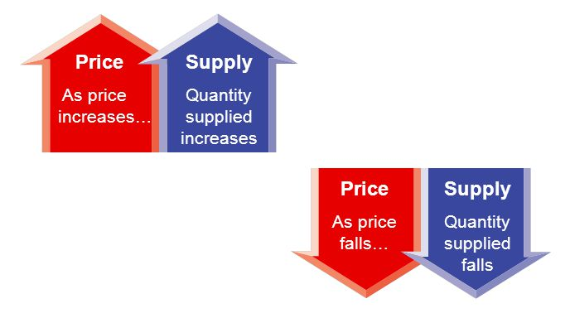
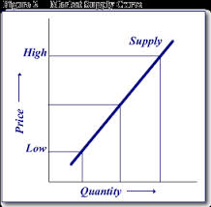
Law of Supply
The Law of Supply is a direct relationship between price and quantity supplied.
The Law of Supply states that producers will offer more of a product at higher prices and less of a product at lower prices. Producers supply more goods and services when they can sell them at higher prices. They will supply fewer goods and services when they must sell them at lower prices.

Slide 43

Profit
The amount of money remaining after producers have paid all of their costs is called profit.
Businesses make money when revenues (incoming money) are greater than the costs of production .
Businesses take risks and make decisions based on
profits. They rely on supply schedules and supply
curves to make decisions on what, how and for
whom to produce.

Slide 44
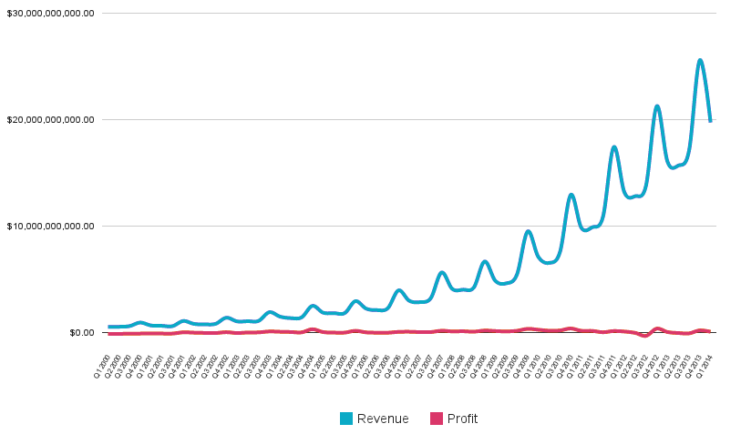
Profit vs Revenue
Revenue-
The money that comes in from selling goods and services
Profit-
All the money made after costs
The goal of capitalist businesses is to maximize profit. Businesses do this in a number ways:
-increasing price of product
-using cheaper supplies
-reducing amount in packaged products

Slide 45
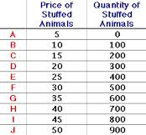
Supply Schedule
A supply schedule shows the relationship between the price of a good and the quantity producers are willing to supply.
The supply schedule lists each quantity of a product that producers are willing to supply at various market prices.
Supply schedules and curves are a snapshot because they represent a specific time period.

Slide 46
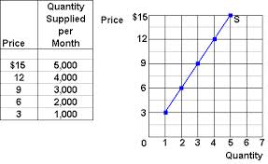
Supply curves
  A supply curve plots the information from a Supply Schedule on a graph. This allows us to easily and quickly make decisions on supply.
Normal supply curves reflect a steady relationship between quantity and price, like the graph on the right.

Slide 47
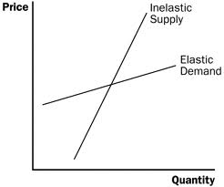
Elasticity of Supply
  Degree to which price changes affect the quantity supplied. There are two sides, elastic and inelastic.
  Elastic- when a small change in price causes a major change in the quantity supplied.
  Inelastic- when a change in price does not affect the quantity supplied.
The Big Idea: A small increase in the cost of production may result in a cut back in quantity supplied.

Slide 48
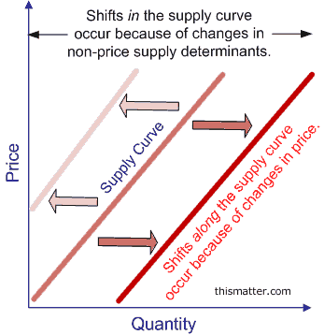
Supply Shifts
Supply can change for a variety of reasons other than price including:
●price of resources
● government tools
● technology
● competition
● prices of related goods
● producer expectations
Markets are constantly changing. The factors above are able to shift the ENTIRE supply curve.
A right shift means an increase in Supply
A left shift means a decrease in Supply

Slide 49


Supply Shifts
Prices of Resources
Any price increase or decrease in resources will effect their costs
Resources include raw materials, electricity and workers’ wages.
Technology
New technology can reduce the costs of production, leading to an increase in supply

Slide 50

Supply Shifts
Government tools
Tools include taxes, subsidies and regulation, which can change how much a company is willing to produce
Taxes: payment to fund government services. Taxes add to cost of production
Subsidies: payments to private businesses to ensure an affordable supply of some essential goods like dairy, wheat, etc.
  Example- Corn-vs-Wheat
Regulations: rules on how a business can operate which are meant to protect the consumer
  Example- Coca-Cola

Slide 51

Supply Shifts
Competition
Competition increases supply because there are more companies producing similar goods
  Example: As new video game consoles come out, the demand for new games increases. As such, more suppliers come to the market, creating plenty of supply.

Slide 52

Supply Shifts
Prices of Related Goods
Suppliers may choose to produce different goods which are selling for a higher profit
Example: farmer growing wheat will want to switch to growing corn if the price of corn goes up
Producer Expectations
If the producers think the demand for or the price of their products will increase they will increase their supply

Slide 53
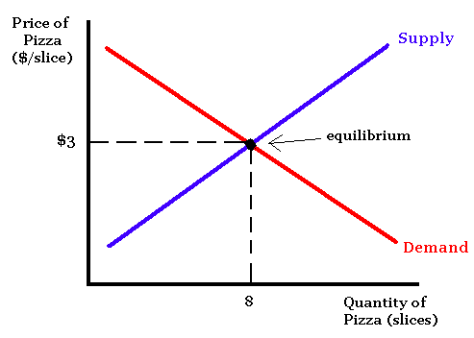
Equilibrium
The goal of supply and demand is to reach equilibrium between the two. By reaching the equilibrium there are exactly enough goods to be sold, at a price the producers are willing to supply at. All items will be sold, and there will be nothing left over, nor anyone still demanding the product.
Watch this video for more information: Market Equilibrium

Slide 54
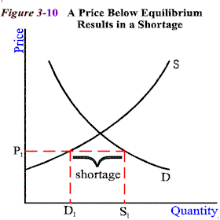
Shortages
Sometimes shortages can occur, or a difference in the amount demanded and the amount supplied (quantity demanded is more than quantity supplied)
Shortages occur in competitive markets when prices are too low or when supply is too low.
When prices are too low, more people buy
the goods, and when supply is too low
there are not enough to be purchased.
This causes suppliers to raise their prices until
they reach a new equilibrium.

Slide 55
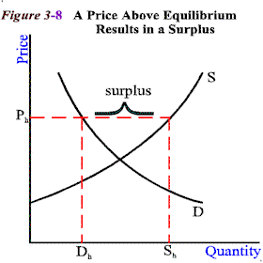
Surplus
Sometimes a surplus can occur, or a difference in the amount demanded and the amount supplied (quantity demanded is less than quantity supply)
Surplus occurs in competitive markets when prices are too high or when supply is too high.
When prices are too high more people
refuse to buy the goods, and when supply
is too high there are too many goods
to be purchased. This causes suppliers to
lower their prices until they reach a new
equilibrium.

Slide 56

Making Production Decisions
Decisions are made based on productivity-how many goods or services can be produced per unit of input.
Producers want to make the greatest total output- amount produced in a given period of time with current resources and input.
Once total output is calculated the producers also determine their marginal output- the change in output by adding one more unit of input.

Slide 57
Marginal Product
Labor Input | Total Product | Marginal Product
0 | 0 | 0
1 | 10 | 10
2 | 50 | 40
3 | 110 | 60
4 | 175 | 65
5 | 245 | 70
6 | 320 | 75
7 | 400 | 80
8 | 485 | 85
9 | 575 | 90
10 | 675 | 100
11 | 875 | 200
12 | 985 | 110
13 | 1000 | 15
14 | 975 | -25
15 | 925 | -50
Marginal Product- change in output by one more unit of input (input may be human resources, raw materials, etc.)
Study the chart to the right which shows the production amounts and marginal product of a the Golden Rubber Duck Factory.
As the labor input goes up, the total and marginal product tend to increase. However, at a certain point you will notice marginal product starts to decrease, eventually becoming negative.
This represents the law of diminishing returns.

Slide 58
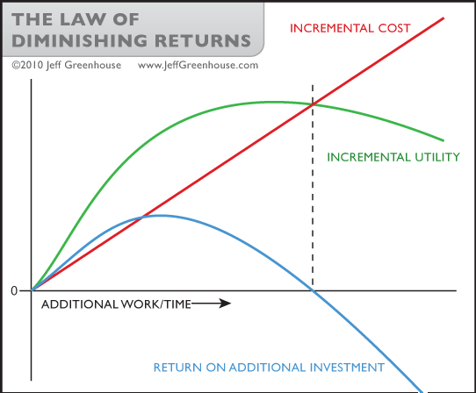
Law of Diminishing Returns
Describes the relationship the level of an input has on total and marginal products. It states that as more of one input is added to a fixed supply of other resources, productivity increases up to a point.
This law works when ONLY one input is changed. If more than one is changed then it is difficult to make a cause and effect relationship
In laymen’s terms: the more work time you put in, eventually you get less out of it.

Slide 59
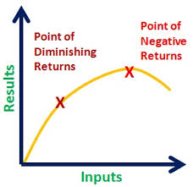
Law of Diminishing Returns
The Law of Diminishing Returns is similar to the Diminishing Marginal Utility. Putting more in does not always equal more output or usefulness.
At some point diminishing returns will eventually hit negative returns. Think back to the Taco Example. As you continue to eat your hunger is no longer being satisfied and at some point you will become sick (negative returns).

Slide 60

Costs of Production
Producers also examine their costs of production to determine the best amount of goods to supply. Costs include any goods and services used to make a product.
There are several categories of production costs:
Fixed
Variable
Total
Marginal costs

Slide 61

Fixed Costs
Some production costs do not change, no matter how many goods are made. These are known as fixed costs.
Examples of fixed costs include rent, interest on loans, property insurance, property taxes and salaries.
Big Idea: Even if the Golden Duck factory makes zero ducks, they still owe rent, taxes and other fixed costs.

Slide 62

Variable Costs
These are costs that change as the level of output changes. These include raw materials and wages.
For example, the Golden Duck factory raises production from 100 ducks to 1000 a day. The cost of production will go up because the factory must pay more workers and buy more raw materials.

Slide 63
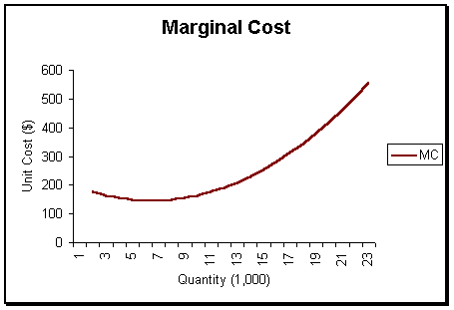
Marginal Costs
Marginal costs are the additional costs of producing one more unit of output.
To determine this they must look at the variable costs ONLY. These are the costs that will change to increase production.
This makes sense because these costs include price of materials, workers’ wages and electricity.

Slide 64

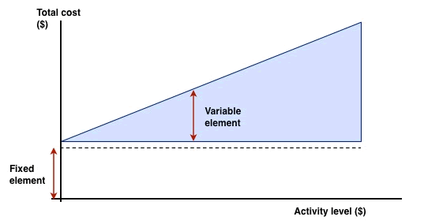
Total Costs
The sum of the fixed and variable production costs are the total costs.
When a factory has no production it has no variable costs, but will still owe the fixed costs of rent, taxes, and others.
Companies graph their total costs by including the fixed costs (element) and then calculating the variable costs. You will notice that as the x-axis activity level increases, the total costs increase.
In this case activity level means the output, or quantity produced.

Slide 65
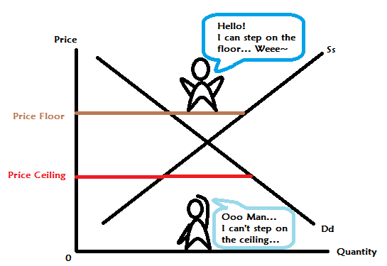
Government Set Prices
Although markets tend to lean toward equilibrium, in some cases the government steps in to control prices.
The government can impose a Price Ceiling or a Price Floor to regulate prices.

Slide 66

Price Ceilings
A price ceiling is a maximum price that can legally be charged for a good. The price is artificially held below the equilibrium price and is not allowed to rise.
  Who benefits from this?
The government places price ceilings on some goods that are considered “essential” and might become too expensive for consumers.
Because these price ceilings are set below equilibrium, they end up causing shortages (more demand than supply)

Slide 67
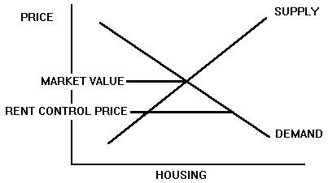
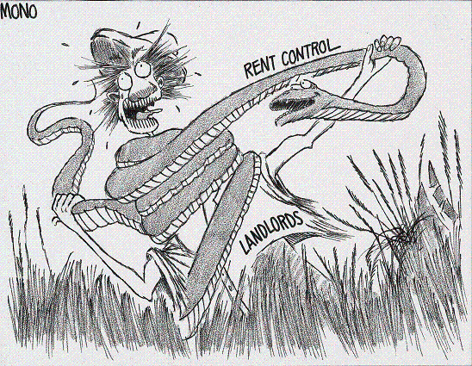
Example: Rent Control
  Some cities like NYC instituted rent controls when housing prices were rising rapidly and current city residents could no longer afford rent
  Rent is only allowed to rise a certain percentage each year, but stays below equilibrium
  Price ceilings provide a gain for buyers and a loss for sellers
  Has resulted in a shortage of apartments because they require owners to accept a price that is lower than
  the equilibrium price. Rather than
  accept the low price, owner often
  convert the apartments to condo-
  miniums and sell them, decreasing
  the supply of available apartments

Slide 68
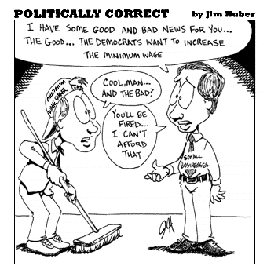
Price Floors
A price floor is a minimum that can legally be charged for a good. The price is artificially held above the equilibrium price and is not allowed to fall
The government sets price floors when it wants sellers to receive a minimum price
  Who benefits from this?
Because these price ceilings are set above equilibrium, they end up causing surpluses (more supply than demand)

Slide 69
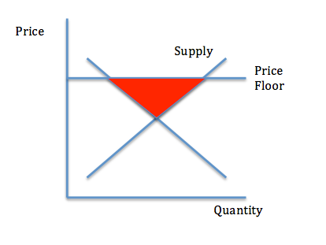
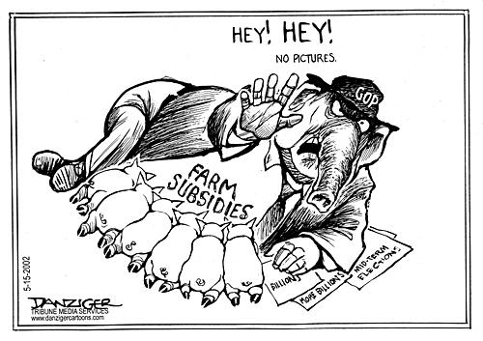
Example: Farm Subsidies
Technological advances have greatly increased the supply of agricultural products, but demand has increased much less.
The government sets a price floor that allows farmers to produce as much as they want to sell at a set price.
Because there’s a shortage, the government will buy excess crops and store them, sell them, or give
them away

