Slide 1
Graphics in Perl
Bill Dillon

Slide 2
Outline
My history with Perl
Work Motivation for Perl graphics
Some difficulties
Graphing data
References and TMTOWTDI

Slide 3
My history with Perl
Consultant developed code-counting script with Perl
    Replaced 14 C-shell and C programs with one Perl script
Started learning Perl ~1999
Most work-related coding related to defect tracking and web forms
    Replaced 21 C-shell and C programs with one Perl script
Also handy for my astronomy hobby

Slide 4
Work Motivation for Perl graphics
Defect tracking
Web Tables
Defect DB
Query
Extracted
Data
Defect
Graphs

Slide 5
Difficulties
Could get basic graphic shapes to work on PC/Active State/Perl 5.6 but …
Could not get line graphs to work but …
Line graphs did work on unix!
Try Perl 5.8?

Slide 6
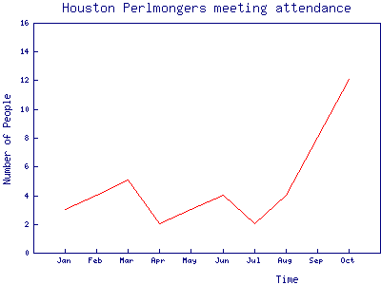
Line graphs
Show wgd_graph_lines.pl

Slide 7
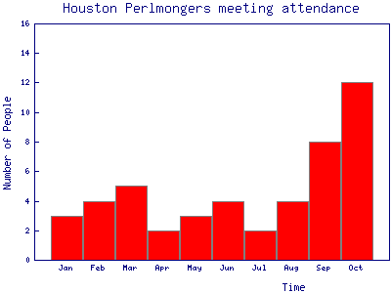
Bar Charts
my $graph = new GD::Graph::bars();

Slide 8
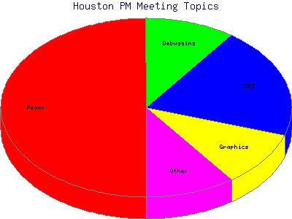
Pie Charts
my $graph = new GD::Graph::pie();

Slide 9
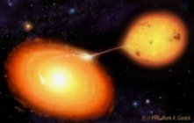
SS Cyg
One of my hobbies:

Slide 10
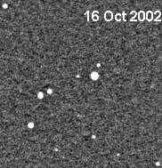
WW Ceti
Cataclysmic variable star in action:

Slide 11
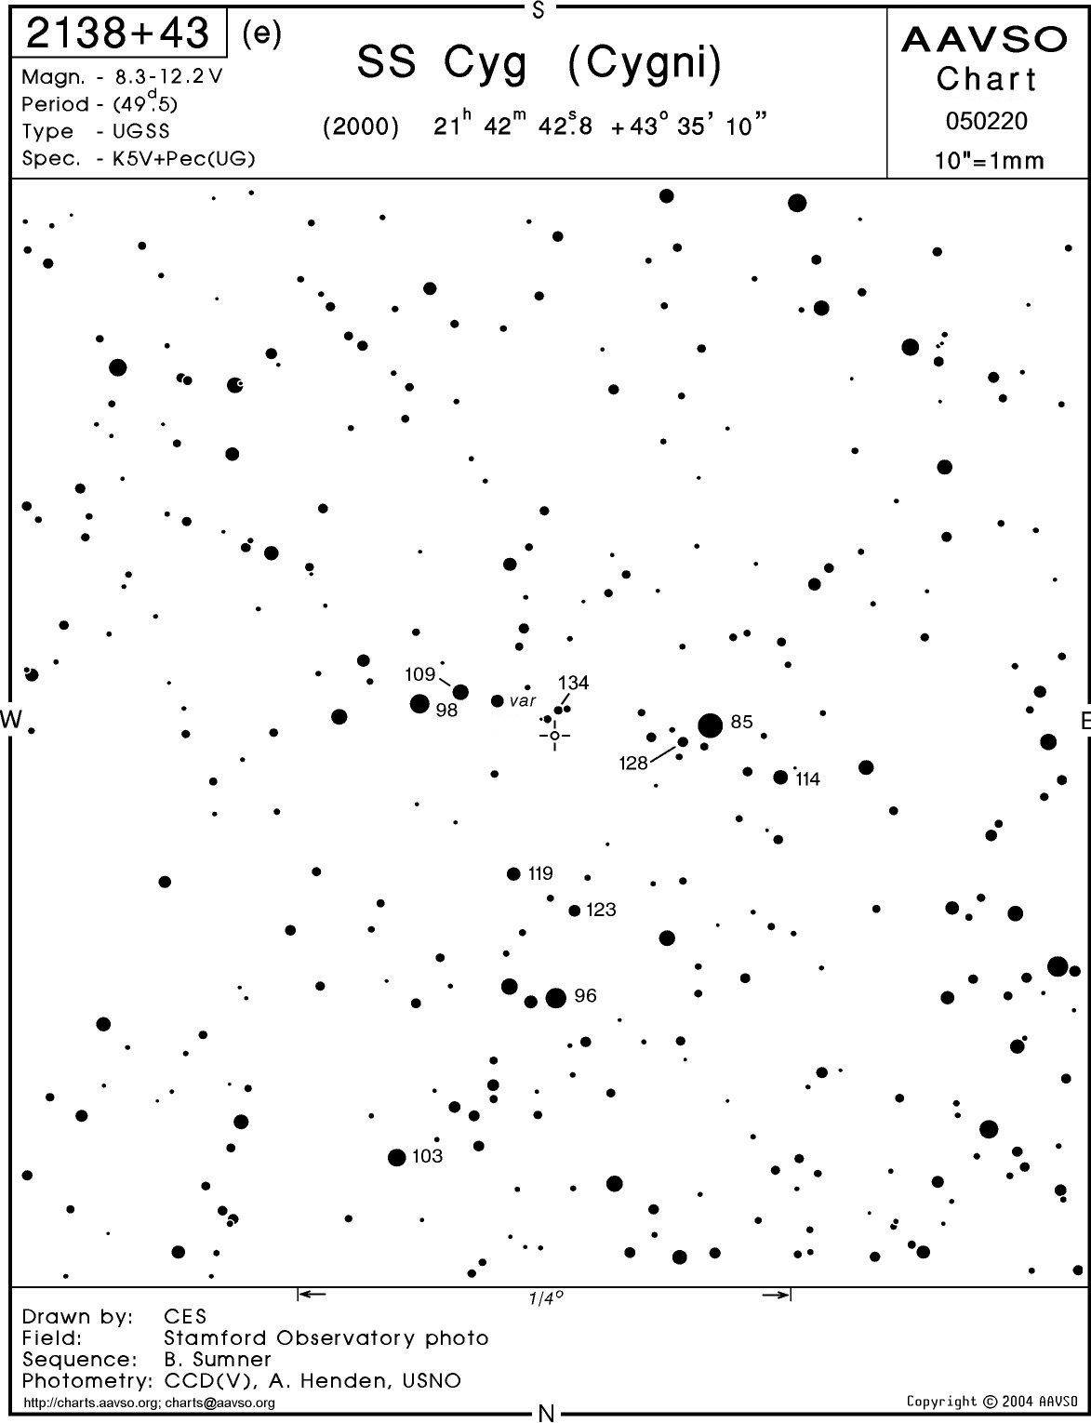
Making brightness estimates

Slide 12
The Problem
Graph the light curve of SS Cyg
  More than a quarter million data points, covering almost a century!
  Excel barfed on the size of this set
    Could only graph about 30,000 points at a time
Perl graphics to the rescue!
  See graph_jd_mag.pl
  View graph

Slide 13
References and TMTOWTDI
Perl Graphics Programming
    Shawn Wallace (O’Reilly)
Graphics Programming with Perl
    Martien Verbruggen (Manning)
Perl modules for:
  PGPLOT
  ImageMagick
  GIMP
  Gnuplot

