Slide 1

Super basic perl

Slide 2
Setting up
Using a unix-like OS? Great, you're all set!
(Most likely…)
You can double check with perl –v
Using Windows? There's a good package that includes everything you will need called Strawberry Perl.
The installer will set up any necessary environment variables and such as well.
You can also execute perl scripts online, for example on this webpage.

Slide 3

Slides, example code and more
Please, go ahead and clone everything in this presentation from
https://github.com/gwaerondor/basic_perl.git

Slide 4
Types
There are three different data types:
Scalars
Lists
Hashes
Variables are prepended with a character depending on which type they belong to: $scalar, @list, %hash
Notes:
This is almost true. In reality, arrays also exist. They are similar to lists in many ways (and are often initialized with lists), but they are also different from lists in some respects. That will be outside of the scope in this presentation.

Slide 5
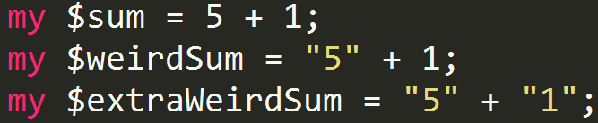
Types: scalars
A scalar is an anything that isn't a list or a hash.
Scalars begin with a $ sign.
Scalars get the type that makes the most sense where it's being used (weak typing).

Slide 6
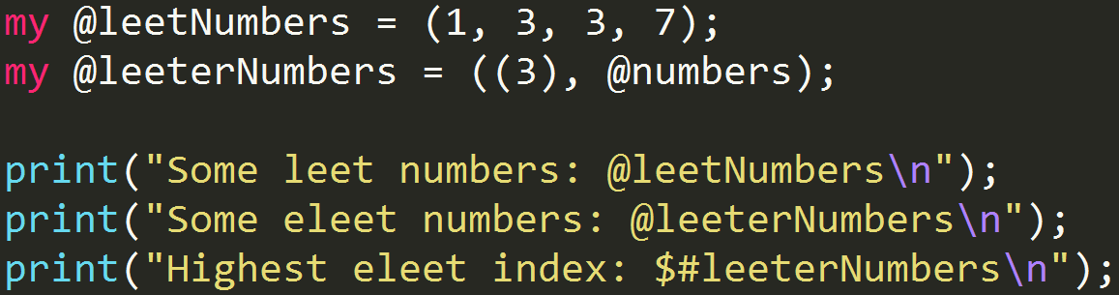
Types: lists
A list is what it sounds like; an ordered series of things.
A list variable starts with the character @. If $# is used before a list variable, we get the highest index of that list (meaning, its length minus one).
A list is surrounded by parentheses.
Deep lists are automatically flattened!

Slide 7
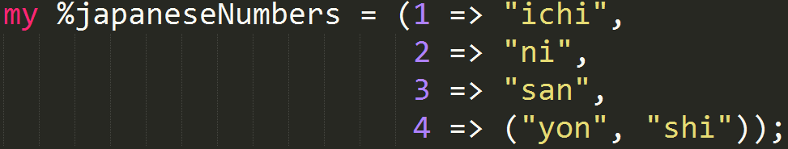
Types: hashes
A hash is an unordered key-value storage, in some languages called maps, hashmaps or dictionaries.
A variable containing a hash begins with the character %
Keys and values are separated by commas or fat commas, =>, and can be intiated with lists.

Slide 8
These are equivalent. Remember that => is just a comma and that lists are flattened automatically! "Shi" will be initiated as a key without a value. This illustrates a common pitfall for those new to Perl.

Slide 9
Just a few more things before we start with the fun stuff…

Slide 10
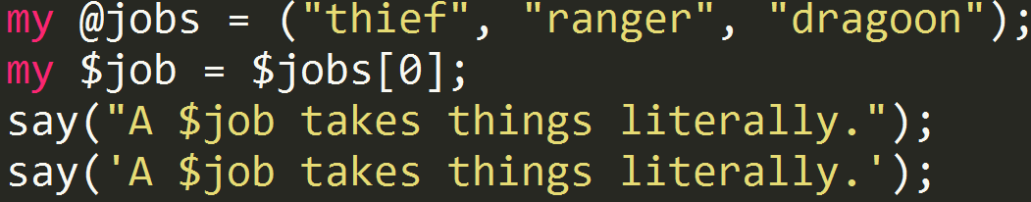
All statements are terminated with semicolons, ;
Strings surrounded with single quotes are taken literally. Double quotes will expand variables.
A value in a list is a scalar, therefore when they are referred to, the scalar character $ is used.

Slide 11
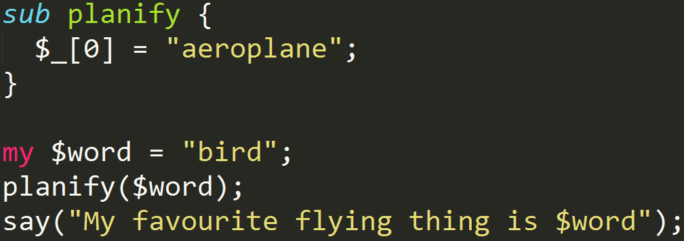
Subroutines are defined with the keyword "sub".
The input parameters for a subroutine are automatically passed in a list called _ (underscore).
Subroutines are surrounded with curly braces.
Data in Perl is, in general, mutable!

Slide 12
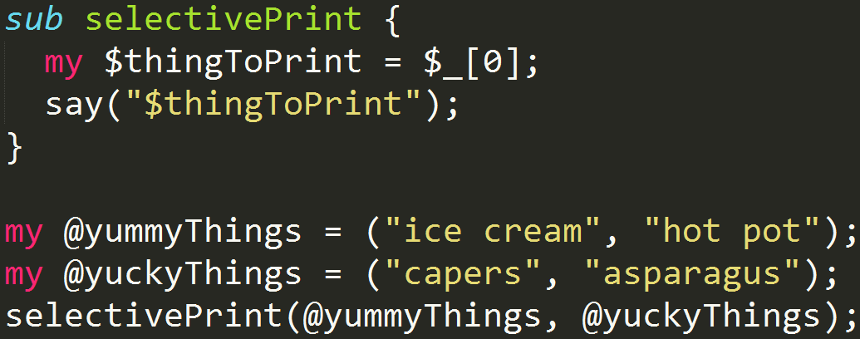
Since inputs to subroutines are lists, this means that _ is flattened.

Slide 13
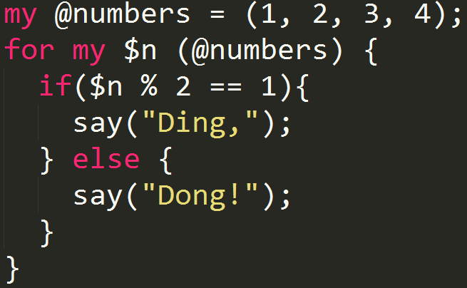
Flow control
Perl has structures such as if, for and while for flow control.
I will not go into detail. Below are the general ideas for ifs and fors.
Notes:
Documentation for regex in Perl can be found at http://perldoc.perl.org/perlre.html

Slide 14
Subroutines terminate when they encounter a "return" statement. Whatever expression is after return, will be returned to the calling routine.
If a return statement is missing, the last evaluated value is returned.
That was the quick version of Perl syntax. Much more is available in the Perl documentation, http://perldoc.perl.org/

Slide 15
Regular expressions
Perl has excellent support for regular expressions!
Check for matches using the match operator =~ and its inverse !~
Many operations with regex-like syntax exist.
Notes:
Documentation for regex in Perl can be found at http://perldoc.perl.org/perlre.html

Slide 16
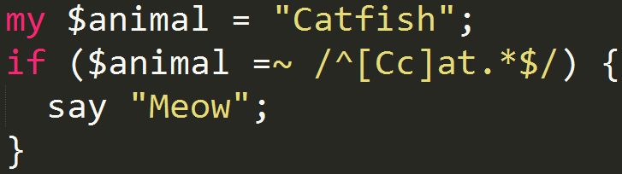
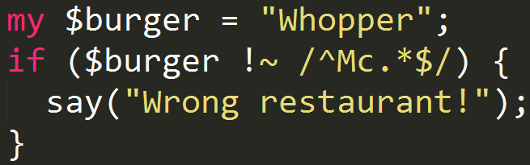
Regular expressions (2)
Notes:
Documentation for regex in Perl can be found at http://perldoc.perl.org/perlre.html

Slide 17
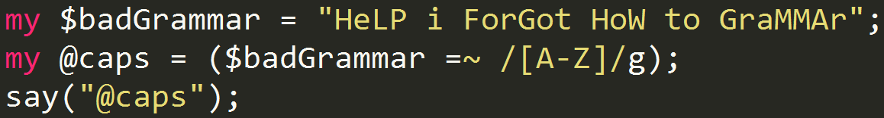
Regular expressions (3)
The match operation will return a list containing all of the matches in a list context (basically, if we try to assign the result to a list).
The g after the regex will make the matching global, meaning it will try to find more than one match.
Notes:
Documentation for regex in Perl can be found at http://perldoc.perl.org/perlre.html

Slide 18
Executing from shell
Of course we don't want to insert all our data into variables in script files.
The list @ARGV contains all input parameters to the script passed from the shell.
Let's use this together with the flag -e which lets us execute a "one-liner" script straight from the shell.
perl -e "if($ARGV[0] !~ /^.*Duck$/){ print \"$ARGV[0] is not a duck!\"; }" "Mickey Mouse" Mickey Mouse is not a duck! perl -e "if($ARGV[0] !~ /^.*Duck$/){ print \"$ARGV[0] is not a duck!\"; }" "Scrooge McDuck"

Slide 19
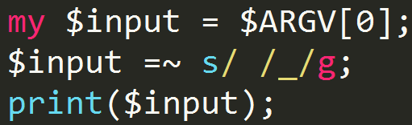
Substitution
Similar to sed, we can substitute a match with something else.
The syntax is similar to sed, and the substitution modifies the variable rather than returning a value (the operation is mutable).

Slide 20
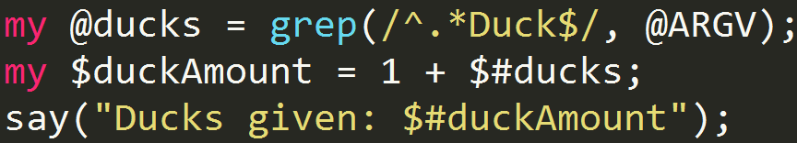
grep
grep is a command that is similar to, but not the same as, grep in unix.
It goes through a list and returns all matches.
perl ducks.pl "Donald Duck" "Mickey Mouse"

Slide 21
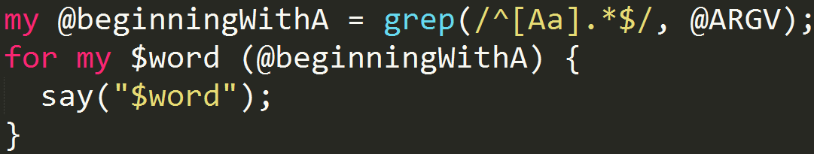
Together with other shell tools
Perl is great at handling streams of text, so if we combine it with other shell tools we can do cool stuff easily and quickly with perl.
perl filter_a_words.pl $(cat dictionary.txt)

Slide 22
Those are some of the basics of Perl
Perl has a massive library for all kinds of stuff, and I have only scratched the surface of the language.
Some exercises will follow for those interested in trying the language out.

Slide 23
Exercise 1
Write a Perl script that echoes input from the user.
Example usage:
perl echo.pl such echo many perl wow such echo many perl wow

Slide 24
Exercise 2
Write a Perl script that counts the number of times the words "FAILED" and "PASSED" appear in an input string. Print the numbers to the shell.
Example usage:
perl wc.pl "test 1: FAILED, test 2: PASSED" FAILED: 1
PASSED: 1

Slide 25
Exercise 3
Write a Perl script that sums every number from a file and prints the result to the shell.
A number is any group of one or more digits.
Use periods and/or commas as decimal separators if followed instantly by another number.
Also sum numbers followed by commas or periods even if there is no number after, for example if a number is at the end of a sentence.
Remember to include negative numbers starting with a minus sign.
You can use other shell commands to read the file and input the contents to the script. You can treat each word as a separate argument, and not wrap the input in quotes.
Suggestion: use an RFC, such as https://www.ietf.org/rfc/rfc3261.txt

