Slide 1
erlang – part 4 More about Testing
eunit meck
Notes:
This is an extension of Erlang Part 3, TDD.
Since a lot of the basics of eunit have already been covered there,
some topics will be skipped as previous knowledge is assumed.

Slide 2

Clone me!
All code examples, snippets, instructions and this presentation itself are available on github:
git clone https://github.com/gwaerondor/unit_testing_in_erlang.git
Notes:
git clone https://github.com/gwaerondor/unit_testing_in_erlang.git
A lot of code not shown in the snippets in this presentation is also available in the code examples.

Slide 3
Part 1: Eunit Part 2: Meck
Notes:
http://erlang.org/doc/apps/eunit/chapter.html

Slide 4
Eunit
Test modules and test functions
Fixtures
Macros
Control
Notes:
http://erlang.org/doc/apps/eunit/chapter.html

Slide 5
Test modules and test functions
eunit recognizes any module with a name ending in _tests as a test module.
eunit recognizes any function with a name ending in _test as a test function.
eunit will run all test functions upon execution. Each test function that does not crash is considered a success.

Slide 6
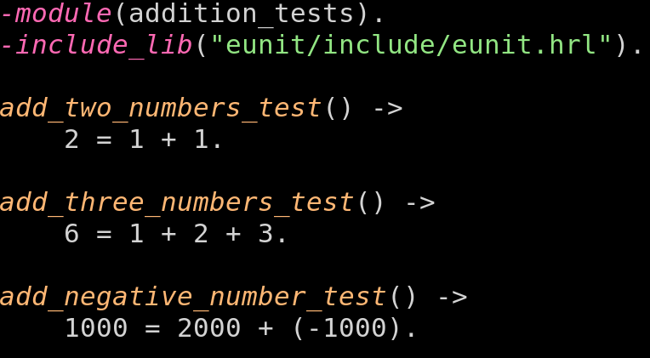
Test modules and test functions
Notes:
${ROOT}/test/addition_tests.erl

Slide 7
Test modules and test functions
esekilvv7837:~/basic_erlang_4> rebar3 eunit
...
Top 3 slowest tests (0.000 seconds, 0.0% of total time):
addition_tests:add_two_numbers_test/0
0.000 seconds
addition_tests:add_negative_number_test/0
0.000 seconds
addition_tests:add_three_numbers_test/0
0.000 seconds
Finished in 0.181 seconds
3 tests, 0 failures

Slide 8
Eunit
Test modules and test functions
Fixtures
Macros
Control
Notes:
http://erlang.org/doc/apps/eunit/chapter.html

Slide 9
Fixtures
A fixture is a state that is necessary for a certain set of tests to run.
A fixture can define a setup and cleanup function to apply either for the entire set, or for each test case in the set.
There are a few different ways of writing a fixture and we will look at the ones that are probably the most commonly used.

Slide 10
Fixtures
eunit recognizes any function with a name ending in _test_ as a test fixture.
A test fixture contains a set of tests to run, represented as lambda functions in a list.
You can also use tuples of a description and a lambda function.

Slide 11
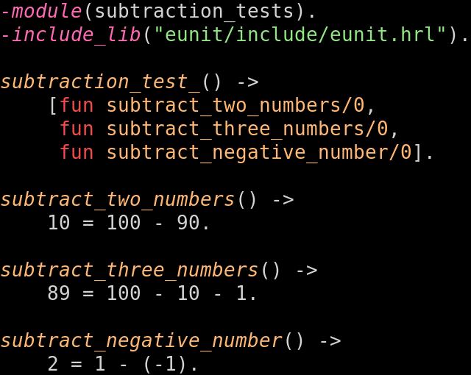
Notes:
${ROOT}/test/subtraction_tests.erl

Slide 12
addition_tests:add_two_numbers_test/0
0.000 seconds
subtraction_tests:subtraction_test_/0
0.000 seconds
addition_tests:add_negative_number_test/0
0.000 seconds
addition_tests:add_three_numbers_test/0
0.000 seconds
subtraction_tests:subtraction_test_/0
0.000 seconds
subtraction_tests:subtraction_test_/0
0.000 seconds
Finished in 0.179 seconds
6 tests, 0 failures

Slide 13
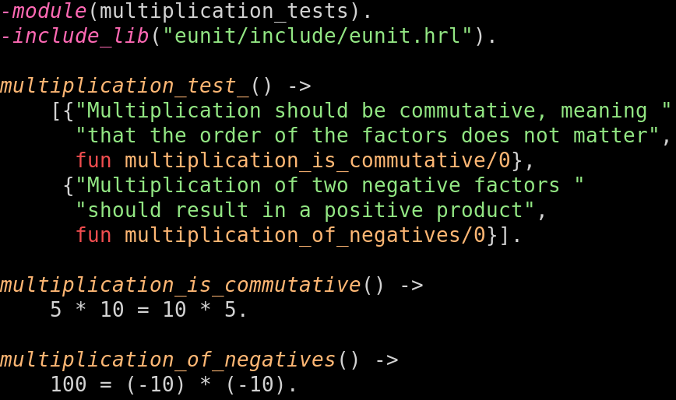
Notes:
${ROOT}/test/multiplication_tests.erl

Slide 14
multiplication_tests:multiplication_test_/0:
Multiplication of two negative factors should
result in a positive product
0.000 seconds
multiplication_tests:multiplication_test_/0:
Multiplication should be commutative, meaning
that the order of the factors does not matter
0.000 seconds

Slide 15
Fixtures
Using the setup or foreach keywords, we can define setup and cleanup actions to be taken for each fixture.
setup executes the setup function once, before the test fixture is run, and then cleans up with the cleanup function.
foreach executes the setup and cleanup functions for each test case in the fixture.

Slide 16
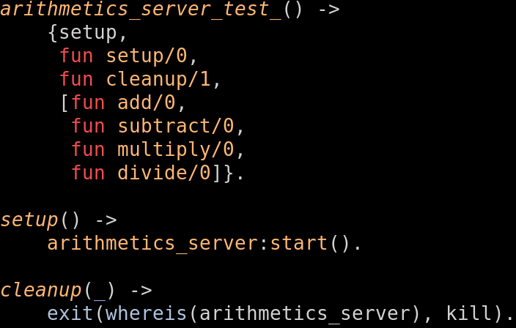
Notes:
${ROOT}/test/arithmetics_server_tests.erl

Slide 17
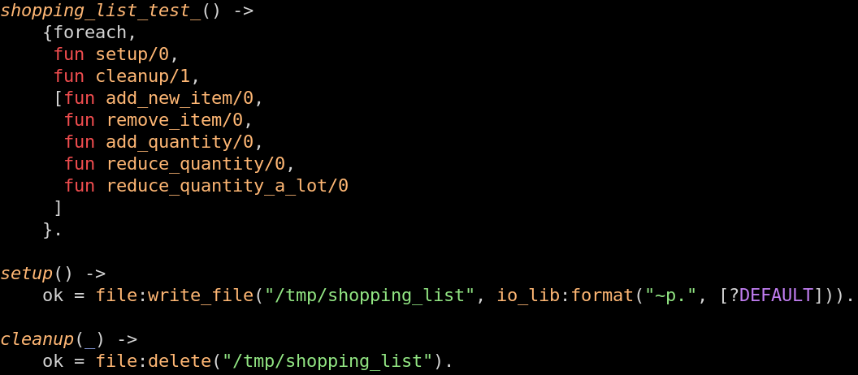
Notes:
${ROOT}/test/shopping_list_tests.erl

Slide 18
Fixtures
There are more advanced ways of executing fixtures such as with an instantiator that generates test cases, or with the foreachx keyword.
For almost every use case, the basic functionality that is explained in the previous slides is recommended – it is readable and easy to write and understand.

Slide 19
Eunit
Test modules and test functions
Fixtures
Macros
Control
Notes:
http://erlang.org/doc/apps/eunit/chapter.html

Slide 20

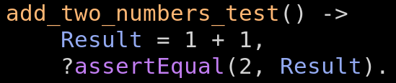
Macros
The eunit library includes a lot of macros to make writing tests easier.
The assert macros are useful. Let's rewrite one of the earlier tests to look more unit testy.
Notes:
${ROOT}/test/addition_alternative_tests.erl

Slide 21
Macros
Other macros include:
?assert(Bool) – Succeeds if Bool is true.
?assertNot(Bool) – Inverse of ?assert
?assertMatch(ExpectedPattern, Result) – Checks if Result will properly pattern match with ExpectedPattern and succeeds if it does.
?assertNotEqual(Expected, Result) – Inverse of ?assertEqual

Slide 22
Test objects
Remember the fixtures from before and how the tests in the list could either be just a fun or a tuple with a description and a fun?
These are only some of many different representation a test can have – these different representations are called test objects.

Slide 23
Test objects
Another example of a test object is {LineNumber, TestObject} where LineNumber is an integer and TestObject is another test object, for example a fun() or a {Description, fun()}.
In other words, a simple nullary fun() – a fun() with 0 arguments – is also a test object.

Slide 24
Macros
All assert macros from before also have versions starting with _ (underscore). For example: ?_assertEqual(5, 3+2).
The difference: underscore macros generate test objects – incidentally, they generate {LineNumber, fun()}
This is a nice shorthand for creating fixtures of multiple short tests.

Slide 25
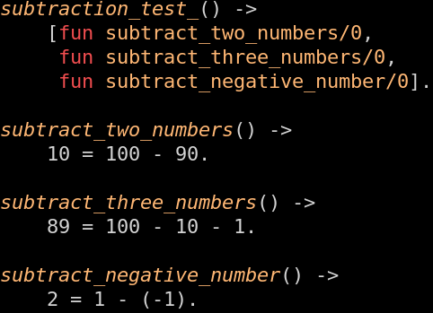
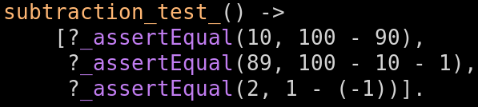
Macros
Again, let's rewrite some of the earlier tests.
Notes:
${ROOT}/test/subtraction_alternative_tests.erl

Slide 26
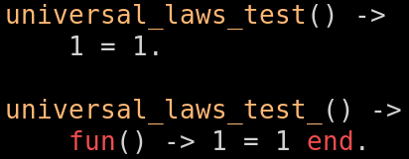
By the way…
eunit will automagically convert all of your some_test() cases to test descriptors, fun() -> some_test() end and run them like that.

Slide 27
Eunit
Test modules and test functions
Fixtures
Macros
Control
Notes:
http://erlang.org/doc/apps/eunit/chapter.html

Slide 28
Control
There are also some control options available.
{spawn, Tests} runs the test in a new subprocess.
{spawn, Node, Tests} additionally runs the tests on the specified node.
{timeout, Seconds, Tests} sets a timeout value for the tests.
{inorder, Tests} runs the tests in the specified order.
{inparallel, Tests} runs the tests in parallel, if possible.
{inparallel, Max, Tests} runs at most Max tests in parallel.

Slide 29
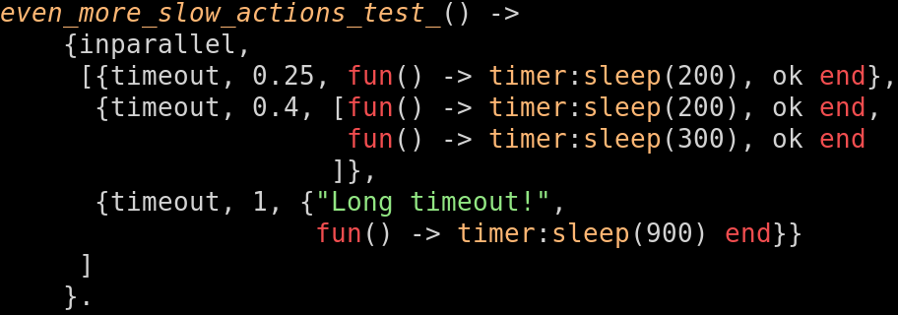
Control
Remember that a test representation contains another test representation, which in turn can contain another test representation.
This test is completely legal:
Notes:
${ROOT}/test/control_tests.erl

Slide 30
meck
A mocking library for Erlang
https://github.com/eproxus/meck
Notes:
https://github.com/eproxus/meck

Slide 31
Oh no! ☹
meck is not part of OTP. No-one knows why.
We must add it to dependencies to be able to use it.

Slide 32
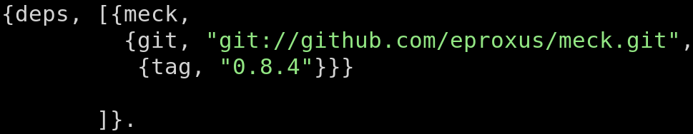
Dependencies
If rebar3 is used, it is easy to add external dependencies.
Your project root has a file called rebar.config. Add meck as a dependency.
(This will also make meck available in the shell if you want to play around with it)
Notes:
${ROOT}/rebar.config

Slide 33
meck:new/1 and meck:new/2
meck:new(Module) will start mocking Module.
The dyadic version also takes a list of options. meck:new(Module, Options) We will look at some of the options in detail.

Slide 34
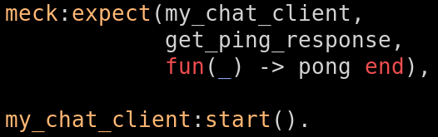
meck:expect/3
meck:expect(Module, Function, Fun) will define the behavior of a function in a mocked module.
Notes:
${ROOT}/test/my_chat_client_tests.erl

Slide 35
Options – passthrough
If a module is mocked, by default, all functionality will be replaced by the mocked instance of the module.
What if we just want to mock some functionality?
The passthrough option keeps all functionality of a module intact, unless it has been explicitly overwritten by meck:expect/3. meck:new(my_chat_client, [passthrough]), meck:expect(my_chat_client, get_ping_response, fun(_) -> pong end).

Slide 36

Options – non_strict
It is possible to mock modules that do not even exist. This is done with the option non_strict.
Notes:
${ROOT}/test/better_lists_tests.erl

Slide 37
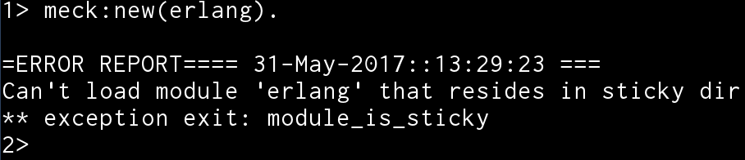
Sticky modules
Some modules are not possible to mock due to the fact that erlang might stop working the way you expect it to, such as the erlang (core) module.
These modules are called "sticky modules". You will know when you find them.

Slide 38
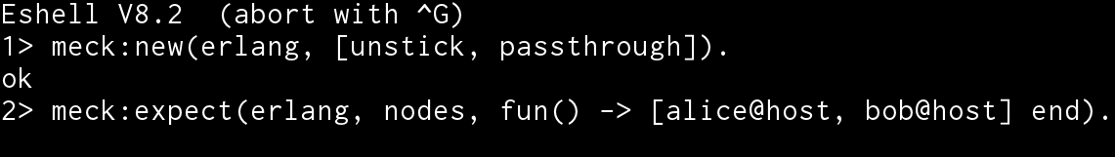
Options – unstick
Except we can mock them anyway! The unstick option must be used in meck:new/2.
Be careful. There is a reason these modules are sticky. You might break something.

Slide 39
Clone me!
All code examples, snippets, instructions and this presentation itself are available on github:
git clone https://github.com/gwaerondor/unit_testing_in_erlang.git
Notes:
git clone https://github.com/gwaerondor/unit_testing_in_erlang.git
A lot of code not shown in the snippets in this presentation is also available in the code examples.

