Slide 1


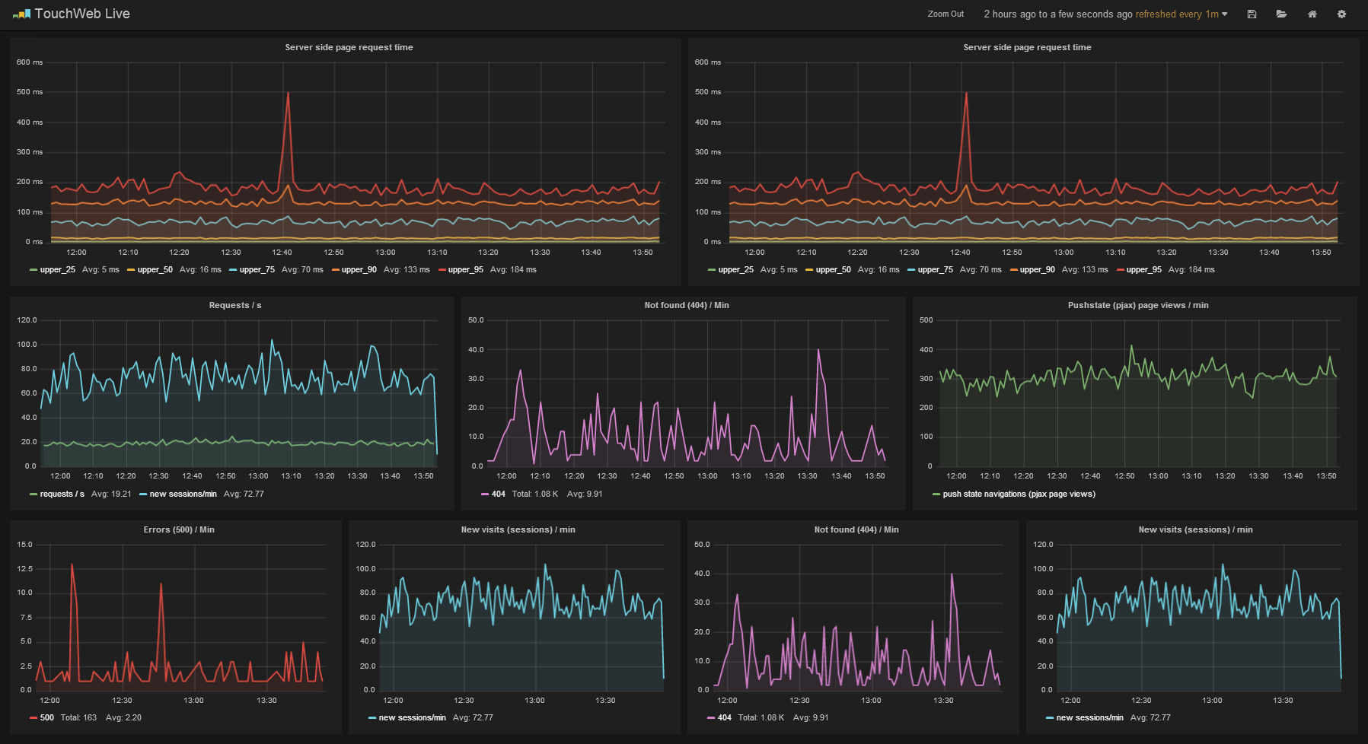

Xentis Monitoring «MONSTAR» - Big Picture of the Solution
Quantities that represent or trace the values taken by a variable over a period such as a month, quarter, or year. Time series data occurs wherever the same measurements are recorded on a regular basis. Read more: http://www.businessdictionary.com/definition/time-series-data.html
Monitor Host (VM) based on Docker (Linux RED Hat 7.3)
Xentis
To be Clarified with
Customer if accepted
XENTIS Prozesse
+ XMON
Own Setup Docker Image 1
(offical RED Hat Image)
Class extension
Monitor API
More Complex
Datatypes
ElasticSearch
(TCP PORT 9200)
Collectd
New Class
Time Series Metrics
(Typical Metric Data)
Own Setup Docker Image 2
(offical RED Hat Image)
OS based Metrics, if
available
Dockermount
- DB Data
Logfie
Graphite
(TCP PORT 2003)
Delivered with XENTIS 5.5
Own Setup Docker Image 3
(offical RED Hat Image)
Grafana
(TCP port 80)
Access Grafana over Browser
Docker
network

Slide 2
Xentis Monitoring - INITIAL INSTALLATION of the HOST
Quantities that represent or trace the values taken by a variable over a period such as a month, quarter, or year. Time series data occurs wherever the same measurements are recorded on a regular basis. Read more: http://www.businessdictionary.com/definition/time-series-data.html
Monitor Host
Own Setup Docker Image 1
(offical RED Hat Image)
ElasticSearch
(TCP PORT 9200)
Own Setup Docker Image 2
(offical RED Hat Image)
Initial Installation of the host will be done with ovf (open virtualization format) importfile delievered by Profidata
Graphite
(TCP PORT 2003)
INITIAL INSTALLATION HOST
OR
The customer setup their own VM or a Real Hardware based on Red Hat and the instruction of Profidata
Own Setup Docker Image 3
(offical RED Hat Image)
Grafana
(TCP port 80)
Docker
network

Slide 3
Xentis Monitoring - release updates
Quantities that represent or trace the values taken by a variable over a period such as a month, quarter, or year. Time series data occurs wherever the same measurements are recorded on a regular basis. Read more: http://www.businessdictionary.com/definition/time-series-data.html
Monitor Host
Own Setup Docker Image 1
(offical RED Hat Image)
ElasticSearch
(TCP PORT 9200)
Own Setup Docker Image 2
(offical RED Hat Image)
Graphite
(TCP PORT 2003)
Profidata delievers the Container Image(s) to replace
Own Setup Docker Image 3
(offical RED Hat Image)
Ver: 1.0
Own Setup Docker Image 3
(offical RED Hat Image)
Ver: 1.1
Replace
Grafana
(TCP port 80)
Grafana
(TCP port 80)
Docker
network

Slide 4
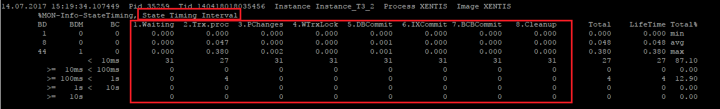
Xentis Monitoring - SCOPE of OBJECTS (TRANSACTION (TRX) RELATED)
1. Grafik: Anzahl der laufenden TRX zum Zeitpunkt t, auf Basis vom Typ {Bus, Cpp,Cp2, LL, NoL, SMA}
2. Grafik: Anzahl der laufenden, zu modifizierenden TRX zum Zeitpunkt t, auf Basis vom Typ {Bus, Cpp,Cp2, LL, NoL, SMA}
3. Grafik: Anzahl der laufenden TRX zum Zeitpunkt t, auf der Basis von State {Waiting, Trx.proc,…,Cleanup}

Slide 5
Xentis Monitoring - SCOPE of OBJECTS (TRANSACTION (TRX) RELATED)
4. Anzahl: Anzahl Abgeschlossene TRX innerhalb des gewählten Zeitintervall auf Basis vom Typ {all, bus, cpp, cp2, ll, noL, sma}
5. Anzahl: Anzahl Abgeschlossene modifizierte TRX innerhalb des gewählten Zeitintervall auf Basis vom Typ {all, bus, cpp, cp2, ll, noL, sma}
6. Anzahl: Anzahl Rollbacks innerhalb des ausgewählten Zeitraum
7. Tabelle: Auslistung von den TRX im ausgewählten Zeitraum, sortiert nach Laufzeit absteigend

Slide 6
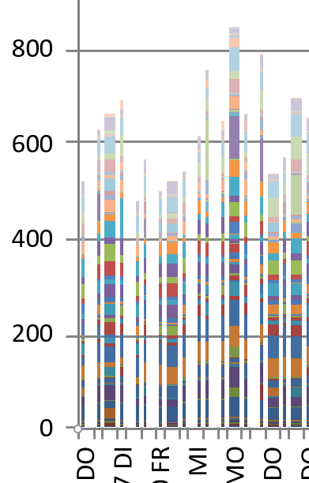
Xentis Monitoring - SCOPE of OBJECTS (Jobs & AWZ)
1. Anzahl: Anzahl laufender Jobs aller Art zum aktuellen Zeitpunkt → Neue Metric, nicht in XMON
2. Anzahl: Anzahl wartende Jobs aller Art zum aktuellen Zeitpunkt → Neue Metric, nicht in XMON
3. Grafik: Anzahl Jobs vom Typ AWZ (Abwicklungszyklen) für den gewählten Zeitraum → Neue Metric, nicht in XMON
auf der Basis vom Typ {Wartend, Laufend}
4. Grafik: Anzahl Jobs, nicht vom Typ AWZ für den gewählten Zeitraum → Neue Metric, nicht in XMON
auf der Basis vom Typ {Wartend, Laufend}
5. Tabelle: Jobs im ausgewählten Zeitraum, absteigend sortiert → Neue Metric, nicht in XMON
6. Säulengrafik: Hochrechnung der durchschnittlichen Laufzeit der verschiedenen AWZ Jobs → Neue Metric, nicht in XMON
zusammengefasst pro Tag
7. Säulengrafik: Anstehende AWZ Jobs vom ausgewählten Zeitraum aufgelistet pro Tag → Neue Metric, nicht in XMON

Slide 7
Xentis Monitoring - POTENTIAL RISK
Quantities that represent or trace the values taken by a variable over a period such as a month, quarter, or year. Time series data occurs wherever the same measurements are recorded on a regular basis. Read more: http://www.businessdictionary.com/definition/time-series-data.html
Monitor Host
Xentis
XENTIS Prozesse
Own Setup Docker Image 1
(offical RED Hat Image)
Xentis
Class extention
More Complex
Datatypes
ElasticSearch
(TCP PORT 9200)
Monitor API
Xentis
New Class
Own Setup Docker Image 2
(offical RED Hat Image)
Time Series Data
(Typical Metric Data)
Graphite
(TCP PORT 2003)
Potential Risk 1
Slow down Xentis if the ElasticSearch or Graphite Interface is not available or slow
AND
We will loose information if the interface(s) are not available
Own Setup Docker Image 3
(offical RED Hat Image)
Potential Risk 2
Grafana
(TCP port 80)
Changed Xentis code can have negative influence on the sensitive stabaliltity of xentis

Slide 8
Xentis Monitoring - aim
Xentis
Monitor Host
Version 1:
Setup and delivered Infrastructure
Required SW addjustetments in Xentis to fullfill the
requirement agreed with UI
XENTIS Prozesse
ElasticSearch
Xentis
extension
Graphite
XENTIS XNON
expanded
Monitor API
Grafana
Version 2:
Expand Scope in order to depricate Xentis XMON
Final Report Statistics
Current DB locks
Xentis
Monitor Host
XENTIS Prozesse
ElasticSearch
Version 3:
Expand functoinality further in order to be able to finally put off XMON in Xentis
Xentis
extension
Graphite
XENTIS XMON
expanded
Monitor API
Grafana

Slide 9
Xentis Monitoring - NEXT STEPS
Next Steps:
Present this (without Risk Slide) to UI and get his agreement on the Idea of docker/Redhat/Host based on VM
Define Responsibilties
Licence Responsability (REL 7.3)
Who is managing docker host

