Slide 1
Social Networking Website
Team:
Annocki
Fast
Gwalthney
Norris
Shanline

Slide 2
Summary
System Requirements
ER Diagram
SQL Queries
Implementation in SQLite 3
Q & A

Slide 3

Background
This product will enable users to create public profiles within the website. This service will be available for free and will allow users to upload photos, find friends, create social groups and events.

Slide 4
Use case Diagram
Database Requirements

Slide 5
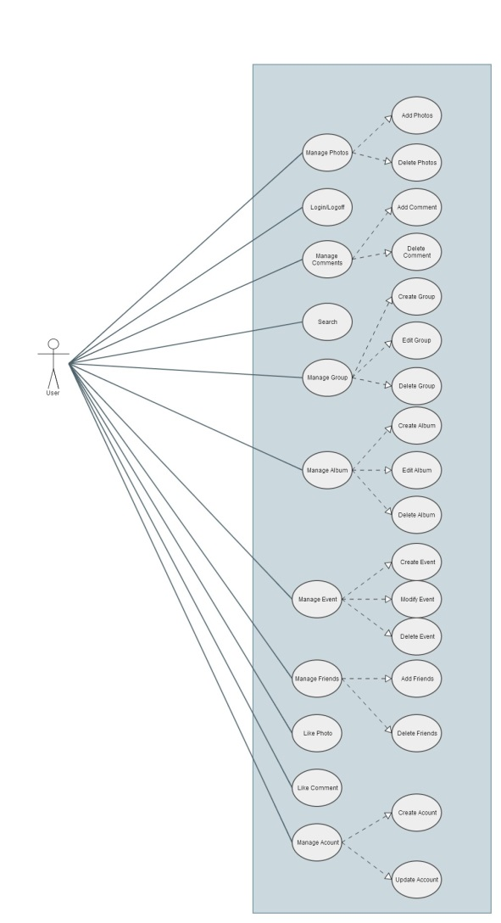

Slide 6
ER Diagram
Database Architecture

Slide 7
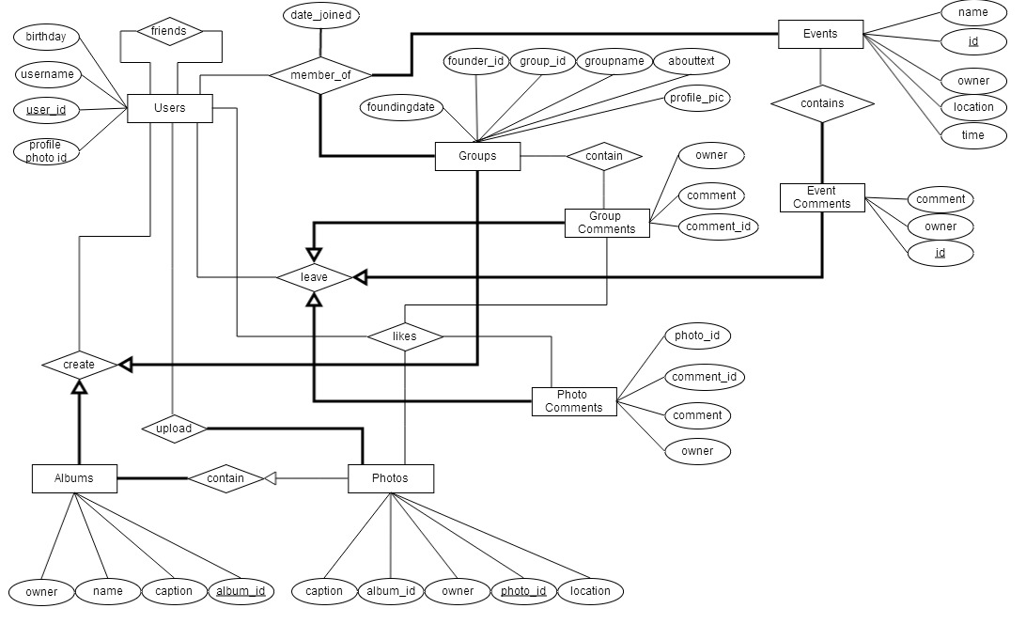

Slide 8
Relationship View Diagram
Database Architecture

Slide 9
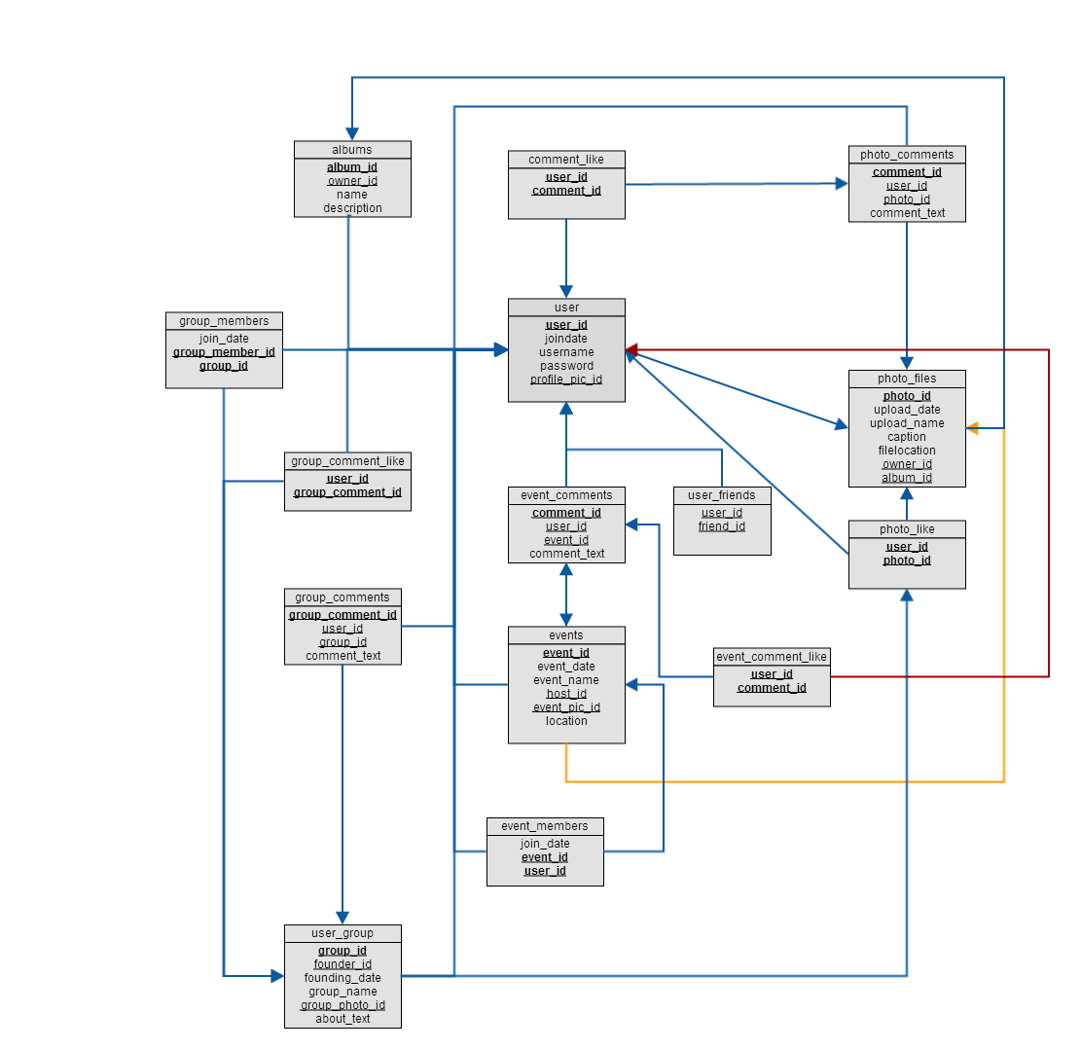

Slide 10
Normalization Analysis
In our initial schema we had the following tables:
GroupCommentLike[user_id, group_Comment_id, group_id]
UserGroups[group_id, founder_id, founding_date, groupname, group_pic_id, about_text]
GroupComments[comment_id, user_id, group_id, comment_text]
EventCommentLike[user_id, comment_id, event_id]
Events[event_id, eventdate, eventname, host_id, event_pic_id]
EventComments[comment_id, user_id, event_id, comment_text]
In table 1, group_comment_id is dependent on group_id, since the group ID can be derived from the group comment ID. The same thing is valid for table 4 with the event ID.
As a solution, we completely removed the group ID because it carried redundant data that was already included in the group comment ID.
1N
2N

Slide 11
Normalization Analysis (cont.)
In our schema implementation there are no tables that are not in 3NF.
3N

Slide 12
Schema
Database Design

Slide 13
User[user_id, joindate, username, password, profile_pic_id]
UserFriends[ userID, friend_user_id]
PhotoFiles[photo_id, uploaddate, uploadname, caption, filelocation, owner_id, album_id]
PhotoComments[ comment_id, userID, photo_id, comment_text]
PhotoLike[user_id, photo_id]
CommentLike[user_id, comment_id]
UserGroups[group_id, founder_id, founding_date, groupname, group_pic_id, about_text]

Slide 14
GroupComments[comment_id, user_id, group_id, comment_text]
GroupMembers[joindate, group_id, user_id]
GroupCommentLike[user_id, group_Comment_id]
Events[event_id, eventdate, eventname, host_id, event_pic_id]
EventComments[comment_id, user_id, event_id, comment_text]
EventMembers[joindate, event_id, user_id]
EventCommentLike[user_id, comment_id]
PhotoAlbums [album_id, owner_id, albumname, description]

Slide 15
Query 1
Add photos
Delete photos
Delete comments
Show all photos

Slide 16
Query 2
Add friends
Delete friends
Show all friends

Slide 17
Query 3
Create group
Edit group
Show all group comments
Delete groups comments

Slide 18
Query 4
Create photo album
Add photos to album
Edit album
Delete album

Slide 19
Query 5
Create event
Edit event
Show all event comments
Delete event comments

