Slide 1
Social Networking Website
Team:
Annocki
Fast
Gwalthney
Norris
Shanline

Slide 2
Summary
System Requirements
ER Diagram
SQL Queries
Implementation in SQLite 3
Q & A

Slide 3

Background
This product will enable users to create public profiles within the website. This service will be available for free and will allow users to upload photos, find friends, create social groups and events.

Slide 4
Use case Diagram
Database Requirements

Slide 5
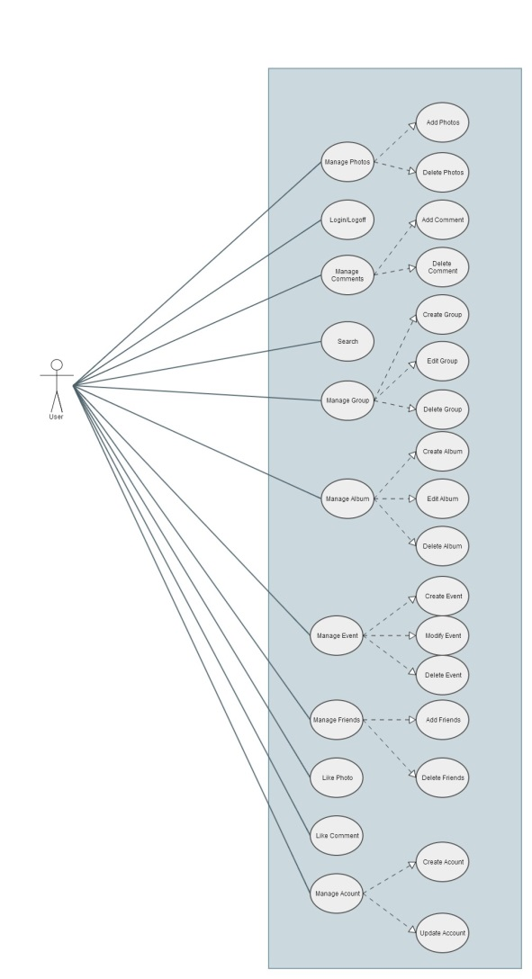

Slide 6
ER Diagram
Database Architecture

Slide 7
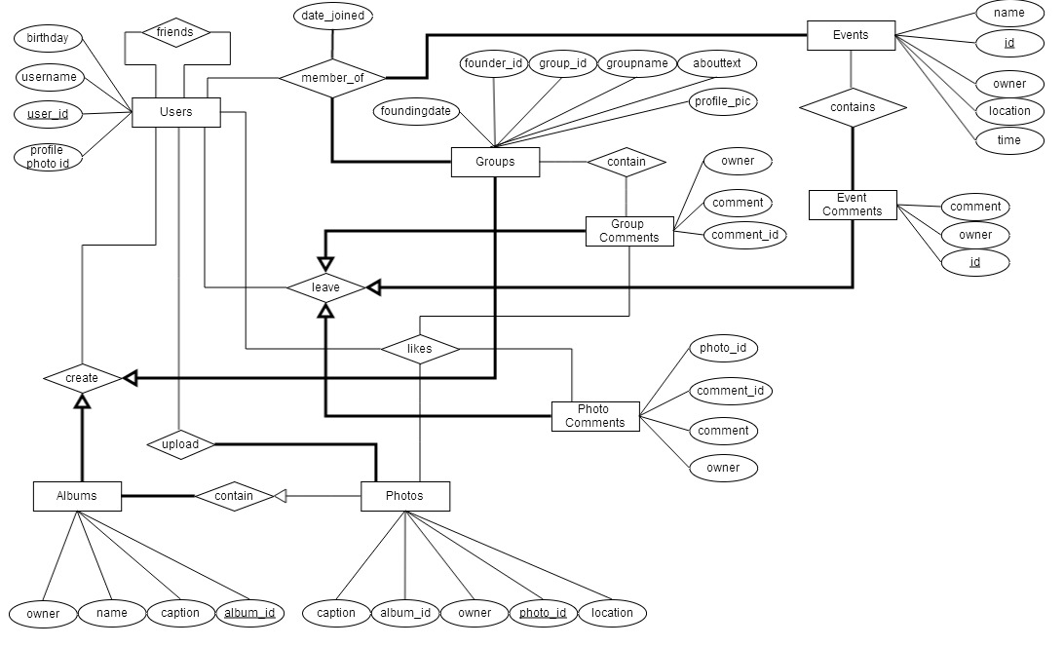

Slide 8
Relationship View Diagram
Database Architecture

Slide 9
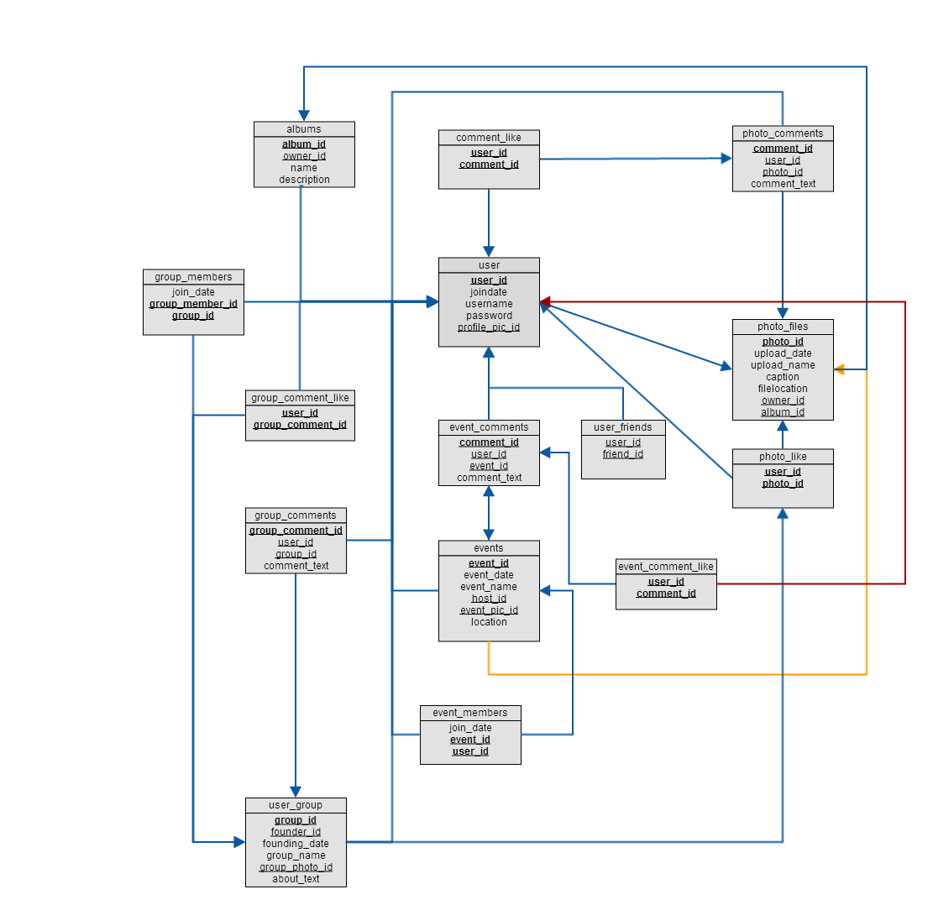

Slide 10
Normalization Analysis
To make the ‘User’ relation satisfy 1NF, we change it in the following way:
PhotoFiles[photo_id, uploaddate, uploadname, caption, filelocation, owner_id, albumname, description] →
PhotoFiles[photo_id, uploaddate, uploadname, caption, filelocation, owner_id, album_id]
PhotoAlbums [album_id, owner_id, albumname, description]
In our initial schema we had the following tables:
GroupCommentLike[user_id, group_Comment_id, group_id]
UserGroups[group_id, founder_id, founding_date, groupname, group_pic_id, about_text]
GroupComments[comment_id, user_id, group_id, comment_text]
EventCommentLike[user_id, comment_id, event_id]
Events[event_id, eventdate, eventname, host_id, event_pic_id]
EventComments[comment_id, user_id, event_id, comment_text]
In table 1, group_comment_id is dependent on group_id, since the group ID can be derived from the group comment ID. The same thing is valid for table 4 with the event ID.
As a solution, we completely removed the group ID because it carried redundant data that was already included in the group comment ID.
1N
2N

Slide 11
Normalization Analysis (cont.)
In our schema implementation there are no tables that are not in 3NF.
3N

Slide 12
Schema
Database Design

Slide 13
User[user_id, joindate, username, password, profile_pic_id]
UserFriends[ userID, friend_user_id]
PhotoFiles[photo_id, uploaddate, uploadname, caption, filelocation, owner_id, album_id]
PhotoComments[ comment_id, userID, photo_id, comment_text]
PhotoLike[user_id, photo_id]
CommentLike[user_id, comment_id]
UserGroups[group_id, founder_id, founding_date, groupname, group_pic_id, about_text]

Slide 14
GroupComments[comment_id, user_id, group_id, comment_text]
GroupMembers[joindate, group_id, user_id]
GroupCommentLike[user_id, group_Comment_id]
Events[event_id, eventdate, eventname, host_id, event_pic_id]
EventComments[comment_id, user_id, event_id, comment_text]
EventMembers[joindate, event_id, user_id]
EventCommentLike[user_id, comment_id]
PhotoAlbums [album_id, owner_id, albumname, description]

Slide 15
Query 1
Show all photo by user “Sean Fast”
SQL> SELECT photo_users.username, photo_files.uploadname
FROM photo_users
INNER JOIN photo_files
ON photo_users.user_id = photo_files.owner_id
WHERE photo_users.username = "Sean Fast";

Slide 16
Query 2
Show all photo by user “Sean Fast” in album “cats”
SQL> SELECT photo_users.username, photo_files.uploadname, photo_albums.name_of_album
FROM photo_users
INNER JOIN photo_files
INNER JOIN photo_albums
ON photo_users.user_id = photo_albums.owner_id
AND photo_files.album_id = photo_albums.album_id
WHERE photo_users.username = "Sean Fast" AND photo_albums.name_of_album = "Cats";

Slide 17
Query 3
List all comments user Dave left on photo somepic
SQL> SELECT photo_users.username, photo_files.uploadname, photo_comments.comment_text
FROM photo_users
INNER JOIN photo_files
INNER JOIN photo_comments
ON photo_comments.photo_id = photo_files.photo_id AND photo_comments.user_id = photo_users.user_id
WHERE photo_users.username = "Dave Shanline" AND photo_files.uploadname = "somepic";

Slide 18
Query 4
List all users in group YOLO that are attending event Final Project Presentation.
SQL> SELECT photo_users.username, user_group.groupname, events.eventname
FROM photo_users
INNER JOIN user_group
INNER JOIN events
INNER JOIN group_members
INNER JOIN event_members
ON photo_users.user_id = group_members.user_id AND photo_users.user_id = event_members.user_id
WHERE user_group.groupname = "YOLO" AND events.eventname = "Final Project Presentation";

Slide 19
Query 5
List all users that are in group YOLO that are also friends.
SQL> SELECT photo_users.username, user_group.groupname, temp_photo_users.username
FROM photo_users, photo_users temp_photo_users
INNER JOIN user_group
INNER JOIN group_members, group_members temp_group_members
INNER JOIN users_friend
ON photo_users.user_id = group_members.user_id
AND photo_users.user_id = users_friend.user_id
AND users_friend.friend_user_id = temp_group_members.user_id
AND users_friend.friend_user_id = temp_photo_users.user_id
WHERE user_group.groupname = "YOLO";

Slide 20
Query 6
List all users that are friends of Sean Fast.
SQL> SELECT photo_users.username, temp_photo_users.username
FROM photo_users, photo_users temp_photo_users
INNER JOIN users_friend
ON photo_users.user_id = users_friend.user_id AND users_friend.friend_user_id = temp_photo_users.user_id
WHERE photo_users.username = "Sean Fast";

Slide 21
Query 7
List all items that user Bill Annocki has liked.
SQL> SELECT photo_users.username , photo_like.photo_id, comment_like.comment_id, group_comment_like.group_comment_id, event_comment_like.comment_id
FROM photo_users
INNER JOIN photo_like
INNER JOIN comment_like
INNER JOIN group_comment_like
INNER JOIN event_comment_like
ON photo_users.user_id = photo_like.user_id
AND photo_users.user_id = comment_like.user_id
AND photo_users.user_id = group_comment_like.user_id
AND photo_users.user_id = event_comment_like.user_id
WHERE photo_users.username = "Bill Annocki";

