Slide 1


DevOps and Managing Ops
Largely Inspired by Adam Jacob’s and Theo Schlossnagle’s Velocity Talks

Slide 2

Who’s Waldo
Geek
Problem Solver
Systems Engineer
@gwaldo
github.com/gwaldo

Slide 3
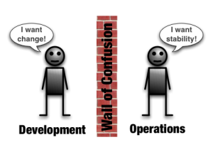
The Old Way

Slide 4

The Old Way’s Result
Resentment

Slide 5
DevOps
Improving Operations
Breaking down Barriers
Adding Sanity

Slide 6
What DevOps Is
Cultural and Professional Movement
Cooperation
SysAds participating in and using Agile

Slide 7
What DevOps Isn’t
Magic Wand
Not a Job Title

Slide 8
Not just ‘more dev in your Ops’
It’s also getting more Ops in your Dev

Slide 9
Operational Mentality
Not Developing with an Operational Mentality
Antithesis of “...but it works on my machine.”
Operations doesn’t care
    your machine is not Prod

Slide 10
Operational Mentality
Introspective
Fault-Tolerant
Fail Gracefully...
...but Loudly!

Slide 11
How can you say that?!
Because you’ve never had to care.

Slide 12
Ops Responsibilities
Availability
Efficiency

Slide 13
Ops Should:
Set Standards
Enable Everyone
Troubleshoot
Put Out Fires
Ensure Documentation Matches Reality

Slide 14
Give Devs
Rights & Access
Educate & Empower
Let them deploy
Help each other automate
Teach them how apps run in Prod
Introduce them to your CM

Slide 15
Benefits to Devs
More Autonomy
Fewer blocks from Ops
Doing your own Deployments == Instant Gratification
Realistic Environment Assumptions

Slide 16
Benefits to Ops
Delegation
Solving Better Problems
End to Code Thrown Over the Wall
Stability is a Feature

Slide 17
Deployments
Why has Ops EVER done code deployments?
Why wouldn’t Devs deploy their own code?

Slide 18
Pager
Ops should not be Tier-1 On-Call
Dev are Tier-1 On-Call
Ops gets escalated to

Slide 19
Devs on Pager: What Madness is This?
Incentivizes that apps are Production-ready
Devs know how their apps work.
Typically there are many more Devs than Ops

Slide 20
Method to the Madness
Basic Troubleshooting
    Check Logs
    Identified Failed Component
    Do your best to Remediate
When you’re stuck?

Slide 21
When you’re stuck?
Escalate to Ops

Slide 22
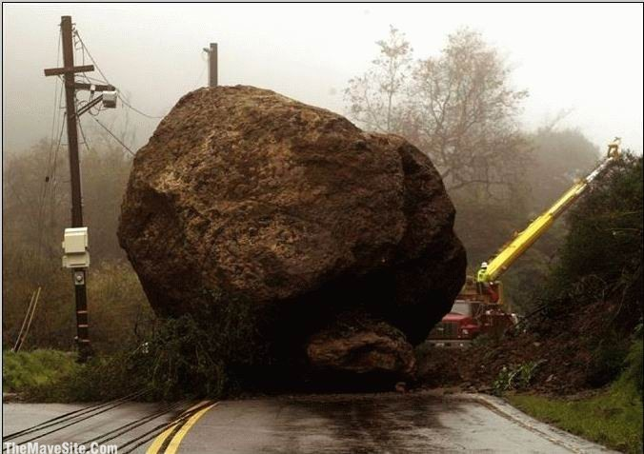
On “No”
As Operations, try to avoid saying “No”.
Our job is not to be a RoadBlock

Slide 23
Try “Yes, but”
“... your team is responsible for maintaining it.”
“... I’m understaffed, and you have an unfulfilled req...”
...

Slide 24
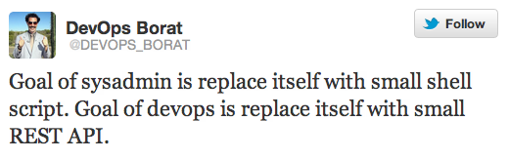
Engage Early
Engage Often
Not Limited to DevOps; but it’s a Side-Effect
Just good Project Management

