Slide 1


Configuration Management
Largely Inspired by Adam Jacob’s Velocity Talks

Slide 2

Who’s Waldo
Geek
Problem Solver
Systems Engineer
@gwaldo
github.com/gwaldo

Slide 3
Configuration Management and
DevOps

Slide 4
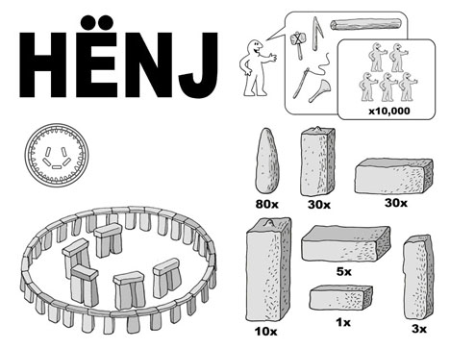
What is CM
Establishing and Maintaining Consistency of a System
Path to Scaling, Redundancy, and fewer Pages

Slide 5



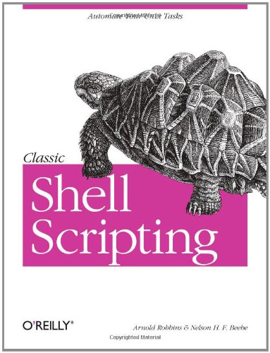

CM Examples
Group Policy
Chef
Puppet
CFEngine
Config Scripts
Salt

Slide 6
CM Examples (cont’d)
Turn your head and squint:
  Jumpstart / Kickstart / PXE / Templates
  Vagrant & VM Templates
  Sysprep w/ Imaging Tools

Slide 7
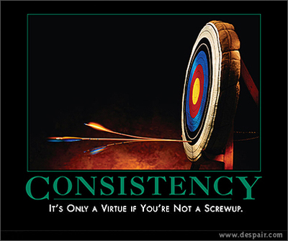
Why Use CM?
You like consistency

Slide 8
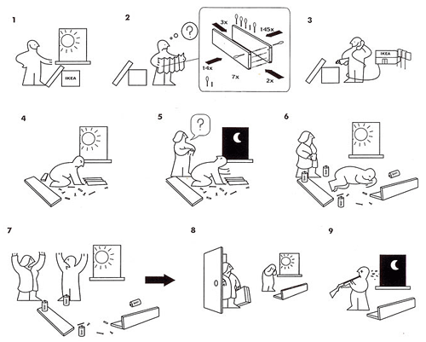
Why Use CM?
You have better things to do than configure each box

Slide 9

Why Use CM?
You want better problems to solve
  a.k.a “A better job

Slide 10

Why Use CM?
You’re Professionally Lazy

Slide 11
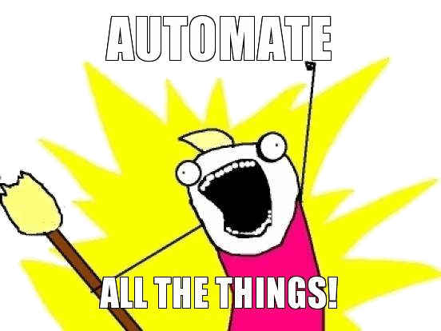
Why Use CM?
Automate

Slide 12
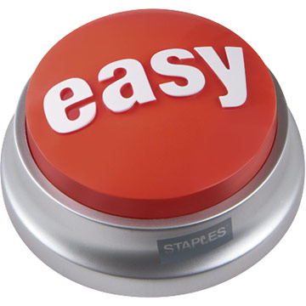
Why Use CM?
You want to lower the bar to add machines
You might one day get to auto-scaling

Slide 13
Why Use CM?
If you’re using virtualization, you need practice CM
  You’re always going to spin up more boxes than you expect

Slide 14
CM -->
Automation -->
Better Life

Slide 15
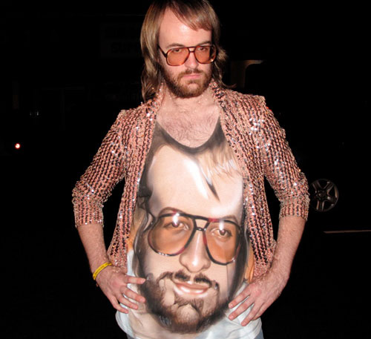
Why Wouldn’t You?
  Believe in artisinal organic retro fair-trade server crafting

Slide 16


Why Wouldn’t You?
  You like doing the same thing every day

Slide 17

Why Wouldn’t You?
You’re (plain) Lazy

Slide 18
CM -->
Automation -->
Better Life

Slide 19
What to Automate?
Get a machine up and on a network
  BootStrap
  PXE
  Kickstart
  Template
  Whatever

Slide 20

What to Automate?
Make Machine Findable by Name
  DNS
  AD / LDAP

Slide 21

What to Automate?
Identity Management
  AD / LDAP Authentication
  SSH Keys
  Establish Root

Slide 22
What to Automate?
Server Inventory
  Answer “What do we have?”

Slide 23

What to Automate?
Use Inventory to configure Monitoring
  Nagios
  Zenoss
  Zabbix
  Whatever
If monitoring isn’t automatic, it won’t get done.

Slide 24
What to Automate?
Manage Servers Over Time
  Config Management Tools
    Chef, Puppet, CFEngine, Salt
    Scripts
    Whatever

Slide 25
What to Automate?
Configs in Version Control

Slide 26
What to Automate?
Make new releases easy to deliver.
  CF Tools
  Capistrano
  Murder
  For x in `*`
  Heroku

Slide 27
Holy Crap That’s a LOT
overwhelmed
  Automate in stages, according to need
    Reduce Friction
    De-Suckify

Slide 28
Your Best Skill
overwhelmed
    You know your systems and your problems

