Slide 1

MongoDB
An Introduction

Slide 2
Who’s Waldo
Geek
Problem solver
Systems Engineer
@gwaldo
github.com/gwaldo

Slide 3
Caveats
No affiliation with 10gen.
Language

Slide 4
What is MongoDB?
“MongoDB (from "humongous") is a scalable, high-performance, open source NoSQL database. “

Slide 5
Features! Quick!
JSON Document-oriented
    (actually BSON)

Slide 6
Features! Quick!
Indexing

Slide 7
Features! Quick!
Querying
db.geeks.find({name:”waldo”}, {sexy: 1})

Slide 8
Features! Quick!
Replication

Slide 9
Features! Quick!
Sharding

Slide 10
More Features
Journaling

Slide 11
More Features
Write Concern

Slide 12
More Features
‘Stored Procedures’
function addNumbers( x , y ) {
  return x + y;
}
db.system.js.save({_id:"addNumbers", value:function(x, y){ return x + y; }});

Slide 13
More Features
‘Stored Procedures’
> db.eval('addNumbers(17, 25)');
42

Slide 14
More Features
...

Slide 15
More Features
Seriously, ...

Slide 16
MongoDB is a ______
Database
Document
Open-Source
High-Performance
Horizontally-Scalable
Full-Featured

Slide 17
MongoDB is a Document Database
Not .pdf or .doc files
JSON objects
Associative Arrays (PHP array, Python Dict, Ruby & Perl Hash, etc)

Slide 18
MongoDB is an Open-Source Database
https://github.com/mongodb
AGPL license
Originated and Sponsored by 10gen
Commercial licenses available
Contributions welcome

Slide 19
MongoDB is a High-Performance Database
C++
Extensive use of MMapped-files
Runs in ALL THE PLACES
Data serialized as BSON

Slide 20
MongoDB is a Horizontally-Scalable Database
Replication
Sharding
Both Dead-Simple

Slide 21
MongoDB is a Full-Featured Database
Rich Querying
Real-time Aggregation
Traditionally Consistent
Geospatial

Slide 22
“NoSQL?”
Non-Relational
Flexible (if any) Schema
not-ACID-ic
Does not use SQL
    uses a JSON Query style

Slide 23
Platforms
64- and 32-bit
    Don’t use 32-bit
*nix, Mac, & Windows
Binary, source, and package managers

Slide 24
Officially SupportedLanguages
MongoDB Supported:
    C & C++
    Erlang
    Haskell
    Java
    JavaScript
.NET
Perl
PHP
Python
Ruby
Scala

Slide 25
Community-Supported Languages
Too many for me to list
http://www.mongodb.org/display/DOCS/Drivers

Slide 26
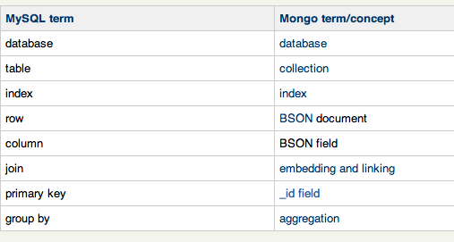
SQL to MongoDB

Slide 27
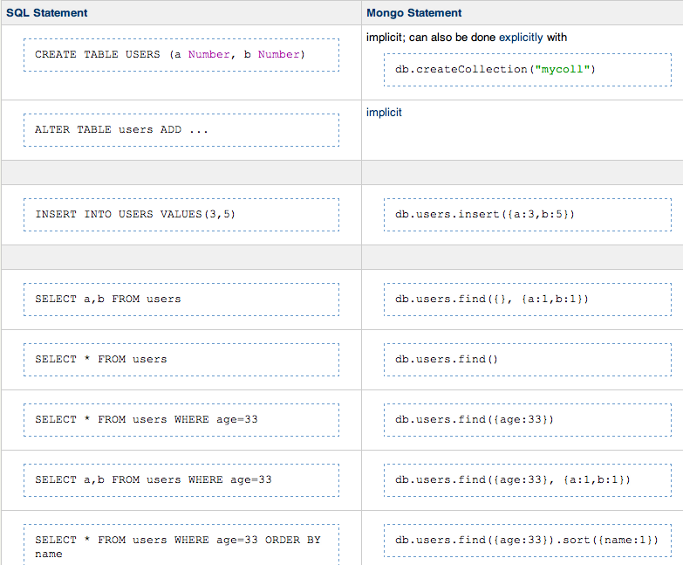

Slide 28
What it’s Good at
Archiving & Event Logging
Documents / Content Management
Gaming
Mobile & Location Services
Agile Development
Real-Time Stats / Analysis

Slide 29
What it’s Bad at
Complex Transactional (Banking & Accounting)
Traditional Data Warehousing
Where you absolutely need SQL (complex joins)

Slide 30
On Joins
Data Design
    by-ref
    by copy
Separate queries in app logic

Slide 31
Caveats & Gotchas
Global Write Lock
    On Writes, read first

Slide 32
Caveats & Gotchas
Queries are case-sensitive
    var test1 = db.test.find({'tags': 'jquery'}).count();
    var test2 = db.test.find({'tags': 'jQuery'}).count();
    test1 == test2; // Output is false - they do not query for the same information

Slide 33
Caveats & Gotchas
Don’t store numbers as strings
    {'count': 102}; // 'count' is stored as an int
    {'count': "102"}; // 'count' is stored as a string

Slide 34
Caveats & Gotchas
Document sizes capped at 16MB
    Not a problem for much of the world...
    but for the rest, GridFS

Slide 35
Other tips
Unless speed is paramount,
    getLastError
Use .limit() when using .find()
When doing mass-updates, narrow the search AMAP

Slide 36
Cool Tools
`mongostat`
db.serverStatus()
db.stats() & db.<collection_name>.stats()
db.printReplicationInfo()
db.printSlaveReplicationInfo
<query>.explain()

Slide 37
What to watch for
Page Faults
Index Misses
Queue Length

Slide 38

Massive Cop-Out

Slide 39
_id
primary key
Automatically created
Automatically indexed
you may override if desired

Slide 40
ObjectID
special 12-byte value
Guaranteed unique across cluster

Slide 41
Shell vs Drivers
Don’t build your apps in the shell

Slide 42
Officially SupportedLanguages
MongoDB Supported:
    C & C++
    Erlang
    Haskell
    Java
    JavaScript
.NET
Perl
PHP
Python
Ruby
Scala

Slide 43
Now what?
Lots of concepts introduced

Slide 44
Now what?
Documentation is awesome
10gen.com/presentations
“Snail in a Turtleneck” blog
  Kristina Chodorow

Slide 45
Now what?
  Play!
  Talk about it!

Slide 46
Who Again?
Geek
Problem solver
Systems Engineer
@gwaldo
github.com/gwaldo

