Slide 1
Open Access
experiences of
journal publishing
George Walkden
University of Manchester
george.walkden@manchester.ac.uk
http://personalpages.manchester.ac.uk/staff/george.walkden/

Slide 2
About me
PhD in linguistics, 2009–2012
Set up and ran my own e-journal in 2011 using Open Journal Systems (OJS)
Lecturer in English Linguistics at Manchester (SALC, Humanities) since January 2012
Continued to advocate for fee-free open access as part of Manchester Open Library and elsewhere
Role today: advocate for OA and discuss the practical aspects of running an OA journal

Slide 3
This talk
Open Access: why should you care?
Idealistic reasons
Cynical reasons
Running an OA journal in linguistics
Experiences
Challenges
OJS as a platform

Slide 4
1. Why Open Access is important
(in general, and for you)

Slide 5
The principle
Most UK research is taxpayer-funded, but taxpayers have no access to the results.
In the digital era, costs for (online) publication are lower than ever.
Much of the skilled work involved in publication (e.g. reviewing, journal editing) is, and has always been, carried out by academics for nothing or for nominal amounts.

Slide 6
Value added?
Professional publishers still have value to add:
Typesetting
Copy-editing and proofreading
Indexing and marketing
BUT the market is not in a healthy state:
Elsevier, Springer and Wiley have cornered 42% of the journal article marker
Elsevier profit margin 2010: 36% (£724m)

Slide 7

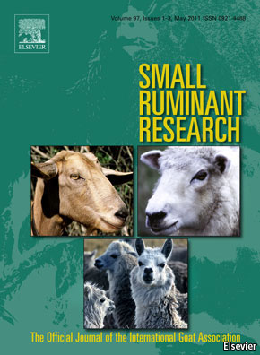
Journal subscription costs
Small Ruminant Research (Elsevier, print edition)
£17,871
£2,288
Biochimica et Biophysica Acta (Elsevier, print edition)

Slide 8
Time for some competition
Libraries spend a huge amount on journal subscriptions (mostly in bundles)
If value really is being added, the market should be able to handle some scholar-led competition!

Slide 9
Why you need to think about OA
Since the 2012 Finch report, two major bodies have come out in favour of Open Access:
HEFCE: the body that runs the Research Excellence Framework (REF)
RCUK: the body that administers research grants and studentships (via e.g. AHRC, ESRC)
Between them these two are responsible for almost all UK research funding.
Both now require Open Access outputs.

Slide 10
Open Access citation advantage
Many studies have shown that papers published Open Access get cited more.
Most results are for the hard sciences, but 45% increase in citations has been found for philosophy, and 86% for political science (Swan 2010)
Not surprising: more people are able to read your work!

Slide 11
2. Running an OA journal

Slide 12
Starting a new journal
2011: no journal in the field of historical syntax, despite a well-attended annual conference and much other research activity.
Gap in the market!
Opportunity: LSA’s eLanguage programme: hosted e-journals on Open Journal Systems (OJS)
Applied, but needed senior figure on board…

Slide 13

Journal of Historical Syntax
Independent journal on eLanguage platform
Fast, no embargo, no fees, full peer review
No funding!
Copy-editing and typesetting done by editorial team
Lifespan: 2011–13

Slide 14
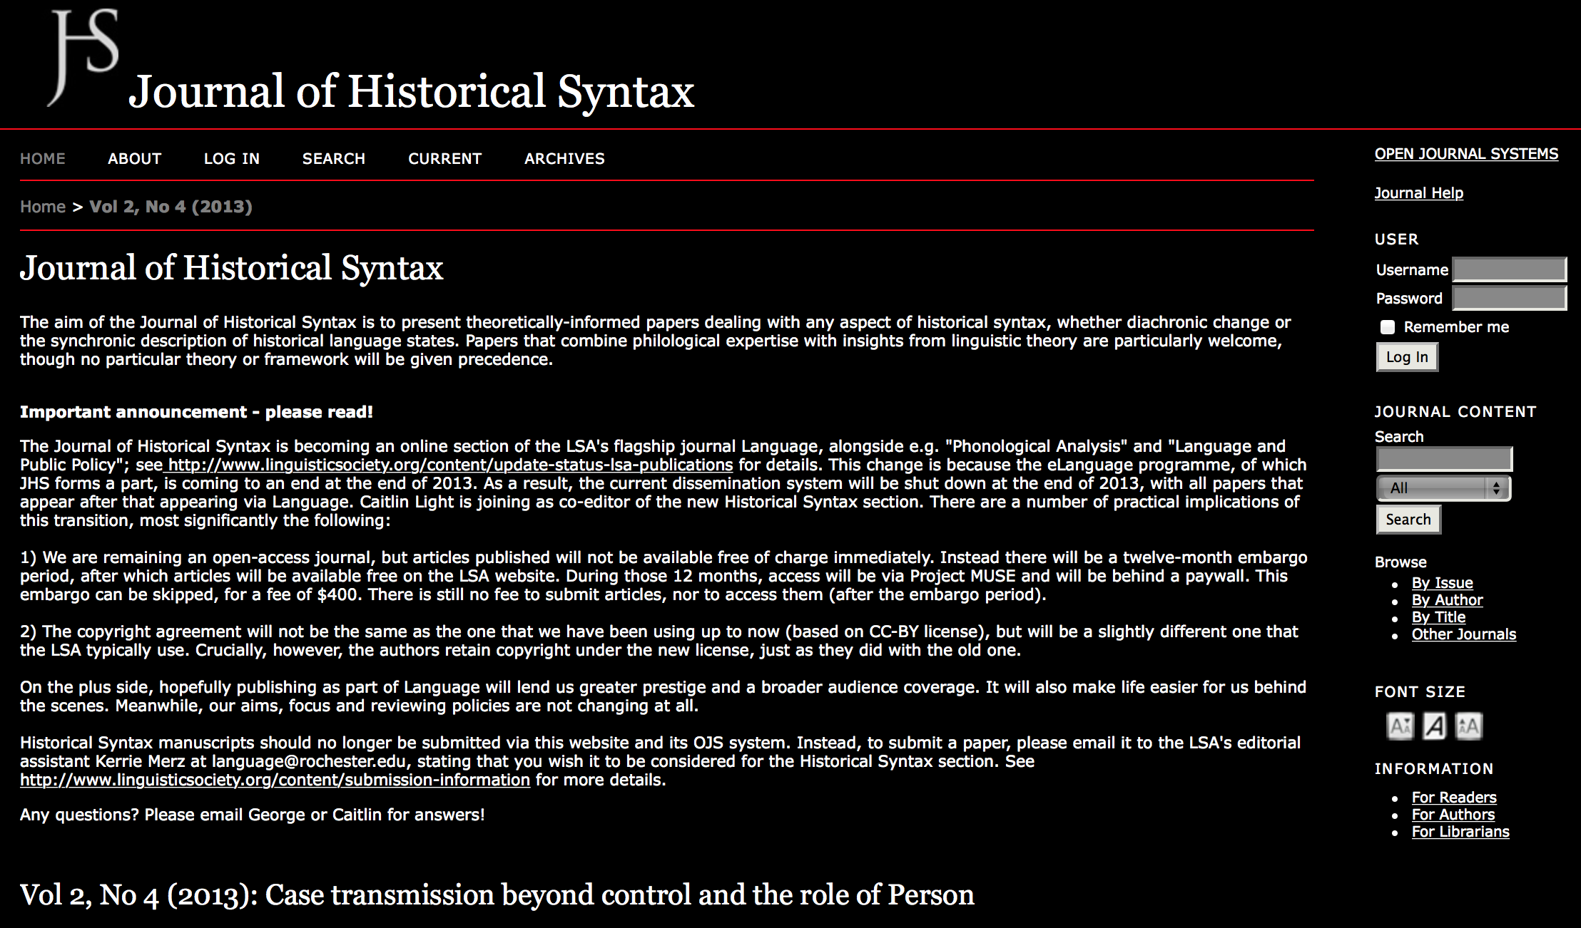
JHS front page

Slide 15

Since 2013: Historical Syntax
In 2013, LSA pulled the plug on eLanguage’s funding.
New home: online section of Language
1-year embargo (behind a paywall at Project Muse)
$400 to skip embargo
Supported financially by LSA, who do typesetting, copy-editing, etc.

Slide 16
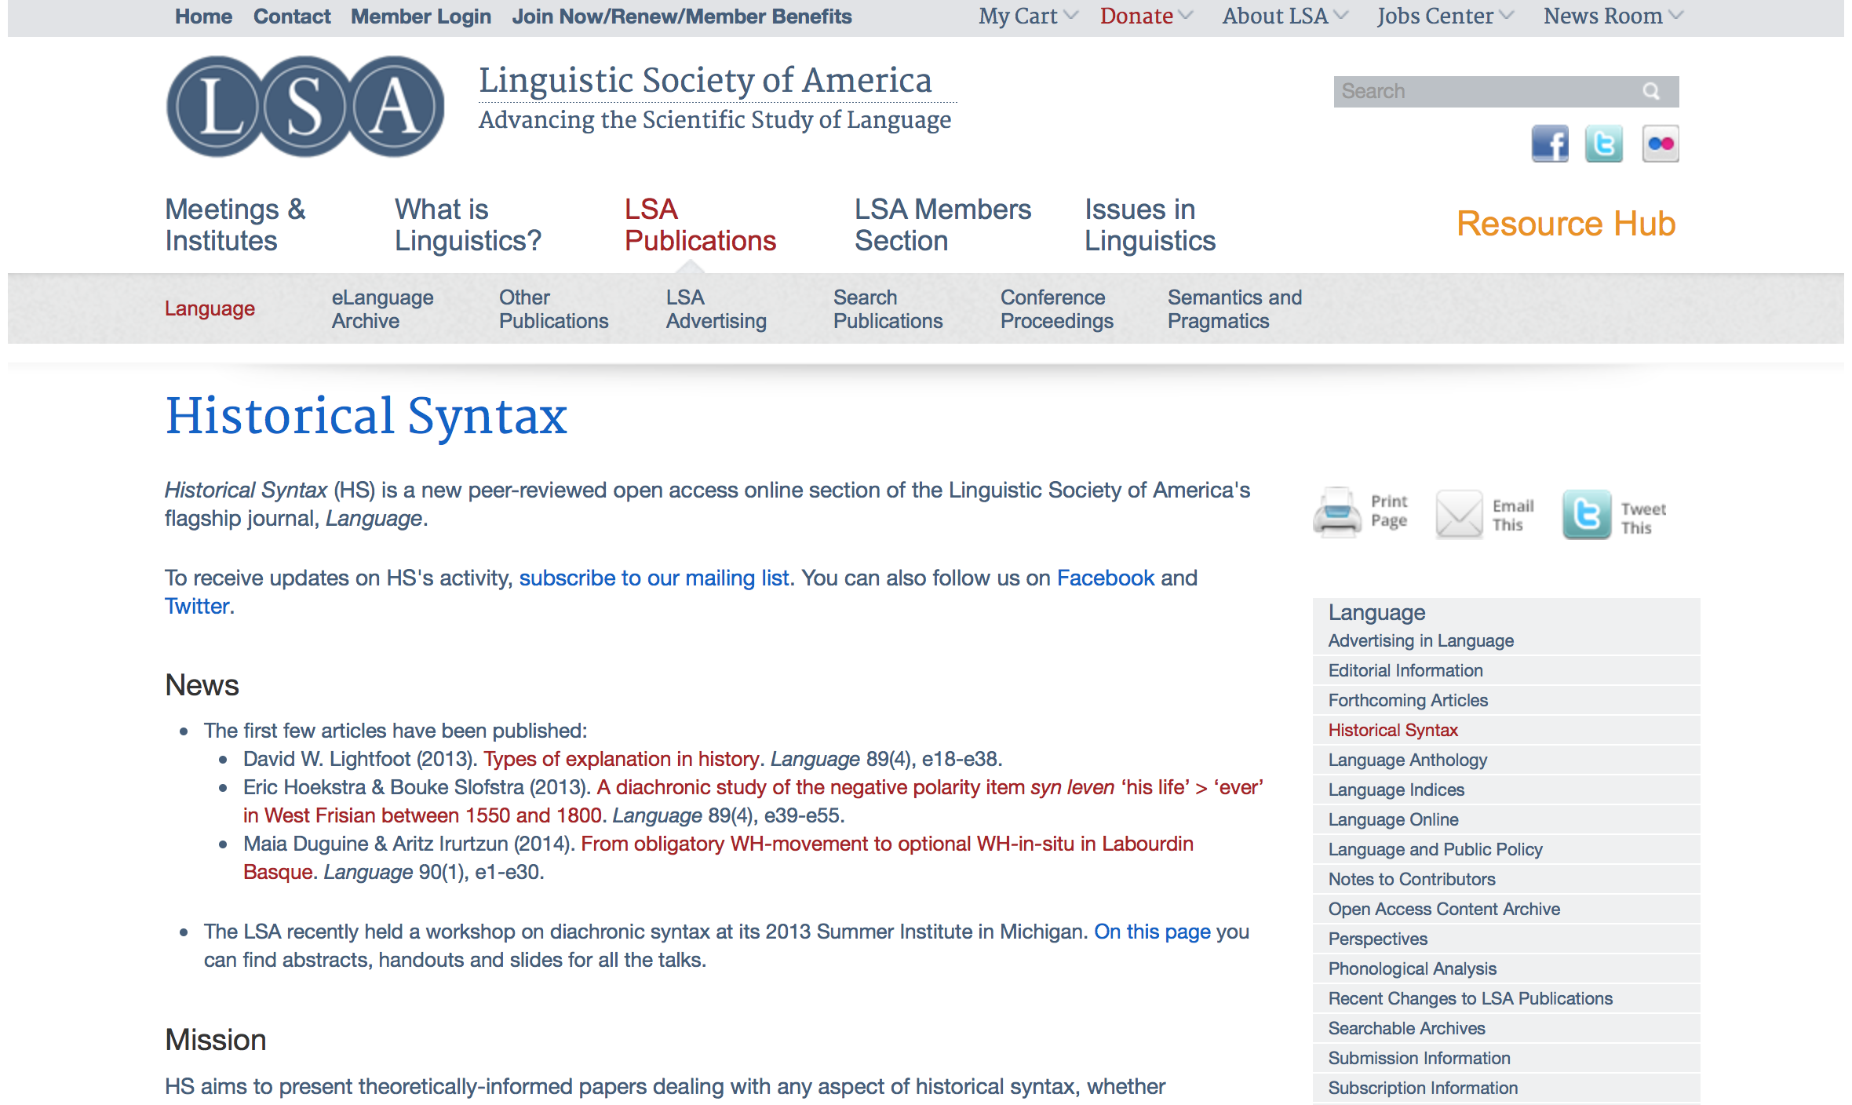
Historical Syntax front page

Slide 17
3. OJS as a platform

Slide 18

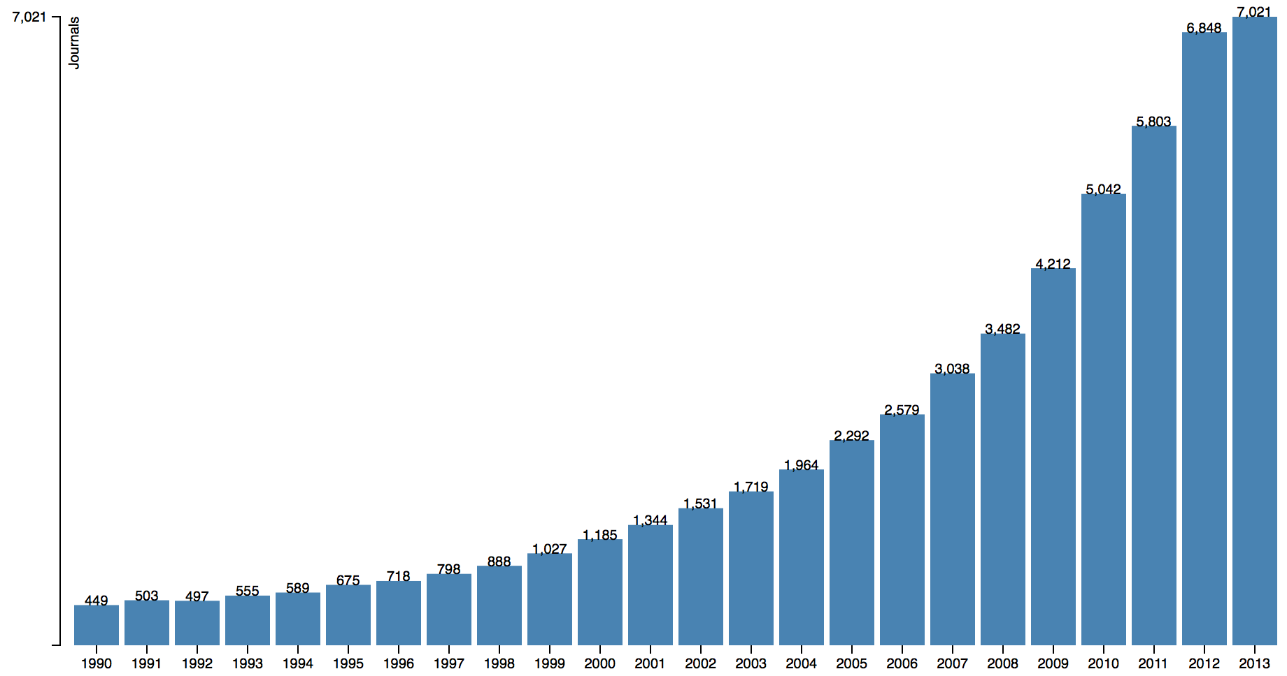
OJS: overview
Open source software developed through Public Knowledge Project
https://pkp.sfu.ca/ojs/
Once installed, similar in ease of use to a blog
Already used by many e-journals (at least 7,021 in 2013)

Slide 19
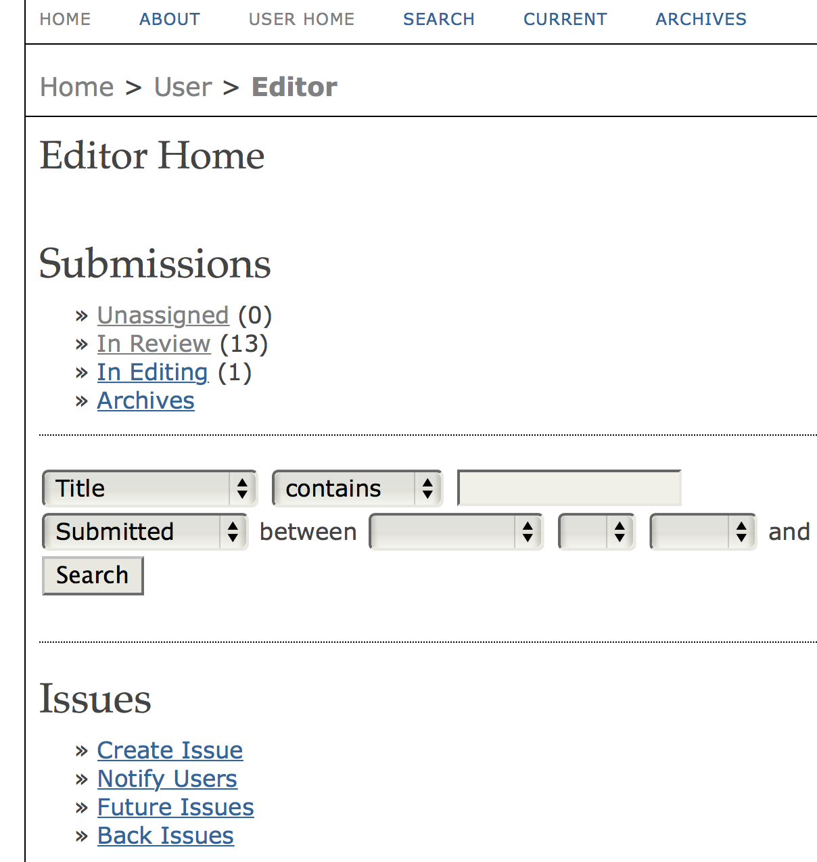
OJS: features
OJS is installed locally and locally controlled.
Editors configure requirements, sections, review process, etc.
Online submission and management of all content.
Subscription module with delayed open access options.
Comprehensive indexing of content part of global system.
Reading Tools for content, based on field and editors’ choice.
Email notification and commenting ability for readers.
Complete context-sensitive online Help support.

Slide 20
Thank you for your attention!
I’ll be putting this on my website so you can follow the links – feel free to email me if you have questions!

Slide 21
Useful links
The Finch Report (2012)
RCUK, Policy on Open Access (2013)
HEFCE, Policy for Open Access (2014)
important for the REF!
Harnad (1995), A Subversive Proposal
early advocate for green open access
Monbiot (2011), The Lairds of Learning
short, angry summary of the problems with for-profit publishers
Suber (2012), Open Access
a comprehensive book-length treatment
British Academy, Debating Open Access (2013)
a collection of papers discussing key issues
My blog on open access in linguistics

