Slide 1
Open Access
and changes in the linguistics
publishing landscape
George Walkden
University of Konstanz
george.walkden@uni-konstanz.de
http://walkden.space/

Slide 2
This talk
Journal publishing in linguistics
Changes in the linguistics publishing landscape
Open Access: why should you care?
Open Access case studies in linguistics

Slide 3
Introduction
Publishing in linguistics serves multiple purposes!
Share your research with others in the field
Important for career progression and evaluation (increasingly; it depends)
In most areas of linguistics, peer-reviewed journal publishing is the main route.
Exceptions: phonetics, computational linguistics, discourse analysis

Slide 4
Picking a journal
Criteria:
Who reads it? (Who do I want to reach?)
How prestigious is it?
“Soft” measures: peers’ opinions
“Hard” measures: Impact Factor
How hard is it to get into?
This sometimes correlates with prestige, but not always!
How easy is it to access?

Slide 5
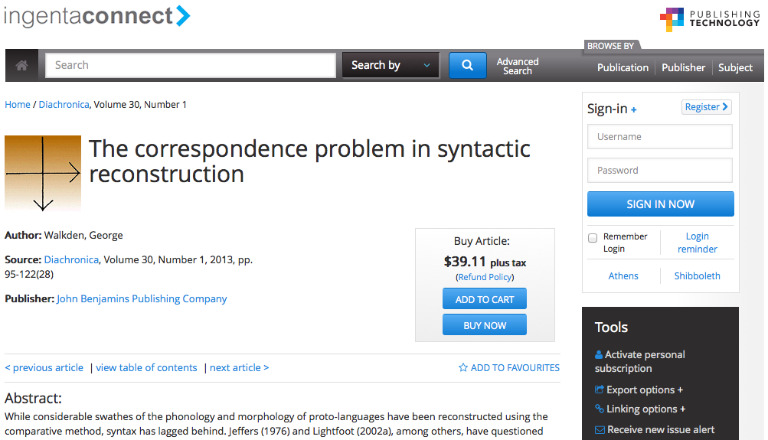
Traditional journals
Subscription model:
Author pays nothing to publish
Copyright is transferred to publisher
Libraries (and other entities) pay for access

Slide 6
Value added?
Professional publishers still have value to add:
Typesetting
Copy-editing and proofreading
Indexing and marketing
BUT the market is not in a healthy state:
Elsevier, Springer and Wiley have cornered 42% of the journal article marker
Elsevier profit margin 2010: 36% (£724m)

Slide 7
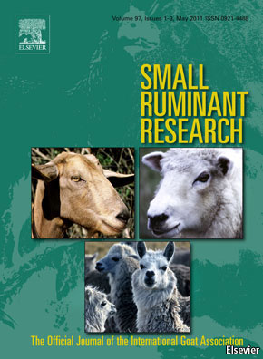
Annual journal subscription costs
Small Ruminant Research (Elsevier)
£2,517
£4,464
Journal of Memory and Language (Elsevier)

Slide 8
Technological changes
In the digital era, costs for (online) publication are lower than ever.
Much of the skilled work involved in publication (e.g. reviewing, journal editing) is, and has always been, carried out by academics for nothing or for nominal amounts.

Slide 9
Open Access
Open Access (OA) publications are made available to anyone, free at the point of access.
Two types of Open Access:
Green
Gold

Slide 10


Green open access
Self-archiving of research work in places where it’s freely available on the web, e.g.:
Institutional repositories
Subject-specific repositories
(Optimality Archive, semanticsarchive.net, lingBuzz)
Personal website or social media profile

Slide 11
Green OA: pros and cons
Advantages:
Cheap and easy.
Disadvantages:
In most repositories, no guarantee of quality (or even peer-review).
Version control can become difficult.
Often no proofreading/copy-editing/typesetting.
Not always good for dissemination.

Slide 12
Gold open access
Journals that specifically offer open access.
Fully gold journals in which all articles are OA.
“Hybrid” journals in which some articles are OA.
Directory of Open Access Journals (DOAJ) maintains an (inevitably incomplete) list.
Gold does NOT mean that you have to pay an Article Processing Charge (APC)!
Depends on the business model.

Slide 13
Hybrid gold journals
Very many journals offer the option of paying an APC to make your article open access.
This can be very expensive.
“Fees range from $500–$5000 USD” (Elsevier)
The hybrid model is flawed (see Shieber 2012):
Disincentivizes universities to pay APCs
Doesn’t obviously lead to drop in subscription costs
More expensive than normal gold APCs

Slide 14
Gold OA: pros and cons
Advantages:
The gold standard! More reliable than green.
Disadvantages:
You may have to pay an APC.
Susceptible to exploitation by predatory publishers. NB: this issue isn’t unique to gold OA! Traditional journals have this problem as well.

Slide 15
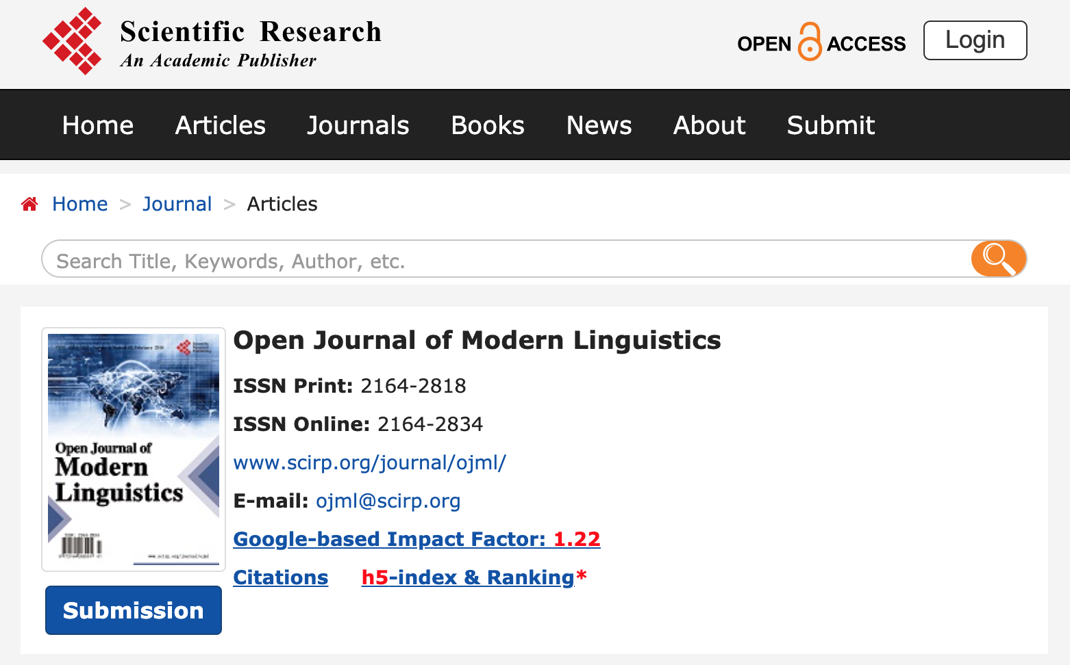
Predatory OA
The Open Journal of Modern Linguistics:
$599 per article
No evidence of thorough review process
Poor production standards
Accepts submissions in the fields of “Cosmic Linguistics” and “Paralinguistics”

Slide 16
Why you should think about OA
Funding bodies across the world are starting to require authors to publish Open Access
Greater accessibility for scholars with no university affiliation, or in poorer universities or countries
It’s good for the visibility of your research

Slide 17
Open Access citation advantage
Many studies have shown that papers published Open Access get cited more.
Most results are for the hard sciences, but 45% increase in citations has been found for philosophy, and 86% for political science (Swan 2010)
Not surprising: more people are able to read your work!

Slide 18
Gold OA journals without fees
Find a list at https://oaling.wordpress.com/
Two case studies:
Glossa
Journal of Historical Syntax

Slide 19
Case study: Glossa
http://www.glossa-journal.org
Arose in 2015 out of a dispute between Elsevier and the editorial board of Lingua
Covers all areas of linguistics (in principle)
No fees for authors who don’t have funding

Slide 20
Case study: Journal of Historical Syntax
http://historicalsyntax.org
Narrow focus: historical syntax; few articles per year
No fees for any authors (though we do require authors to do the bulk of their own typesetting)

Slide 21
What about books?
See Vincent (2013) for discussion.
Some academic publishers already offer APC-funded book options.
Case study: Language Science Press.

Slide 22
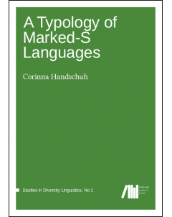
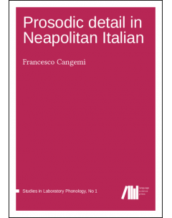
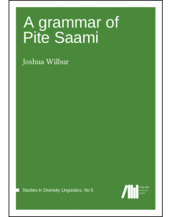
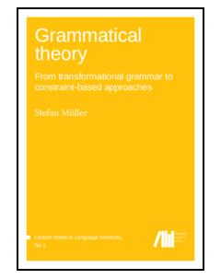
Case study: Language Science Press
Founded 2012; funded by a DFG grant.
Aim: APC-free open access e-book publication.
Almost all tasks performed by volunteers, inc. full review, typesetting, copy-editing, proofreading.

