Slide 1
Open Access publishing
an introduction to
in the arts & humanities
George Walkden
University of Manchester
george.walkden@manchester.ac.uk
http://personalpages.manchester.ac.uk/staff/george.walkden/

Slide 2
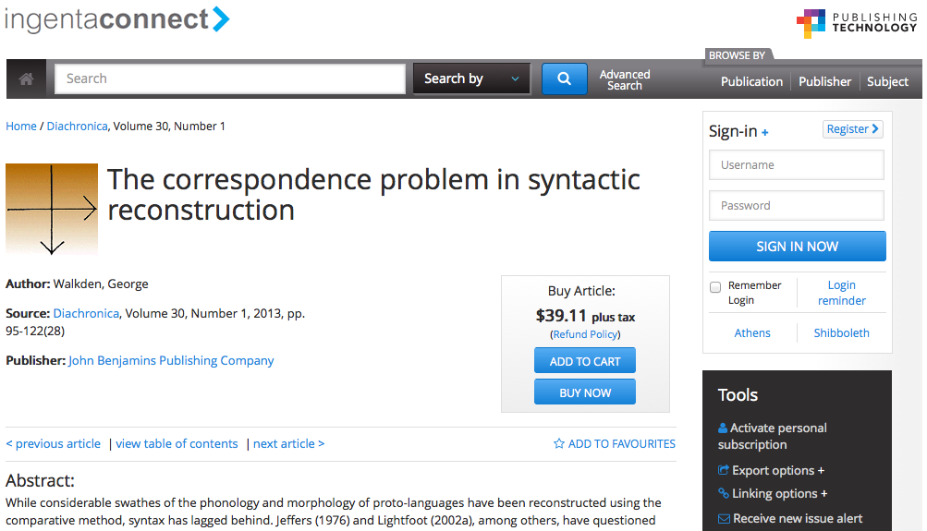
The problem
Too many screens like this.

Slide 3
The solution
Open Access publications are made available to anyone, free at the point of access.
The Open Access movement has been gaining momentum steadily since the early 1990s
It has become particularly important in the UK since the publication of the Finch Report in 2012.

Slide 4
This talk
Types of open access
Green
Gold
Open Access: why should you care?
Idealistic reasons
Cynical reasons
Some open access initiatives in linguistics

Slide 5
1. Types of Open Access
Green vs. Gold

Slide 6


Green open access
Self-archiving of research work in places where it’s freely available on the web, e.g.:
Institutional repositories
(Manchester’s eScholar; Cambridge’s DSpace)
Subject-specific repositories
(Optimality Archive, semanticsarchive.net, lingBuzz)
Personal website or social media profile

Slide 7
What can be archived?
Publishers typically place restrictions on what can be self-archived for green open access.
Is it the final PDF, or the typeset proof copy?
Is it a final, non-typeset version incorporating reviewers’ comments?
Is it a pre-review version?
Venues differ. Check the website of the journal/publisher before uploading anything!

Slide 8
Green OA: pros and cons
Advantages:
Cheap and easy.
Disadvantages:
In most repositories, no guarantee of quality (or even peer-review).
Version control can become difficult.
Often no proofreading/copy-editing/typesetting.
Not always good for dissemination.

Slide 9
Gold open access
Journals that specifically offer open access.
Fully gold journals in which all articles are OA.
“Hybrid” journals in which some articles are OA.
Directory of Open Access Journals (DOAJ) maintains an (inevitably incomplete) list.
Gold does NOT mean that you have to pay an Article Processing Charge (APC)!
Depends on the business model.

Slide 10
Hybrid gold journals
Very many journals offer the option of paying an APC to make your article open access.
This can be very expensive.
“Fees range from $500–$5000 USD” (Elsevier)
The hybrid model is flawed (see Shieber 2012):
Disincentivizes universities to pay APCs
Doesn’t obviously lead to drop in subscription costs
More expensive than normal gold APCs

Slide 11
Gold OA: pros and cons
Advantages:
The gold standard! More reliable than green.
Disadvantages:
You may have to pay an APC.
Susceptible to exploitation by predatory publishers. (Find a list of them here.)
NB: this issue isn’t unique to gold OA! Traditional journals have this problem as well.

Slide 12
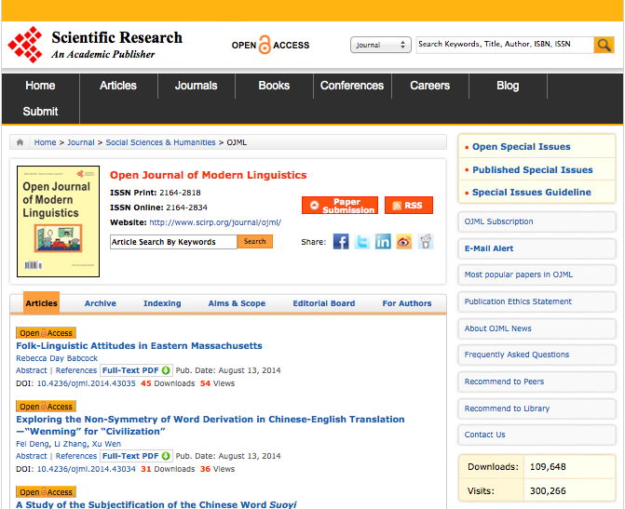
Predatory OA
The Open Journal of Modern Linguistics:
$600 per article under 10pp; $50 each extra page
No evidence of thorough review process
Poor production standards
Accepts submissions in the fields of “Cosmic Linguistics” and “Paralinguistics”

Slide 13
2. Why OA is important
(in general, and for you)

Slide 14
The principle
Most UK research is taxpayer-funded, but taxpayers have no access to the results.
In the digital era, costs for (online) publication are lower than ever.
Much of the skilled work involved in publication (e.g. reviewing, journal editing) is, and has always been, carried out by academics for nothing or for nominal amounts.

Slide 15
Value added?
Professional publishers still have value to add:
Typesetting
Copy-editing and proofreading
Indexing and marketing
BUT the market is not in a healthy state:
Elsevier, Springer and Wiley have cornered 42% of the journal article marker
Elsevier profit margin 2010: 36% (£724m)

Slide 16
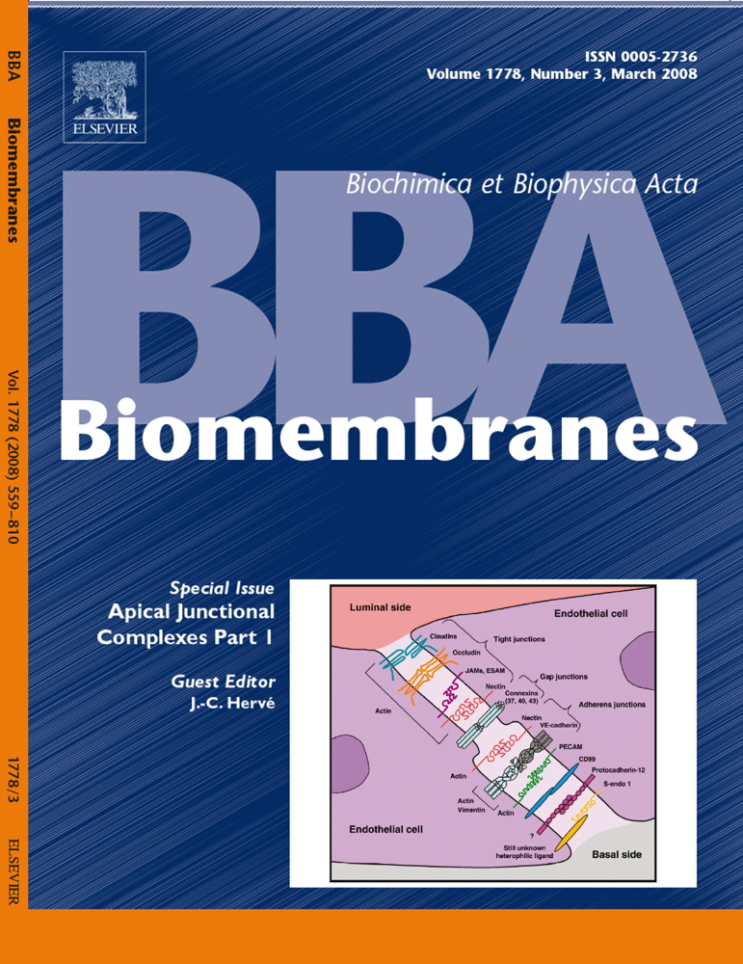
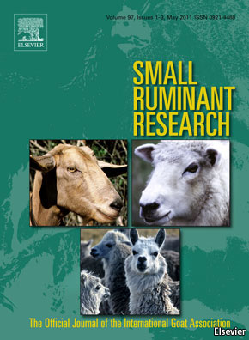
Journal subscription costs
Small Ruminant Research (Elsevier, print edition)
£17,871
£2,288
Biochimica et Biophysica Acta (Elsevier, print edition)

Slide 17
Time for some competition
Libraries spend a huge amount on journal subscriptions (mostly in bundles)
If value really is being added, the market should be able to handle some scholar-led competition!

Slide 18
Why you need to think about OA
Since the 2012 Finch report, two major bodies have come out in favour of Open Access:
HEFCE: the body that runs the Research Excellence Framework (REF)
RCUK: the body that administers research grants and studentships (via e.g. AHRC, ESRC)
Between them these two are responsible for almost all UK research funding.
Both now require Open Access outputs.

Slide 19

HEFCE
Papers published after 1 April 2016 must be OA to be eligible for the REF.
“authors’ final peer-reviewed manuscripts must have been deposited in an institutional or subject repository on acceptance for publication” (green)
Only applies to journal articles and proceedings papers (not e.g. monographs)
Maximum embargo: 24 months (for us)

Slide 20

RCUK
By 2018, all papers should be Open Access.
“RCUK has a preference for … the ‘gold’ route to Open Access” but allows green too.
Universities are provided with ‘block grant’ funding to cover charges to authors
Only applies to journals and proceedings
Maximum embargo: 12 months (for us)

Slide 21
Open Access citation advantage
Many studies have shown that papers published Open Access get cited more.
Most results are for the hard sciences, but 45% increase in citations has been found for philosophy, and 86% for political science (Swan 2010)
Not surprising: more people are able to read your work!

Slide 22
3. Open Access in Linguistics
lingBuzz, Historical Syntax, and Language Science Press

Slide 23
Case study: lingBuzz
“An article archive and a community space for linguistics” – http://ling.auf.net/lingbuzz
Established by Michal Starke; hosted by the University of Tromsø
Great for green OA. Features:
Searchable, with version control
Top downloads “charts”
Mostly theoretical linguistics, but open to all linguists

Slide 24
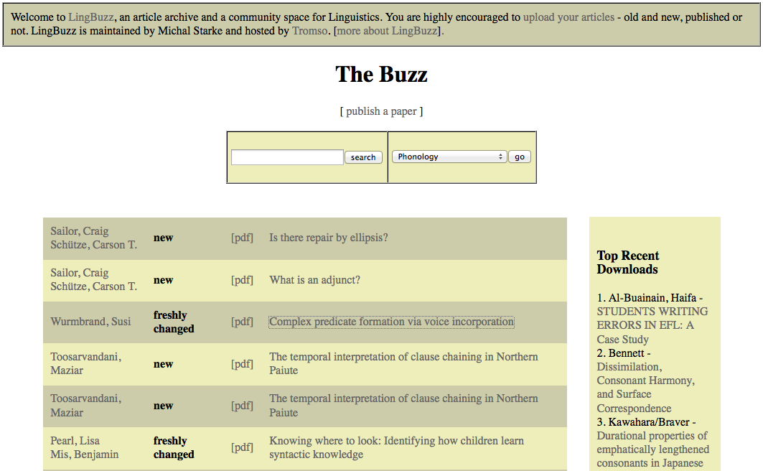
lingBuzz front page

Slide 25
Fully gold OA journals
Open Linguistics (de Gruyter)
SKY Journal of Linguistics (no APCs)
Biolinguistics (no APCs)
Semantics & Pragmatics (LSA; no APCs)
Language (Linguistic Society of America)
inc. five online-only sections: Teaching Linguistics, Language and Public Policy, Phonological Analysis, Historical Syntax, Perspectives

Slide 26

Case study: Historical Syntax
Online section of Language with a relatively narrow remit
Formerly the Journal of Historical Syntax (JHS)
1-year embargo (behind a paywall at Project Muse)
$400 to skip embargo
Supported financially by Linguistic Society of America, who do typesetting, copy-editing, etc.

Slide 27
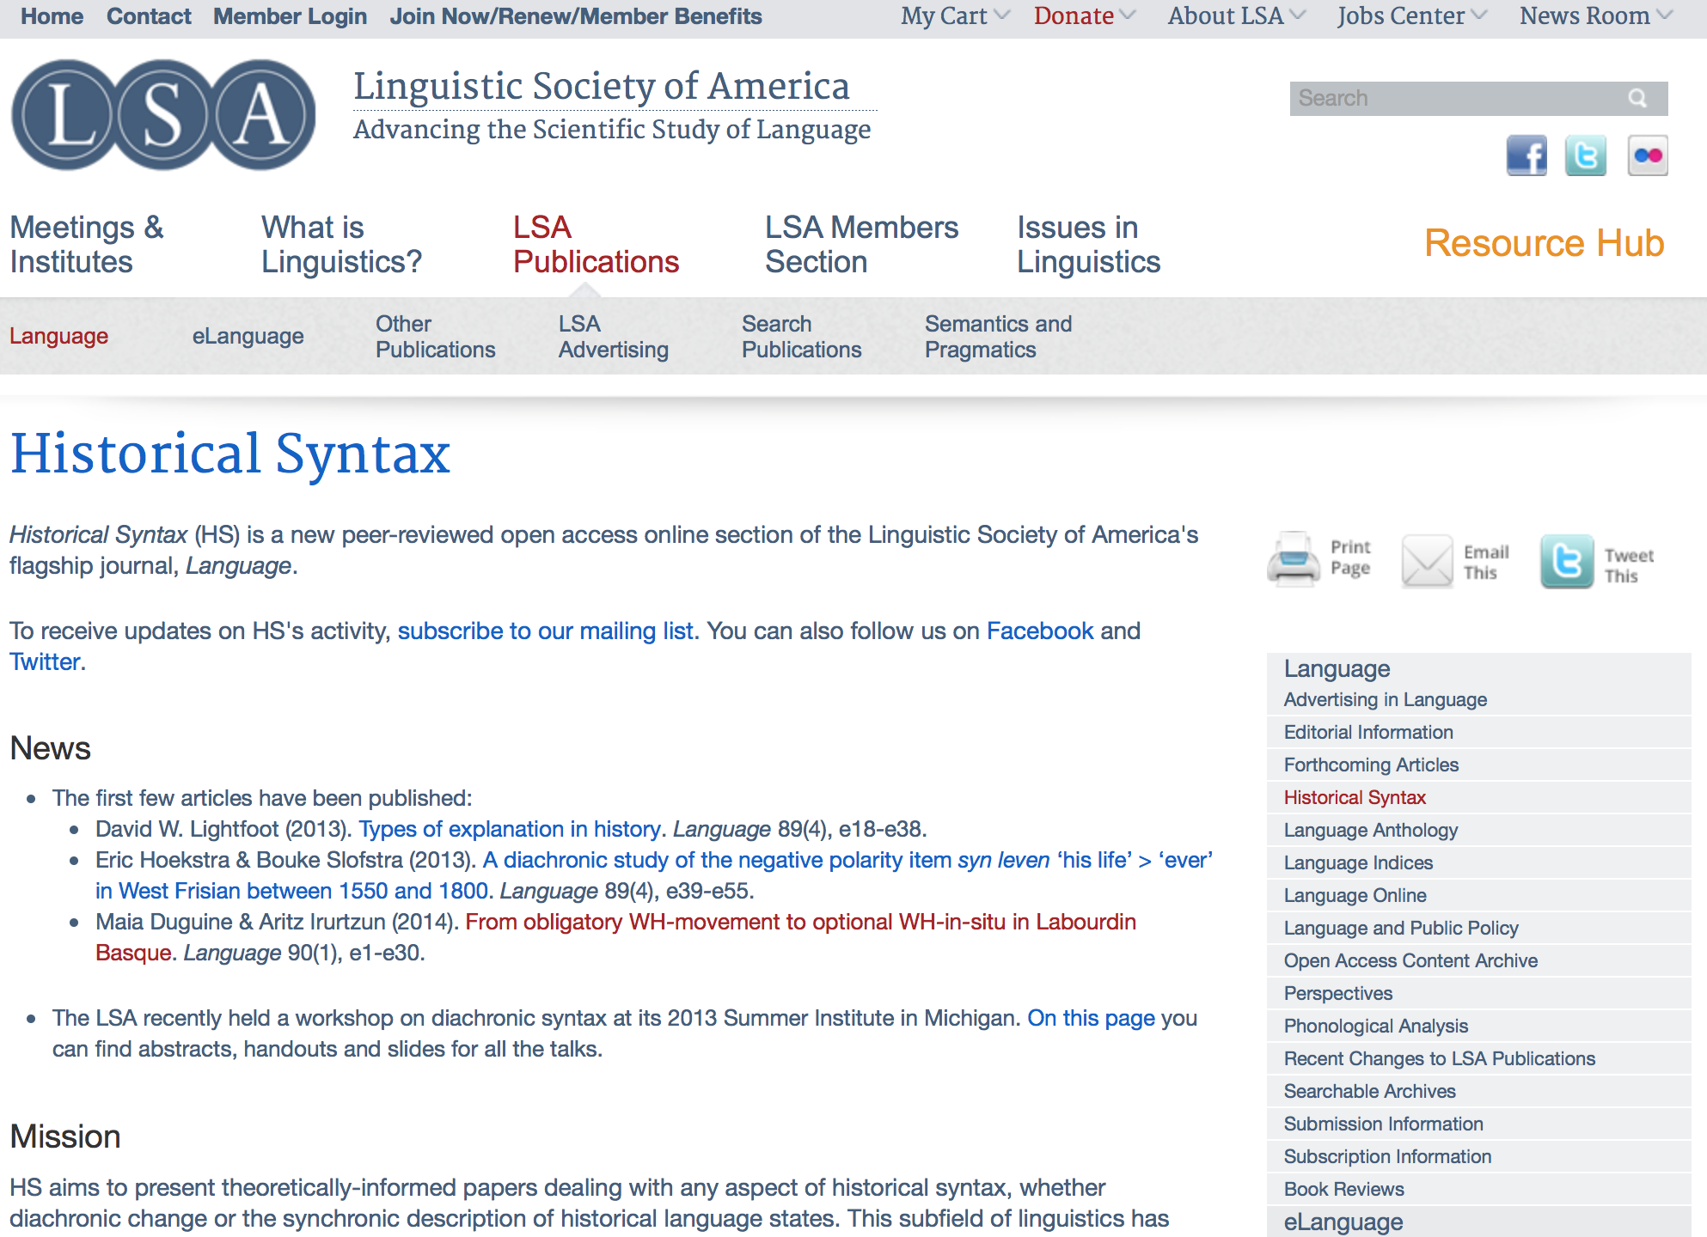
Historical Syntax front page

Slide 28
What about books?
See Vincent (2013) for discussion.
Some academic publishers already offer APC-funded book options.
Manchester University Press: £5,900 for titles up to 80,000 words.
There are other routes to OA monographs: e.g. Knowledge Unlatched.
Case study: Language Science Press.

Slide 29
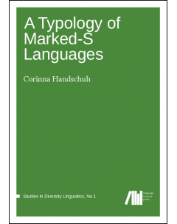
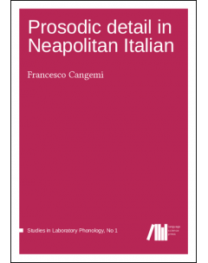
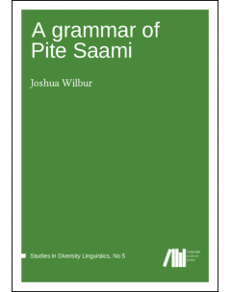
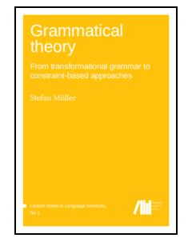
Case study: Language Science Press
Founded 2012; funded by a DFG grant.
Aim: APC-free open access e-book publication.
5 books so far!
14 forthcoming.
Almost all tasks performed by volunteers, inc. full review, typesetting, copy-editing, proofreading.

Slide 30
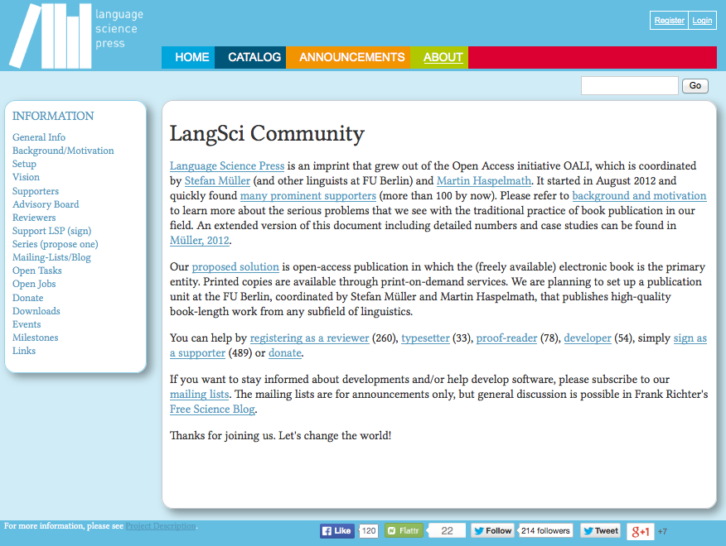
Language Science Press site

Slide 31
A word on copyright and licensing
Open access is a separate issue from copyright and licensing – though they are often conflated.
Traditional journals/publishers usually require you to sign away the copyright for your work.
OA journals often use Creative Commons licenses, under which the author retains copyright while permitting various uses.
See this blog post by Martin Paul Eve for a good summary of the issues.

Slide 32
Thank you for your attention!
A version of this is on my website so you can follow the links – feel free to email me if you have questions!

Slide 33
Useful links
The Finch Report (2012)
RCUK, Policy on Open Access (2013)
HEFCE, Policy for Open Access (2014)
important for the REF!
Harnad (1995), A Subversive Proposal
early advocate for green open access
Monbiot (2011), The Lairds of Learning
short, angry summary of the problems with for-profit publishers
Suber (2012), Open Access
a comprehensive book-length treatment
British Academy, Debating Open Access (2013)
a collection of papers discussing key issues
A blog post written by me on open access (2013)

