Slide 1

SQl Saturday - SALT LAKE CITY - 2020
SQL Login Data warehouse
George Walkey
Sr SQL DBA
PatientFirst Corp
Richmond, VA
https://github.com/gwalkey

Slide 2




Answer my Login question:
Who
How Often
Database
Application
Client/Host
When
Server

Slide 3
Pieces of the Solution
Extended Event Sessions
Powershell XE Importer
OLTP Relational Database
OLAP Star Schema Database
SSAS Tabular Database
SQL Agent Jobs – Data Collectors/Aggregators
Excel Pivot Table as Front-End

Slide 4
ExtendeD Event Session
Collects only the XE Login Event to a file target
Collects only successful logins
XE is very lightweight
Even with fast-polling apps (50 logins/sec)
XE Sessions automatically start when SQL Starts
Logs 18M+ Events per day for one server
The XEL trace files are copied up to the Central Server for ETL and reporting

Slide 5
Powershell extended Events importer
MS Recommends
https://docs.microsoft.com/en-us/sql/relational-databases/system-functions/sys-fn-xe-file-target-read-file-transact-sql?view=sql-server-2017
One server Took 11 Hours on 9M+ Trace file
Dan Guzman – SQL MVP – (QueryableXEventData)
https://dba.stackexchange.com/questions/206863/what-is-the-right-tool-to-process-big-xel-files-sql-server-extended-events-log
Same Server now takes 11 Minutes on 9M+ Trace file
Uses 2 Standard SQL Server/SSMS Assemblies
Microsoft.SqlServer.XEvent.Linq.dll
Microsoft.SqlServer.XE.Core.dll

Slide 6
OLTP Relational Database
Used to Bulk-Load the XE session files from all Servers into SQL
Collects these Metrics:
Server
Database
Host
Application String
User/Login
Hour of Day
Login Count
ETL Errors go to Errors Table for Review/QA inspection

Slide 7
OLAP Star Schema Database
Typical Star-Schema Database
Dimensions
Date
Server
Database
Host
Application
Login/User
Hour of Day
Fact Table Measure
Login Count

Slide 8
SQl Agent Jobs
On each Monitored Server
Manages the XE Session
XE Session Target Filename
changes at Midnight
matches Day of Week
On Central Server
Copy XE Session files up from Monitored servers
Import and Clean all XEL Session Files
ETL loads OLTP and OLAP Databases
Process Tabular Model

Slide 9
Operational Statistics
Running since 2015
20 Servers
350 Databases
8600 Hosts
1100 Application Strings
9500 Users
Fact Table 35M+ Rows
25 Billion Logins
SQL DW is 7GB, MD Cube is 300MB, Tabular is 520MB
Entire Daily Import takes 17 Minutes using 1 PoSH Thread

Slide 10
Excel Front-End
Why Excel and Not Power BI?
Pivot Tables fit better
Easier Drill-Down
Easier Filtering

Slide 11
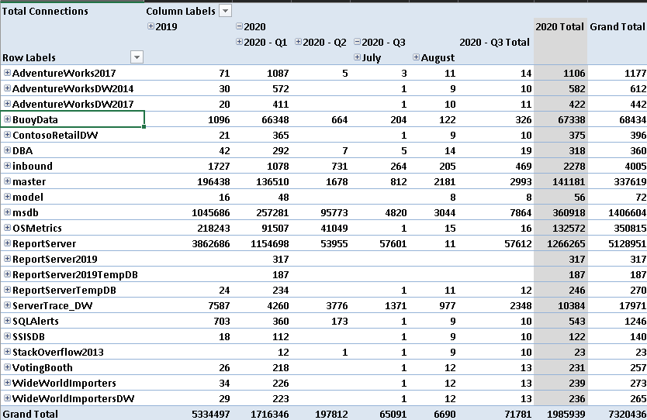
Excel Front-End

Slide 12

Demo
https://github.com/gwalkey

Slide 13
Extended setup Notes
Posh, SQL and Agent Job Script Customizations
Posh – remote and local XEL file copy locations
SQL – Cleaning Steps
Jobs – Edit XE Job on remote servers for XEL file target path
Jobs – Edit Step 3 Job on Central Server to match above folders
Tabular Model
Default Datasource connects to SSAS Instance on localhost
Assumes your SQL engine and SSAS instance are on same box
Publish included VS Solution or restore sample ABF file
Edit the Tabular solution Datasource connection and republish to put each on different boxes

Slide 14
Thank You!
https://github.com/gwalkey

