Slide 1


O.O.Programming
Assignment 3
Mini Excel w/ Qt Framework
T.A.
Gwangmu Lee

Slide 2
Assignment summary
OOP Assignment 3

Slide 3
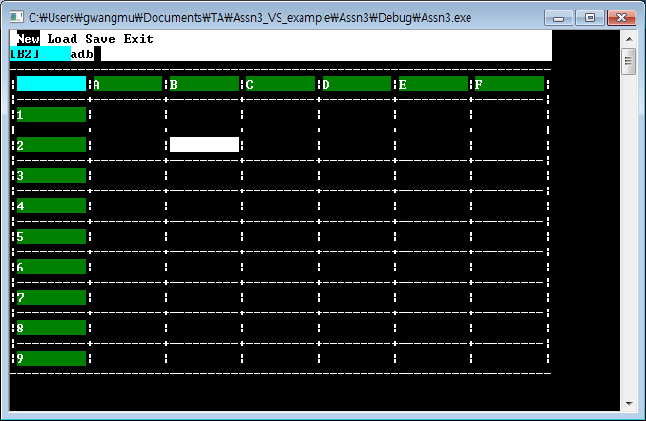
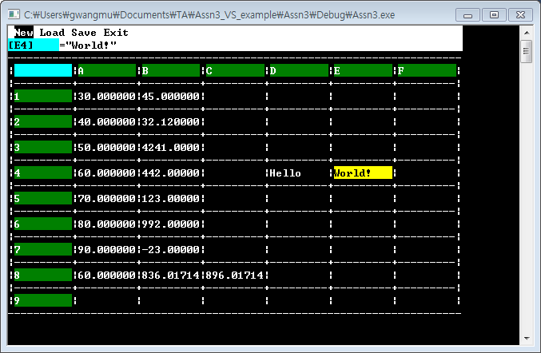
Based on a given skeleton,
Build your own Mini Excel engine.

Slide 4
Two-stage Implementation
Build a Mini Excel engine first.
:: We use the skeleton as our temporary
UI shell(or, 껍데기).
Mini Excel
Engine
Mini Excel
Engine
Then we replace the UI 껍데기 to Qt.
:: The structure of the skeleton and Qt 껍데기
will almost have 1-to-1 correspondence.
Qt Framework
UI Skeleton
Think this part as a 20% bonus point!
Trust me. It’s really nothing.

Slide 5
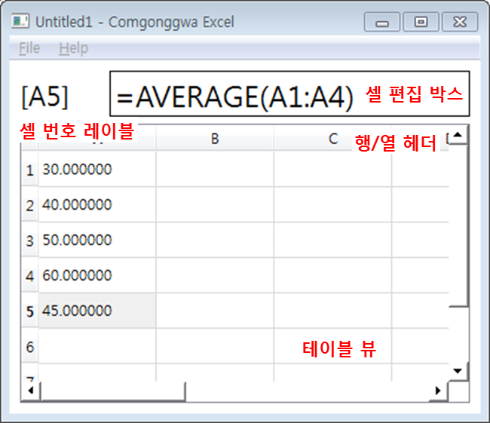

Slide 6
About skeleton
OOP Assignment 3

Slide 7
Press ‘Tab’ key to move the focus.
Tab
Tab
Tab

Slide 8
Enter
(Call ‘onSelectedAtMenuStrip ()’ function)
←
→

Slide 9
Backspace
Enter
(Call ‘onEnterKeyPressed AtTextBox ()’ function)
a-z, 0-9, !@#$...

Slide 10
↑
(Call ‘onFocusChanged AtArrayView()’ function)
←
→
↓

Slide 11
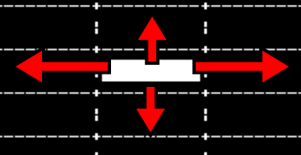
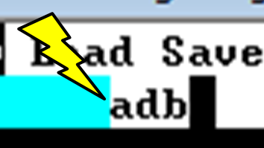

Summary
onFocusChangedAtArrayView ()
:: Called when the focused cell was changed
at ArrayView.
onEnteryKeyPressedAtTextBox ()
:: Called when Enter key was pressed
at TextBox.
onSelectedAtMenuStrip ()
:: Called when a menu button was selected
at MenuStrip

Slide 12
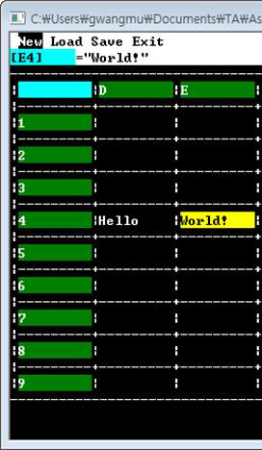
What to Implement
onFocusChangedAtArrayView ()
:: Reset the text of TextBox to the raw string of the selected cell.
:: Change the cell number in ColorLabel
Raw String
onEnteryKeyPressedAtTextBox ()
:: Replace the cell’s value with the evaluated (or, calculated) string.
:: Refresh every cell’s value. CReference variables can change other cell’s value indirectly.
Evaluated
(Calculated)
String

Slide 13
Extended tsv format
OOP Assignment 3

Slide 14
TSV Format
This | is | TSV
123 | 456 | 789 | 012
Columns are separated by a TAB.
This <TAB> is <TAB> TSV
123 <TAB> 456 <TAB> 789 <TAB> 012
Rows are separated
by a New-Line.
Usually it contains strings or number values.

Slide 15
TSV Format
Value
Format
Evaluation Result
Number
<정수/실수>
ex) 13, -32, 12.392
Itself
String
“<문자열>”
ex) “Hello, World!”
The string embraced with “.

Slide 16
Extended TSV Format
Value
Format
Evaluation Result
Function
<함수이름>(<인수1>,<인수2>..)
ex) ADD(1,2), SUM(A3:A8)
(Depends on functions)
Reference
<열번호 A~Z><행번호 1~>
ex) A8, D15
Same as the evaluated result of the referencing cell.
Range
<레퍼런스>:<레퍼런스>
ex) A8:A15, D1:D10
(Cannot be evaluated!)
Expression
=<값>
ex) =“hello”, =ADD(B1,C5)
Same as the evaluated result of <값>

Slide 17
Extended TSV Format
Any words are permitted other than ( and ).
Value
Format
Evaluation Result
Function
<함수이름>(<인수1>,<인수2>..)
ex) ADD(1,2), SUM(A3:A8)
(Depends on functions)
Reference
<열번호 A~Z><행번호 1~>
ex) A8, D15
Same as the evaluated result of the referencing cell.
Range
<레퍼런스>:<레퍼런스>
ex) A8:A15, D1:D10
(Cannot be evaluated!)
Either column or row should be the same.
(Whether the other case is illegal is up to your design choice.)
Expression
=<값>
ex) =“hello”, =ADD(B1,C5)
Same as the evaluated result of <값>

Slide 18
Extended TSV Format
Every values should be evaluated with an expression!
(Except numbers)
=“Hello”
=ADD(10,ADD(30,30))
85
Hello
70
85
“Hello”
A8
ADD(10,20)

Slide 19
Engine structure
OOP Assignment 3

Slide 20
High chance of recursive inclusion!
<Has-a>
Relation
CCell
CSheet
- CSheet *sheet
- idxRow, idxCol
- CValue *value
- CCell *cells[ROWS][COLUMNS]
- numRows, numCols
+ getNextRowCell ()
+ getPrevRowCell ()
+ getNextColumnCell,()
+ getPrevColumnCell ()
Hint
While CCell might have to know the members of CSheet,
CSheet only need to know the existence of CCell.

Slide 21
class CCell;
class CSheet {
…
};
class Ccell {
…
};
CSheet knows that
CCell exists somewhere.
CCell knows what members are in the CSheet class.

Slide 22
<enum> CValueType
+ CVALUE_NUMBER
+ CVALUE_STRING
+ CVALUE_NONE
Evaluated results can only have one of these types.
What is the evaluated result’s type?
CValue
What is the evaluated result?
(in string)
+ virtual CValueType getType () = 0;
+ virtual string getEvaledString () = 0;
+ virtual string getRawString () = 0;
What is the raw string?
CConstant
CFunction
- string name
- CValueType retty
- CValue *args[ARGSMAX]
CString
CNumber
CNull
- string str
- double number
CAdd
CMul
CSum
CAverage
class CConstant : public CValue { /* Nothing! */ };

Slide 23
When the raw string is syntactically incorrect, so that your engine cannot even analyze the string.
CValue
+ virtual CValueType getType () = 0;
+ virtual string getEvaledString () = 0;
+ virtual string getRawString () = 0;
CExpression
CReference
CRefRange
CError
- CValue *evalee
- Ccell *cell
- CReference *begin, end
- string rawstr
ex) ADD{12,34} → No brackets, so not a function.
→ No double quotation, no not a string.
→ …
→ No matching format. CError!

Slide 24
<namespace> CValueFactory
- CExpression *createExpressionFromString ()
- CFunction *createFunctionFromString ()
- CString *createStringFromString ()
- CNumber *createNumberFromString ()
- CReference *createReferenceFromString ()
- CRefRange *createRefRangeFromString ()
- CError *createErrorFromString ()
Call each other
when they need.
→ Mutually recursive!
+ CValue *createValueFromString ()

Slide 25
qt porting
OOP Assignment 3
20% bonus points!

Slide 26
I assume you have leant the basics of Qt Framework!

Slide 27
4 Things that Might Come in Handy in This Assignment
ColorLabel
TextBox
QLabel
QLineEdit
QTableView
QMenuBar
ArrayView
MenuStrip

Slide 28
References
QTableView
:: QT: QTableView Example – Short and Quick
http://www.thedazzlersinc.com/source/2012/06/04/qt-qtableview-example-short-and-quick/
:: QTableView Class - Qt 5.5 Reference
http://doc.qt.io/qt-5/qtableview.html
QMenuBar
:: Adding a menu bar and a status bar
http://www.dazzle.plus.com/linux/QtCreator/part02.htm
:: Saving to a file
http://www.dazzle.plus.com/linux/QtCreator/part09.htm

Slide 29
Example (Header)
class MiniExcel : public QMainWindow {
Q_OBJECT
QTableView *tblSheetView;
QMenu *menuFile;
QAction *actNew;
};

Slide 30
Example (Definition)
MiniExcel::MiniExcel () {
tblSheetView = new QTableView ();
QStandardItemModel *model = new QStandardItemModel (8, 8, this);
model->setHorizontalHeaderItem (0, new QStandardItem ("A"));
model->setHorizontalHeaderItem (1, new QStandardItem ("B"));
model->setHorizontalHeaderItem (2, new QStandardItem ("C"));
tblSheetView->setModel (model);
connect (tblSheetView, SIGNAL(clicked (const QModelIndex &)),
this, SLOT(onTableClicked ()));
…
#Rows and #Columns
Column Header

Slide 31
Example (Definition)
…
actNew = new QAction ("&New", this);
menuFile = menuBar()->addMenu ("&File");
menuFile->addAction (actNew);
connect (txtCellEdit, SIGNAL(returnPressed ()),
this, SLOT(onCellEditEntered ()));
}

Slide 32
question
OOP Assignment 3

