Slide 1
Integration Layer

Slide 2
Nifi 사용 Architecture
NIFI
( Data flow control )
Application
controller
controller
controller
controller
controller
SOURCE DB
KAFKA
TARGET DB1
TARGET DB2

Slide 3
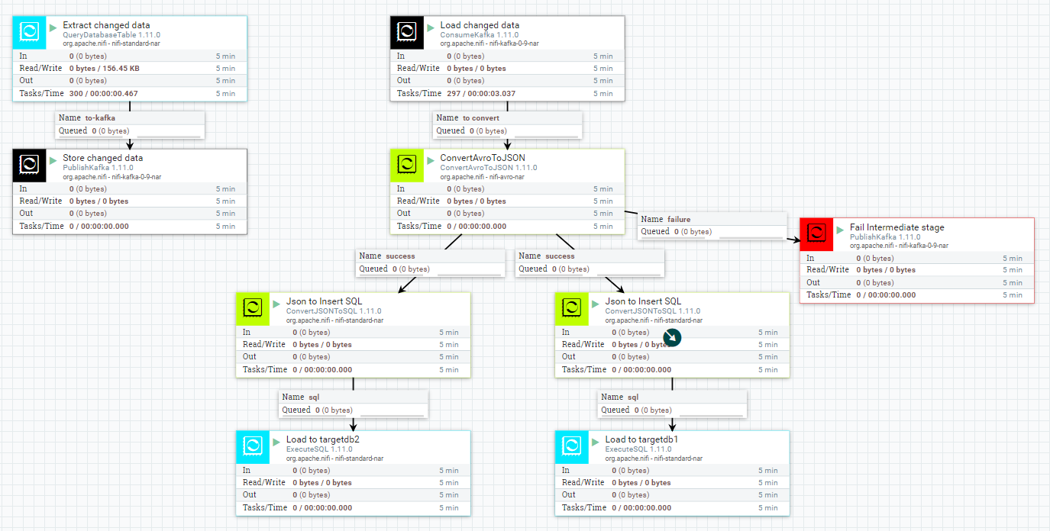
Nifi-template

Slide 4
테스트 환경
Source
DB : Mysql
Flow
Jdbc(select) polling -> kafka
Target
A type
설명 : Table Layout 동일한 경우
DB : Mysql
Flow
Kafka -> AvroToJson -> JsonToSql -> Jdbc Insert
B type
설명 : Table Layout subset 경우
DB : Mysql
Flow
Kafka -> AvroToJson -> JsonToSql -> Jdbc Insert
C type
ㄹㅇㅁㄴ

